Slide 1
Notes:
At the 2021 Synod Convention, delegates enthusiastically approved a WELS Home Missions initiative to plant 100 home mission churches and enhance 75 ministries in 10 years beginning in 2023. During the same time, we want to support 75 enhancement grants to help existing congregations reach more souls, often in other cultures.

Slide 2
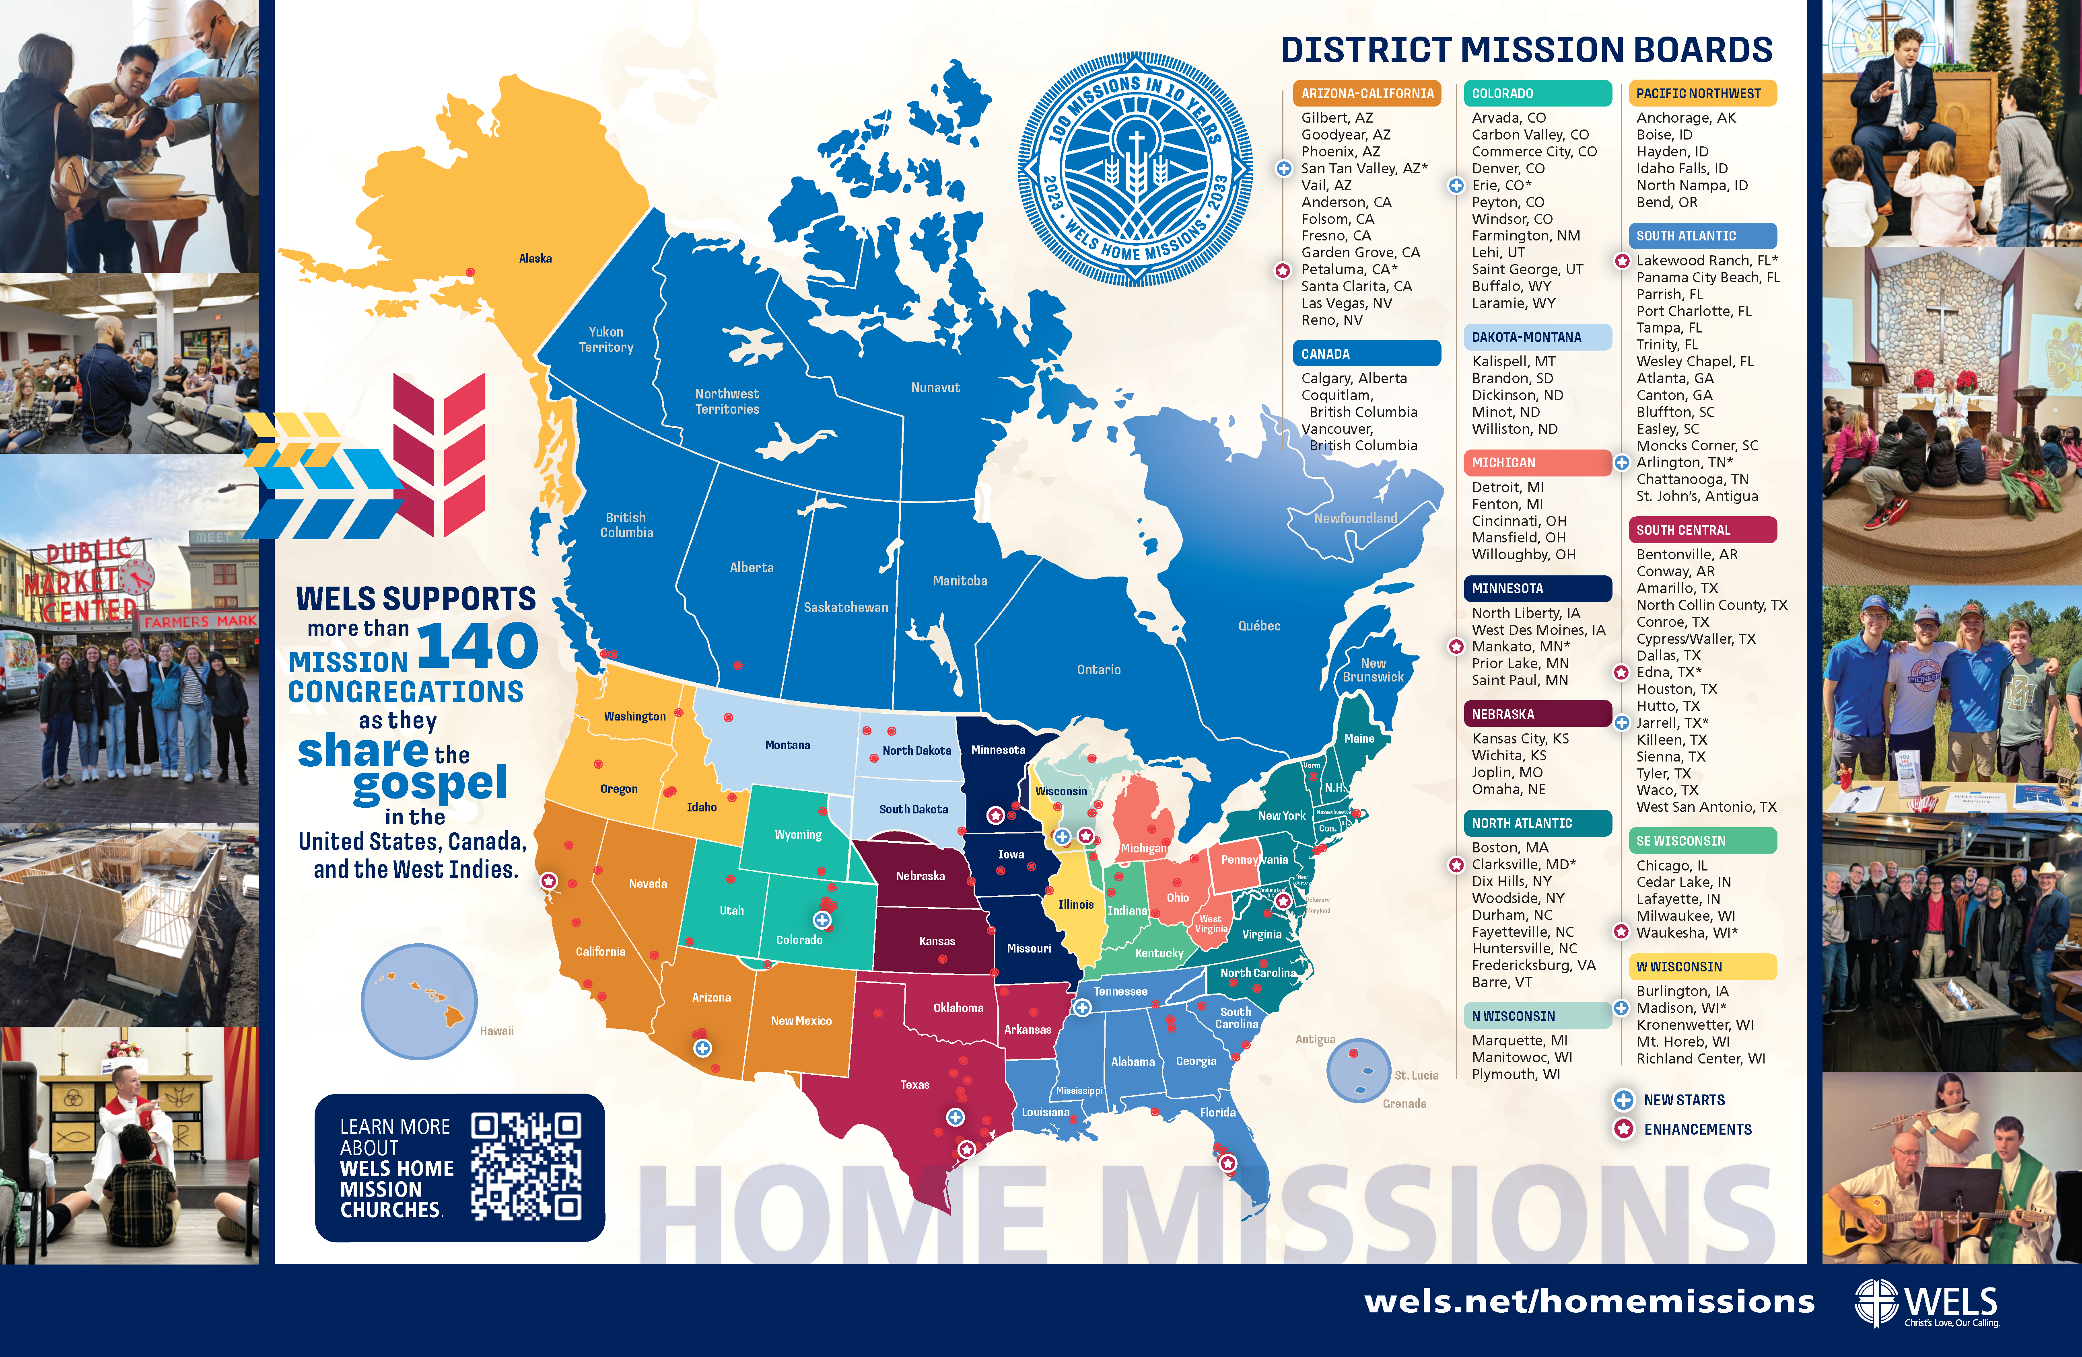
Notes:
WELS Home Missions is blessed to plant churches and assist mission-minded congregations across North America. Home Missions currently supports 151 congregations with financial subsidy or district mission board/mission counselor assistance, with 30 of those being cross-cultural mission congregations. Home Missions also provides nearly 50 campus ministries with financial support, while assisting hundreds of other congregations that serve college students around the United States and Canada.

Slide 3

This is a big goal. Why start 100 new home missions?
Our Savior directs us to reach more souls with the good news. This initiative isn’t as much about planting more churches as it is about sharing the gospel of Jesus Christ. It’s about Christ’s mission to his church. It’s about aggressively reaching lost souls.
Notes:
Why are we doing this?

Slide 4
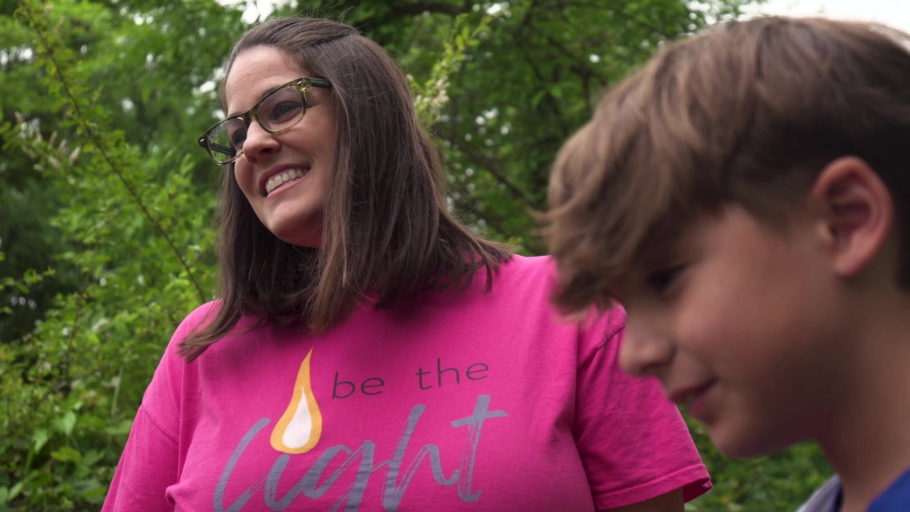
Reaching people like Jill
Notes:
“When we got here, there was just something right. There was something here that we didn’t know that we needed.”
Jill never expected to find hope in a church again. Years of pain and anger had left her convinced she was done with faith—until a persistent invitation led her and her family to Illumine, a WELS home mission church in Rock Hill, S.C. There, surrounded by a caring church family and the pure gospel message, Jill discovered comfort and purpose she didn’t know she was missing.
Watch Jill’s story and see how God’s love can reach us in the most unexpected ways—bringing healing, belonging, and a future filled with hope.
Video link: https://wels.net/faces-of-faith-jill/

Slide 5

Notes:
The “Christ through us” Long-Range Strategic Plan was adopted at the 2025 Synod Convention. This issues-based strategic plan names four strategic priorities—Culture, Congregations, Commission, and Calling. Each priority offers a rationale for its urgency, followed by goals—tangible steps showing how, by God’s grace, we will meet these trials. Priorities frame the struggles; goals forge the path.
The congregations of WELS form the vital backbone that supports our shared gospel efforts. WELS congregations are beacons of light and truth in their communities, proclaiming the life-giving gospel to a dying world. However, these congregations are not only local gospel outposts but also the foundation of the synod’s broader ministry efforts. Through their offerings, they sustain worldwide missions and the planting of new churches. Through their nurture, they identify and encourage the future called workers who will serve the next generation. Through their witness, they embody the love of Christ who reconciled us to God.

Slide 6
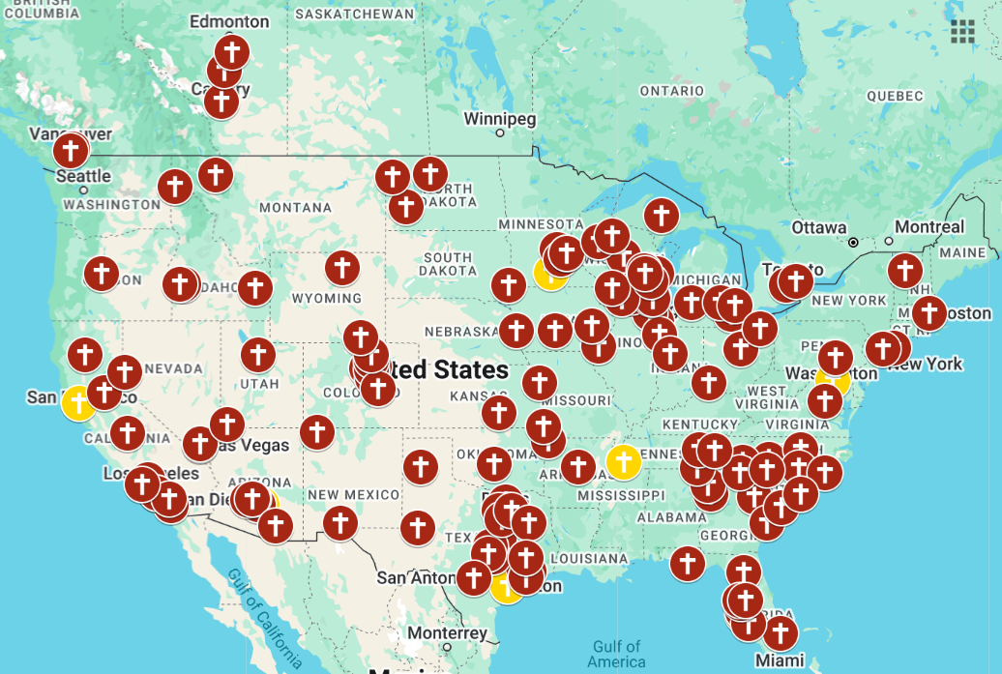
U.S. population: 340 million
WELS current reach:
2% = 6.8 million
WELS’ long-range plan: Increase WELS' reach to 3%
Notes:
WELS Home Missions plays a critical role in the “Congregations” priority. Two goals were identified related to WELS Home Missions:
Support ministry enhancement efforts: Every WELS congregation faces a distinct blend of opportunities and challenges, shaped by shifting ministry contexts. Some will seek to enhance or revitalize their current mission efforts, particularly if their ministry context has changed. Others will explore regional collaboration, shared ministry, or consolidation to amplify their gospel reach. Still others will prayerfully consider the objectives of their childhood ministries, including Lutheran schools: discipleship, outreach, or both. They will seek to ensure such childhood ministries are sustainable long term. Our goal is to offer support to WELS congregations in whatever ministry enhancement effort they choose to undertake for Christ’s glory. When asked, we will help them assess their strategies, providing the encouragement, advice, and resources that can help them plan and implement efforts that enhance their outreach and discipleship ministries.
Expand WELS’ reach through strategic church planting: Driven by Christ’s reconciling love, we are called to bring the gospel to every corner. Yet America’s shifting landscape—marked by growing diversity and population drift—leaves millions beyond the reach of WELS’ gospel witness, with only two percent living near our congregations. This gap cries out for action, as souls hunger for the hope of reconciliation in regions where confessional Lutheran ministry is rare. Planting new churches not only meets this need but fortifies our synod’s backbone for enduring mission impact.
At this point in time, two 2% of the U.S. population currently lives within a 15-minute drive of a WELS congregation. One of the SMART (Specific, Measurable, Achievable, Relevant, and Time-Bound) objectives being set for the ministry of Home Missions was to increase that reach to 3% of the U.S. population.

Slide 7
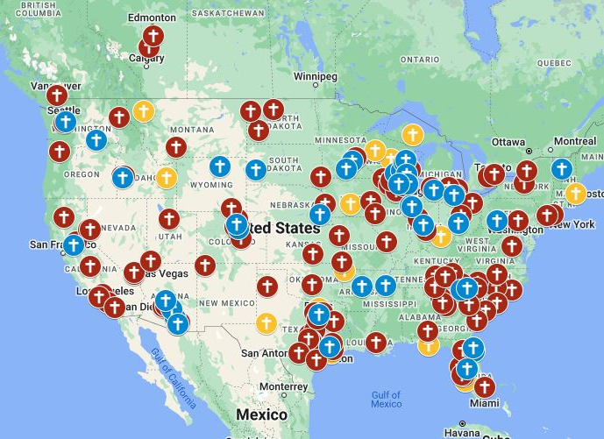
2% 3%
+3.4 million
10.2 million
Notes:
If we were to accomplish that goal in the next 10 years, that would allow WELS to increase their reach from 6.8 million to 10.2 million people.

Slide 8


How does our synod plant churches?
100 Mission in 10 Years
Notes:
So how does it work?

Slide 9
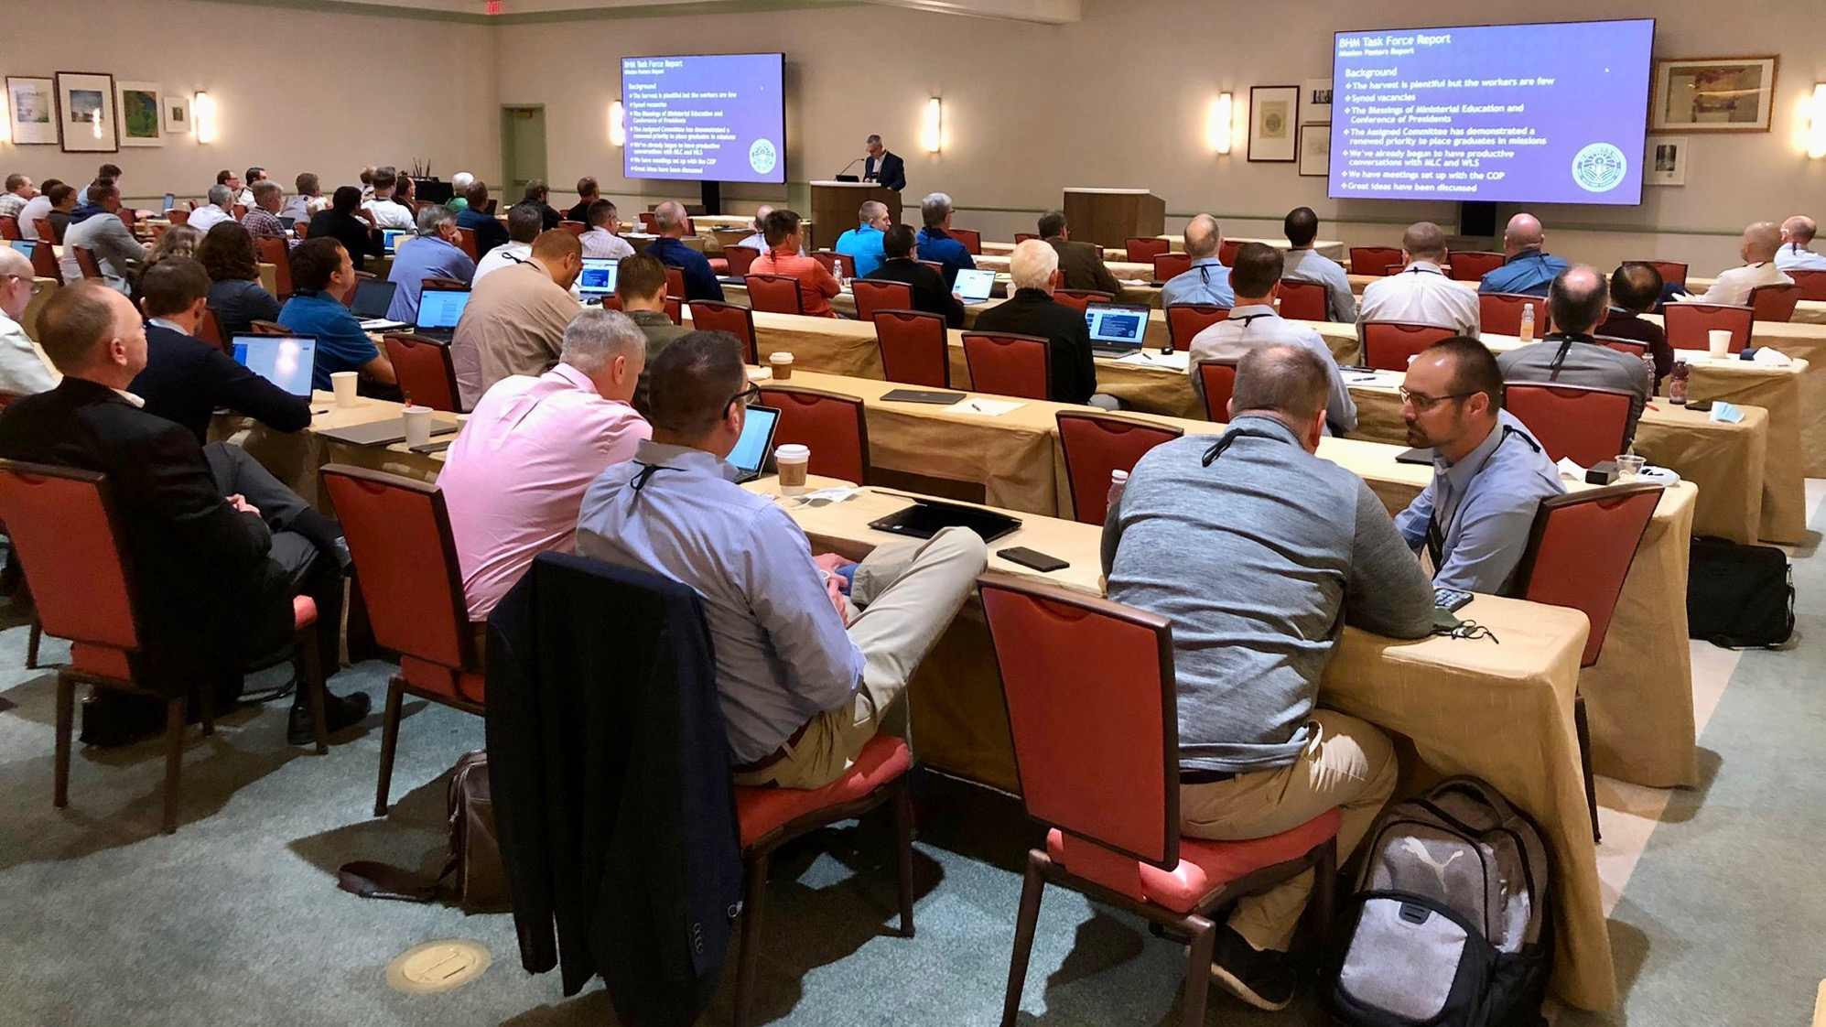

District Mission Boards (DMB)
The heart and core of Home Missions
Notes:
FOR PRESENTERS: I would recommend including a group photo of the DMB where you’re presenting for this slide.
District mission boards (DMB) are the heart and core of Home Missions. They are the “boots on the ground” as they support existing home mission churches and work with area congregations to identify locations to plant new churches throughout their district. This group of 2-4 pastor and 2-4 laymen volunteers helps build a solid foundation for each new mission start and shepherds these new churches and their pastors on their path from starting a new mission to being a self-supporting church. Learn more at wels100in10.net/timeline/dmb.

Slide 10
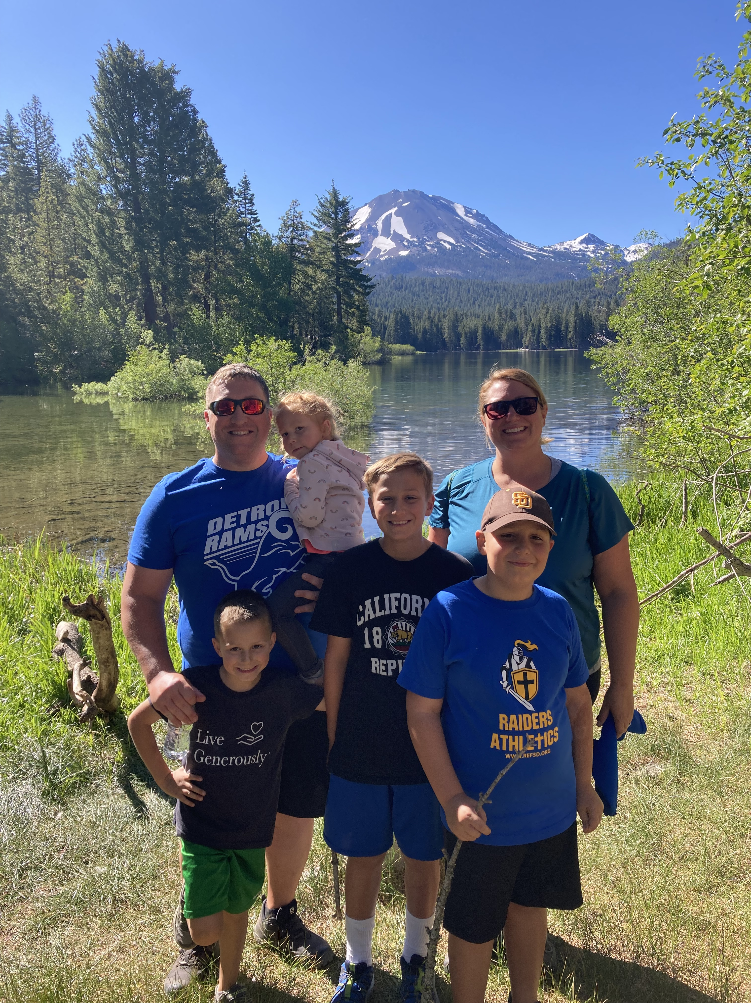
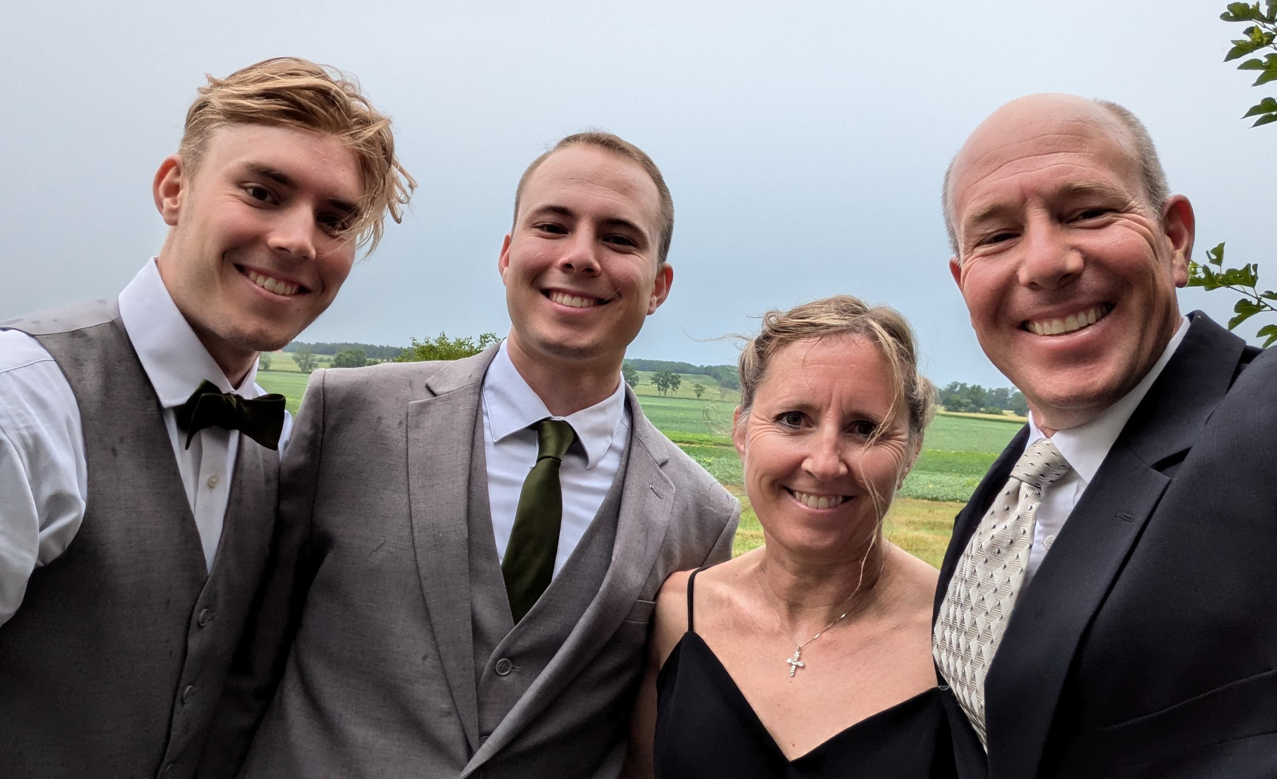
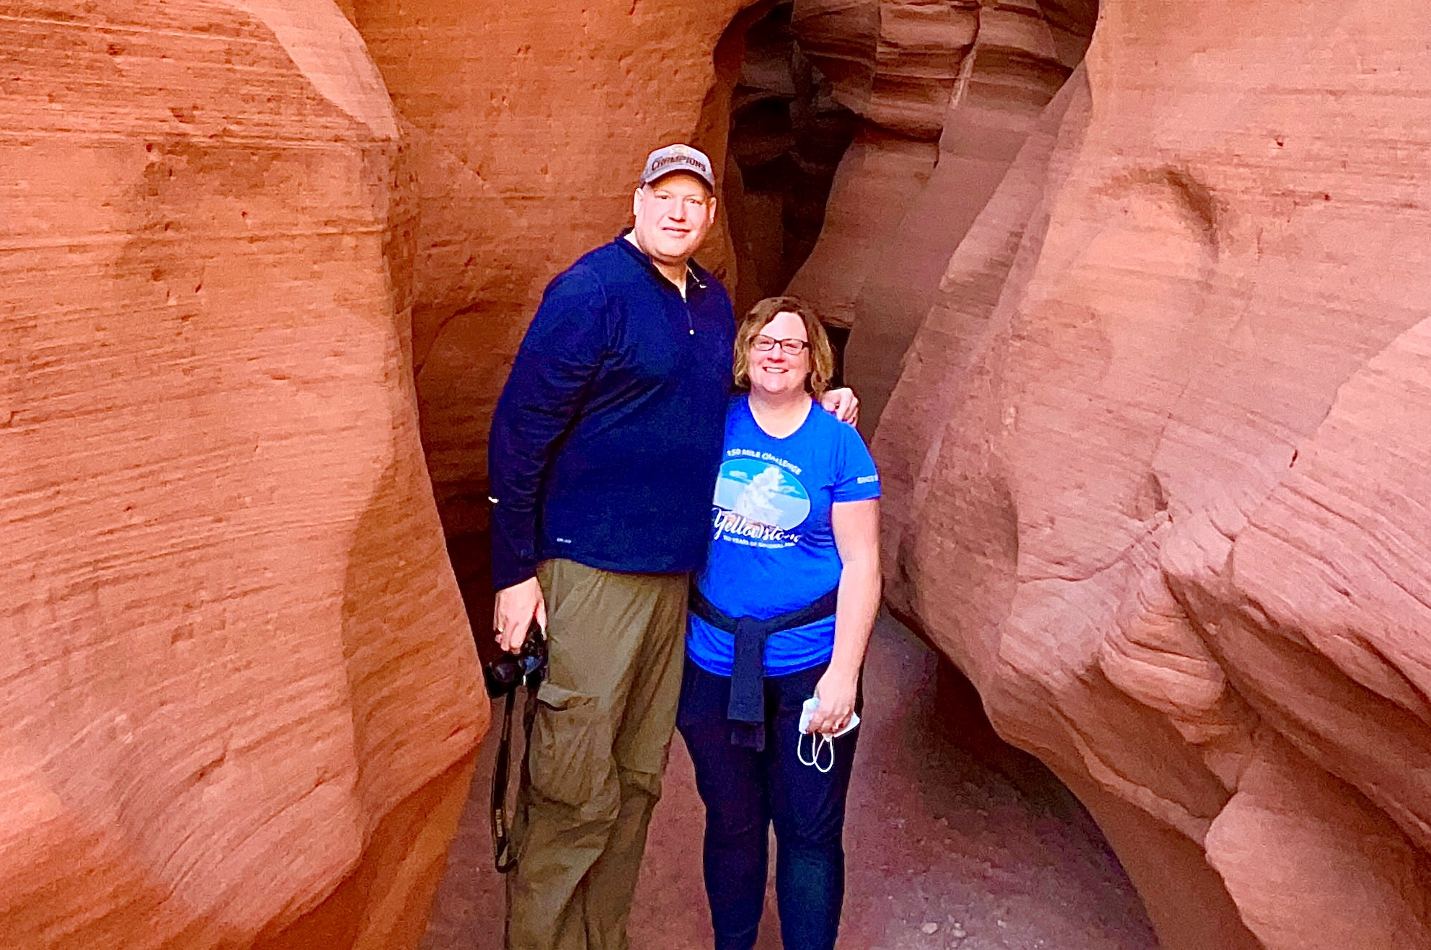
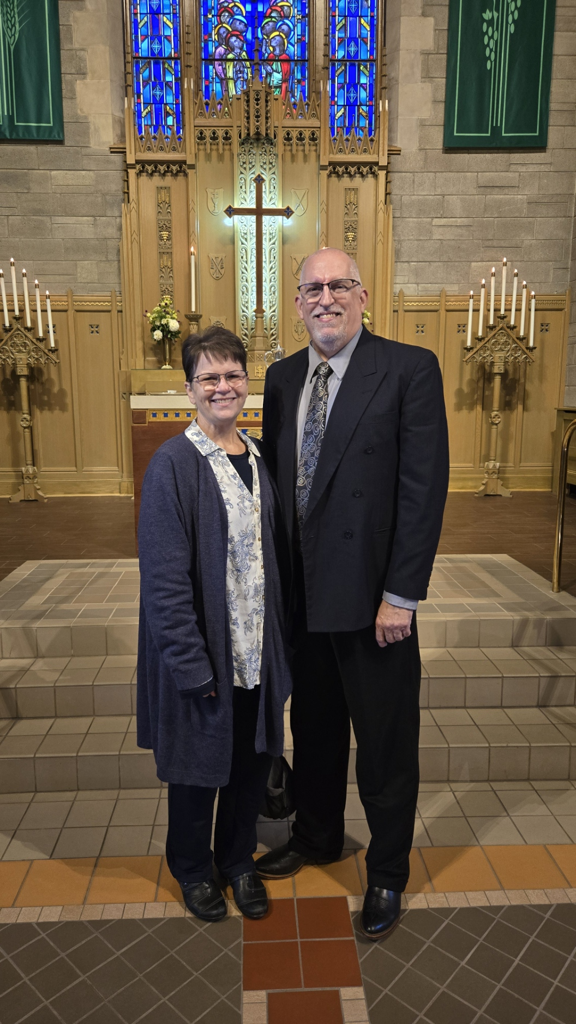
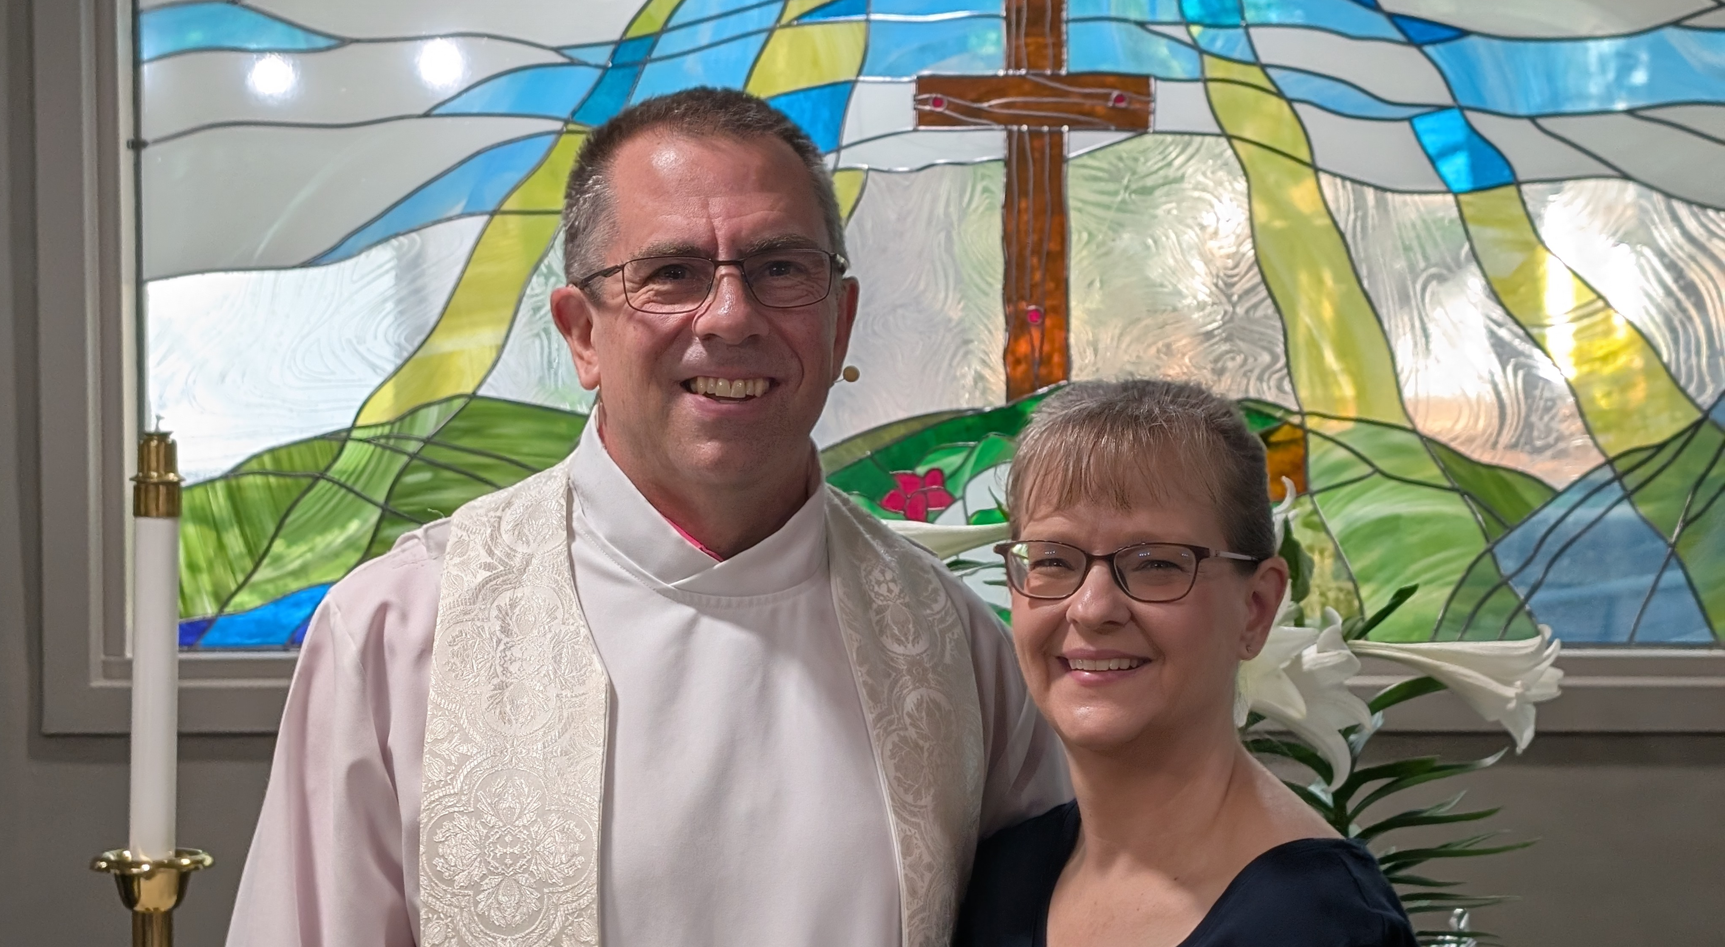
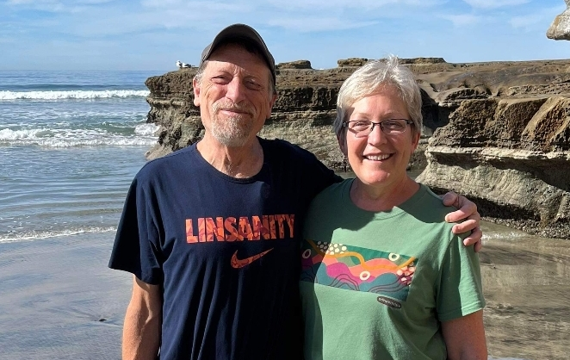
Mission Counselors: Guiding mission congregations and assisting District Mission Boards
Notes:
District mission boards (DMBs) and home mission churches are supported by three home mission counselors. They work with the DMBs to find, evaluate, and develop new home mission locations. They also provide onsite assistance to home mission congregations and counseling and training to the new missionaries who are called to serve them. This support is crucial in guiding mission churches on the way to becoming self-supporting congregations. WELS Home Missions also works with three specialized mission counselors that assist congregations with Hispanic, Asian, and Campus Ministry outreach.
Mission Counselors, top left to right then bottom left to right:
Rev. Neil Birkholz, North American Asian Ministry Consultant
Rev. Matt Vogt, Mission Counselor,
Rev. Dan Lindner, Campus Ministry Mission Counselor
Rev. Tim Flunker, Hispanic Outreach Consultant
Rev. Nathan Strutz, Mission Counselor
Rev. Mark Birkholz, Mission Counselor

Slide 11
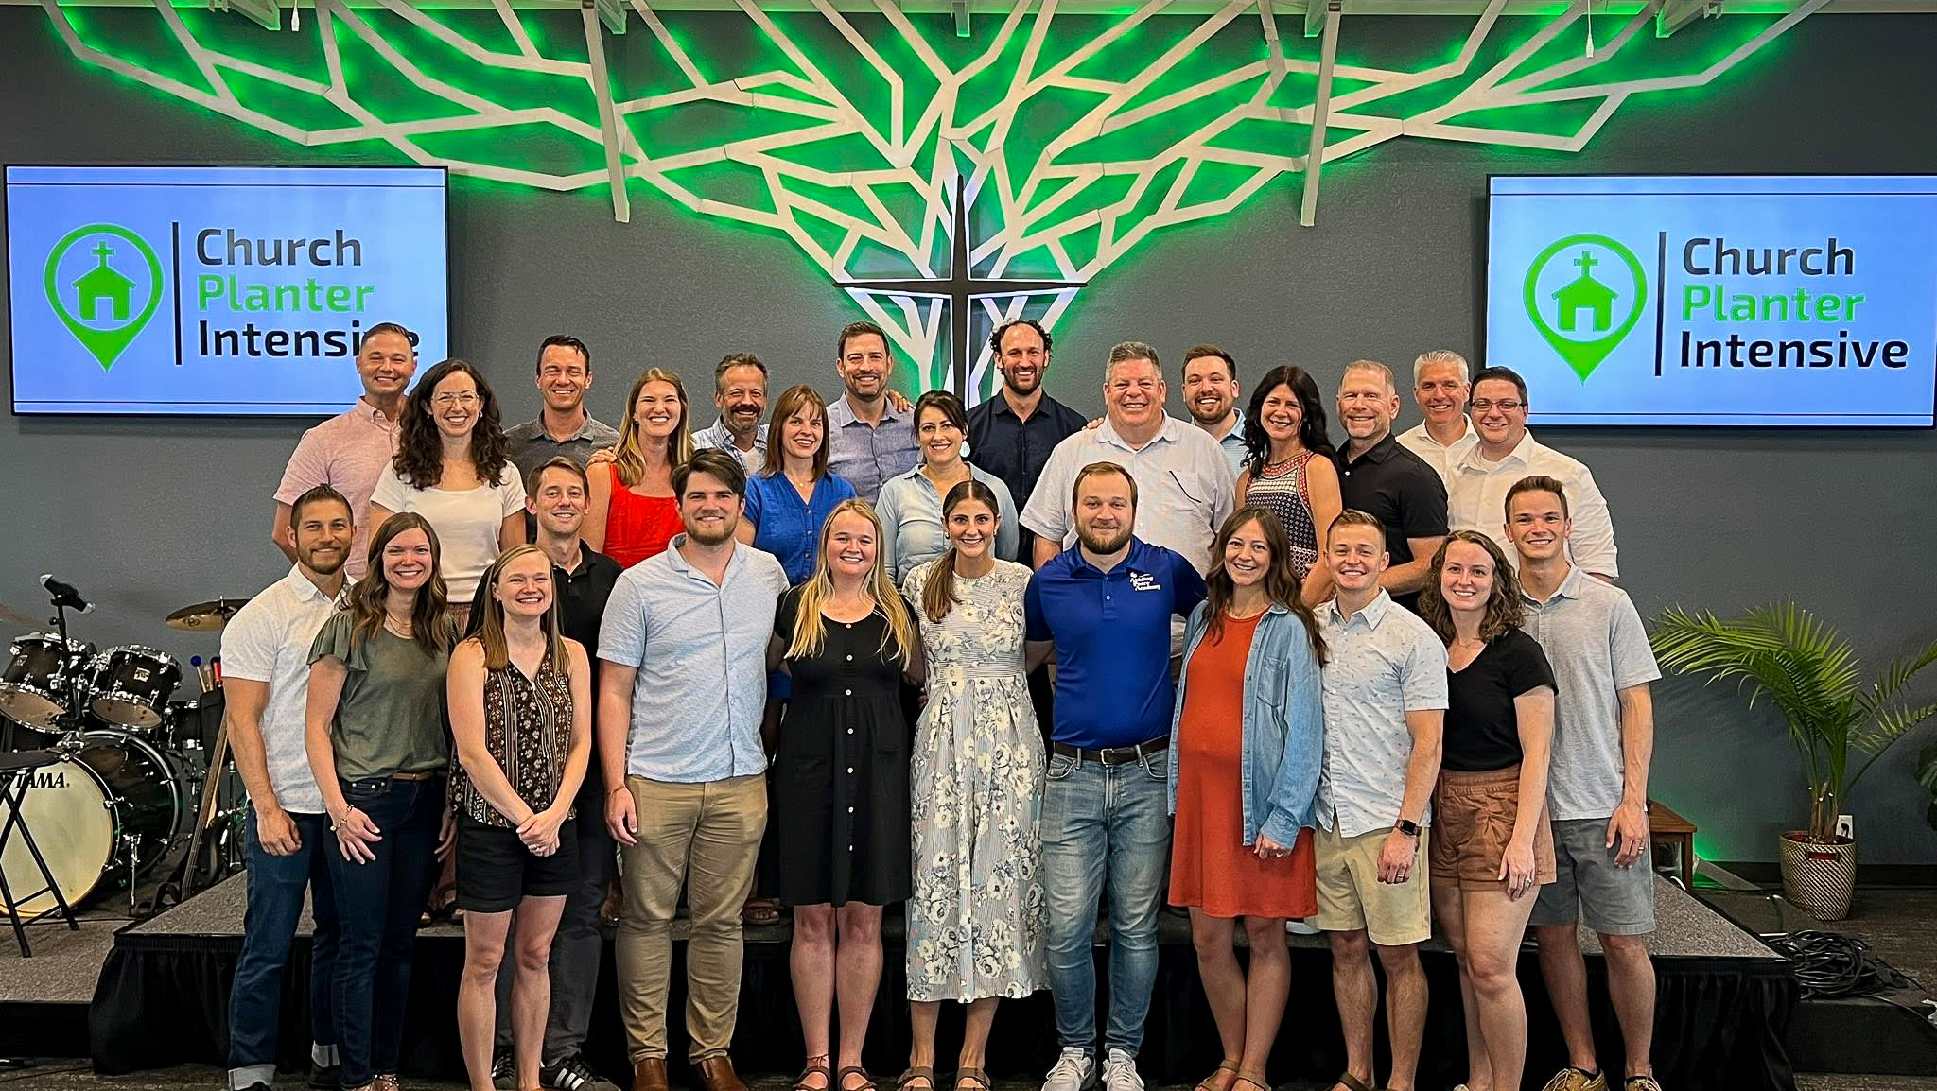
Equipping new missionaries – Church Planter Intensive and coaching program
Notes:
New church planters are not left to fend on their own!
A group of six home missionaries and other experienced church planters gathered together at Carbon Valley Lutheran Church in Firestone, Colo., for the Church Planter Intensive weekend July 23-27. Experienced church planter Jared Oldenburg (Eternal Rock – Castle Rock, Colo.) developed the program and Home Missionary Matt Rothe (The Way – Fredericksburg, Va.) now leads the training. This extended weekend seminar encourages and equips pastors who are called to plant brand new home mission churches. The purpose of this event is to:
Talk through church planting principals.
Be a sounding board to new missionaries and their unique situations.
Give the missionary a chance to think about all aspects of starting a church
Encourage the missionary to make decisions and plans based on the core group, community and place God has placed him. In other words, don’t copy, but instead learn to lead intuitively.
Help the missionary establish some big picture benchmarks/activities.
Offer encouragement by openly sharing what it’s like to be a church planter
Provide the opportunity for a new missionary to network with other missionaries.
After the intensive, new church planters are paired with a coach from an established mission church to guide them for their first two years of launching a new church. Home Missionary Joel Schulz (Divine Savior – Delray Beach, Fla.) leads that portion of the program.
Both the Church Planter Intensive and the coaching program are sponsored and encouraged by WELS Home Missions.
“As much as Church Planter Intensive was able to ground me, set our ministry on a good path, and send us out with valuable information, the coaching program is now my lifeline in an ongoing way. My coach is the most-accessible avenue to bounce ideas off, get input from, and help me grow as a pastor.” – Rev. Joe Lindloff, church planter in Marquette, Mich.

Slide 12
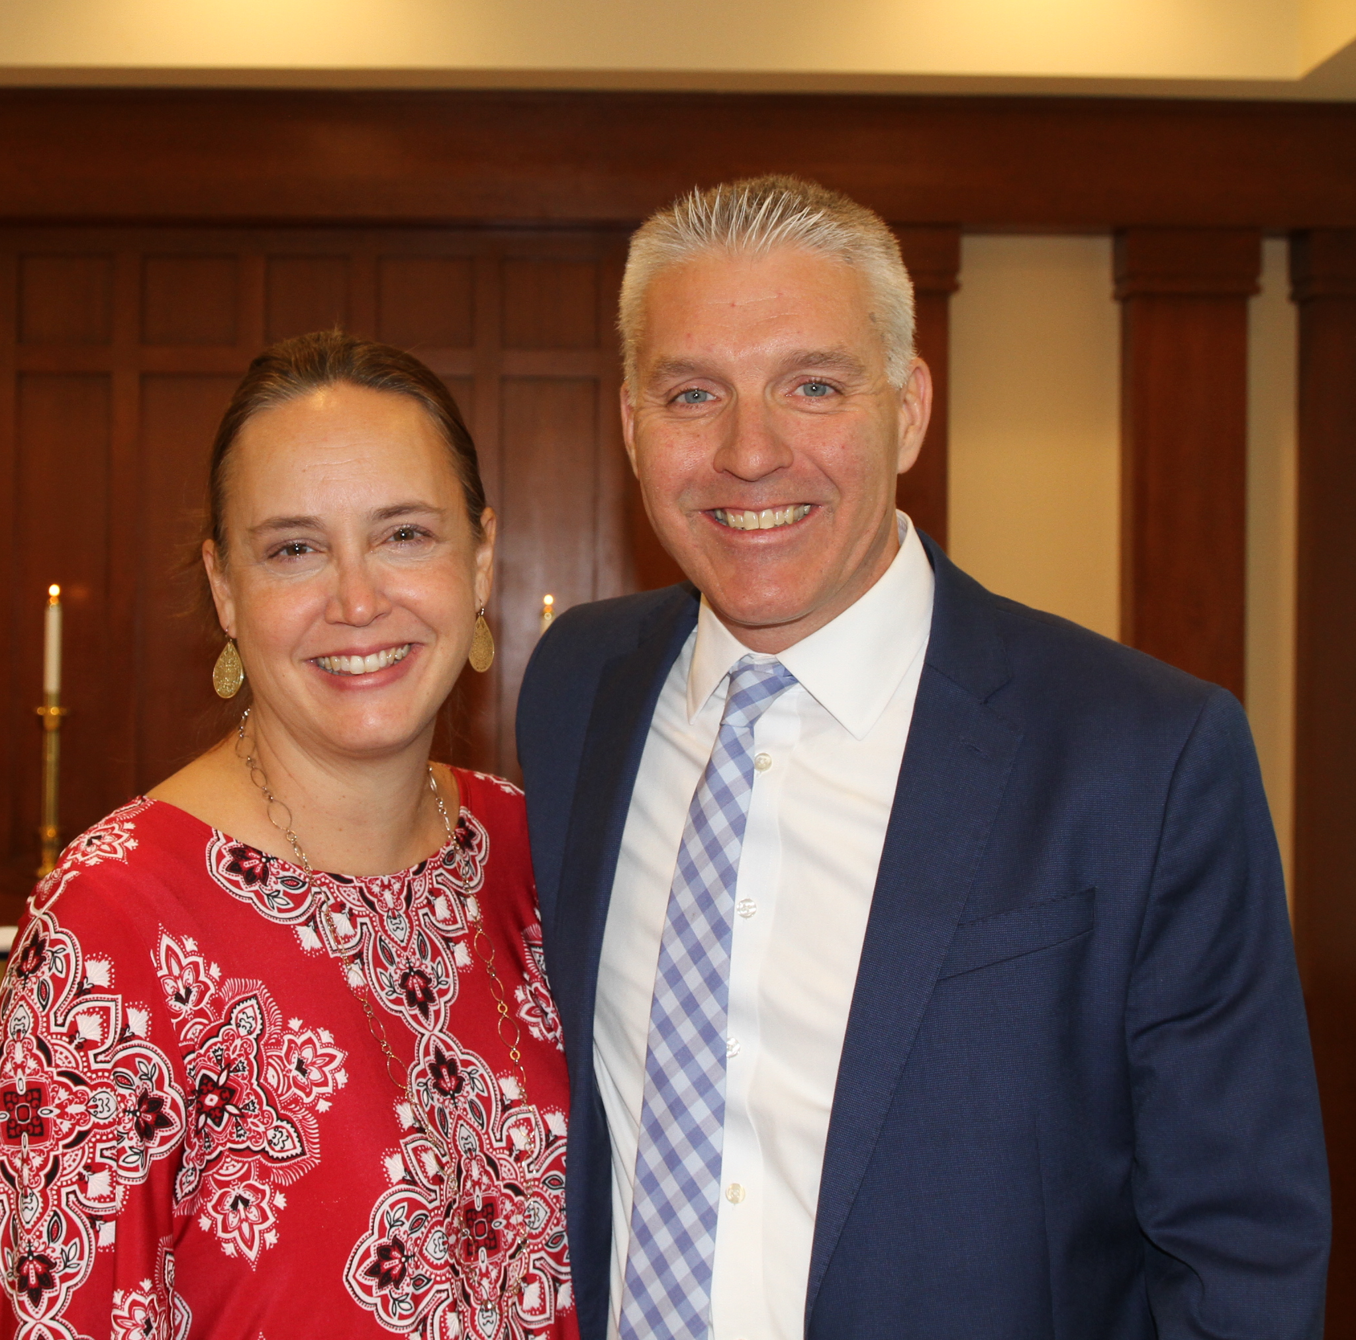
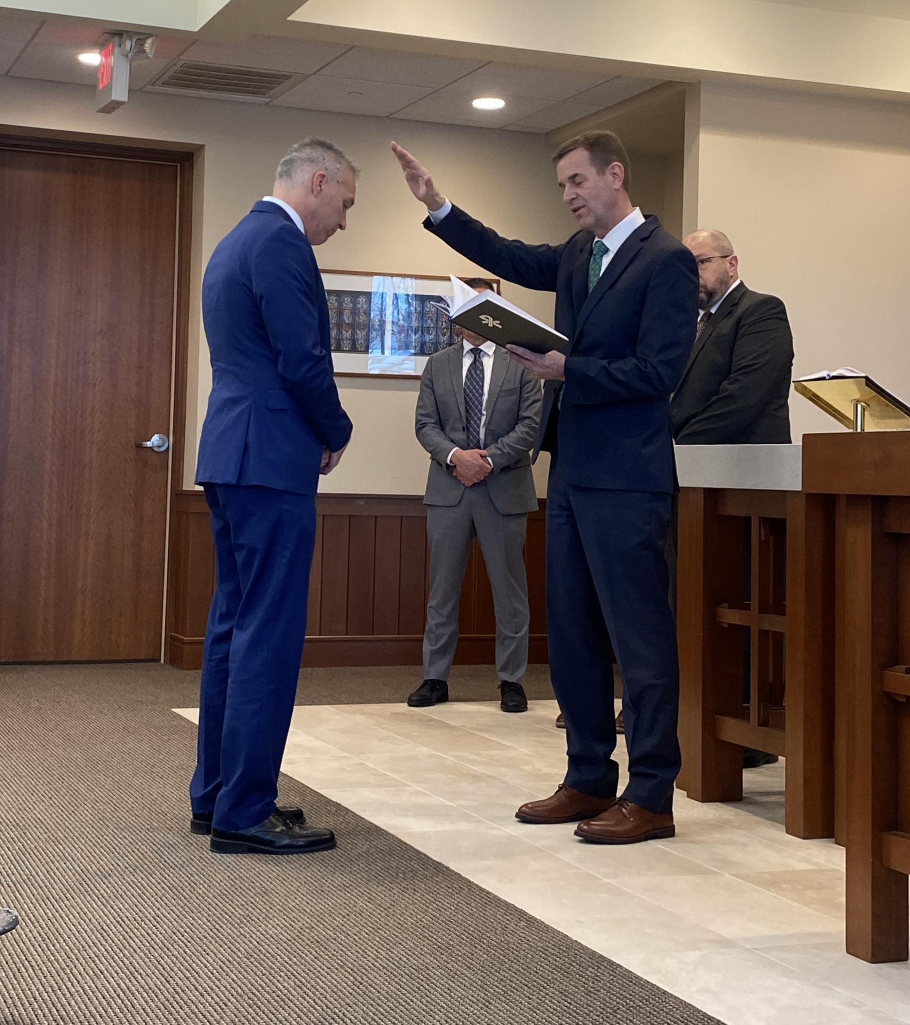
Home Missions administrator
Rev. Mark Gabb
Notes:
WELS Missions welcomed Mark Gabb as the new administrator for WELS Home Missions. Gabb began serving in this role in January 2024 following a vacancy in the position since spring 2022, when previous administrator Keith Free accepted a call to parish ministry. Gabb was formally installed as the Home Missions administrator Wed., Jan. 31, at the WELS Center for Mission and Ministry weekly chapel service. Gabb is not new to the work of WELS Home Missions. He has served as a member of the Board for Home Missions for ten years and as chairman for three, taking on additional leadership responsibilities during the vacancy.

Slide 13
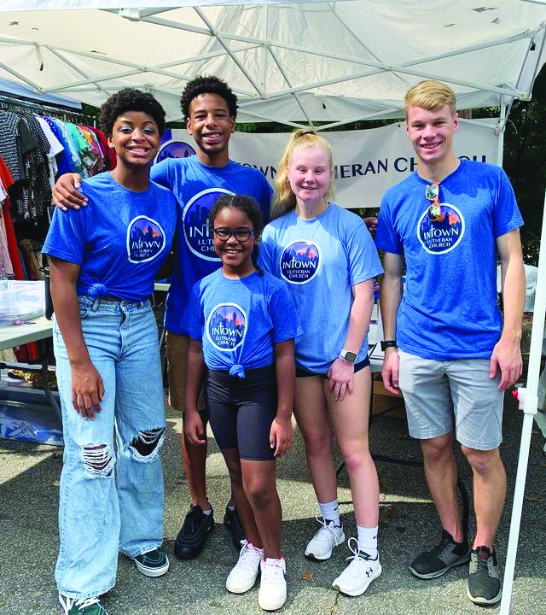
Life of a Home Mission church
No community is the same. No core group is the same. No soul is the same. But we know that all people have the same need for a savior from sin.
Notes:
No community is the same. No core group is the same. No soul is the same. But we know that all people have the same need for a Savior from sin. Those differences mean that no home mission church starts the same way or follows the same path to maturity. However, we pray that all WELS home mission churches contribute in their own unique way to the ultimate outcome: winning souls for Jesus through the proclamation of the gospel.

Slide 14
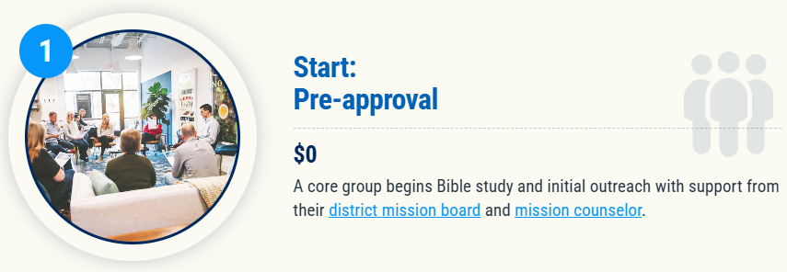
Notes:
Where it all begins.
When an area with possible mission potential is identified, the local WELS members work with their DMB and mission counselor to survey the area. They look at demographic data, explore the area, and conduct personal interviews with community members, local government leaders, other church leaders, etc. At that point they determine if the mission location is a viable option and begin to document potential mission strategies.
At the same time, attention is given to “planting a mission mindset to plant missions”. The core group meets for evangelism/mission-themed Bible studies, they often participate in evangelism training by Praise and Proclaim, and they begin diving into community outreach events to begin making a name for themselves in the community and to practice their personal evangelism.
Once ready, the core group will work with their DMB and mission counselor to begin developing their new start request and full ministry plan.

Slide 15

Exploratory missions in your district
Notes:
View our interactive Google map found at wels100in10.net to see where your district mission board is exploring outreach in your district. Anything in “blue” indicates an exploratory mission. District mission boards and mission counselors work with exploratory missions to develop a core group of members and begin Bible study and initial outreach before coming to the Board for Home Missions for official home mission status. These missions are not currently approved but are preparing the groundwork needed for their formal ministry request to the Board for Home Missions. Each request is thoroughly vetted and either prioritized, deferred, or denied. Prioritized requests are authorized as funding is available. Please note that there might be some exploratory missions on this list that will not end up receiving home mission status after the review process.

Slide 16
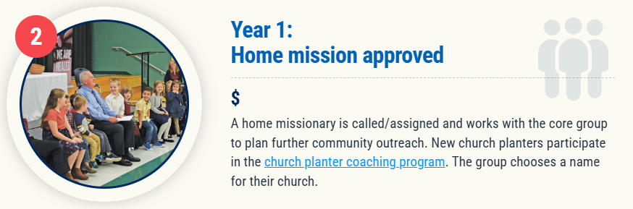
Notes:
The District Mission Board (DMB) and mission counselor works with potential home missions to develop a new start ministry request that gets submitted to the WELS Board for Home Missions (BHM).
A new start ministry request takes quite a bit of time and is quite comprehensive. Some of the things required include:
A full ministry plan, including a proposed timeline for the first year of ministry, community engagement strategies, and specific outreach opportunities
Defined core group: who will be assisting this effort and the spiritual and ministry gifts that each person brings to the mission
Potential temporary worship and/or office space options
A 12-year subsidy projection form with budget for the first three years, including an estimate of future land/construction costs.
One a new home missionary is called/assigned, he works with the core group to perfect their ministry and outreach plan and pick a name for their new church.

Slide 17

2026 New Starts:
Bastrop, Texas
Greeneville, Tenn.
North Marana, Ariz.
Notes:
At its spring meeting, the WELS Board for Home Missions approved three new mission starts, continuing its work of bringing the gospel to growing communities across the United States while navigating ongoing financial and manpower challenges.

Slide 18
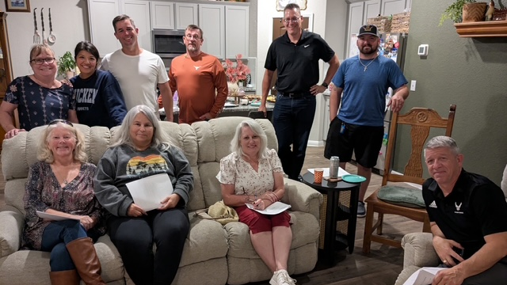
New Start – Bastrop, Texas
Notes:
Located about 25 miles east of Austin, Bastrop is experiencing rapid growth fueled by new residential development and expanding economic activity. Major employers now headquartered in Bastrop, including X and Starlink, have drawn new families to the area. As Bastrop continues to expand, many residents lack church connections, and a confessional Lutheran presence remains limited. Members of Holy Word in Austin, Texas, have formed a committed core group that has been meeting regularly, engaging the community through service and outreach, and building relationships with residents. Bastrop presents a timely opportunity for a new Home Mission start.
Fast facts:
Bastrop County’s population has grown by more than 15 percent since 2020. Large master‑planned developments continue to add thousands of new homes.
A committed core group from Holy Word in Austin has been meeting regularly since mid‑2025, using the name 7:37 Ministry during the early stages of outreach. The name connects Jesus’ invitation in John 7:37, “Let anyone who is thirsty come to me and drink,” with the local 737 area code.
Core group members have actively engaged the community through service partnerships with the Bastrop Food Pantry, outreach booths at local events, neighborhood activities within large residential developments, and door‑to‑door food canvassing, building relationships that have led to ongoing conversations and growing interest.

Slide 19
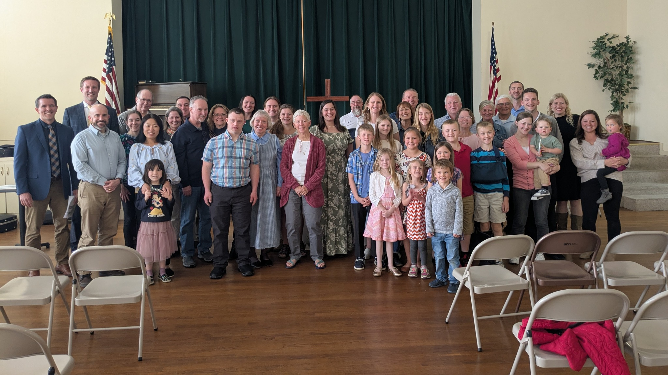
New Start – Greeneville, Tenn.
Notes:
Greeneville, Tenn., is a growing community positioned between the Johnson City/Kingsport/Bristol metro area and Knoxville. While the area reflects strong Bible Belt culture and openness to conversations about faith, currently no confessional Lutheran church serves the community. A committed core group, supported by nearby WELS congregations in Johnson City and Morristown, has been meeting regularly and actively engaging with the community. Greeneville represents an opportunity to establish a confessional Lutheran presence in a community where none currently exists.
Fast facts:
Greeneville serves a county population of approximately 70,000 people, functioning as a regional hub for surrounding rural communities.
The nearest WELS congregations are located 33–35 miles away in Johnson City and Morristown.
A core group of 14 people has been meeting regularly and has already hosted public worship services, drawing more than 40 people to its first service (pictured) and averaging mid‑20s attendance at subsequent gatherings.
Outreach efforts have included door‑to‑door canvassing, participation in community events, and local advertising, resulting in nine new families added to the prospect list and multiple repeat worship visitors.

Slide 20
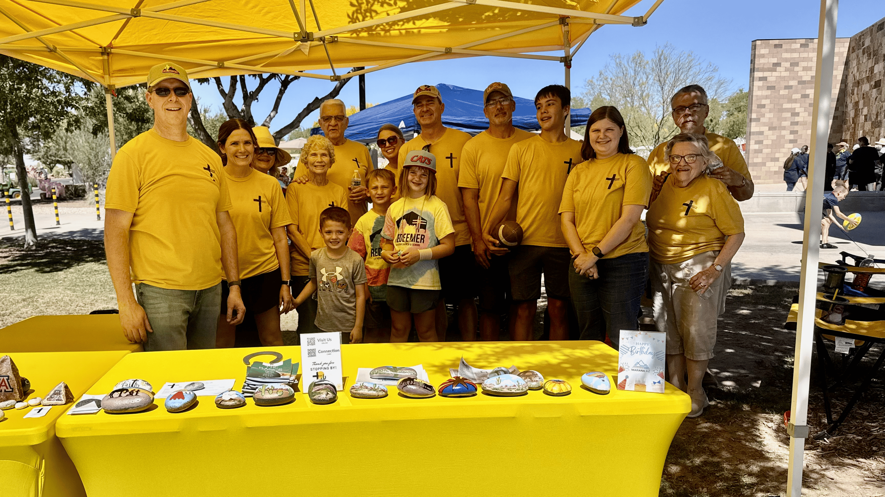
New Start – North Marana, Ariz.
Notes:
North Marana is one of the fastest growing areas in the Tucson metro area, now home to more than 60,000 residents. A new mission effort—known locally as Mission Marana—is already active in the community, with a committed core group that gathers for Bible study and regularly serves at local events across North Marana. With strong local leadership and a clear focus on serving before being served, this new mission is positioned to grow alongside a rapidly expanding population of young families.
Fast facts:
A strong core group of 20–25 people has been meeting regularly since fall 2024 for Bible study, outreach, and mission planning.
Through service at local events such as Founders Day, Movies in the Park, food drives, and holiday festivals, Mission Marana has built community trust and developed a prospect list of more than 150 contacts.
Nearby WELS congregations are actively supporting the effort, including a four-year financial commitment from Shepherd of the Hills.
Plans are in place to begin public worship services in 2027.

Slide 21
2026 Enhancements:
Good Shepherd, Holmen, Wis.
Mount Olive, St. Paul, Minn.
Resurrection, Chesapeake, Va.
Notes:
In addition to the new mission starts, the board approved three Home Missions enhancement grants.
Good Shepherd, Holmen, Wis.: Good Shepherd is a thriving congregation serving the fast-growing community of Holmen, just north of La Crosse, Wis. With a strong culture of outreach, regular door-to-door engagement, and a visible presence at community events, the congregation continues to connect with new families moving into the area. Little Lamb Preschool has become one of Good Shepherd’s most effective ministry bridges, regularly introducing unchurched families to the gospel. A short-term Home Missions enhancement grant will support the calling of a staff minister to build on that momentum, strengthen follow-up and discipleship, and help the congregation keep pace with growth.
Mount Olive, St. Paul, Minn.: Mount Olive is a historic congregation located between downtown Minneapolis and St. Paul, Minn., in a highly populated urban neighborhood. With a debt-free facility and a creative, mission-minded core group, Mount Olive is uniquely positioned to serve as a healthy WELS presence in the urban core. Lay leaders have long been involved with other WELS churches, including a Merge for Mission effort, while continuing to invest locally in worship, children’s ministry, and community engagement. This enhancement grant will support a full-time pastor who will build on existing momentum as Mount Olive grows as a vibrant city church reaching people across the Twin Cities.
Resurrection, Chesapeake, Va.: Resurrection Lutheran Church is an established congregation with a highly visible campus in Chesapeake, Va.—one of the state’s largest and fastest growing cities. In recent years, the congregation has regained momentum under the leadership of a retiring pastor who helped strengthen worship life, stewardship, and outreach. A Home Missions enhancement grant will provide a short-term bridge as Resurrection calls a new pastor, allowing the congregation to build on that progress and continue reaching its community with the gospel.

Slide 22
Fall 2025 New Starts:
Altoona, Wis.
Buffalo, N.Y.
Naples, Fla.
Olathe, Kan.
The Sandhills, N.C.
West Richland, Wash.
Wilmington, N.C.
Notes:
On Sept. 18-19, WELS Board for Home Missions approved seven new mission starts toward the synodwide 100 Missions in 10 Years initiative. This is thanks to the generous gifts received over the past year.

Slide 23
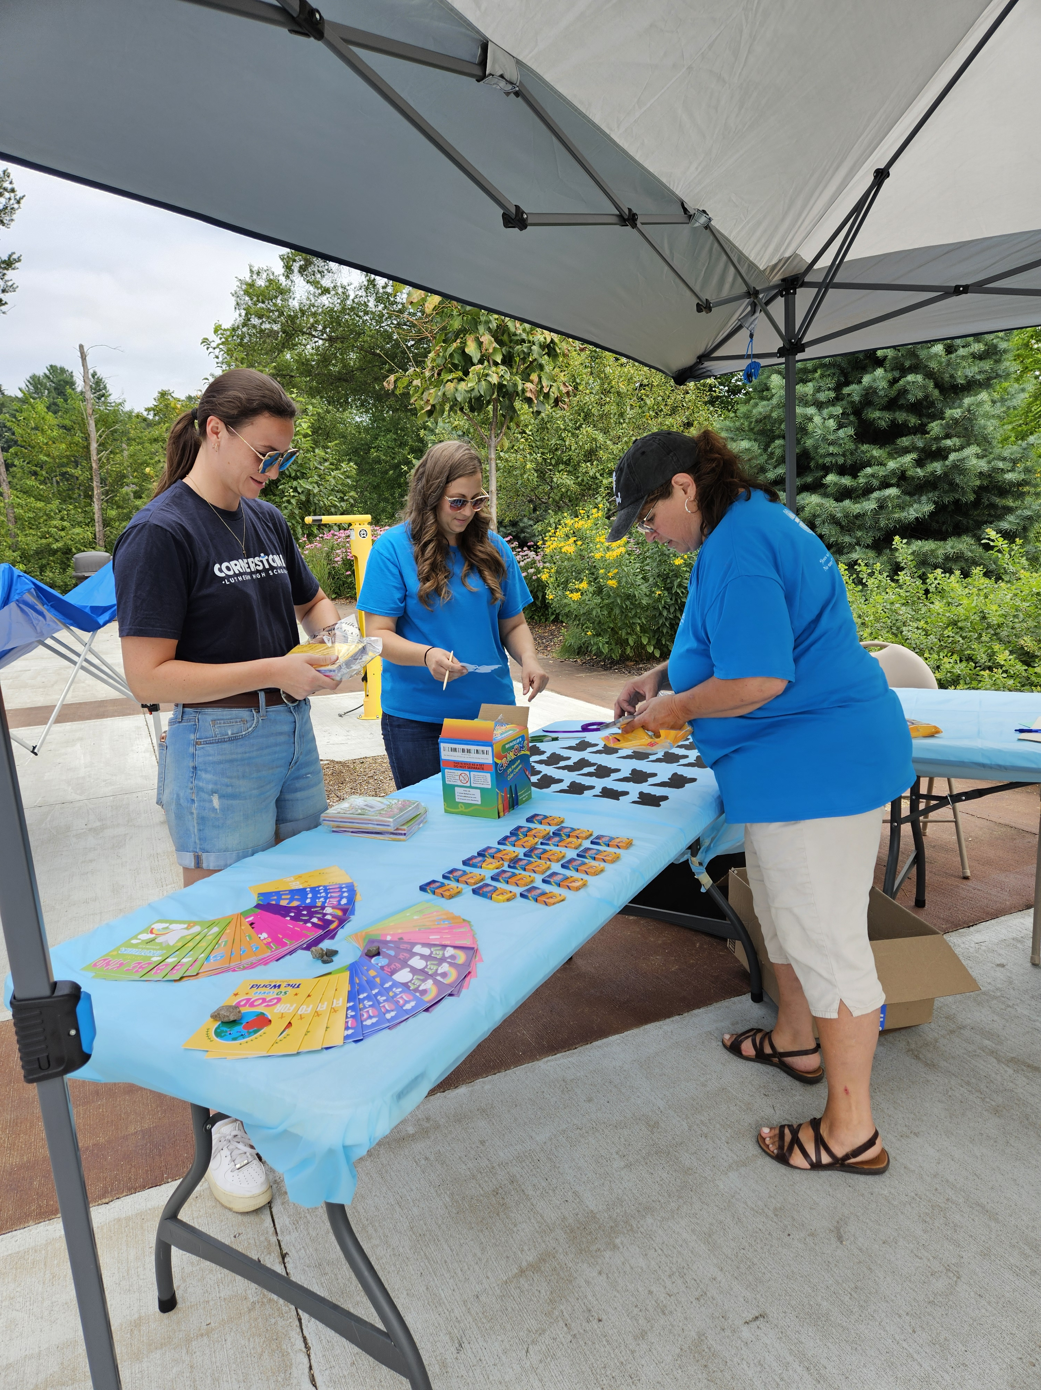
New Start – Altoona, Wis.
Notes:
Located just east of Eau Claire, Altoona is one of the fastest-growing communities in western Wisconsin. With a population nearing 10,000 and projected to grow by 3 percent annually, Altoona attracts young families, professionals, and retirees seeking a small-town feel with access to urban amenities. The Western Wisconsin District Mission Board has been working closely with a core group from St. Mark in Eau Claire since early 2023. This group has been active hosting community events, launching monthly devotional services, and building a growing prospect list. With strong local support, a clear ministry plan, and a heart for outreach, the Altoona mission is poised to bring the gospel to a community eager for connection and truth.

Slide 24
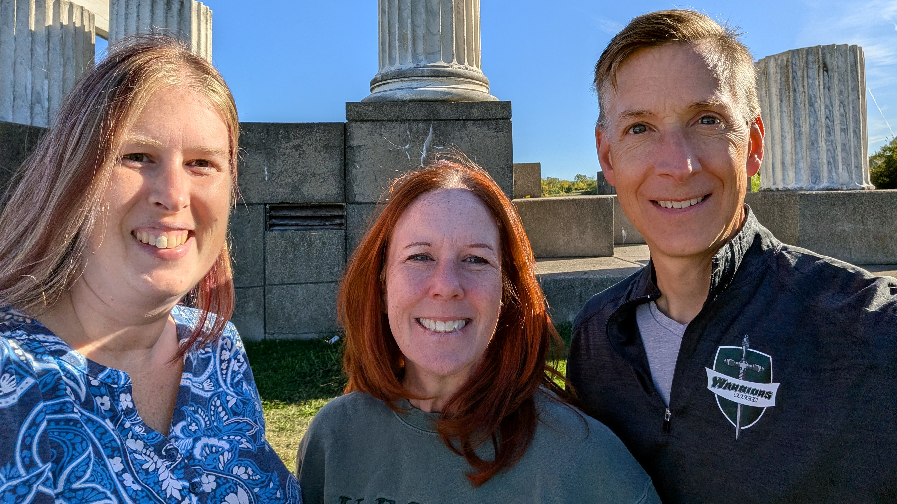
New Start – Buffalo, N.Y.
Notes:
As one of the largest metro areas in the United States without a WELS church, Buffalo presents a unique and urgent opportunity for gospel outreach. The target area—Kenmore, North Buffalo, and Tonawanda—has about 95,000 residents within a 2-mile radius. A dedicated core group has begun gathering for Bible study and outreach, laying the groundwork for a new church plant. With Buffalo’s affordable housing, expanding job market, and a population eager for spiritual connection, the mission team is excited to build relationships and share the hope of Christ with the community.

Slide 25
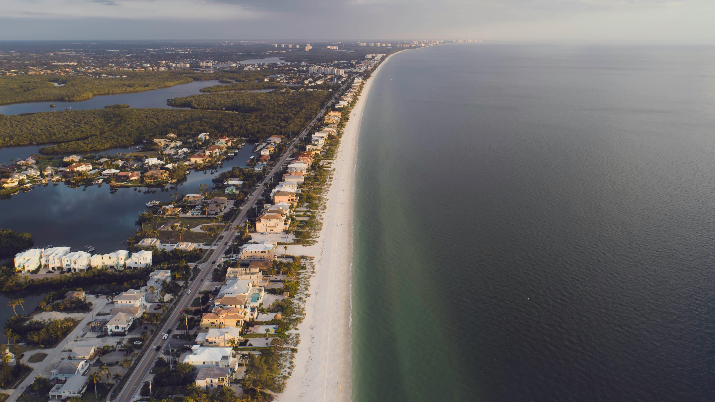
New Start – Naples, Fla.
Notes:
Naples, consistently ranked among the best places to live and retire in the United States, is experiencing rapid growth and demographic change. The district mission board and mission counselor have made multiple visits—talking with locals, meeting community leaders, and learning about the area’s needs. A significant portion of residents are unchurched and eager for spiritual connection. With strong financial support and a clear plan, the mission is ready to hit the ground running—focused on reaching out, making connections, and sharing the hope of Christ with a growing and diverse community.

Slide 26
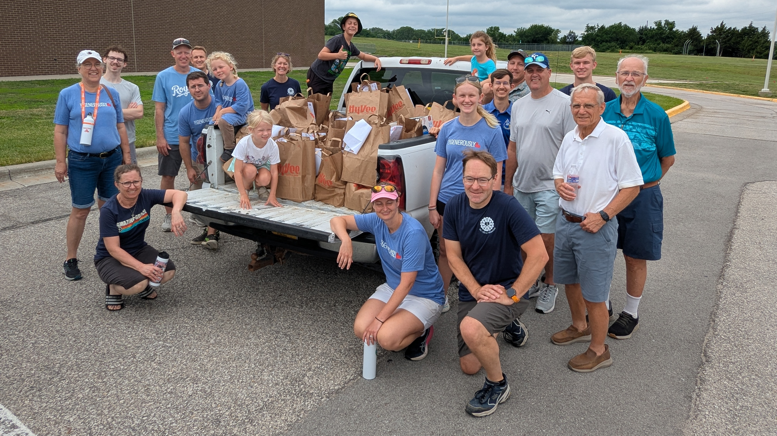
New Start – Olathe, Kan.
Notes:
Olathe, located in the fast-growing southwest Kansas City metro area, has seen its population surge with continued growth expected. Major employers have fueled this expansion, making Olathe one of the most affordable and family-friendly cities in the nation. The Nebraska District Mission Board has been working with Mt. Olive in Overland Park, Kan., to establish a new mission, gathering a dedicated core group and hosting regular Bible studies and planning meetings. With strong support from Mt. Olive and a clear vision for outreach, the Olathe mission is poised to reach many new families with the gospel.

Slide 27
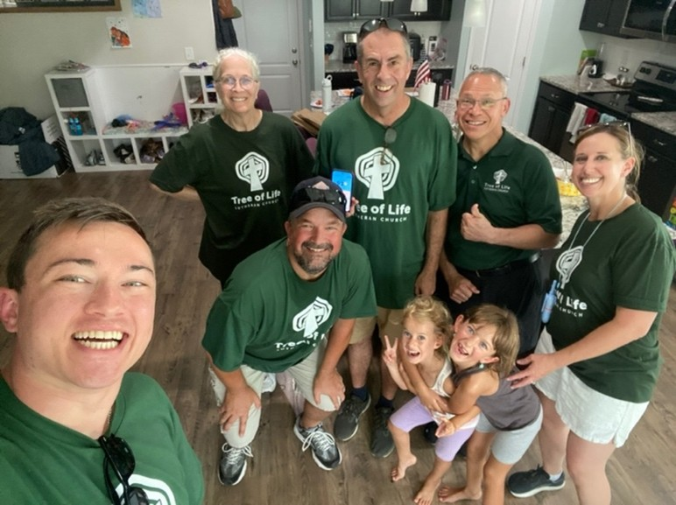
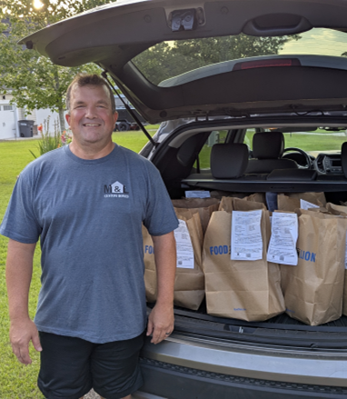
New Start – The Sandhills, N.C.
Notes:
The Sandhills area of North Carolina is experiencing steady growth as both retirees and young families move into the area, with major investments like Amazon’s new data center fueling local development. With close proximity to Fort Bragg—the world’s largest military base—the region also attracts commissioned military personnel who often choose to make the Sandhills their permanent home. The effort is being led by a core group from Tree of Life in Cary, N.C. The team has begun regular outreach and canvassing, building momentum and a growing prospect list in a region where confessional Lutheran churches are few.

Slide 28
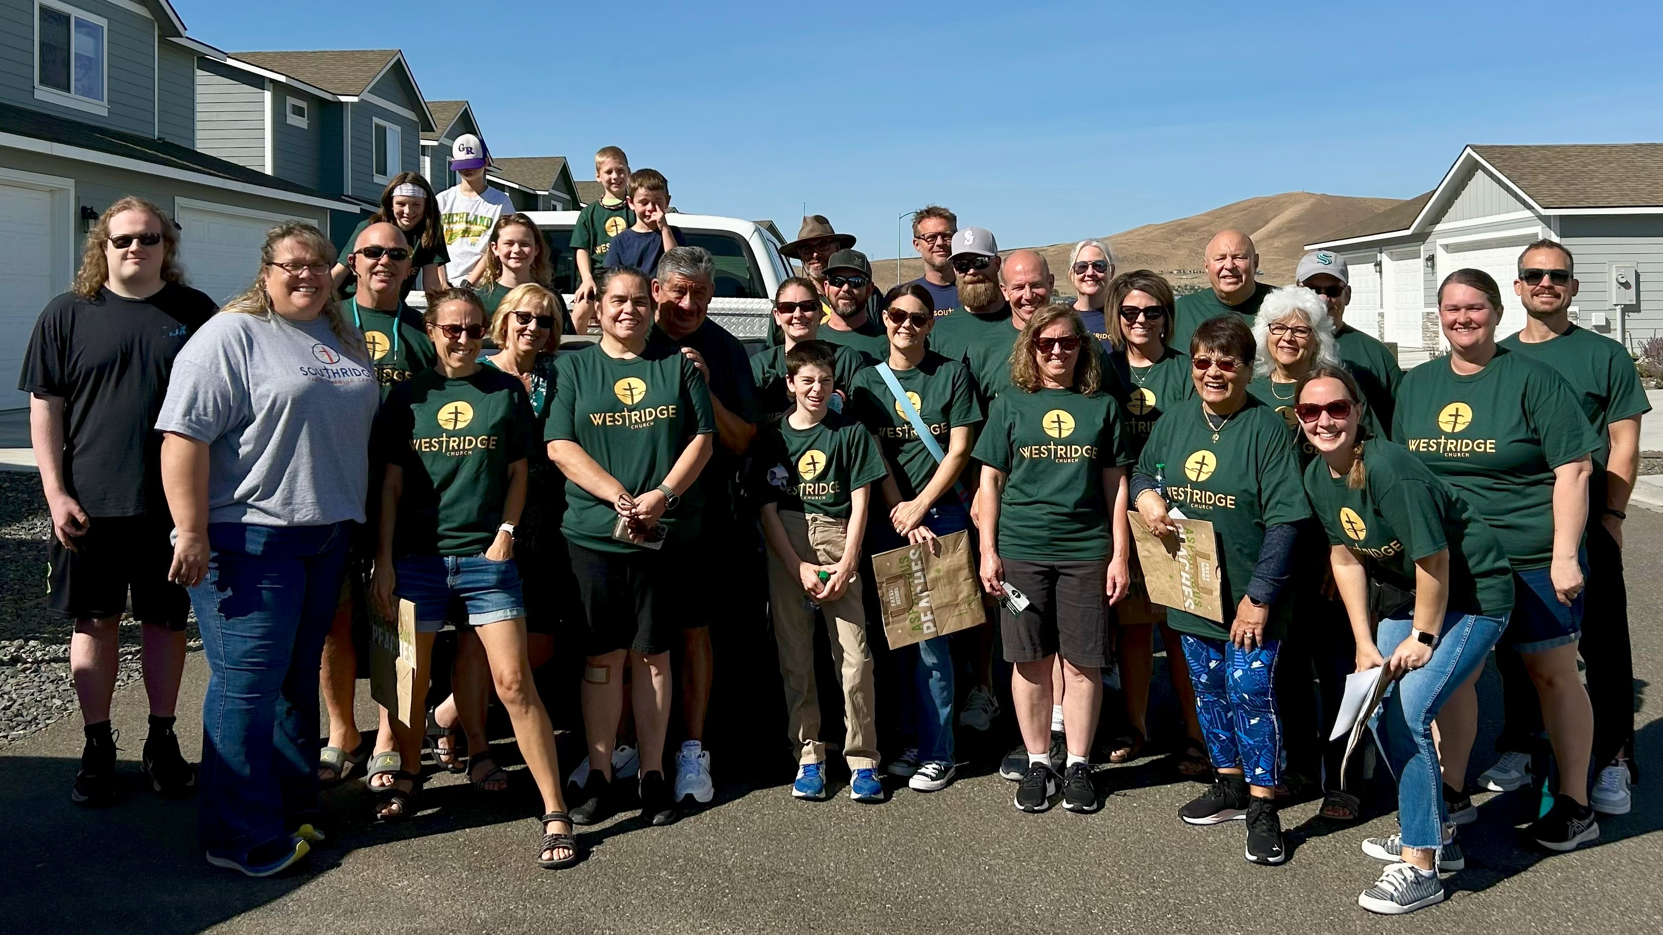
New Start – West Richland, Wash.
Notes:
West Richland, located just outside the Tri-Cities, is experiencing rapid growth as families and professionals move in for its strong job market and quality schools. Since 2024, the Pacific Northwest District Mission Board has been working with a committed core group of members from Southridge Church in Kennewick to establish a second site in West Richland. The group has already begun outreach through community service activities and fellowship events. With continued momentum and support, the new mission aims to launch regular worship and ministry activities in 2025.

Slide 29
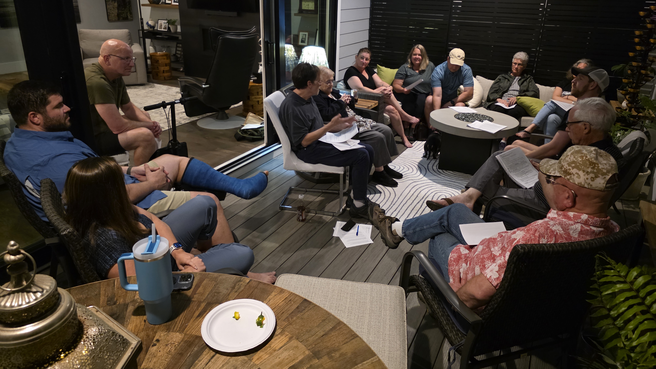
New Start – Wilmington, N.C.
Notes:
Wilmington’s northeast neighborhoods are seeing a surge of new families and rapid development, making this area one of the fastest-growing corners of North Carolina. A core group of 18 people from Ascension in Jacksonville, N.C., meets regularly for Bible study and planning. With no WELS church nearby and easy access along U.S. 17, the group is laying the foundation for a welcoming church that blends in-person and online worship, Bible instruction, and plenty of community service.

Slide 30
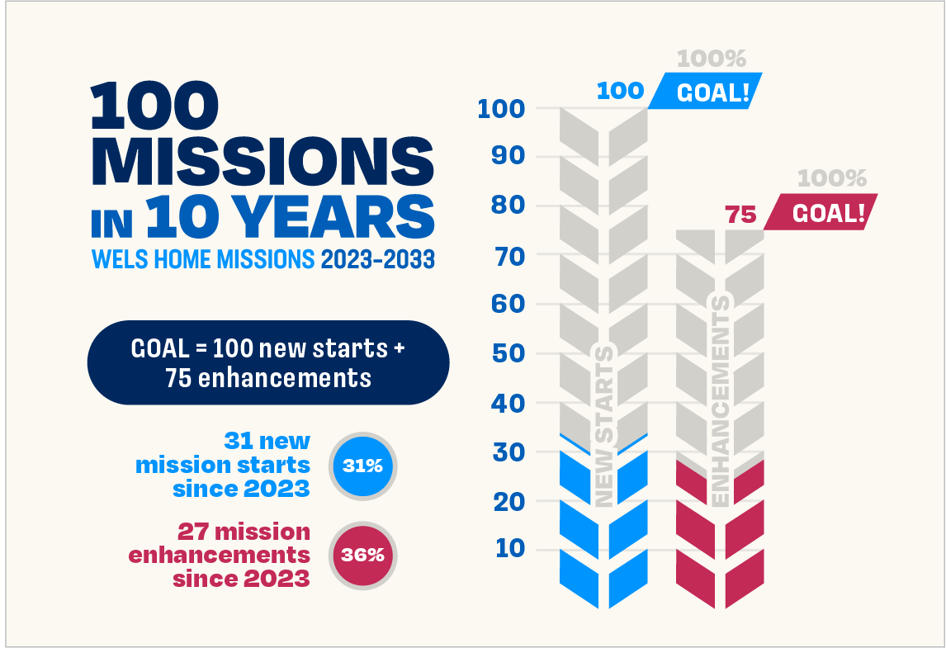
Balancing gratitude, needs, and stewardship
Notes:
Since the launch of the 100 Missions in 10 Years initiative in 2023, 31 new missions have been approved for funding by WELS Home Missions. Approving three new mission starts at the recent meeting of the Board for Home Missions is cause for thanksgiving, but it falls short of the desire to approve ten new starts each year. It does, however, reflect current realities. In WELS today there are 150+ pastoral vacancies. Additionally, Congregation Mission Offerings (CMO) and special gifts to Home Missions have not kept pace with the rising costs of establishing and supporting new missions.
As Home Missions leadership continues this initiative, the focus remains on faithful stewardship. The challenge is not a lack of gospel opportunities, but discerning how best to deploy the finite resources our synod has. This is not a new struggle for the church, but one God’s people have faced throughout history as they seek to balance zeal for mission work with wise use of limited resources.
Even amid these challenges, God continues to work powerfully through dedicated core groups, WELS congregations, and pastors serving in mission settings. Through ongoing prayers, generosity, and partnership, home mission churches are proclaiming Christ, strengthening believers, and reaching the lost with the gospel that endures for eternity.

Slide 31
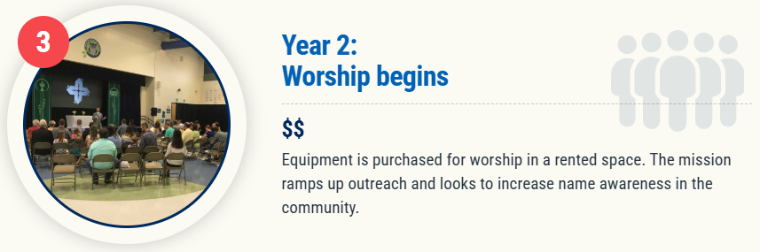
Notes:
Most often, worship doesn’t begin right away. The core group takes time to continue their outreach and build a name for themselves in the community. This allows the group time to explore locations for worship in a rented space, purchase the needed equipment to set up and take down every Sunday, and have “preview services” with their core group before a formal grand opening/launch worship.

Slide 32
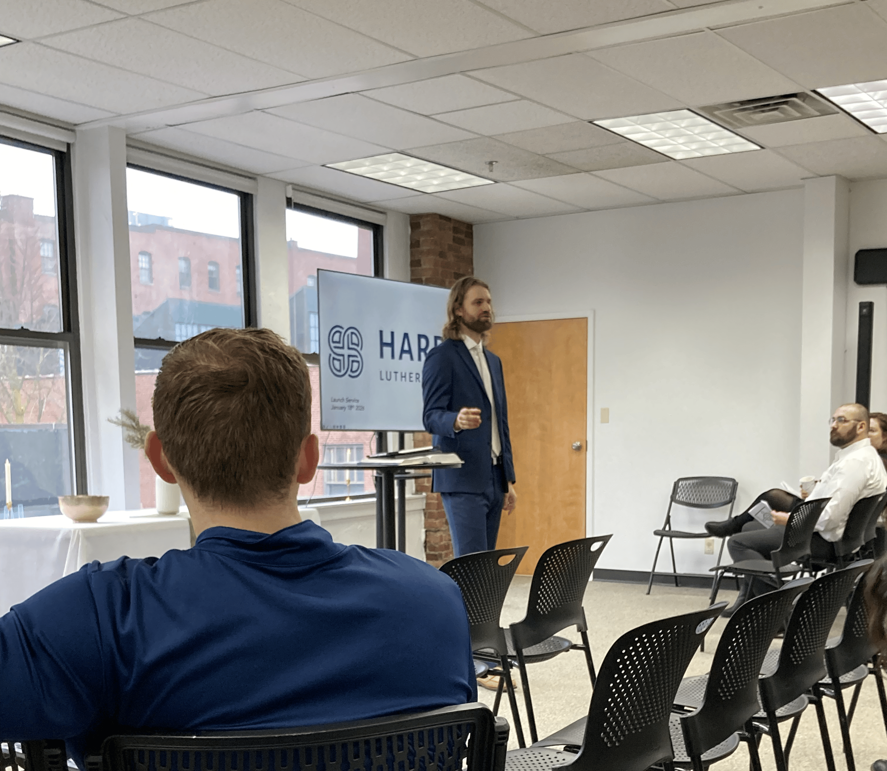
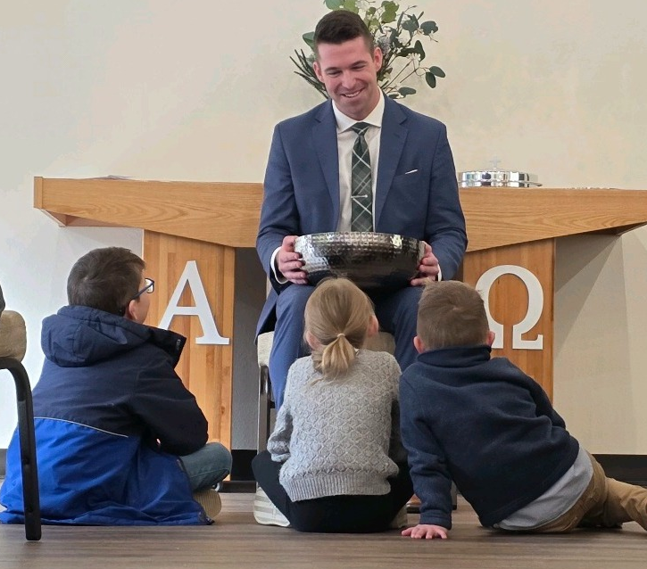
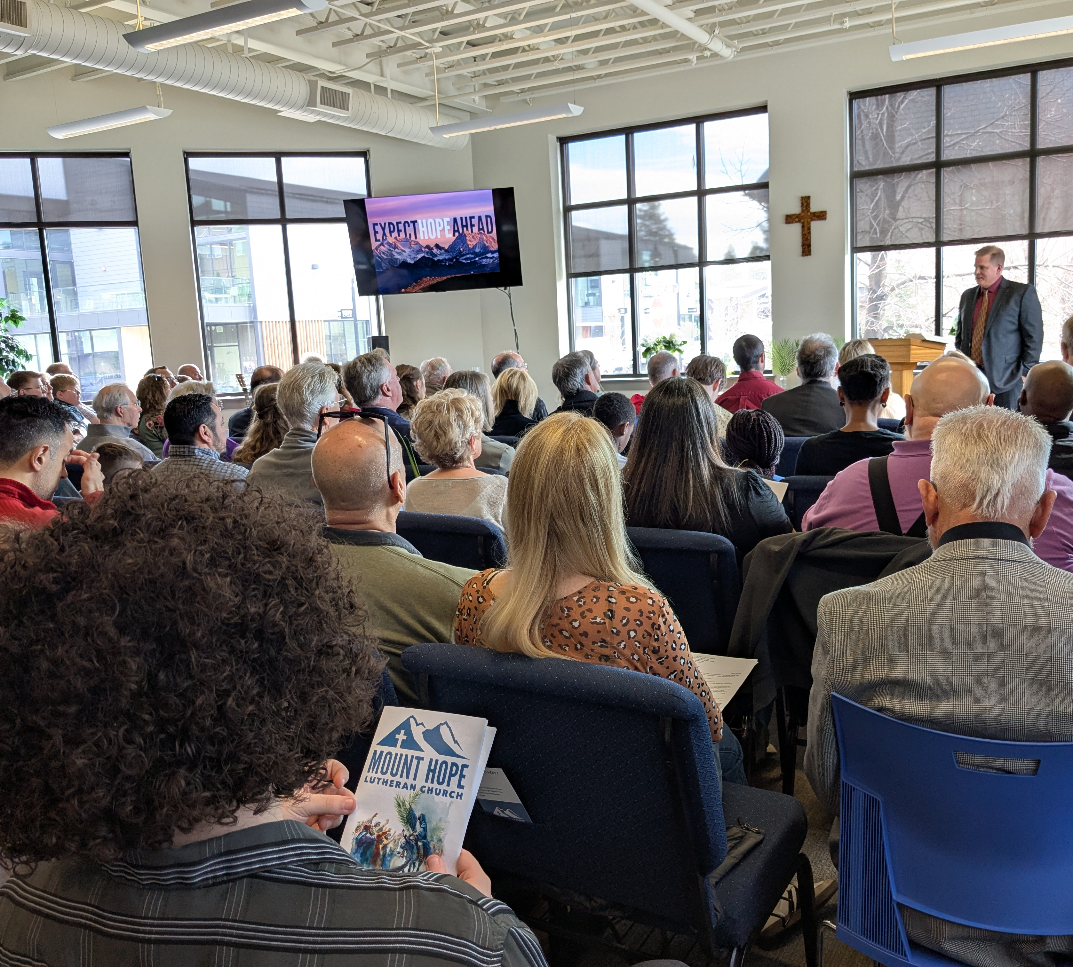
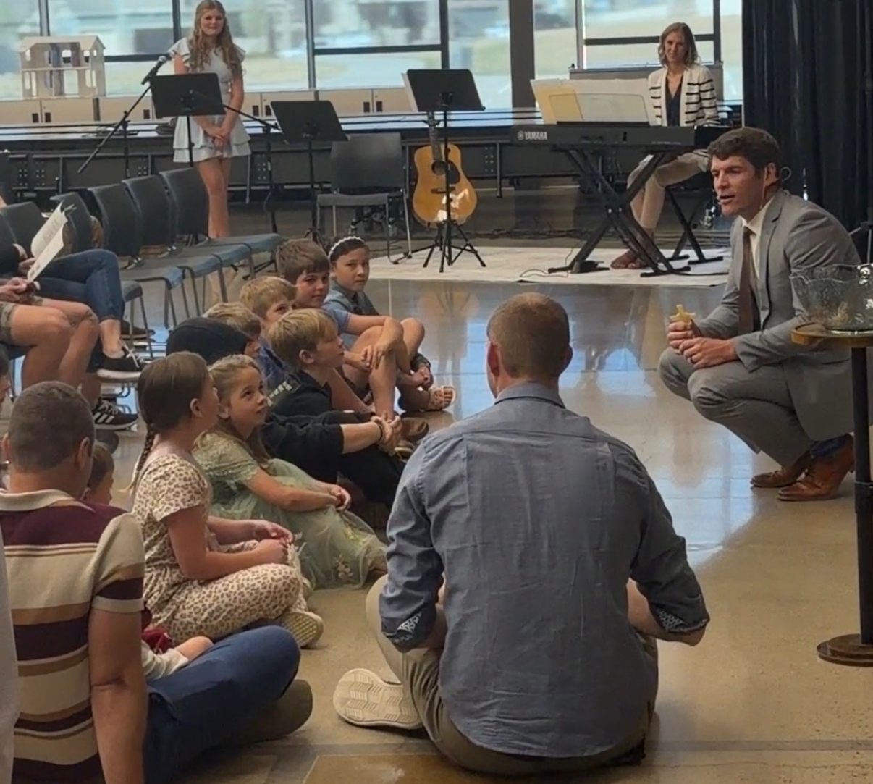
Home missions celebrate grand openings
Harbor – Boston, Mass. (Jan. 18)
Cornerstone - Centerton, AR (Feb. 22)
Mount Hope – Bend, Ore. (March 29)
Redemption – Erie, Colo. (March 29)
Crossroads – Chicago, Ill. (April 5)
Notes:
Harbor – Boston, Mass. (pictured top left) - Harbor Lutheran Church hosted their launch service in their newly finished worship space on Jan. 18. Harbor was approved as a new mission start in 2023, the first year of the 100 in 10 initiative.
Cornerstone - Centerton, AR (pictured top right) - Cornerstone in Centerton (Bentonville), Ark., celebrated their worship launch on Feb, 22. Cornerstone was also approved as a new mission start in 2023, the first year of the 100 in 10 initiative.
Mount Hope – Bend, Ore. (pictured bottom left) – Mount Hope had over 90 people at their grand opening on March 29, including 45 visitors/prospects from the community. Mount Hope was approved in 2024.
Redemption – Erie, Colo. (pictured bottom right) - Redemption welcomed 73 people to its launch service on March 29, including nearly 30 visitors from the community. Redemption was approved in 2025 and launched public worship just a year after approval.
Crossroads – Chicago, Ill .– Crossroads, a mission restart that was approved in 2024, relaunched public worship on Easter Sunday.

Slide 33
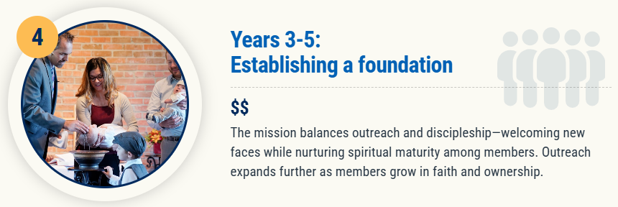

Slide 34

Notes:
It can be hard to grow your ministry and fellowship opportunities when you only have access to a rented facility on Sundays or grow out of your existing worship space. As church membership grows, the home mission begins exploration to buy land or purchase an existing facility and perhaps remodel it to better serve their ministry needs.
What an exciting time in the life of a home mission church! Once land or a facility is purchased, building/construction begins to make it into a facility that the church can use to conduct their ministry.

Slide 35
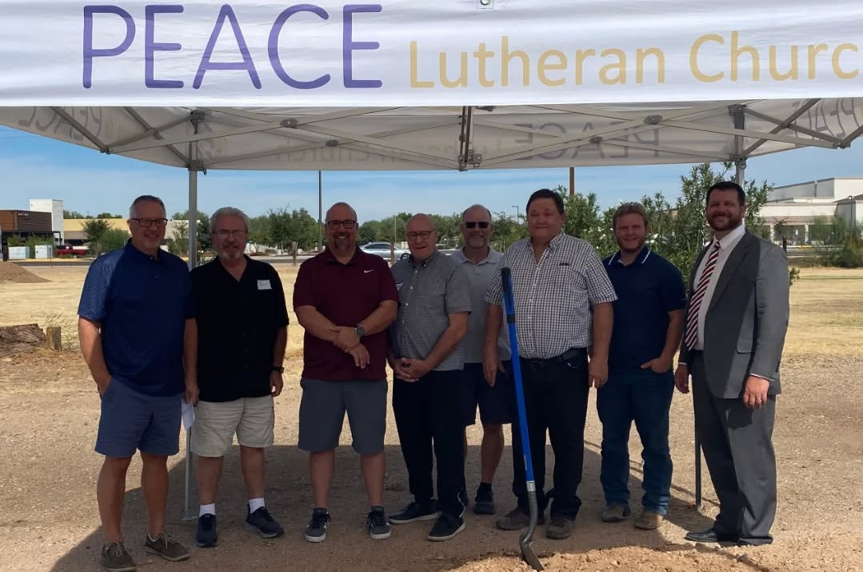
Peace, Gilbert, Ariz., broke ground on their new church in Oct. 2024
Notes:
The church expects to have occupancy of their new church building by the end of 2025.

Slide 36
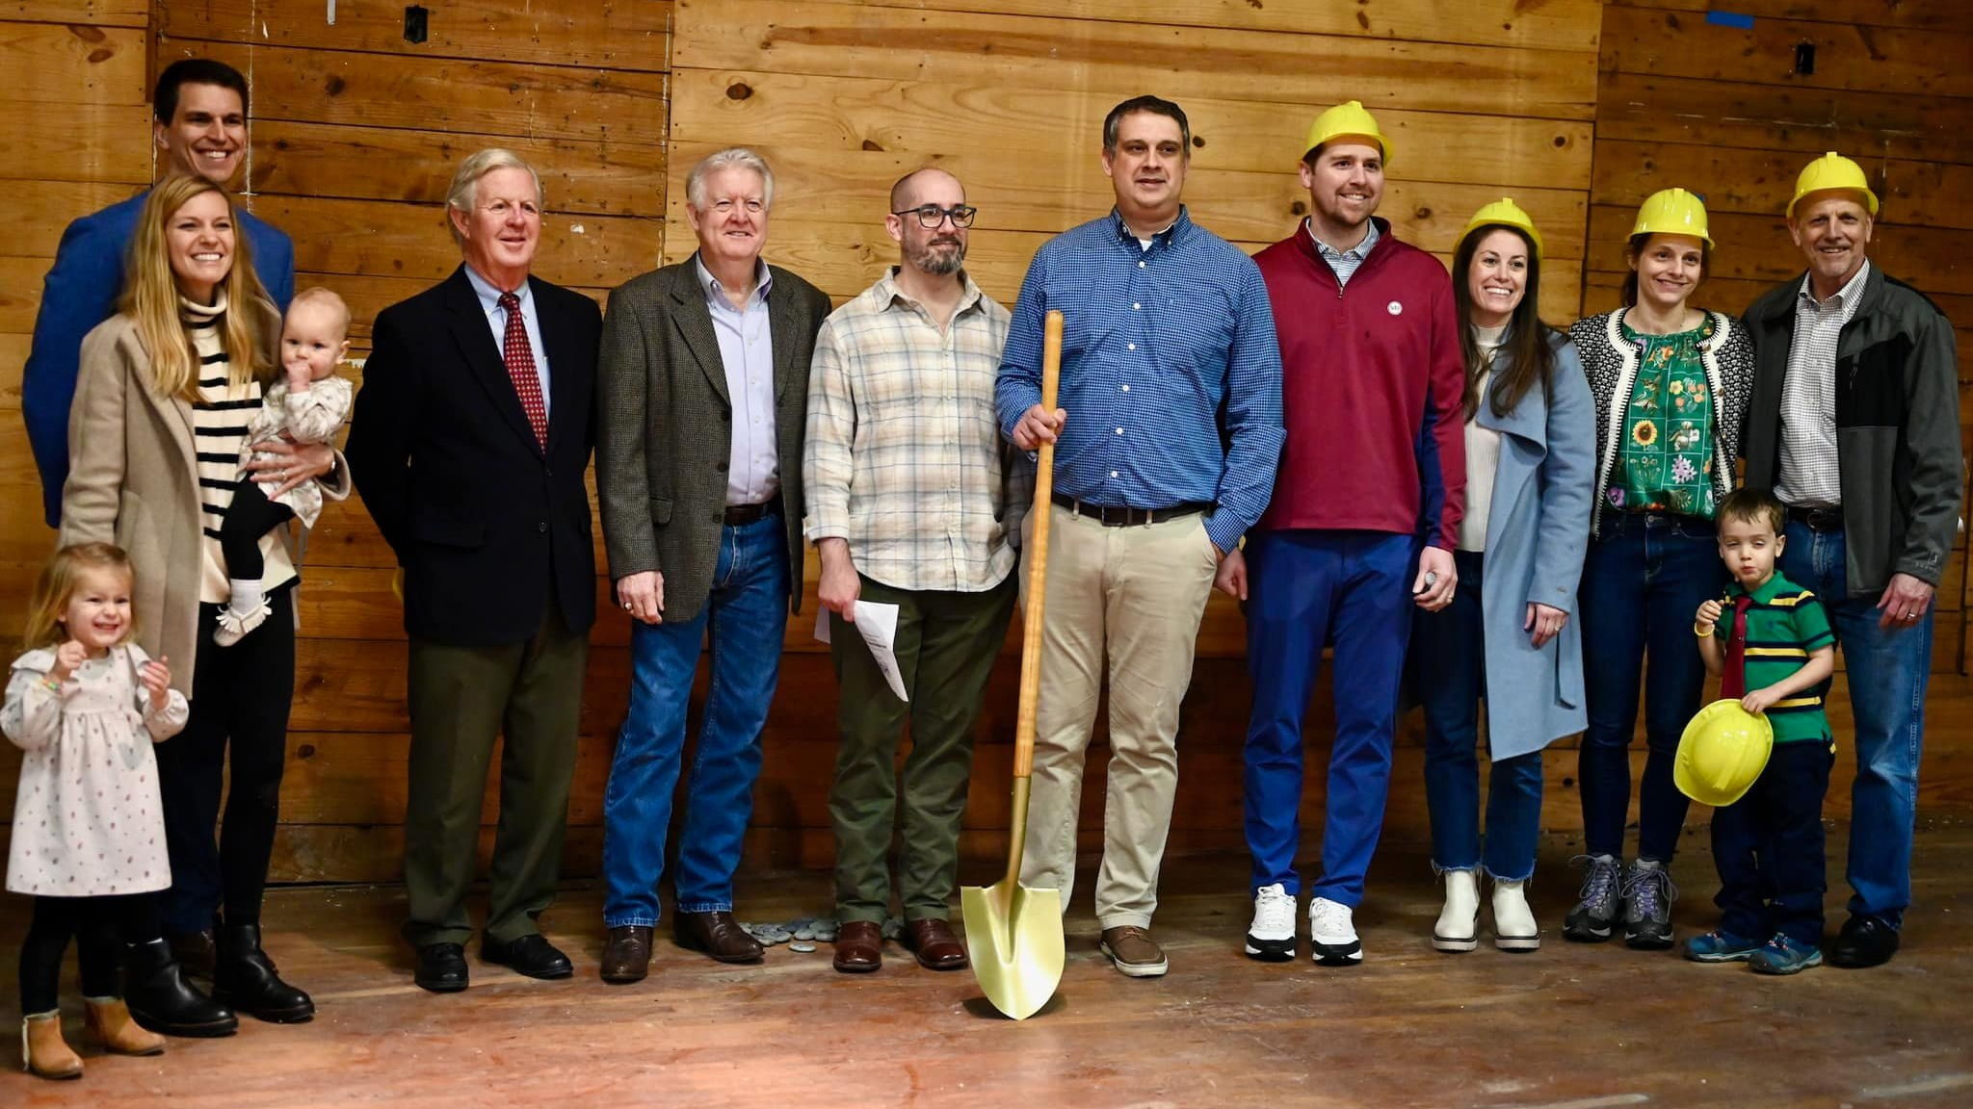
Hope in the Heights breaking ground on renovation of an old church in Houston, Texas
Notes:
Hope in the Heights in Houston, TX, closed in Fall 2023 on a Church of Christ building for sale that was built in 1927 and remodeled in the late 1950s. It is situated on its own block within a neighborhood in their target area. There is a large parking lot, ample street parking, and plenty of green space for kids to run around.
Thanks to the Church Extension Fund’s grant program for new missions, they get a 4:1 match on the land value and a 2:1 match for every dollar they spend on the remodel. Because of this, they can afford the necessary renovations. And because Church Extension Funds grants keep the cost down, they will be able to taper off of synod subsidy faster, which enables WELS to start more missions in the future. They hope to have the remodel completed by late 2024, when they will be able to move in and open their doors to the community.

Slide 37
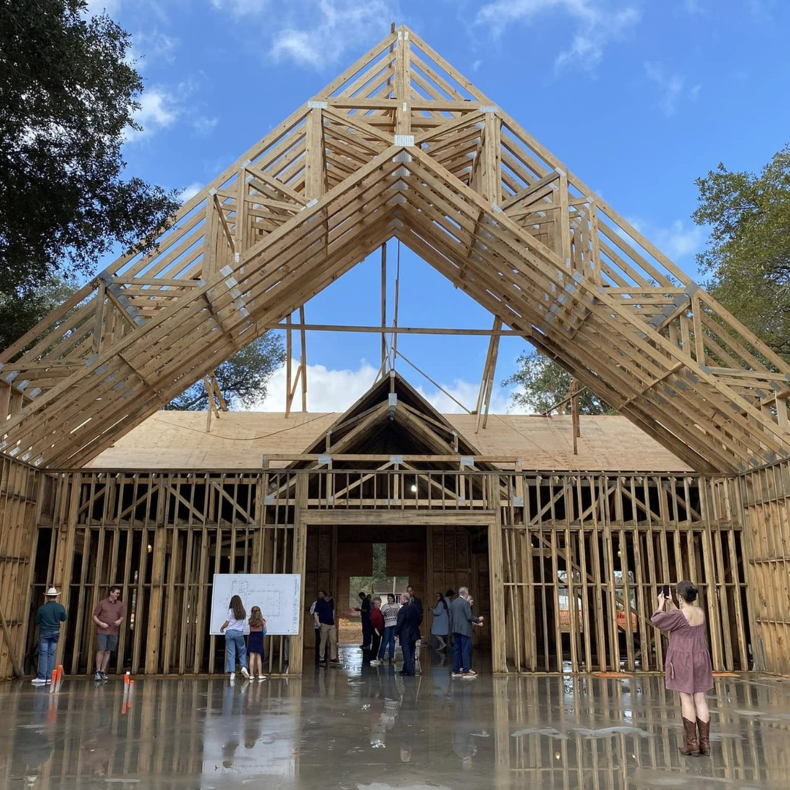

WELS Church Extension Fund A valuable partner of Home Missions
$209.8 million in total loan balances to over 190 WELS congregations
$6.9 million in matching grants to home mission churches since June 2023
$2.9 million in grants to WELS Home Missions since June 2023
Beam signing at TheMission in Willis, Texas, in Dec. 2024
Notes:
WELS Church Extension Fund (CEF) is a VALUABLE partner of WELS Home Missions and the churches it supports. CEF supports the spreading of the gospel by providing loans and grants to WELS home mission congregations.
WELS CEF is a wholly owned, self-supporting, subsidiary corporation of WELS. Individual WELS members, WELS congregations, and WELS affiliates can assist the synod’s mission outreach efforts by investing in WELS CEF investment certificates. Your investments fund the WELS CEF loan program. Gifts, bequests, and donations made to WELS CEF support the grant program.
WELS CEF provides home mission churches a 4-to-1 matching grant for initial land purchase based on their 10% down payment. They also provide a 2-to-1 matching grant on a home mission congregation’s 10% down payment for their facility construction project.
Since 1993, WELS CEF has provided $48.9 million of matching grants to mission congregations and $17 million of special grants directly to Home Missions.
Pictured: TheMission, a home mission congregation in Willis (Conroe), Texas, is anticipated to complete their new church building by July 2025. TheMission received loans and matching grants from WELS CEF.

Slide 38
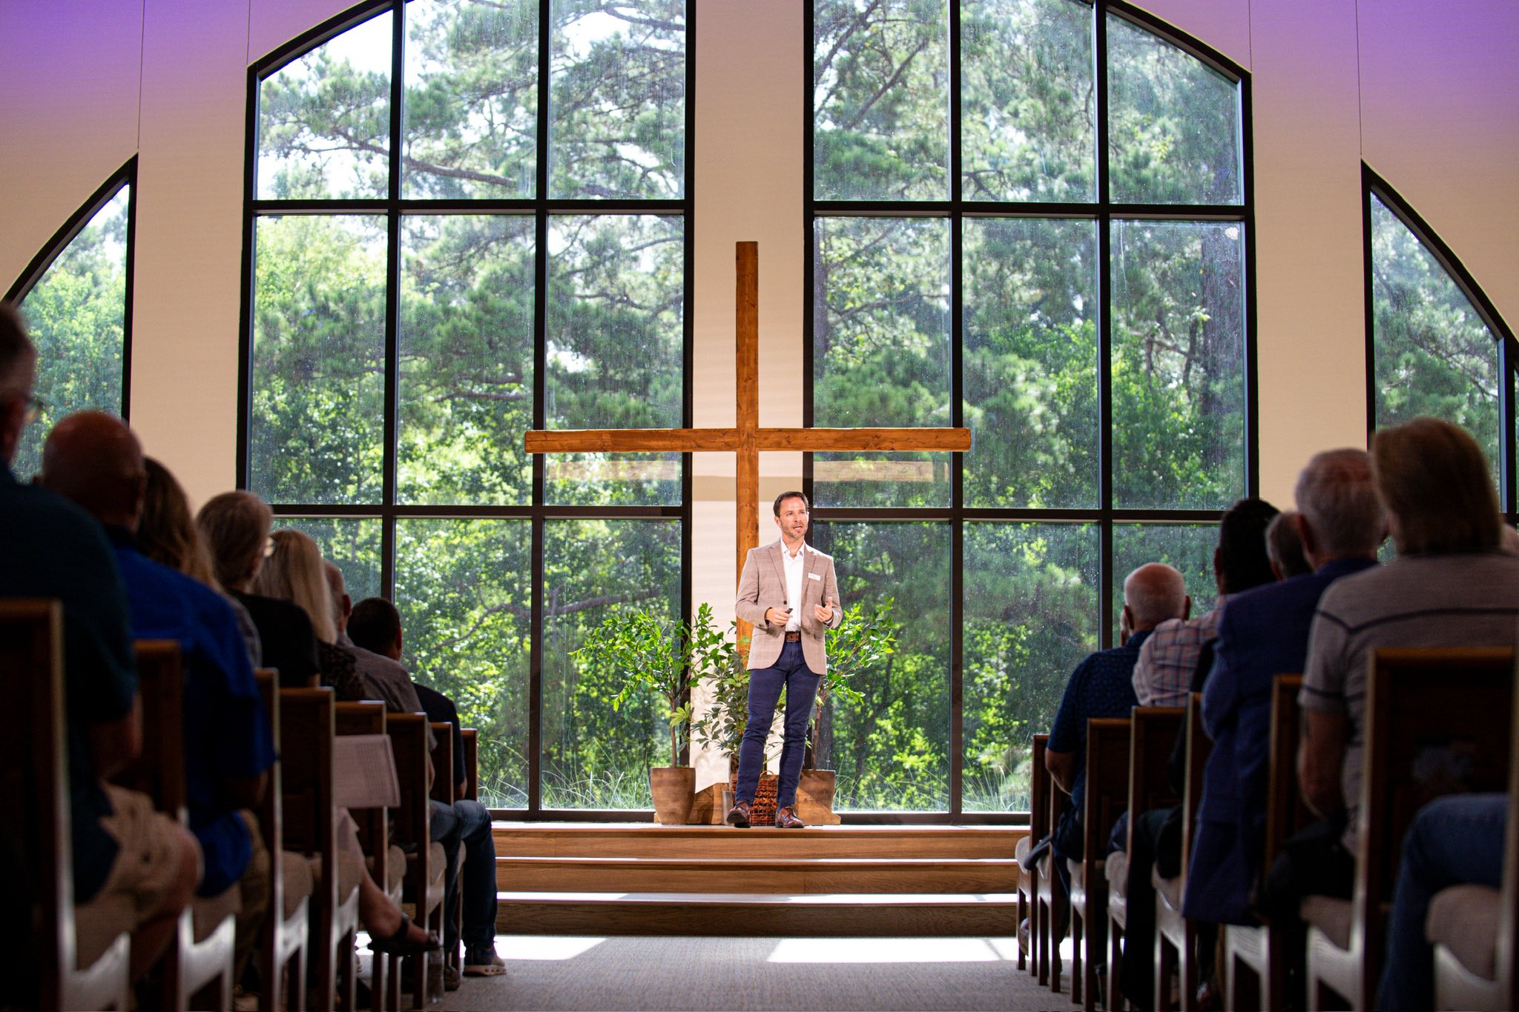
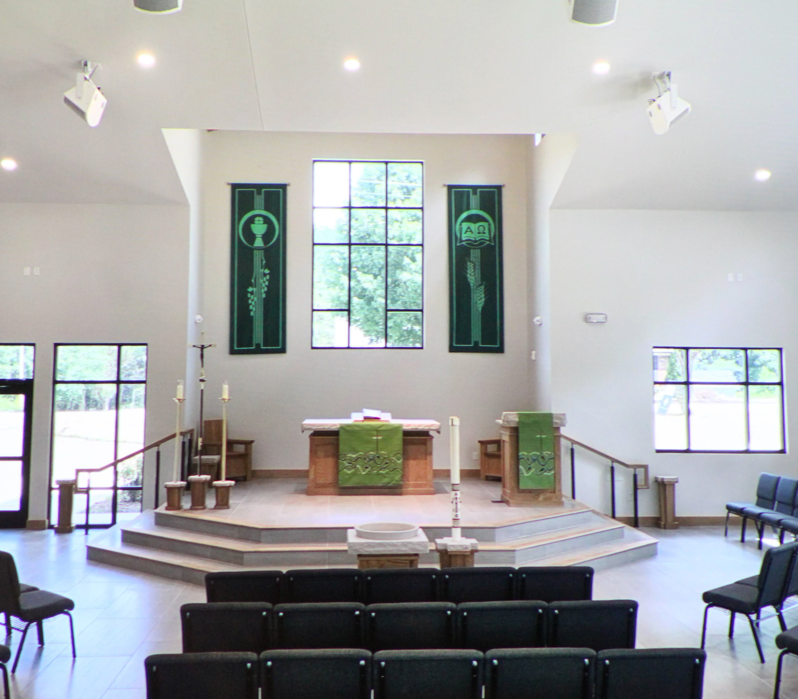
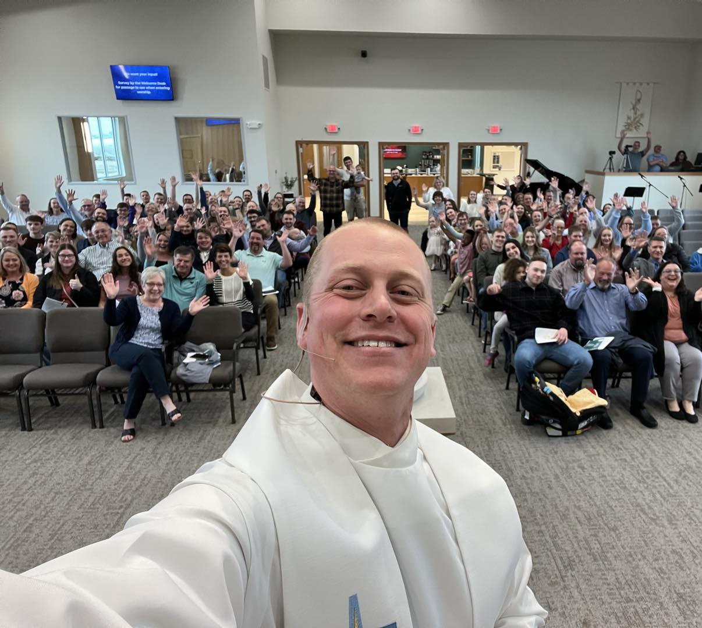
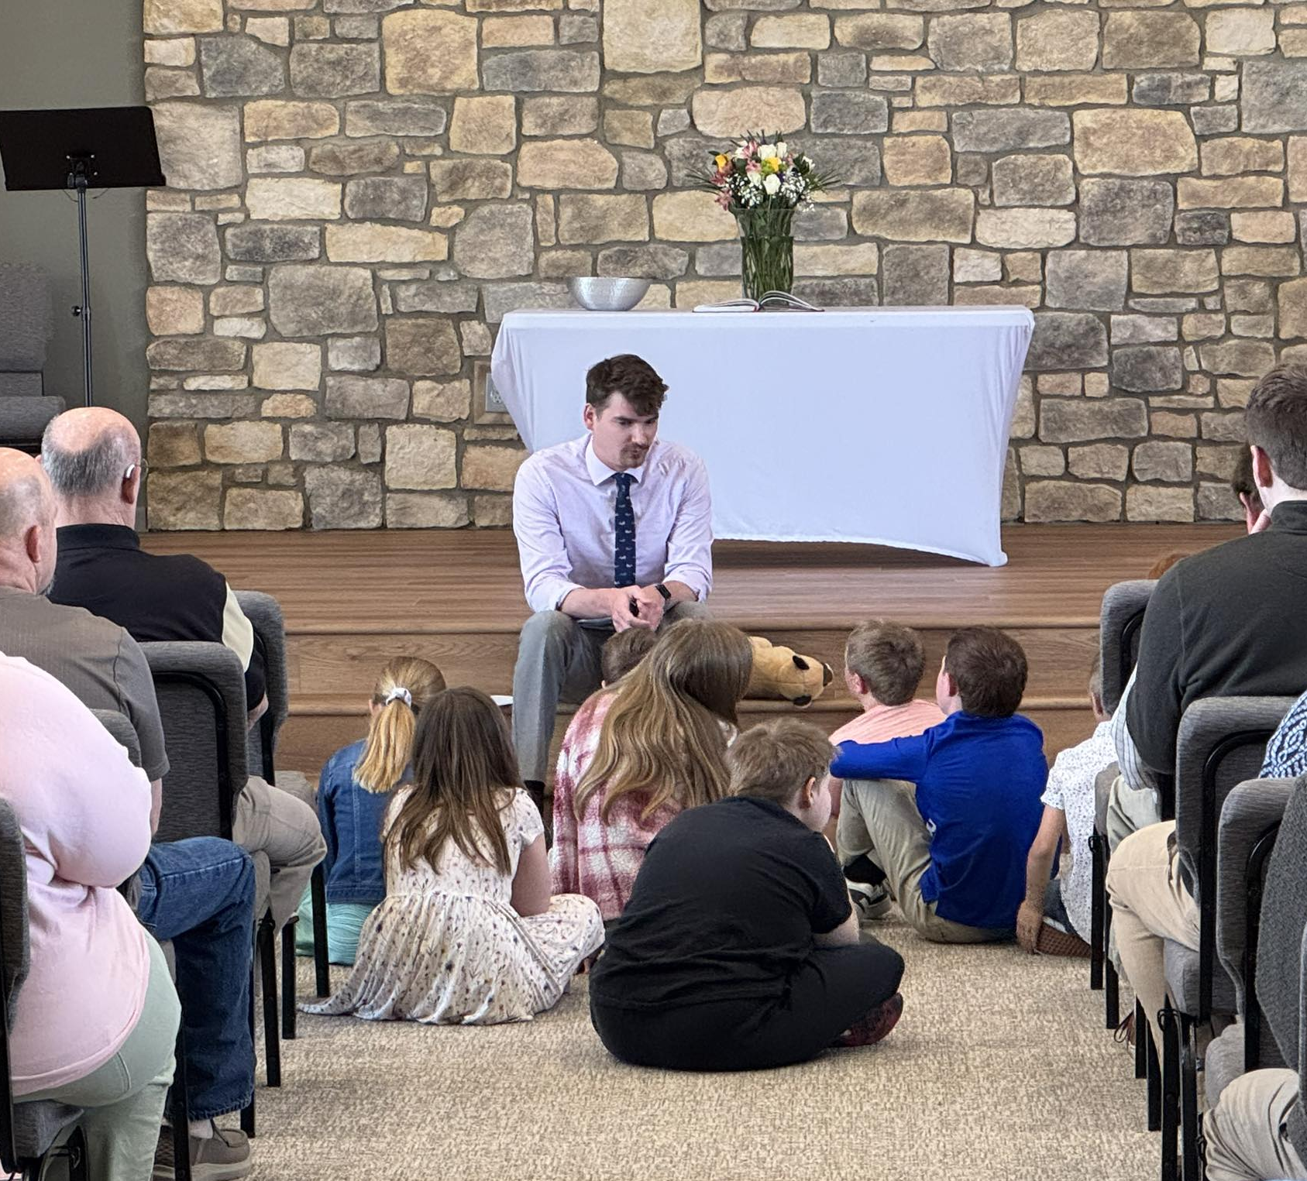
Home missions dedicate new buildings
TheMission – Willis (Conroe), Texas
Huntersville Lutheran Church, Huntersville, N.C.
Sure Foundation, Brandon, S.D.
Foundation, Peyton, Colo.
Notes:
TheMission in Willis (Conroe), Texas – August 17, 2025 (pictured top left)
TheMission has their first worship service in their new church building on Aug. 17, 2025.
Huntersville Lutheran Church in Huntersville, N.C. – July 26, 2025 (pictured top right)
On Saturday, July 26, 2025, Huntersville Lutheran Church in Cornelius, N.C., dedicated their new facility in a special worship service.
Sure Foundation in Brandon, S.D. – April 2025 (pictured bottom left)
In April 2025, Sure Foundation Lutheran Church in Brandon, S.D., celebrated the grand opening of their new church building and hosted a formal dedication worship service in July 2025.
Foundation in Peyton, Colo. – March 23, 2025 (pictured bottom right)
On March 23, 2025, Foundation Lutheran Church in Peyton, Colo., was able to have their first worship service in their brand-new church building.

Slide 39
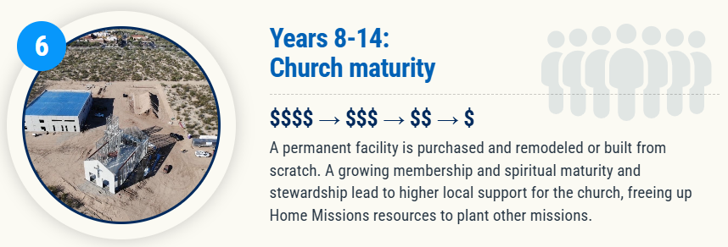
Notes:
The work isn’t done once the home mission has their own church building. The home mission has even more opportunities to expand their ministries from their new home base. As the church grows in numbers and spiritual maturity, it is the prayer that higher local support for the church frees up Home Missions resources to allow us to plant other missions.

Slide 40
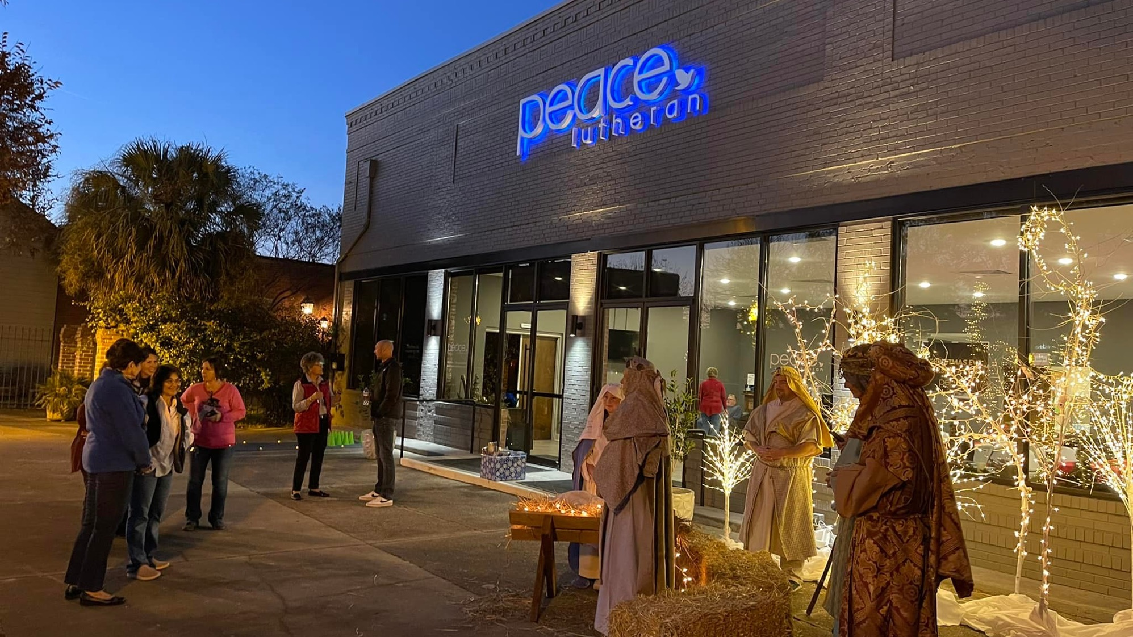
Peace – Aiken, South Carolina
Fully self-supported after eight years
Notes:
Peace in Aiken, SC, started with just a handful of people in December of 2013 and two years later was blessed to find a building downtown and refurbished it for their worship space. This 152-soul congregation confirmed 13 adults in the past year and are averaging 111 in worship each week. Peace is officially off Home Mission subsidy as of July 2022, which means they met their initial eight-year goal.

Slide 41
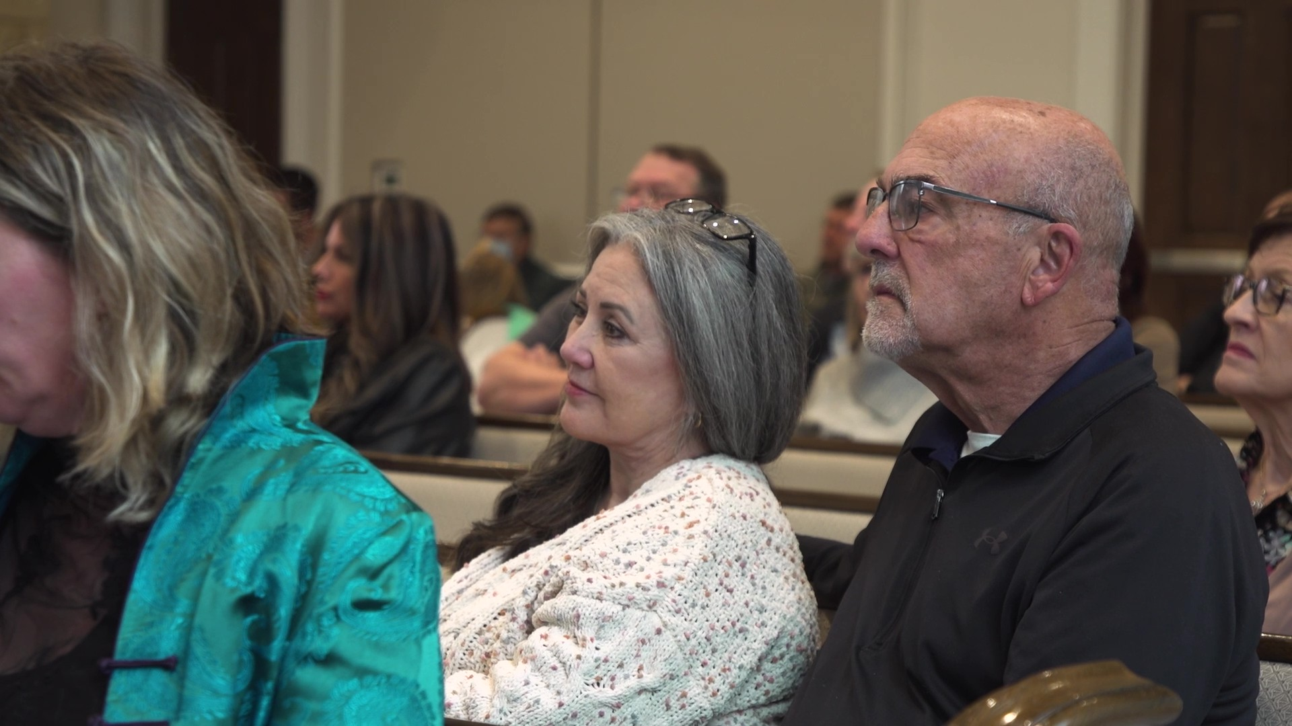
Notes:
As we continue to work towards our goal, we will be featuring more stories of the “Faces of Faith” reached with the gospel message through home mission congregations.
“It was like the light bulb came on, and you felt so much more peace when you went to church,” says Denice.
Hear more from Jerry Laster, a trauma surgeon, who draws a powerful parallel between his work of healing physical wounds and the church’s role as a hospital for sick souls. Discover how he and his wife, Denice, found peace and healing through God’s free grace at Christ Alone Lutheran Church, a WELS home mission congregation in Keller, Texas.
Christ Alone recently became a self-supporting congregation.
Watch video: https://wels.net/faces-of-faith-jerry-and-denice/

Slide 42

Share student information with
WELS Campus Ministry!
Notes:
Campus Ministry programs are a great way to enhance ministry and reach out to a new demographic that desperately needs the gospel.
WELS Campus Ministry, a ministry of WELS Home Missions, provides resources, support, and encouragement to WELS congregations that serve college students. These congregations are vital in connecting college students with fellow Christians, strengthening their faith with the gospel, and encouraging them to share that faith with other college students.
Almost every university in the United States and Canada has an assigned campus ministry contact pastor. Each contact pastor receives a list of WELS student that are attending their school. By sharing information with WELS Campus Ministry, these contact pastors know who the students are and can help them stay connected to Christ and strengthen their faith while at school.
We need your help in this process! Please work with the high school/college age students at your congregation and get them signed up with WELS Campus Ministry. Instructions on how to share student information was shared as supplemental information in your District Convention resources, and you can encourage students to sign up directly at wels.net/college.

Slide 43
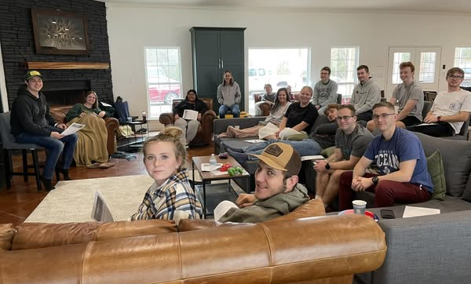
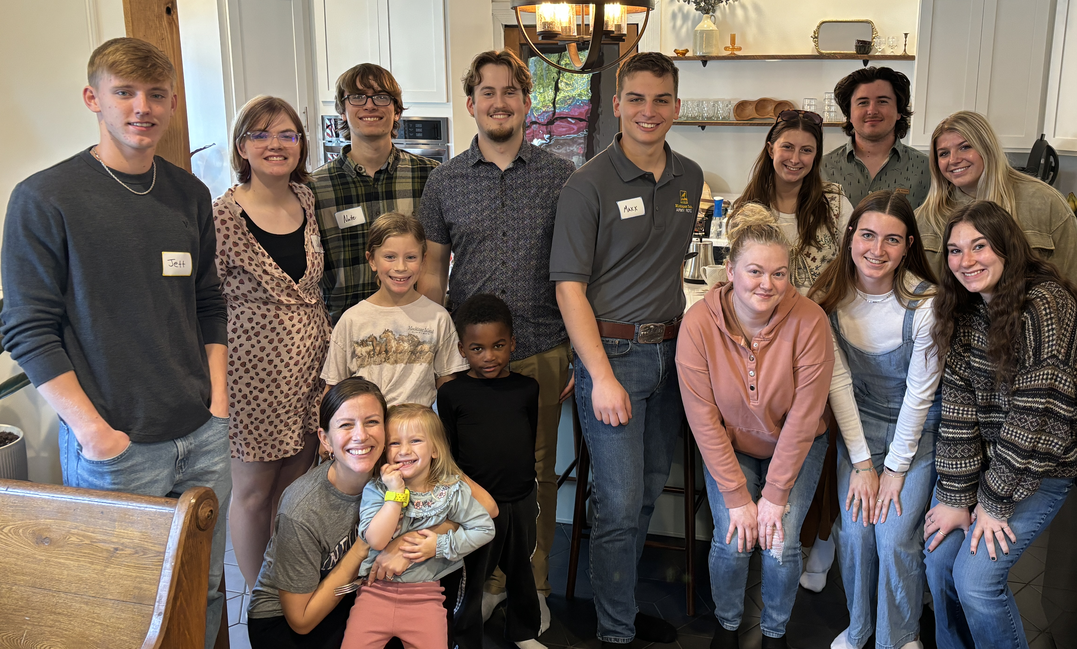
Growth in WELS Campus Ministry
Notes:
Left: Christ Our Refuge in Waco, TX, a home mission congregation that started public worship in 2022 received funding to start a Campus Ministry program. They hosted a Campus Ministry retreat with WELS students from Texas A&M, Tarleton, and Baylor every year since 2023.
Right: The new mission in Marquette, MI, that was approved in the first batch of new missions towards our goal of starting 100 new missions in the next 10 years. They are actively reaching out to students at Northern Michigan University as part of their outreach strategy.

Slide 44
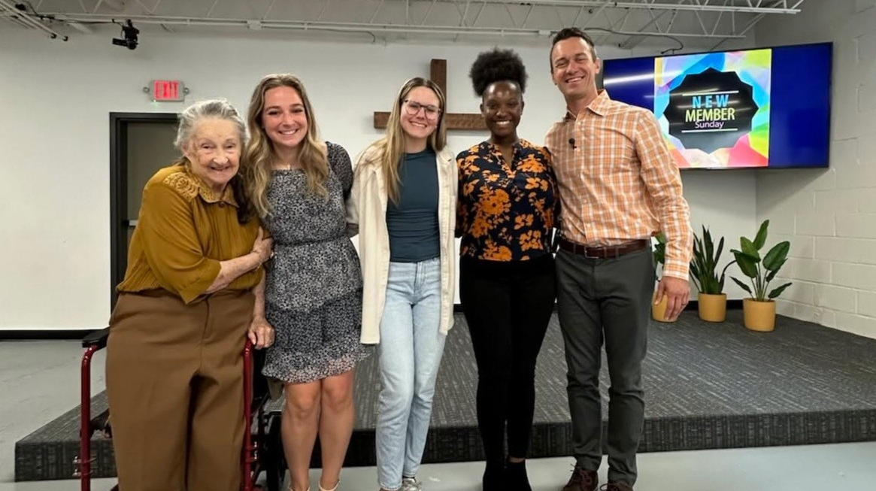
Outreach through Campus Ministry
Notes:
On Sunday March 30, 2025, Intown Lutheran Church welcomed three college students—Grace, Taylor, and Kennedi (pictured middle) as adult confirmands. These young women impressively completed our 12-lesson Bible Basics Class while also managing busy academic schedules and student-athlete responsibilities. All three of them are new to Lutheranism and very excited to be part of our church family!
Grace says: "Intown Lutheran Church not only gave me a place to learn straight from the Scripture and truly understand it, but it also gave me a new family of fellow Christians. This is a place where I can be myself and never feel alone, judged, or out of place."
Kennedi says: “Upon arriving in Georgia for college, I hoped to find a local church. Thankfully, a friend attending Intown invited me to the worship service one Sunday. Being exposed to the great teachings of the Good News and the kind fellowship, I decided to continue attending Intown and even join various Bible Study sessions each week. Now that I’m officially a member, I can say that the meaning of Intown Lutheran Church is to cultivate a body of God’s children and teach and learn the meaning and importance of His word so that we all grow in our faithful walk with Him.”
From Lucas Bitter, pastor at Intown, Atlanta, Ga.

Slide 45
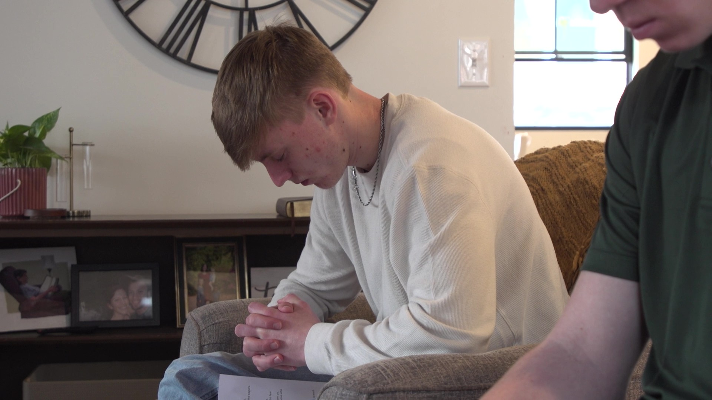
Notes:
“You’re chasing joy, happiness—you’re trying to find it in all these other things that aren’t Christ, and it leaves you feeling empty,” says Jett. “But coming back to church and growing my relationship with the Lord—it’s changed my life.”
Hear more from Jett Starzynski, a college student at Northern Michigan University in Marquette, Mich., who found lasting joy not in success or status but in returning to the Savior he’d drifted from. Through the welcoming community at Anchor, a WELS home mission congregation, Jett rediscovered what it means to be truly anchored in Christ—and now shares that hope with others.
Watch video: https://wels.net/faces-of-faith-jett/

Slide 46
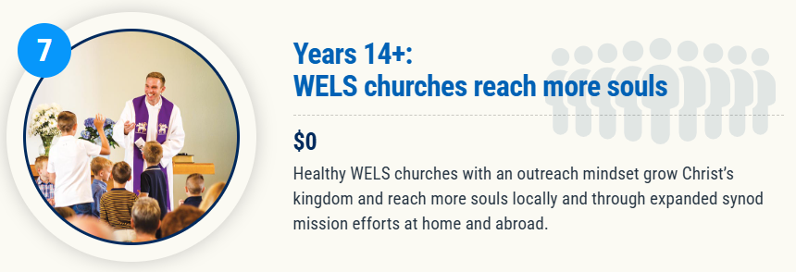
Notes:
While seeing a home mission church become self-supporting is a great thing, we’re MOST thankful for the souls that they have been able to reach with the gospel!

Slide 47

Ascension in Jacksonville, N.C., moves from mission to maturity—and begins expansion
Notes:
Earlier this year, Ascension Lutheran Church in Jacksonville, N.C., marked a major milestone: it transitioned from a home mission congregation to a self-supporting church, no longer receiving financial subsidies from WELS. The shift came after a period of rapid growth in attendance, offerings, and community engagement. Now, just months later, Ascension is multiplying its impact. A core group from the congregation submitted a request to start a new mission church in Wilmington, N.C., and was approved in Fall 2025, signaling a bold new chapter in their journey of outreach and faith.
Read more: https://wels.net/moving-fast-but-staying-grounded/

Slide 48

Notes:
It’s never just about planting one church. It’s about aggressively reaching lost souls. God can use the planting one church to multiply outreach efforts.

Slide 49


Former Home Mission
New Starts
Notes:
Abiding Word in Houston, Texas, is just one example of many where we can see how the seed of the gospel was planted and God caused it to grow over the next 55 years. What started as a home mission church in 1972 with a couple of core group families has flourished. 55 years later, Abiding Word is now a congregation of more than 500 members with a school that provides a Christian education for the children of their congregations while also serving as an outreach arm into the community. Abiding Word generously supports the world-wide mission of WELS with their Congregational Mission Offerings. Former and current members have served or are still serving in the public ministry. Others are preparing to serve in the public ministry.
Additionally, Abiding Word helped daughter new missions in the Houston area. Hope in the Heights in Houston and TheMission in Willis are just two examples of current home mission churches daughtered by Abiding Word. Children and grandchildren of original core members have served as core group members of both these new mission starts in Texas and even some in Arkansas.

Slide 50


Former Home Mission
Second site
Notes:
Risen Savior is a thriving congregation in a rapidly growing community. Since its restart in 2016, the congregation has grown from 66 to 440 members, with 134 adult confirmations in the last three years alone. The church now has 350 families on its prospect list.
They partnered with Ascension in Sarasota, Fla., to start and support a new mission plant in Parrish, FL. Home missionary Ben Balge (pictured left) leads the new church in Parrish. 20,000 to 30,000 homes are expected to be built there in the next 10 years. This new church will be reaching out with the gospel to a community that is 85 percent unchurched.

Slide 51

Self-Supporting Congregation
Enhancing a ministry
Notes:
Established congregations that started as new home mission plants can enhance a ministry! Churches can request short-term, additional funding from Home Missions to enhance a ministry at their current congregation. This extra boost could mean the ability to call an additional pastor or staff minister, starting a new cross-cultural ministry, or even restarting a church where members have renewed their efforts to go with the gospel into their community.
Redeemer in Edna, Texas, is a growing congregation with a mission-minded pastor leading the effort. Over the past three years, membership has increased by 26 percent, with 29 adult confirmations during that time. With 279 names on its prospect list and outreach opportunities expanding beyond what one pastor can manage, Redeemer is requesting short-term Home Missions support to call a second bilingual pastor to help connect with the growing community, both Spanish- and English-speakers, and continue reaching more people with the gospel.

Slide 52



Shepherd of the Mountains Reno, NV
The Springs Sparks, NV
Light of the Valleys
Reno, NV
Notes:
The 120 members at Shepherd of the Mountain were outreach minded. And they knew they didn’t want one big mega church – they wanted to surround the greater Reno area with 4-5 churches to better reach the various communities. They started with The Springs in Sparks, NV, that started around 2008. By 2018, The Springs was completely self-supporting and settling into their new church building, and they partnered with Shepherd of the Mountains to start a third site in Reno. Light of the Valleys is now a subsidized home mission church worshiping in a rented storefront and growing rapidly.
100 Missions in 10 Years isn’t just about the 100. It’s about the hundreds and prayerfully THOUSANDS of churches that are started from those original 100, and ultimately the HUNDREDS of THOUSANDS of individuals that can be impacted by the proclamation of the gospel.

Slide 53

Notes:
Pray: This is no small thing. Pray that the Lord of the church would provide workers. Pray for our WELS Home Missions leaders, our home missionaries, and our worker training schools as they recruit and train future missionaries. Pray that the Lord provides us with the financial support needed to do the work.
Get Involved: If you see nearby mission opportunities, talk with your district mission board to see what you or your congregation might do to get involved in this synod wide church planting effort. Encourage young men and women in your church to consider full-time ministry. Ask your pastor to keep our synod’s work in your congregational prayers and provide updates on a regular basis.
Give: You know the grace of our Lord Jesus Christ. He was rich, yet he became poor so that through his poverty we might become rich (2 Corinthians 8:9). God’s generosity has resulted in the riches of forgiveness, peace, joy, and hope. Let that move you to give generously to your local congregation, to your synod through your church, and to this initiative.
Encourage people to check out the website: Learn more and stay up to date on progress at wels.net/100in10.

Slide 54
PRAY!
Lord, you know that countless souls are still searching for the peace that transcends all understanding. You have commissioned us to find the lost and have equipped us with your Word and Sacraments and your faithful promises. You assure us that you are able to do immeasurably more than all we ask or imagine. Confident of these truths, we humbly and boldly ask for your rich blessing upon the 100 missions in 10 years initiative. Bless our current missionaries and the fields that they serve. Provide ample manpower, money, and ministry resources. Grant wisdom, strength, perseverance, and joy to all involved in this effort. In all we do, move us to see and do our part in spreading the gospel so that more may know your saving peace, all to your glory. Amen.
Notes:
Please pray together.

Slide 55
GET INVOLVED!
Talk with your pastor and/or district mission board to see what you or your congregation might do to get involved in this synodwide church planting effort.
Encourage young men and women in your church to consider full-time ministry
Ask you pastor to keep our synod’s work in your congregational prayers and provide updates on a regular basis.
Learn more at wels100in10.net/getinvolved.
Notes:
This initiative is about aggressively and confidently doing the work that God has called all of us to do. Here are some ways to get out there and help!

Slide 56

Notes:
WELS Mission Journeys provides an opportunity for all WELS members to walk together in the Great Commission. Through service opportunities in WELS mission fields at home and abroad, members can engage in Christian service. While volunteering, the learning and sharing of outreach ideas will allow individuals and teams to explore how they can use their God-given abilities to engage in outreach activities in their local communities upon their return home. With the Lord’s blessing, these trips will inspire a lifelong journey of service and outreach for all who volunteer.
Mission Journeys is also looking for additional host congregations! If your congregations would be interested in hosting a Mission Journeys team, you can fill out an application form online.
Learn more, read FAQs, and sign up to host or send a team at wels.net/missionjourneys/

Slide 57


Mission Journeys opportunities at home mission congregations (Pictured: Trip to Bentonville, Ark.)
Notes:
A six-person WELS Mission Journeys team from St. Matthew's in Janesville, WI, traveled to Bentonville, AR, in October 2024 and May 2025 to assist the new mission start. They partnered with Home Missionary Ross Chartrand and the core group to survey individuals in the Bentonville town square regarding the strengths and needs of the community and how they see a new church meeting those needs. They also participated in a grocery bag food drive collection, bringing in 44 bags of food to be donated to a local food pantry and providing opportunities to talk face to face with residents of Centerton, the home mission’s anticipated future home.
St. Matthew’s is planning more Mission Journey trips with even more members to assist with outreach for the home mission. Likewise, Pastor Chartrand and members of his core group are planning to travel to Janesville to host a mission festival at St. Matthew’s.
Your congregation can also partner with a WELS home mission congregation for mission trips! Visit wels.net/missionjourneys and/or contact Mission Journeys coordinator Shannon Bohme at missionjourneys@wels.net or 651-324-4218 to learn more.

Slide 58

Notes:
Speakers: District Mission Board members, Home Missionaries, Mission Counselors, and other Home Missions representatives are willing and able to present on the 100 missions in 10 years initiative at your next church Mission Festival, LWMS circuit rally, school assembly, or small group gathering. Contact your local District Mission Board OR fill out a request at wels.net/speaker-request to find a speaker for your event this fall.
Social Media: Follow us on Facebook and Instagram @WELSmissions
E-Mails: Subscribe to weekly Missions Blogs and quarterly Missions Update E-Newsletters at wels.net/subscribe.
Faces of Faith: The 6th annual edition of Faces of Faith is now available. This is a great overview of the work we’re doing in Home, World, and Joint Missions, and you can learn more about the 100 missions in 10 years initiative in this magazine.
It is available online and by request at wels.net/facesoffaith. Any congregation OR LWMS circuit is welcome to request up to 50 copies of the magazine, and we are also offering 100 Missions in 10 Years brochures and large home and world mission maps (24” x 36”) free of charge. Note – Faces of Faith is automatically sent to any congregation hosting a Mission Festival.

Slide 59


A valuable partner of WELS Missions
Notes:
LWMS is women dedicated to serving Jesus by increasing awareness of, interest in, and support of the mission outreach of the Wisconsin Evangelical Lutheran Synod (WELS). They are valuable partners of WELS Home Missions and the 100 Missions in 10 Years effort. They offer an annual convention during the last full weekend in June, where hundreds of women (and the men who love them) gather to learn about and support WELS Home, World, and Joint Mission work. Each of the 60 regional circuits of LWMS offer semi-annual circuit rallies where mission-minded women come together to encourage one another in spiritual growth and mission awareness. They are usually held in the spring and the fall. These are a wonderful opportunity to meet or join with women for worship, fellowship, and learning about missions at home and around the world.
Learn more about LWMS and how you can get involved at lwms.org.

Slide 60

GIVE GENEROUSLY!
Visit wels100in10.net/give to donate online!
Send in a check with “100 in 10” in the memo line to:
WELS Attn: Gift Processing N16W23377 Stone Ridge Dr. Waukesha, WI 53188
Notes:
We confidently ask you to consider giving generously to this amazing opportunity to expand our efforts to share the saving gospel right here in our own backyard. This is a BIG challenge. An impossible one you might say. But we prepare and we plan, and we ask God to bless it. Trusting in the Lord, we boldly move forward knowing God will bless us and his kingdom.
You can support this effort by giving a gift online at wels.net/100in10gift; through the QR code on the slide; sending a check with the 100 Missions in 10 Years in the memo line to WELS, Attn: Gift Processing, N16W23377 Stone Ridge Drive, Waukesha, WI 53188; or through appreciated assets (e.g., stock) or from your IRA by calling 800-827-5482. Thank you for your support!

Slide 61
Notes:
Try something that is so hard, that if it succeeds, people will have to say God did this.
We submit all our plans to Him, for He is the Lord of the Church, and we are only servants. We’re trusting God to do immeasurably more than all we ask or imagine.

Slide 62

One soul at a time
Notes:
Video link: https://wels.net/faces-of-faith-sean/

Slide 63
Notes:
Learn more and stay up-to-date on progress at wels.net/100in10.

