Slide 1


Mission partners in 48 countries
Prospective mission fields in 25 new countries
51 missionaries (and counting!)
500+ national pastors
400+ students in theological training
WELS WORLD MISSIONS
Notes:
8.2 billion people inhabit this earth. 384 million of those reside in the United States and Canada.
We have before us the largest mission field the world has ever seen.
WELS World Missions conducts and encourages gospel outreach in 48 countries and is exploring outreach opportunities in 25 prospective new mission fields. World Missions brings the light of God’s Word to the world through evangelism efforts, church planting, training national workers for ministry, and providing religious materials in foreign languages. 51 world missionaries partner with over 500 national pastors to conduct outreach and train more than 400 students for service in Christ’s kingdom.

Slide 2
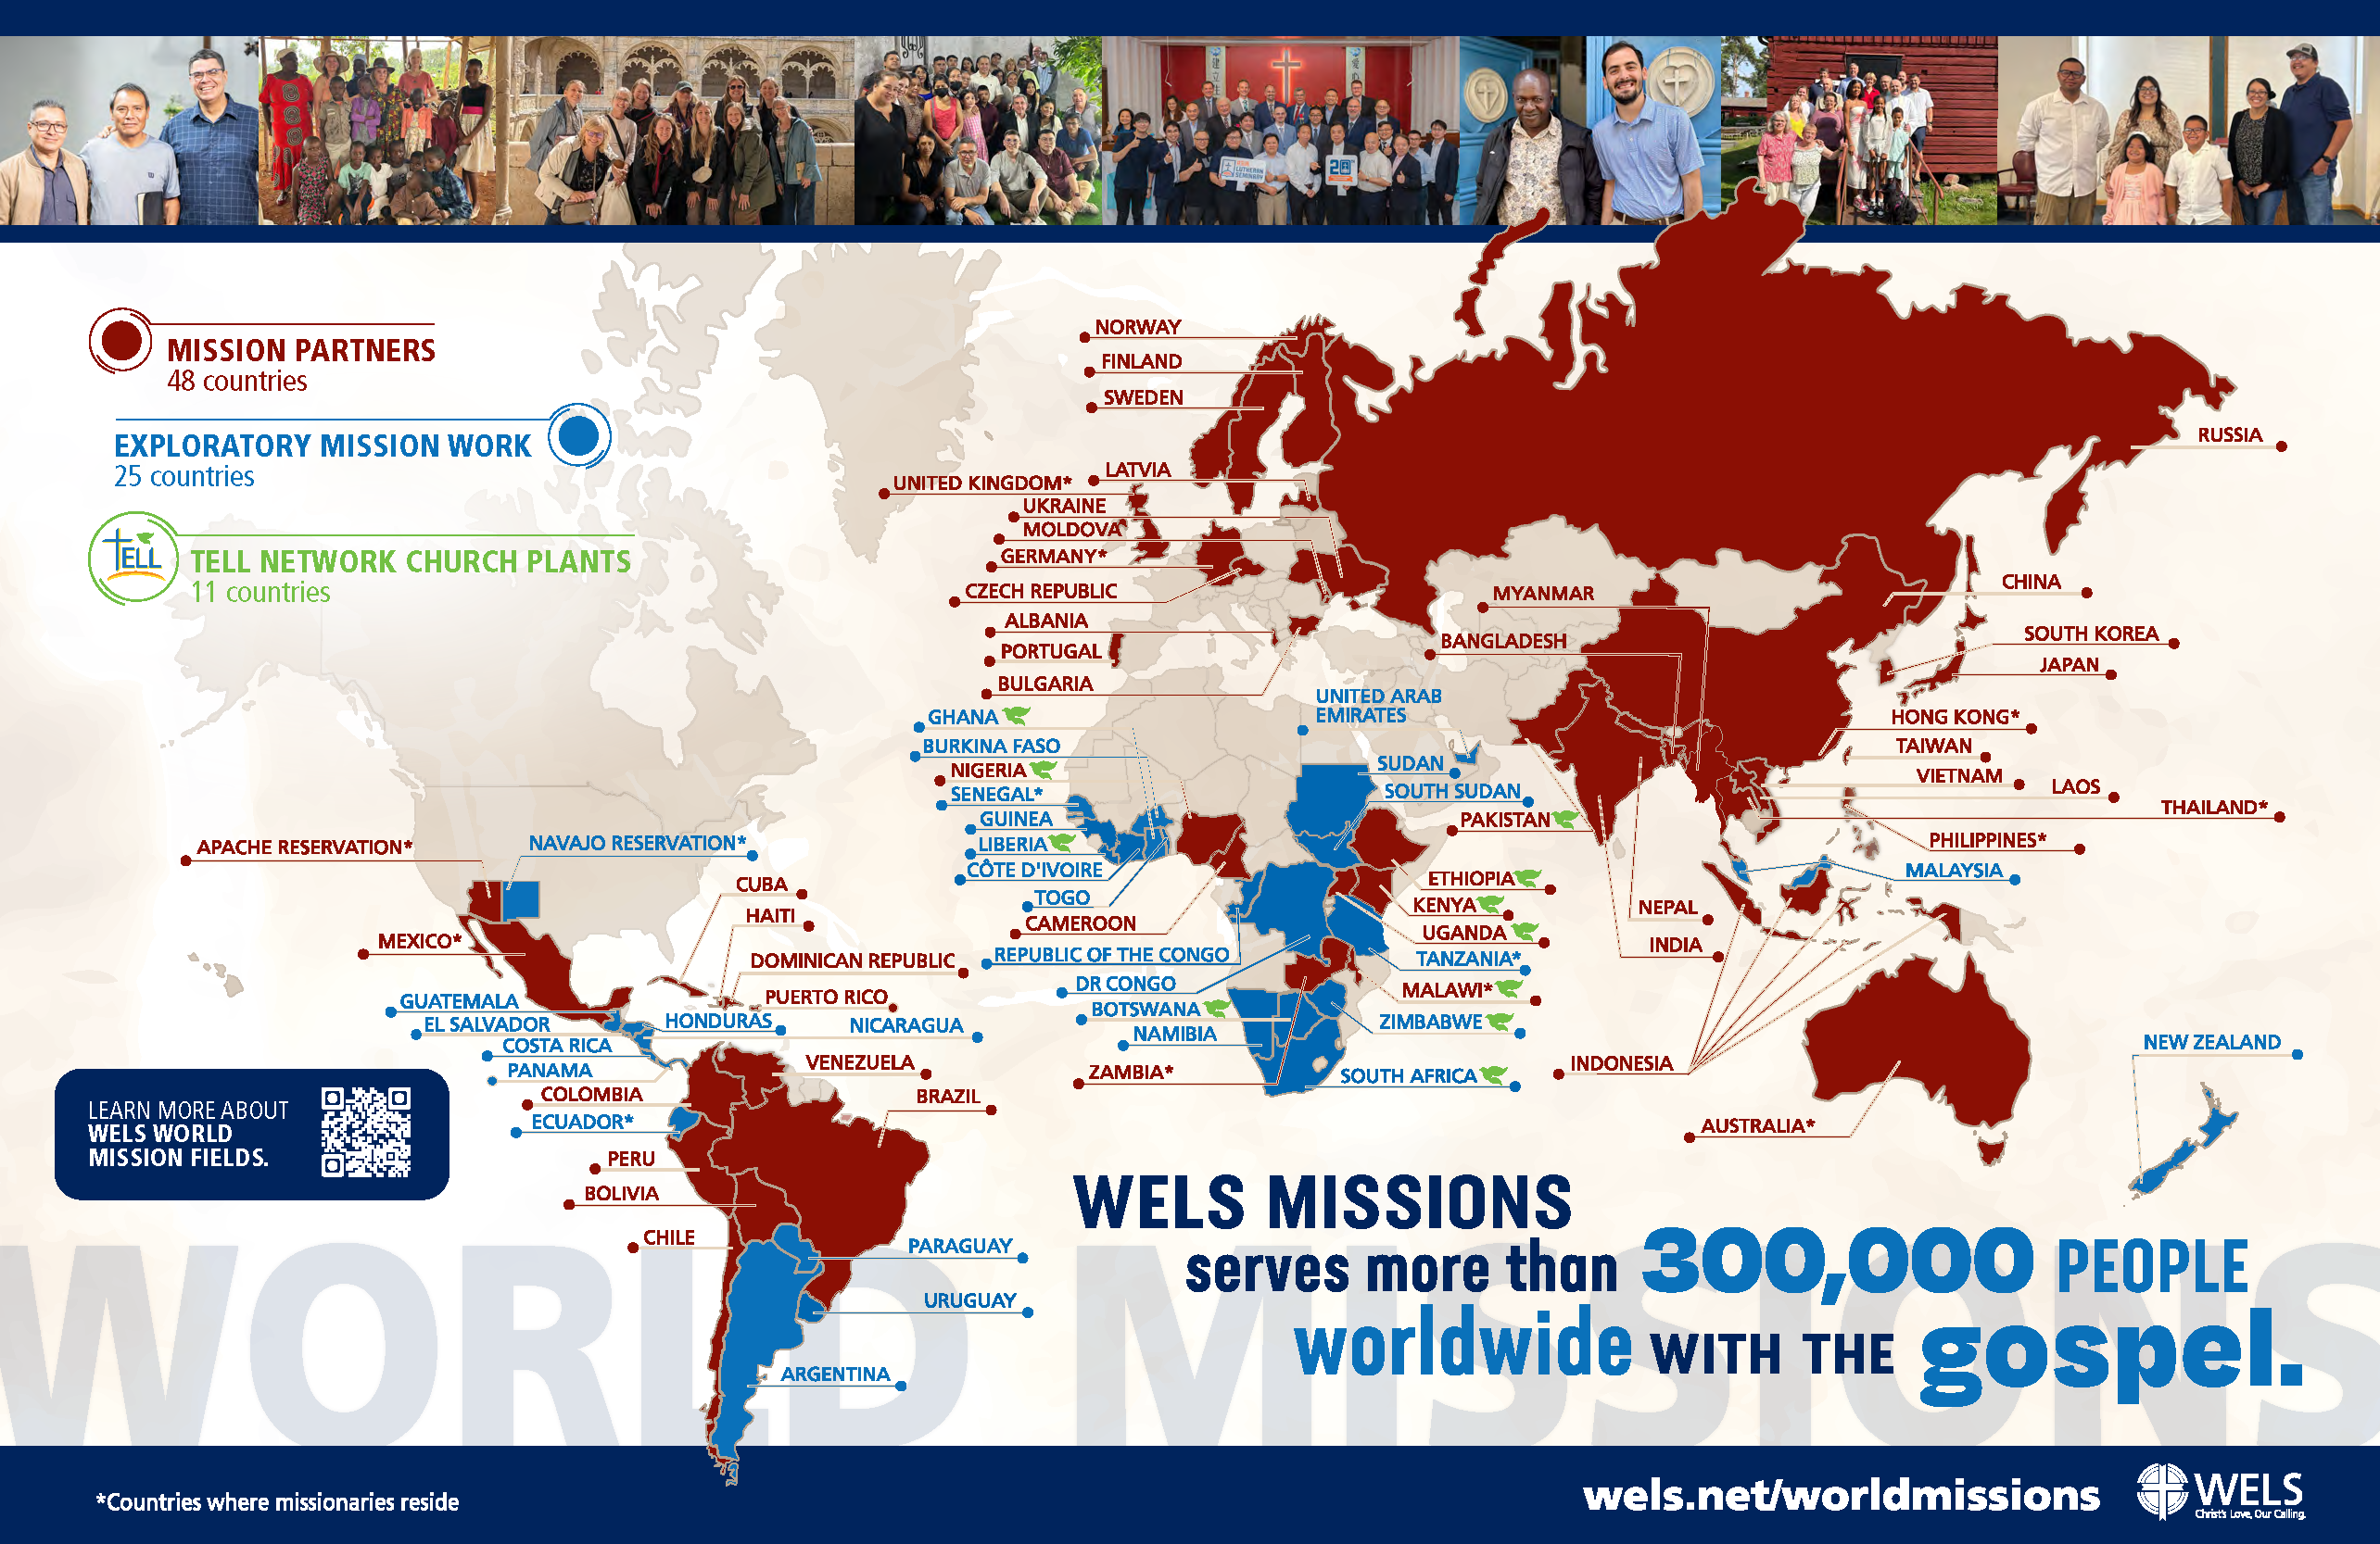
Notes:
World Mission supports mission work:
in Africa, where missionaries partner with national church bodies and are exploring outreach in 23 countries throughout the continent;
in Asia-Oceania, where missionaries partner with God’s people to equip, encourage, and empower others to bring the good news of Jesus Christ to the billions still lost in darkness;
in Europe, where missionaries partner with national churches to train the next generation of church leaders and bring the true gospel to countries without a strong Lutheran presence;
in Latin America, where tens of thousands of people are being reached through Academia Cristo online courses and more than 50 individuals are actively leading a group in worship and study;
through Multi-Language Productions, which has produced materials in 56 languages and reaches tens of thousands of English-speakers through the TELL online training platform;
and on Native American reservations, where the gospel is being shared on the Apache reservations in Arizona and the Native Christian Network has begun outreach to additional tribes.

Slide 3

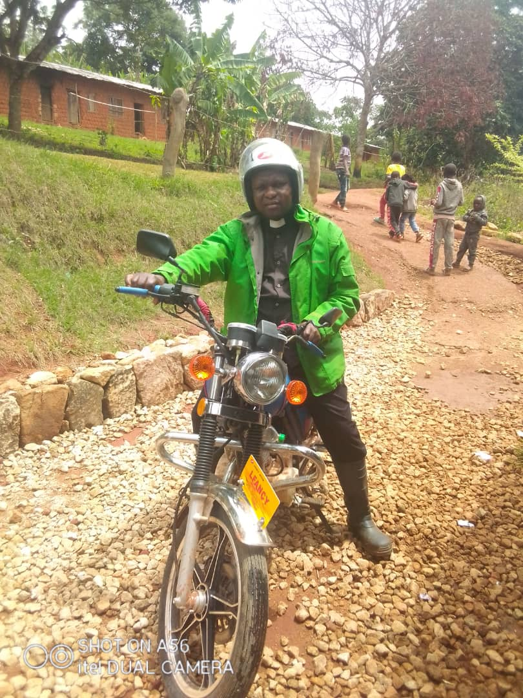
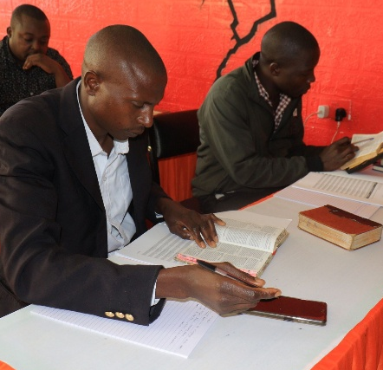
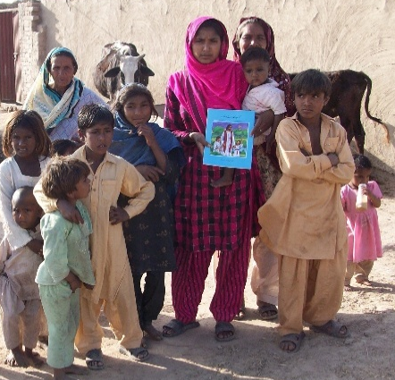
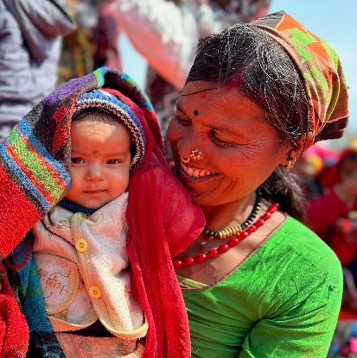
WELS Long-Range Plan: Bringing Christ to the Nations
Forge a borderless support network
Equip a global missionary force
Establish Confessional Lutheran seminaries
Expand multi-language mission efforts
Pioneer missions in high-risk and unreached areas
Notes:
The “Christ through us” Long-Range Strategic Plan was adopted at the 2025 Synod Convention. This issues-based strategic plan names four strategic priorities—Culture, Congregations, Commission, and Calling. Each priority offers a rationale for its urgency, followed by goals—tangible steps showing how, by God’s grace, we will meet these trials. Priorities frame the struggles; goals forge the path.
The “Commission” priority affirms the synod’s commitment to global gospel outreach through WELS World Missions. As the church responds to the spiritual needs of billions who have yet to hear the gospel, this priority calls for bold, Spirit-led action to expand confessional Lutheran witness across continents. The following five goals guide this effort:
Forge a borderless support network: We aim to build a global, cross-border network of generosity and collaboration by partnering with confessional Lutheran church bodies worldwide, equipping pastors and congregations to thrive in gospel ministry beyond traditional U.S.-based support.
Equip a global missionary force: We seek to train indigenous leaders from partner churches around the world to serve as missionaries in their own regions and beyond, shifting from a model of dependence to one of global partnership that strengthens outreach both abroad and in North America.
Establish Confessional Lutheran seminaries: We plan to plant seminaries in strategic global locations to train pastors and leaders with theological depth and Lutheran fidelity, ensuring a strong, sustainable gospel witness rooted in Scripture and the Lutheran Confessions.
Expand multi-language mission efforts: We aim to strengthen global gospel outreach by translating and distributing confessional Lutheran materials in native languages through print, digital media, and theological publications, ensuring doctrinal clarity and deep-rooted faith across diverse mission fields.
Pioneer missions in high-risk and unreached areas: We seek to bring the gospel to the most spiritually isolated regions by developing tailored strategies—such as underground networks, business-as-mission models, and digital outreach—and training workers to serve faithfully in places where Christ’s message is least known.

Slide 4
WELS and the world
WELS
Rest of the world
Goal:
322,000 members
300,000+ members
1,000,000
members
1,200 pastors
500+
pastors
Notes:
As part of the “Commission” priority in WELS’ Long-Range Strategic Plan, the synod envisions a bold expansion of its global gospel outreach—one that culminates in a vibrant fellowship of one million believers inside and outside North America by 2035. From the 150,000 believers in Vietnam to the anticipated declarations of fellowship with various church in Africa and thousands more across Latin America, this isn’t just a numeric milestone—it’s a growing family of faith. The strategic plan supports this vision through their five interwoven goals.

Slide 5

Notes:
Video link: https://wels.net/wels-world-missions-until-every-nation-knows-his-love/
“My name will be great among the nations,” says the Lord Almighty. Today, that promise is taking root in places both expected and unexpected—through the mission God has entrusted to his people.
Across Africa, Asia-Oceania, Europe, Latin America, and Native American communities, WELS World Missions partners with local believers to plant churches, train leaders, and share the gospel in heart languages around the world. It’s not just a mission to the nations—it’s a movement with the nations.
Through your prayers and support, local leaders are reaching their own people and crossing borders with the good news. Seminaries are equipping faithful shepherds. Digital tools are proclaiming Christ where missionaries can’t go. Together, we proclaim his name—until every tribe, tongue, and nation knows the love of the Lamb.
This is not our mission. This is God’s mission. And by his promise, it cannot fail.
Consider sharing this short video with your congregation!

Slide 6
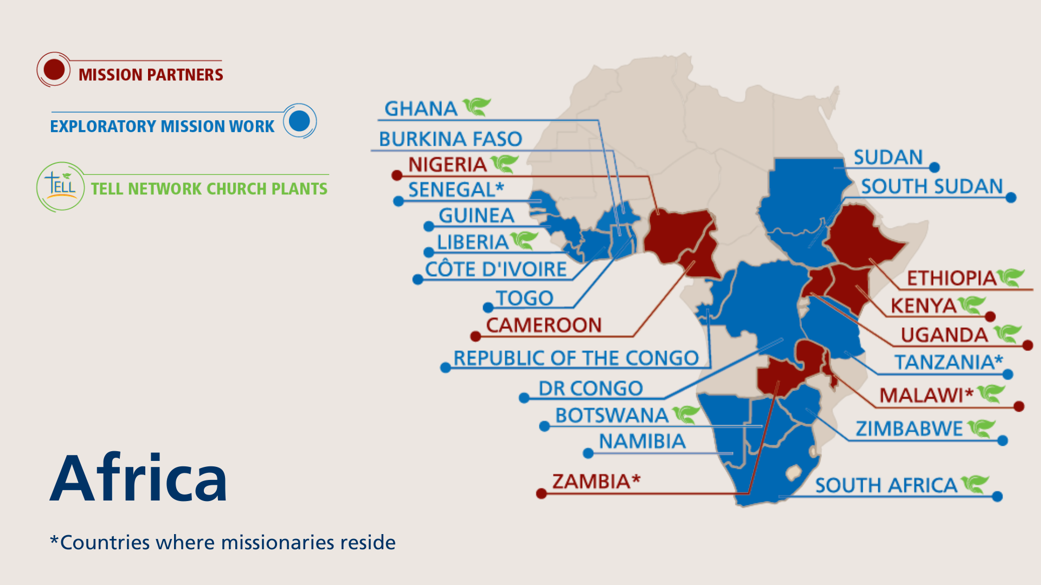
Notes:
The WELS One Africa Team currently works with established church bodies in Cameroon, Ethiopia, Kenya, Malawi, Nigeria, Uganda, and Zambia, partnering in outreach and assisting with theological education programs. The team is also exploring outreach opportunities and following up on promising contacts identified through Multi-Language Production’s TELL program in 15 countries. Nine missionaries serve on the One Africa Team, one of whom works exclusively with the TELL program.
Fast facts
Mission partners in 7 countries
Exploratory mission work in 15 countries (+Senegal by the Board for World Missions)
9 missionaries
TELL church planters in 10 countries

Slide 7
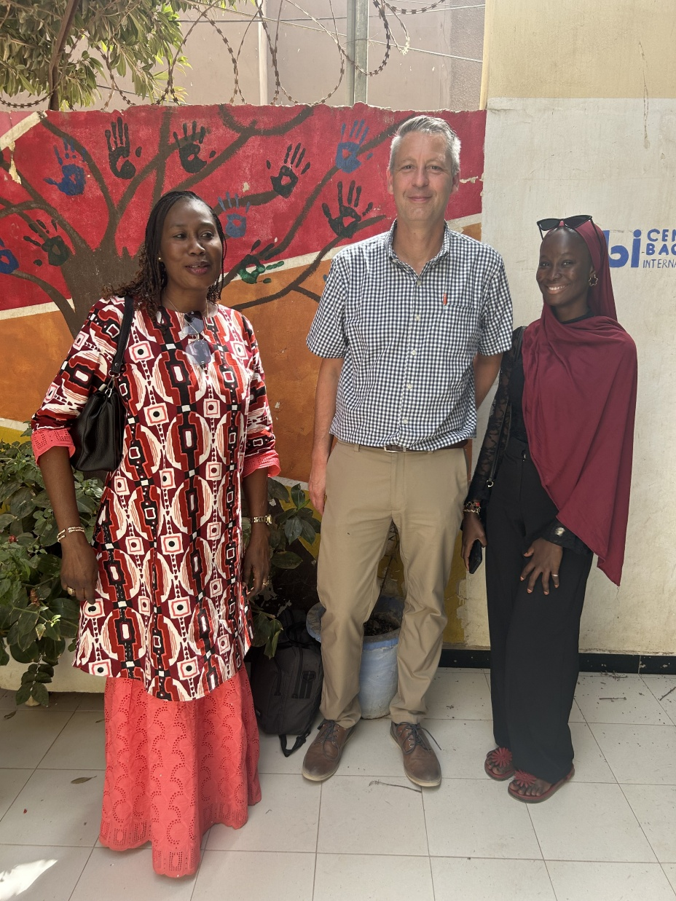
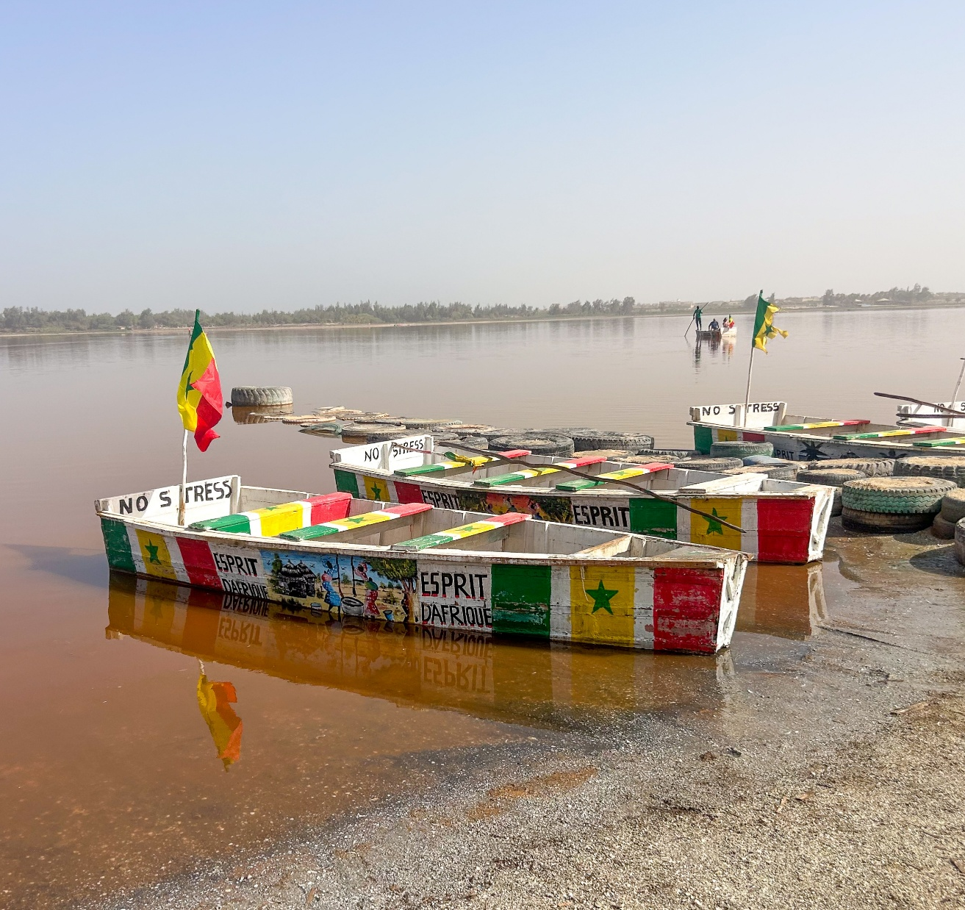

Laying the groundwork for mission work in Senegal
Notes:
In 2023, the Board for World Missions approved a plan to send two missionaries to Senegal to learn the culture and language of the Muslim Wolof tribe in preparation for sharing the gospel and gathering a congregation. The Wolof people make up a large portion of the population and have had very limited exposure to Christianity, making this a new opportunity for “raw” mission work starting from scratch. In February 2026, Director of World Missions Operations Stefan Felgenhauer traveled to Dakar to finalize language and cultural immersion plans that will serve as the first phase of ministry for new missionaries. The visit addressed key logistics such as housing, healthcare, and immigration and formalized partnerships with Africa Consultants International (pictured with Stefan on the left), where missionaries will live with host families and receive intensive Wolof language training.
Learn more: wels.net/laying-the-groundwork-for-mission-work-in-senegal/

Slide 8
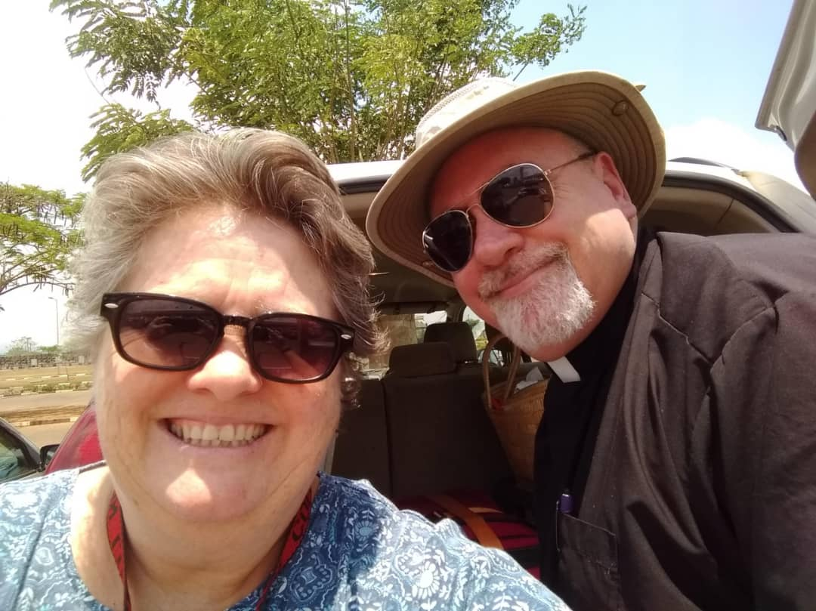
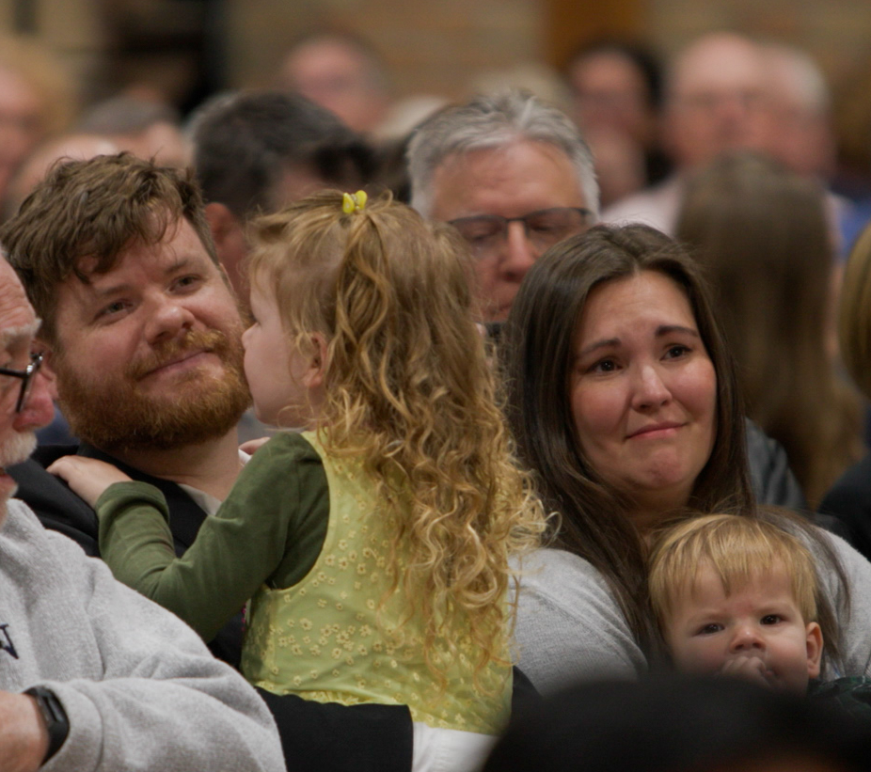
Two missionaries heading to Senegal in September
Notes:
Missionary Dan Kroll, who previously served on the One Africa Team, accepted the call, and Missionary Stephen Gerling was assigned from Wisconsin Lutheran Seminary in May 2026 to serve alongside him in Senegal. Both families will relocate and begin their work in September 2026, pending no unexpected delays. Their first six months will be spent living in with a Muslim Wolof family in Dakar, learning the language and culture, and building relationships that will lay the foundation for future gospel outreach. It is the prayer that this work will not only bring the gospel to the Wolof people but also serve as a resource and encouragement for future outreach in Muslim communities around the world.

Slide 9
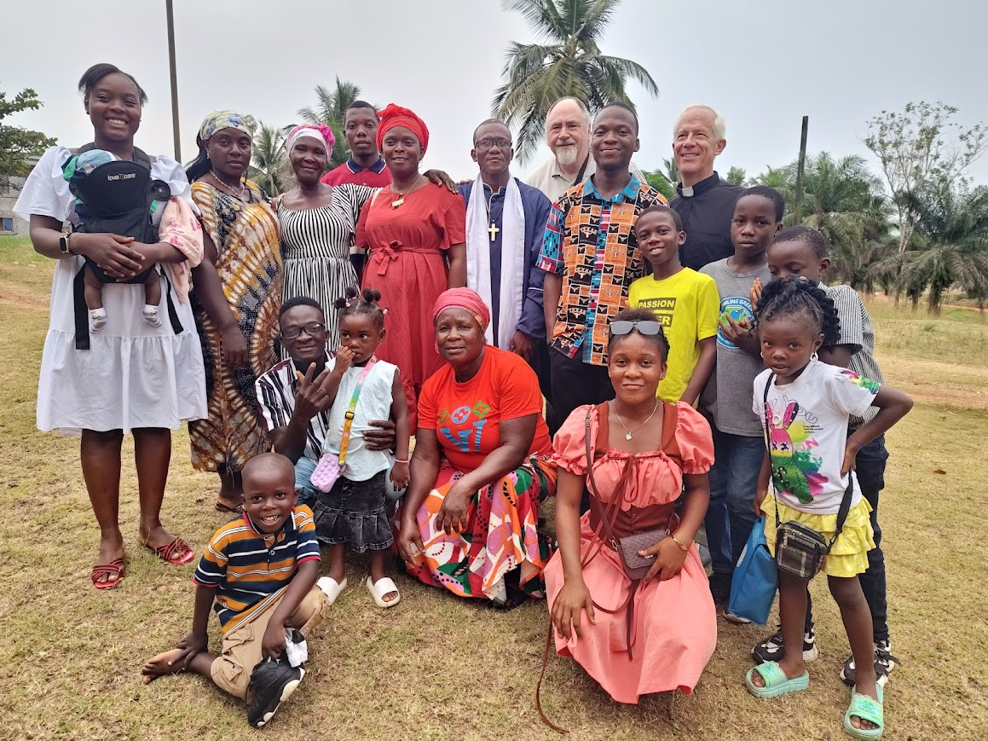
The One Africa Team is exploring partnerships and outreach with more than 15 different groups
Notes:
The One Africa Team is expanding its outreach and exploring potential partnerships with more than 15 different groups in several countries. Here are some examples:
Liberia (pictured): Lamb of God Lutheran Church and its leader, Pastor Toye Barnard, broke away from a Pentecostal group in 2022 and were introduced to the One Africa Team. They are in stage two of the four-stage process the One Africa Team uses to guide discussions with potential ministry partners. They have purchased a piece of land where they plan to build a church as well as a school.
Cameroon: Holy Trinity Lutheran Synod consists of St. John's congregation in Fondonera, as well as its various daughter churches and preaching stations throughout the region. They are served by Pastor Julius Nkwetta. One Africa Team missionaries meet with Pastor Nkwetta and his leadership in the city of Douala, Cameroon, for doctrinal workshops. Holy Trinity would like to begin a ministry to university students in the regional hub of Dschang.
Ethiopia
Opiew Okugn connected with the One Africa Team in 2018. He formed the Gambella Evangelical Lutheran Church after studying in Multi-Language Production’s TELL program. They currently worship in a temporary building on a member's property. They are in stage three of the four-stage process the One Africa Team uses to guide discussions with potential ministry partners.
Because of civil war in South Sudan, many members of the Nuer tribe live in refugee camps throughout Africa. Refugees in the U.S. have connected the One Africa Team with contacts in Gambella, Ethiopia. One Nuer man has graduated from Maor Theological Seminary of the Lutheran Church of Ethiopia in Bishoftu and is serving the Nuer community in Gambella.
Sudan: They are in contact with the Lutheran Church of Sudan (LCS), an Arabic-speaking group with approximately 16,000 members, though visa and passport issues have delayed in-person meetings.
Tanzania: The Africa Mission Evangelism Church (AMEC) split from a larger group of Tanzanian Lutherans in the mid-1990s. The One Africa Team has visited this group two to three times a year since 2021. AMEC is in five provinces of Tanzania and has 81 congregations, which are served by their 65 pastors. They serve about 13,000 members.
Learn more at wels.net/africa.

Slide 10
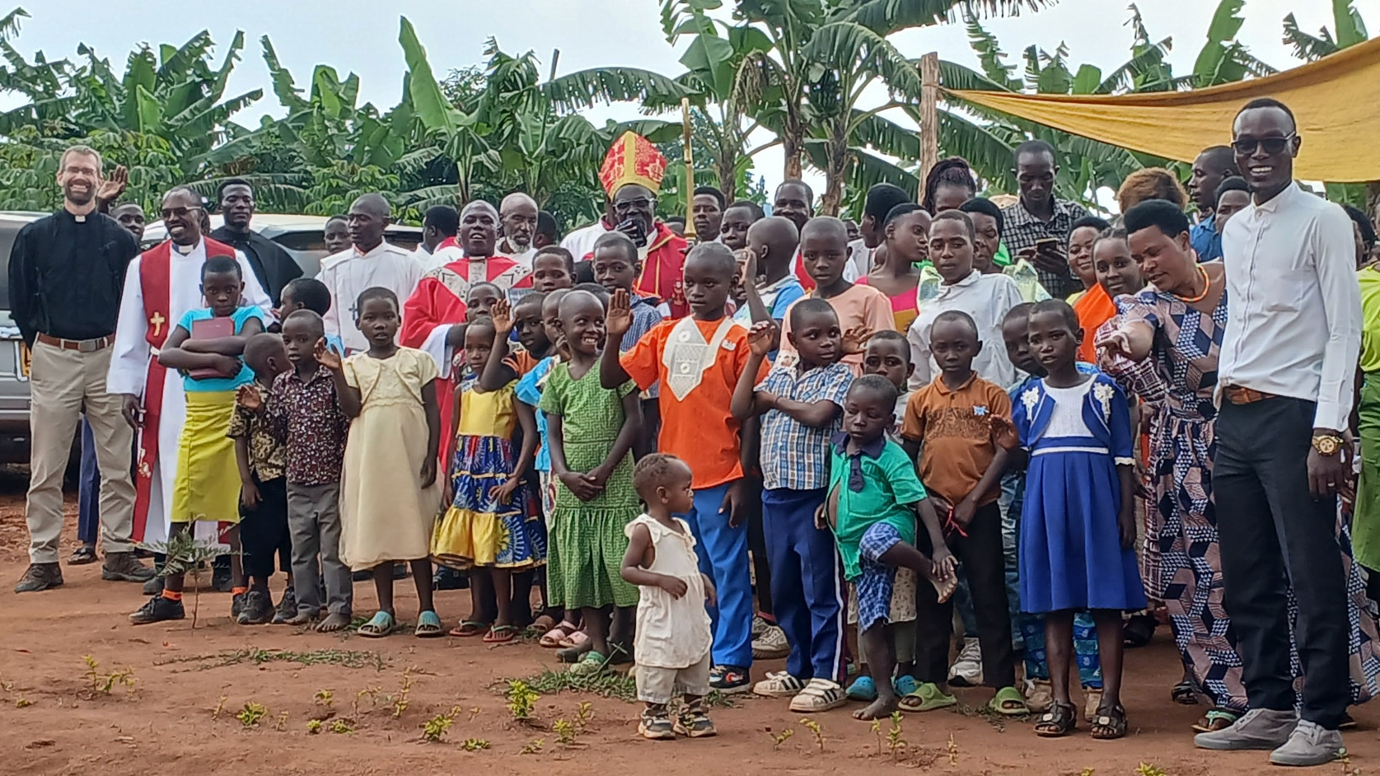
Continued exploratory work in Uganda
Notes:
In Uganda, the One Africa Team is exploring fellowship/partnership with two different synods:
In western Uganda, the Confessional Lutheran Synod of Uganda (CLSU), serves about 3,000 members and operates a small seminary with 7 students graduating in December 2025 and 12 who enrolled right after that. The One Africa Team began visiting this group in 2025.
In central Uganda, the Evangelical Church of the Augsburg Confession in Uganda (ECACU), a smaller synod of around 950 members, focuses on outreach through schools, including one serving 300 children. The One Africa Team began visiting this group in 2025.
In addition to exploring fellowship with these two synods, WELS has been in fellowship with/partners with Obadiah Lutheran Synod in Uganda since 2023.
Pictured: Missionary Ben Foxen (far left) visits Christ the Vine, a congregation within the Confessional Lutheran Synod in Uganda in August 2025.
Read more: https://welsfriendsofafrica.com/seeking-and-strengthening-synods-in-uganda/

Slide 11
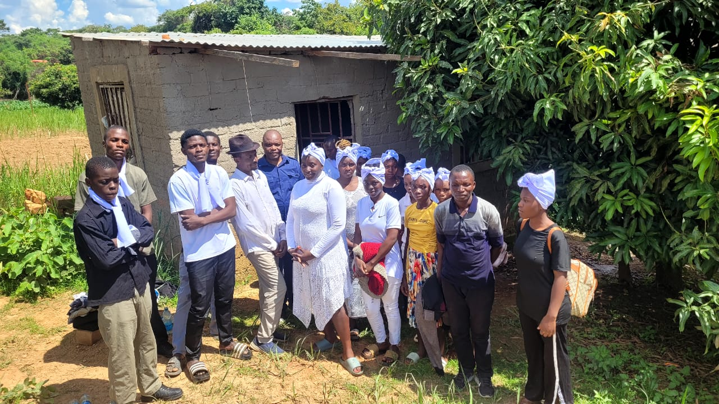
French outreach throughout Africa
Notes:
Gospel outreach among French‑speaking churches in Africa continues to expand as WELS works to build confessional Lutheran relationships in regions where French is a primary language. Through the One Africa Team, WELS is engaging with church bodies such as the Mission Évangélique Luthérienne au Congo (MELC – pictured), meeting with church leaders to study doctrine, discuss theological training, and explore possibilities for formal fellowship. These conversations, held in stable locations when political unrest limits travel, reflect the synod’s careful, Word‑centered approach to partnership and unity of confession. This ministry is featured in the April 2026 WELS Connection.
French outreach is occurring in Burkina Faso, the Democratic Republic of Congo, Republic of Congo, Cameroon, and Ivory Coast. Here are some specific examples:
Burkina Faso: The One Africa Team is Working with the L'Église Évangelique Lutherienne du Burkina Faso (EELBF), a synod of about 700 French-speaking Lutherans across several regions of Burkina Faso.
Democratic Republic of the Congo:
The One Africa Team is working with Mission Évangélique Luthérienne au Congo (MELC), a group of both French- and Swahili-speaking Lutherans that have expressed their desire to come into fellowship with WELS.
The Community of Evangelical Lutheran Churches of Central Africa (CEELAC) is a small church body that spans the biggest country in Africa. They have ten congregations: one in Kinshasa in the west, and nine others in the far east near the city of Uvira. Total membership is about 1,500. The One Africa Team began visiting this group in 2023.

Slide 12
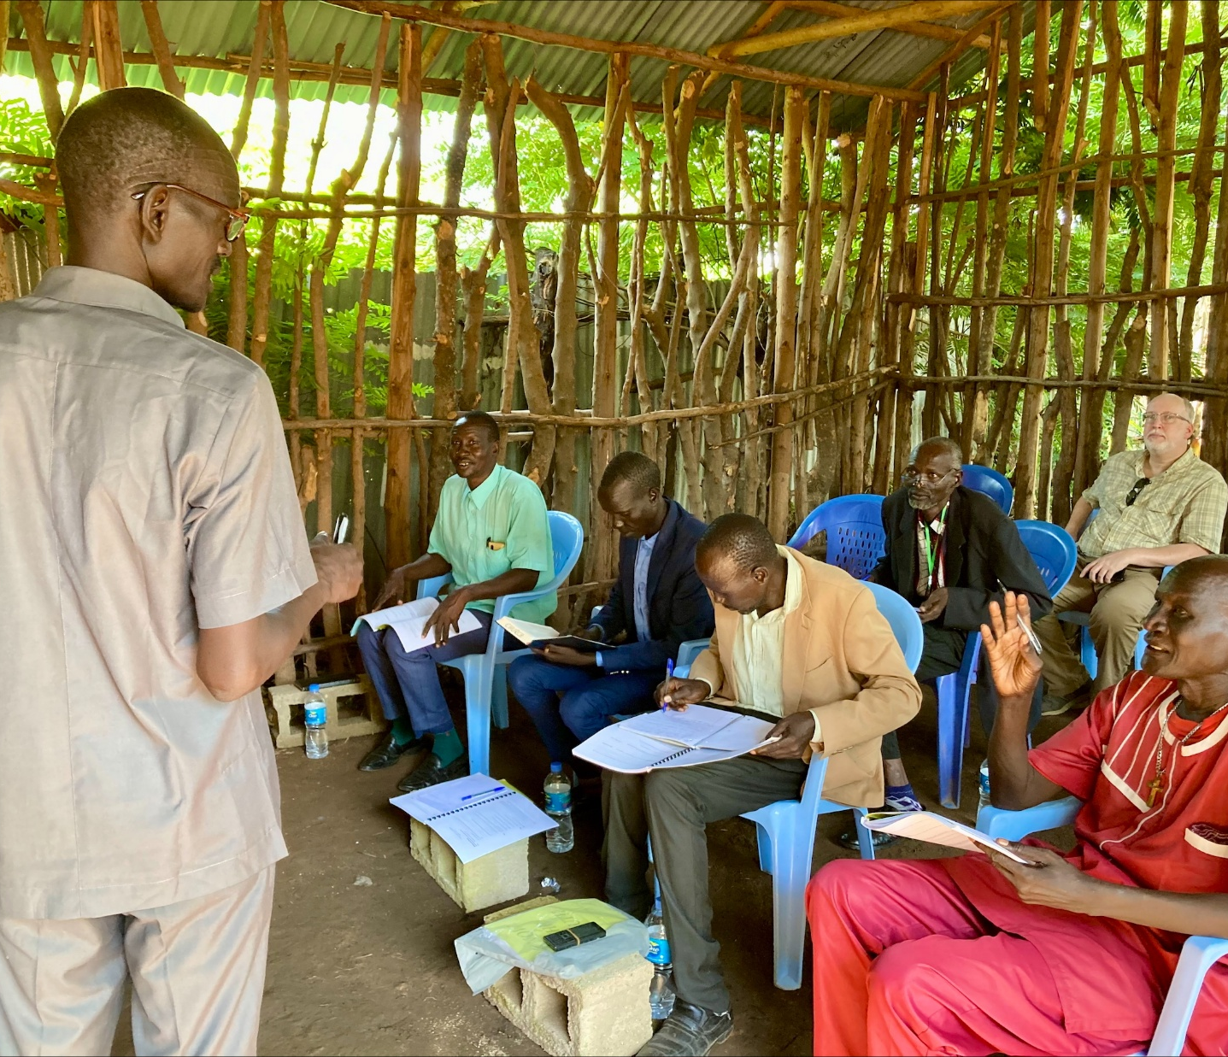
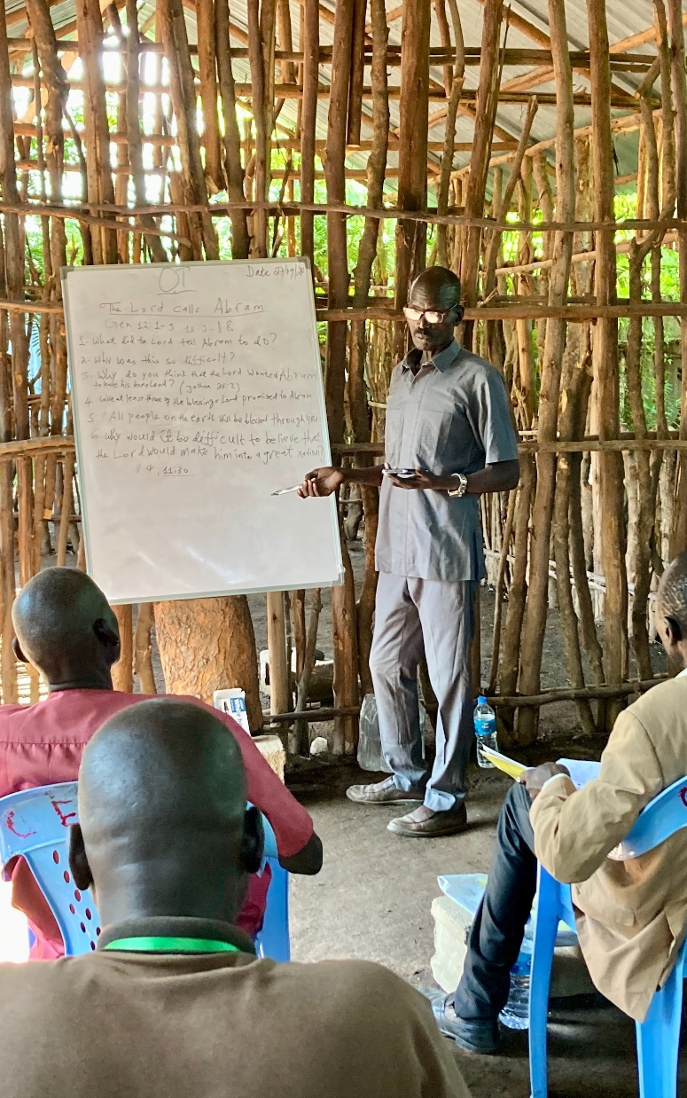
Theological education workshops for the
Nuer Sudanese in Ethiopia
Notes:
In the heart of East Africa, Lam Nhial Luak is equipping the next generation of church leaders. An ethnic Nuer Sudanese born in Ethiopia, Lam grew up in the Gambella refugee camp. As a young man, he became a Christian and felt called to share God’s Word with fellow refugees. This passion led him to theological training, culminating in his studies at Maor Lutheran Theological Seminary, operated by the Lutheran Church of Ethiopia, WELS’ sister church. Now, Lam is using his training to strengthen the Lutheran church in Gambella.
After completing his studies, Lam was ordained into a new teaching ministry in September 2024. Today, Lam leads critical pastoral training workshops for the Confessional Evangelical Lutheran Church in South Sudan and Ethiopia (CELCESS), a church body with 28 congregations and approximately 22,000 members. Many CELCESS pastors faithfully serve their congregations but have little formal training. Lam’s workshops provide them with essential instruction in Luther’s Small Catechism, Old Testament History, and Introduction to Preaching.

Slide 13
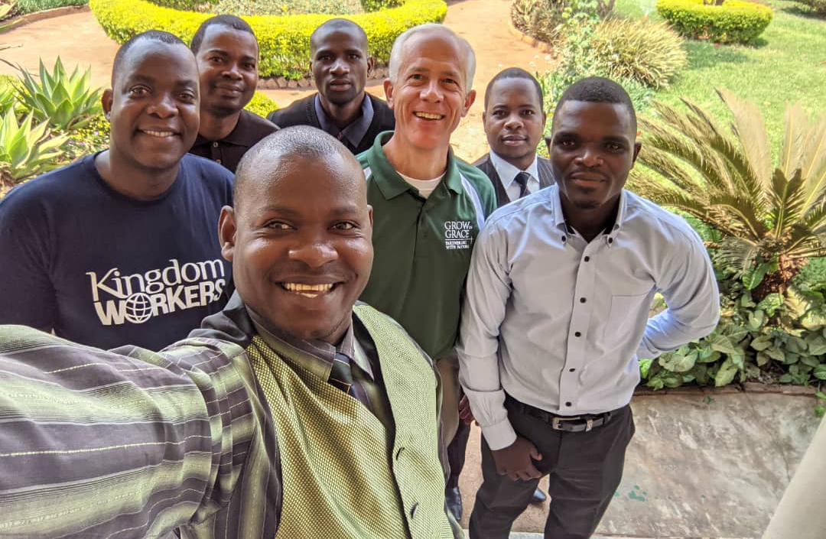
Longstanding theological education in Africa and opportunities in even more countries
Notes:
Previous WELS mission efforts have led to strong, independent church bodies in Zambia, Malawi, Nigeria, and Cameroon. Missionaries work closely with sister synods to support their seminary program.
In addition, the theological education arm of the One Africa Team is currently providing a Bachelor of Divinity degree program (BDiv) to 15 pastors in addition to providing professional development and continuing education courses for pastors at all our African sister synods. The cohort of 15 BDiv students will celebrate their graduation at the CELC Convention in Lusaka, Zambia, at the end of May/early June 2026. Missionary Dan Witte (pictured with some of the cohort) helps lead the ministry training efforts of the One Africa Team.

Slide 14
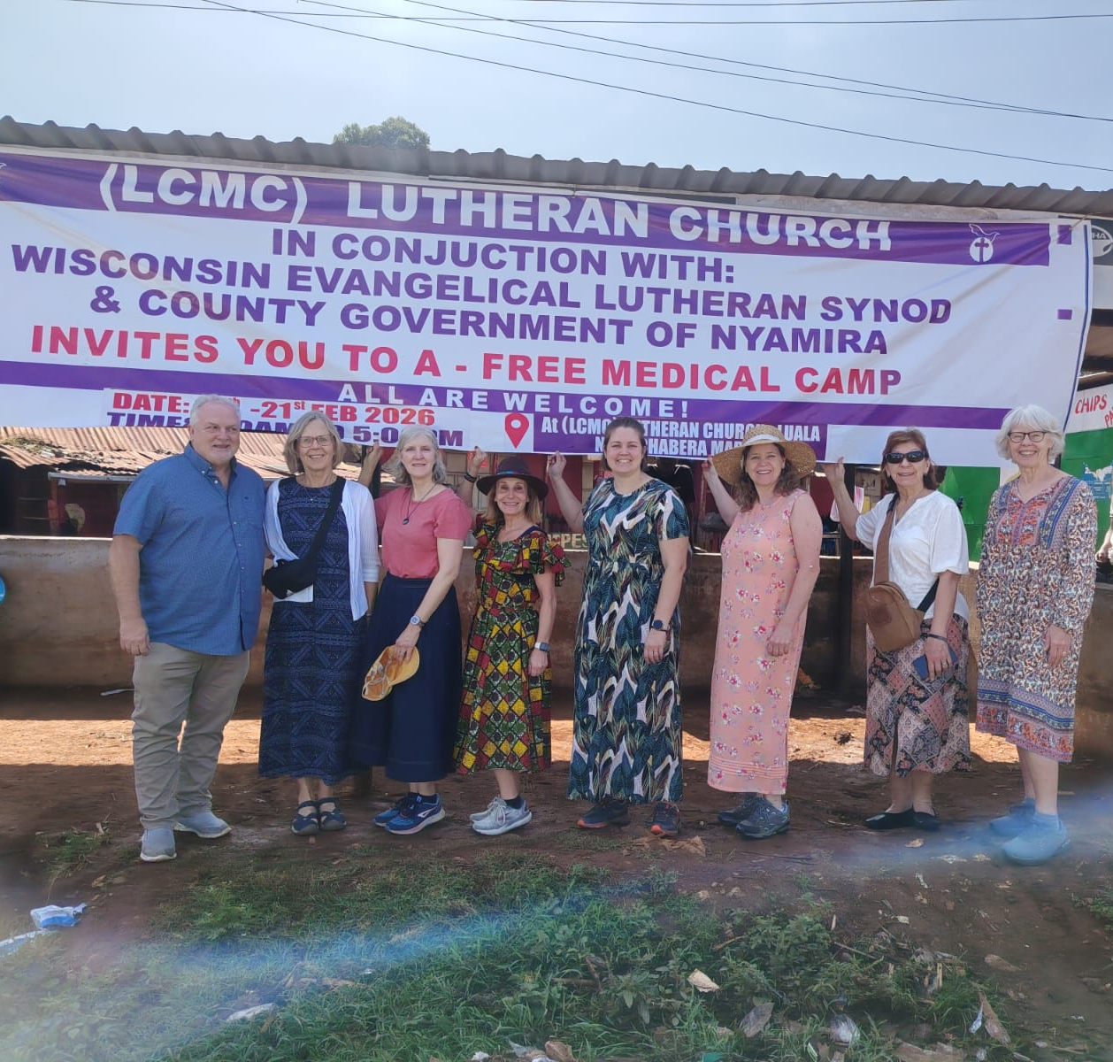
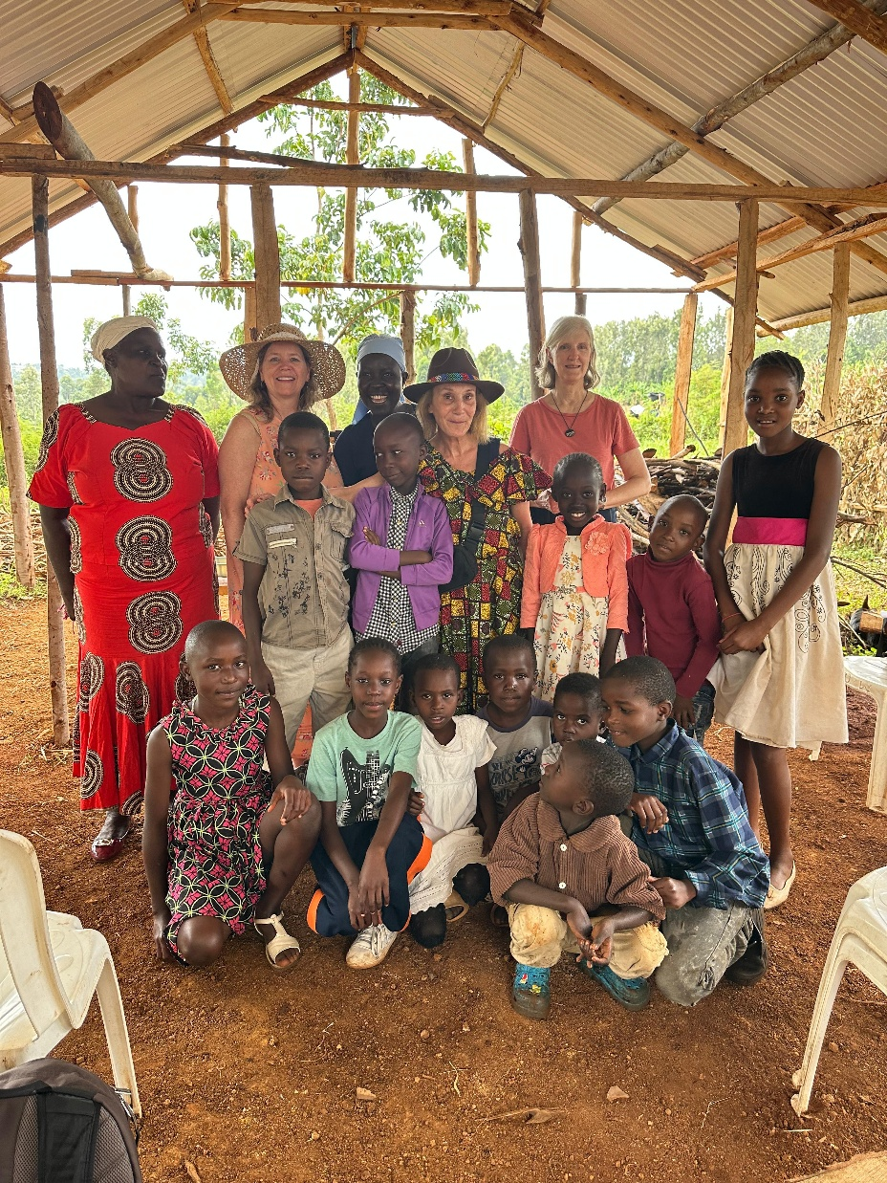
Central Africa Medical Mission (CAMM)
Medical camp in Kenya
Notes:
In February 2026, Central Africa Medical Mission (CAMM), in partnership with the Lutheran Congregations in Mission for Christ–Kenya (LCMC), hosted a short‑term medical camp in Chabera, Kenya, serving as both a mercy effort and an opportunity for gospel outreach. Over five days, the camp provided free medical screening, treatment, and medication to nearly 2,400 children, women, and men, many of whom traveled long distances from this underserved rural area. Kenyan medical professionals worked alongside CAMM volunteers, while local church leaders ensured that each patient also received Christian materials, prayer, and a gospel‑centered welcome.
Read more: https://wels.net/welcome-to-kenya/

Slide 15
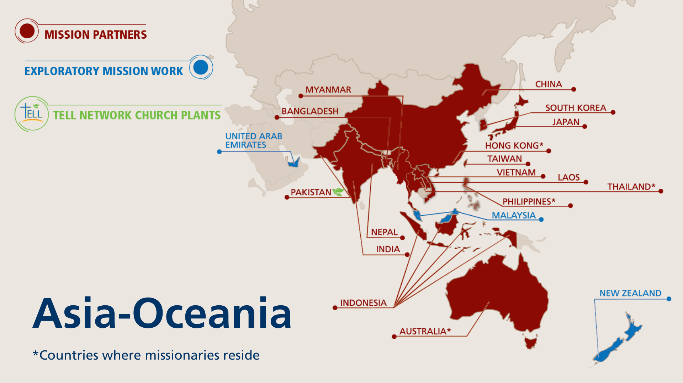
Notes:
The Asia-Oceania Team is made up of 19 missionaries serving 19 different countries throughout Asia and Oceania. The team—with members in Thailand, Hong Kong, the Philippines, and Australia—partners with God’s people to equip, encourage, and empower others to bring the good news of Jesus Christ to the billions still lost in darkness. The Asia-Oceania Team explores new mission opportunities, supports existing sister synods, and trains current and future leaders for service in their churches through Asia Lutheran Seminary.
Fast facts
Mission partners in 16 countries
Exploratory mission work in 3 additional countries
19 missionaries
8,275 people baptized in 2025
110,000+ people gathered weekly around God’s Word in 2025

Slide 16
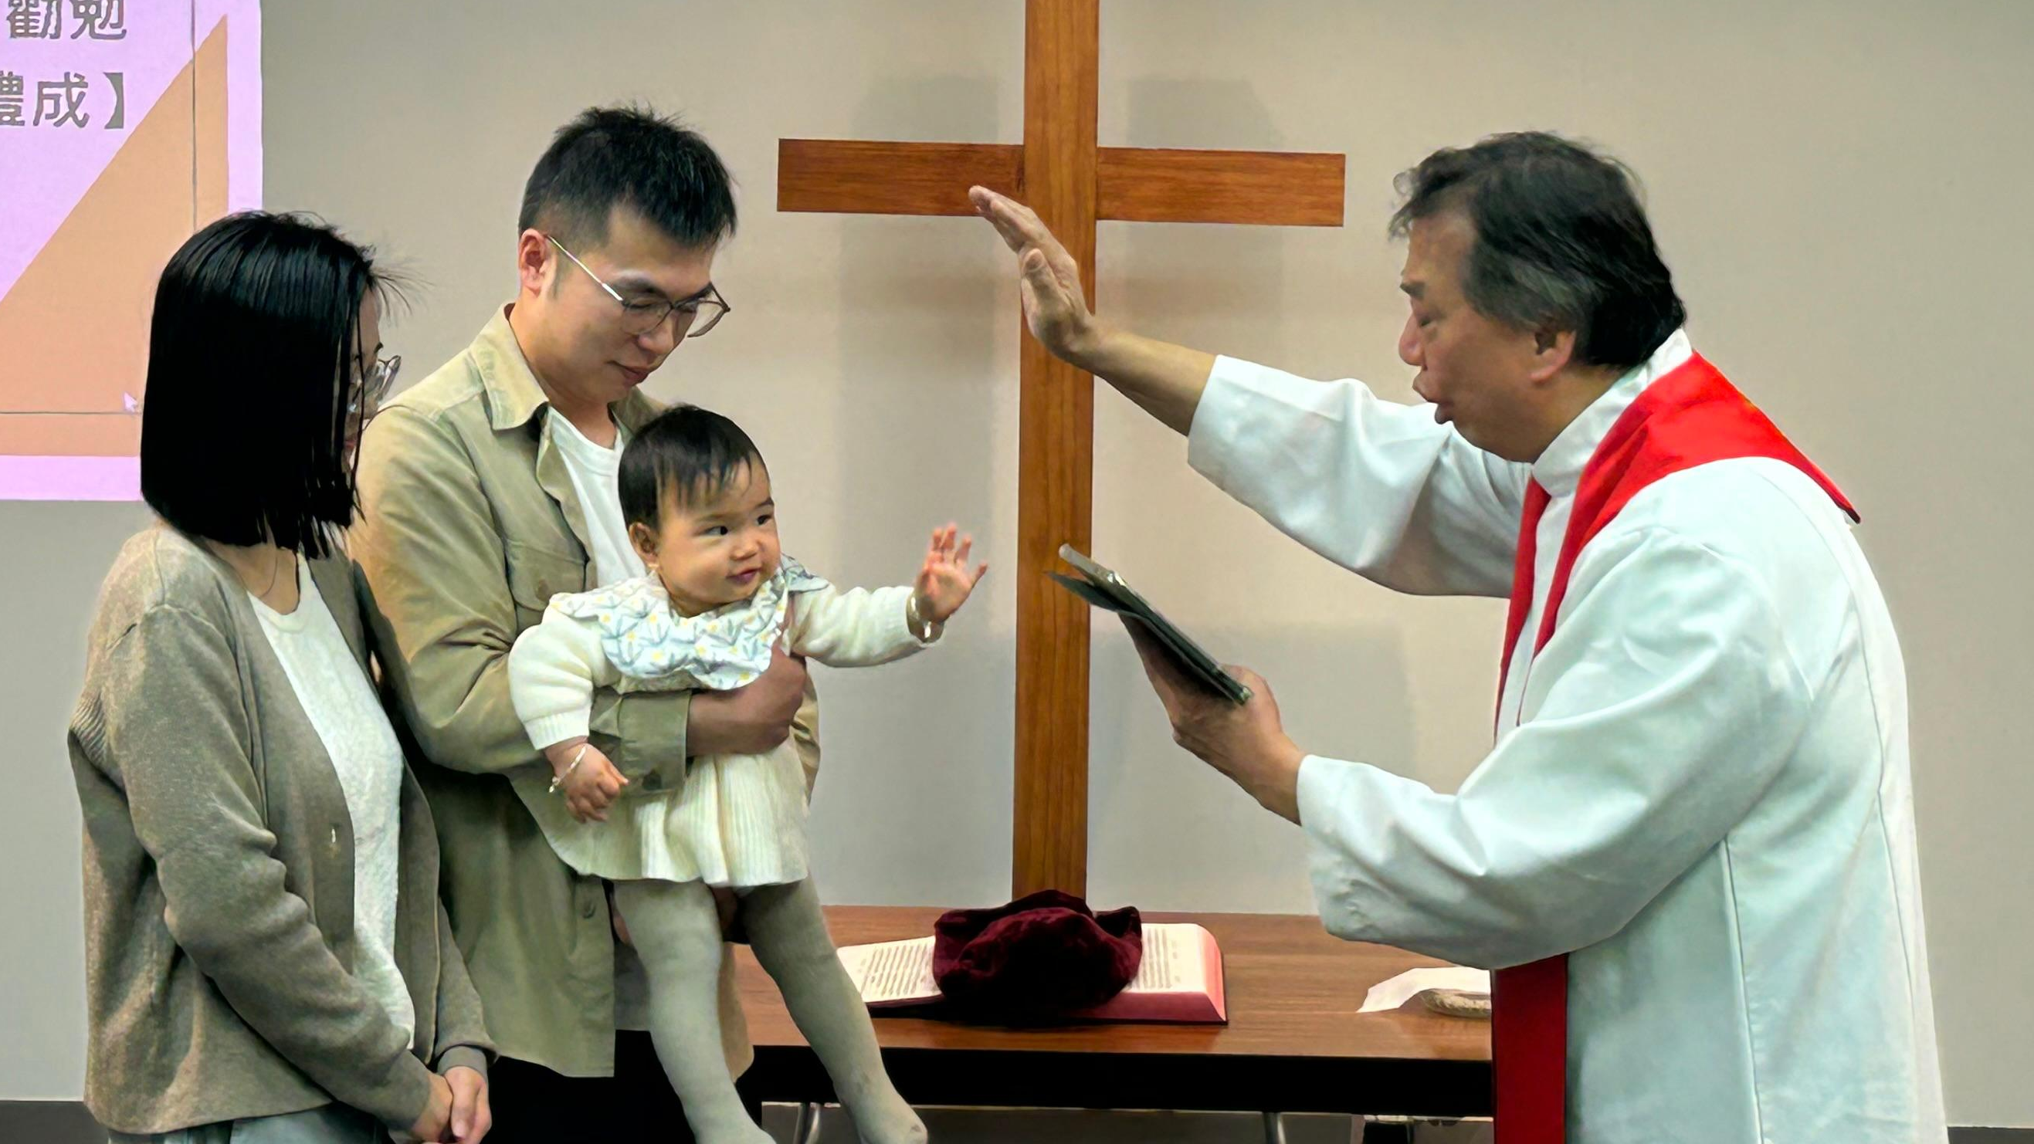
8,275 people were baptized across
Asia-Oceania in 2025
Notes:
Pictured: Rev. Titus Tse, retired chairman of SALEM in Hong Kong, baptized a child in October 2025 at the new Chinese mission in New Zealand. A second adult man was also baptized at the service.
8,275 people baptized in Asia-Oceania in 2025
110,000+ people gathered weekly around God’s Word in 2025

Slide 17
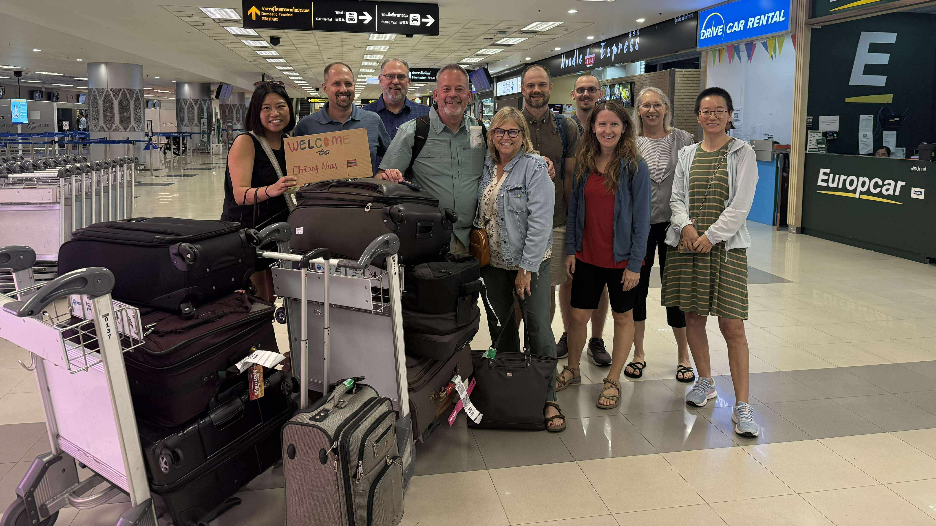
New Asia-Oceania team leader and missionary: Mr. Jim Brandt
Notes:
Mr. James Brandt accepted the call to serve the Asia-Oceania Team as the team leader and arrived in Chiang Mai, in August 2025. In this role, Brandt guides Asia-Oceania Team efforts by leading vision, strategy, and operational planning; coordinating team functions and the efforts of field liaisons; supporting missionaries and their continued development; coordinating mission advancement with the Mission Advancement and Promotions team; and strengthening relationships with national partners and WELS organizations in both the U.S. and Asia-Oceania.

Slide 18
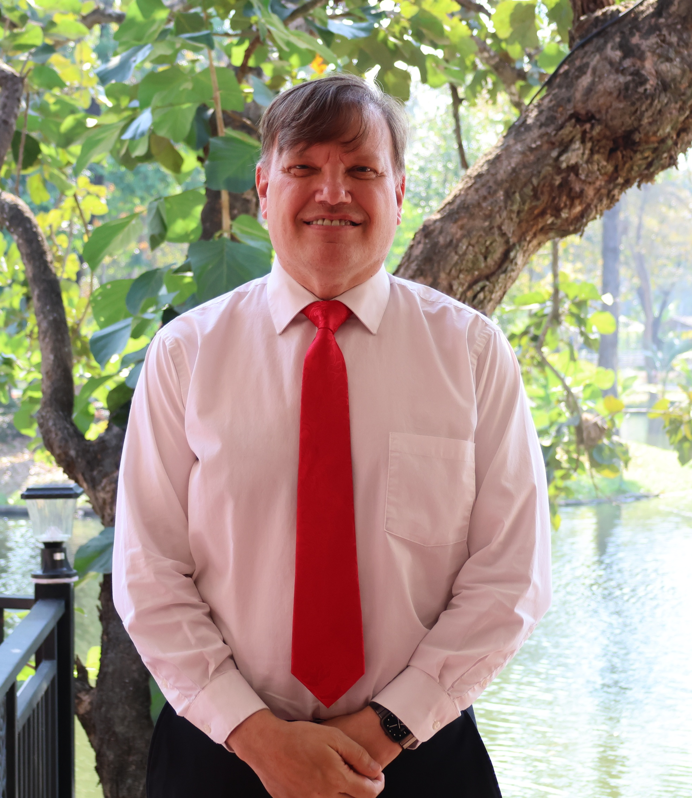
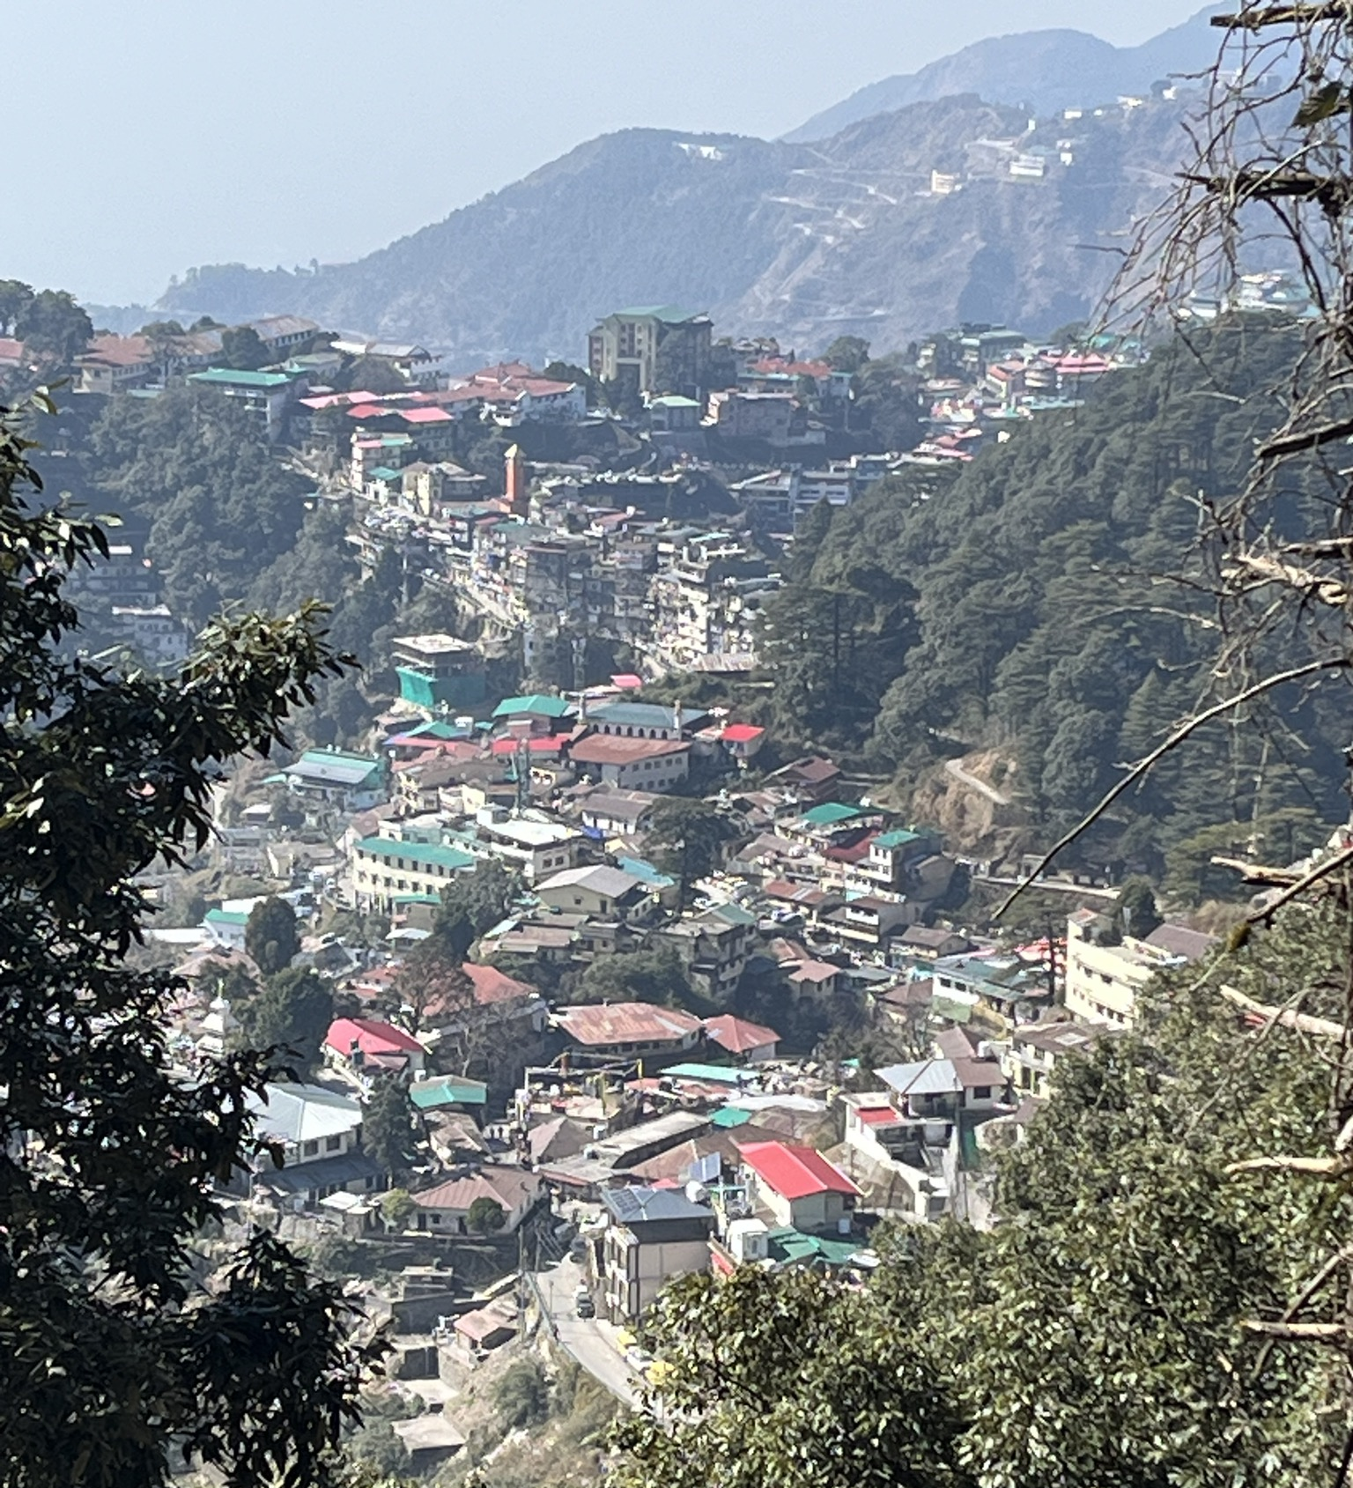
New missionary focused on Hindi outreach
Missionary John Hildebrant
Notes:
New Missionary John Hildebrant is preparing for mission work within the Asia-Oceania Team. He is living in India for one year while studying the Hindi language at a school in Mussoorie. Through this immersion, he will gain insight into South Asian values and communication styles, preparing him to teach, build relationships, and share God’s Word effectively with Hindi people groups across Asia and Oceania. Next, Hildebrant will relocate to Chiang Mai, Thailand, where many missionaries on the team reside. From there, the team will determine how Hildebrant’s gifts can best be used within its purview.
Pastor Hildebrant previously served in India for many years. He has worked in the Hindi language before and will be able to use that experience to engage in new work quickly.
Read more: https://wels.net/climb-the-hill-again/

Slide 19
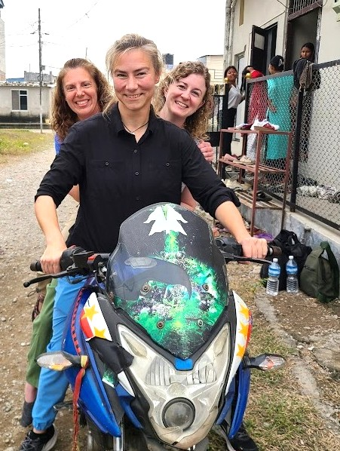
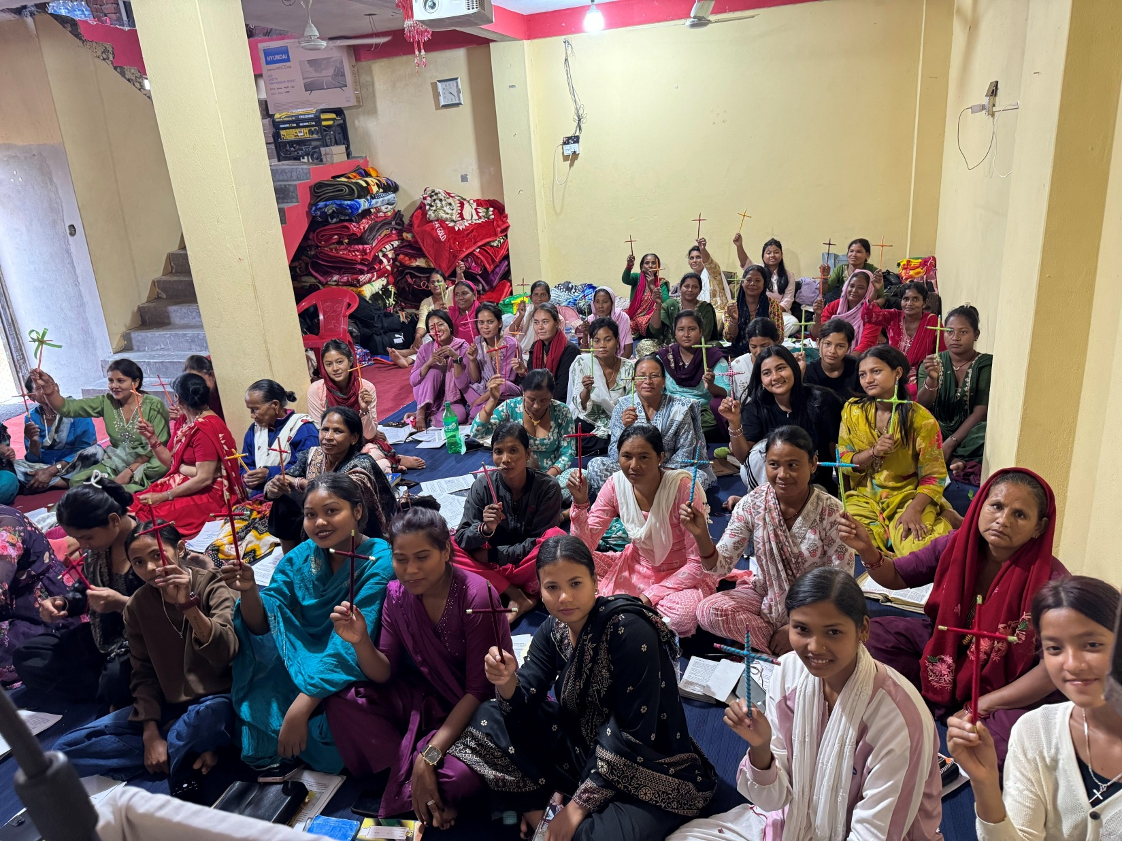
New women’s ministry coordinator in
Asia-Oceania
Notes:
Women’s ministry efforts continue to expand within the Asia‑Oceania Team. Cindy Lendt (pictured left, front) accepted the call to serve as Women’s Ministry Coordinator for the Asia-Oceania Team starting July 2026. Women have unique challenges in many areas of Asia, and this position is focused on increasing their access to the gospel. Lendt will develop and oversee a comprehensive framework for women’s ministry across Asia-Oceania mission fields and coordinate local teams to amplify existing efforts and implement new initiatives.
Prior to accepting this call, Lendt volunteered to participate in a women’s workshop held in Nepal (pictured), offering a helpful example of the types of outreach and training she will now help coordinate more broadly. The workshop, organized in partnership with national church leaders, equipped local Christian women for relationship‑based, woman‑to‑woman gospel conversations grounded in God’s Word.

Slide 20
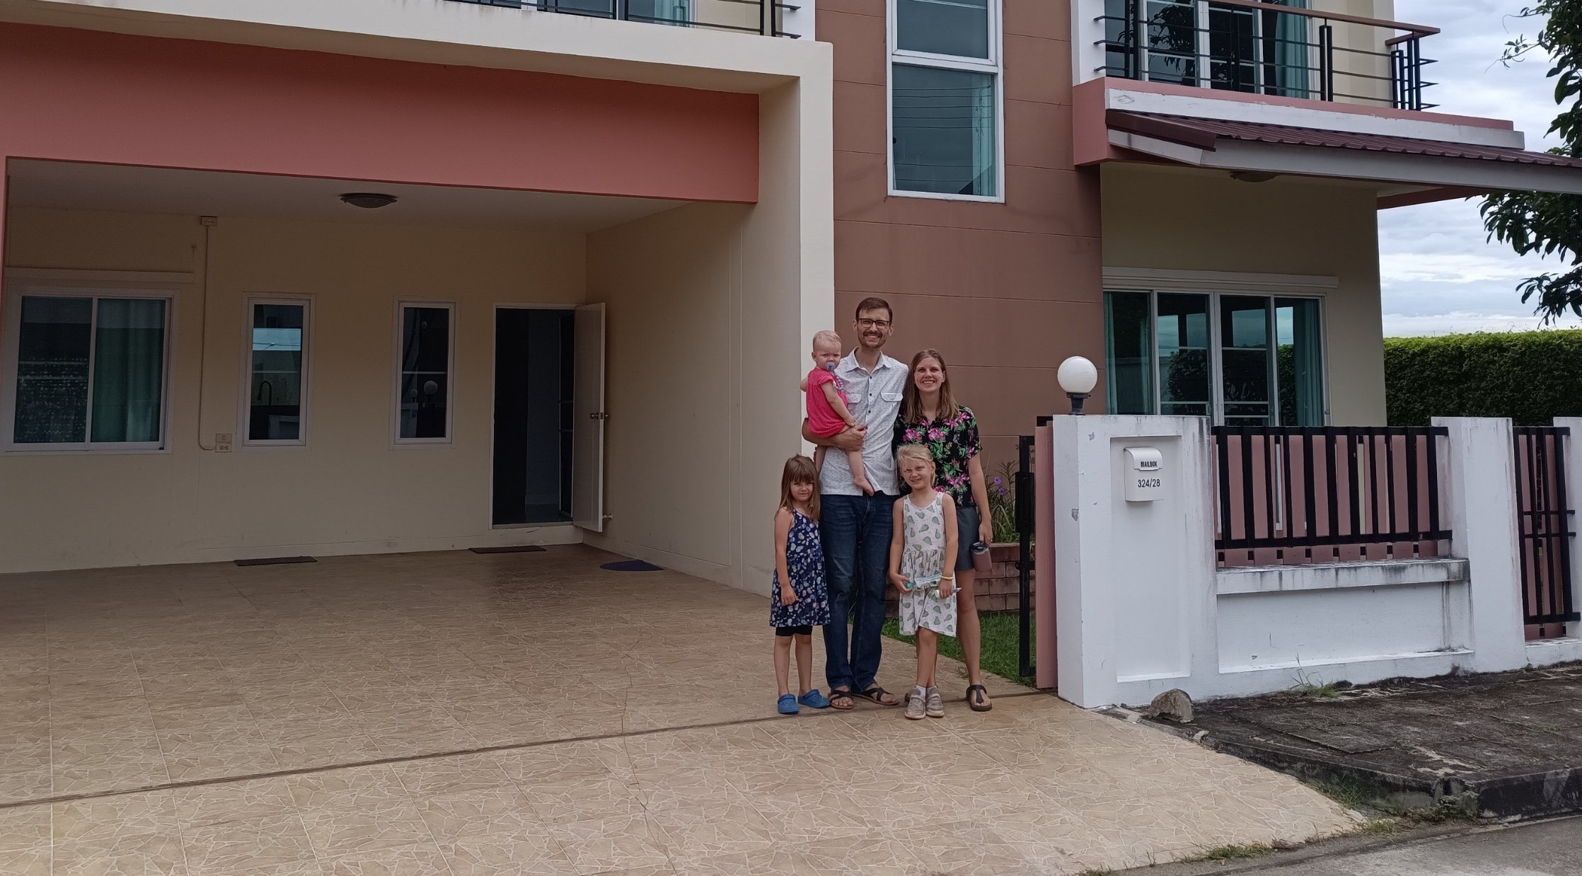
Missionary Zondag and family relocates to Bangkok
Notes:
Zondag family moves from Chiang Mai to Bangkok, Thailand
Missionary Mark Zondag, his wife Sarah, and their three girls have relocated from Chiang Mai, Thailand, to Bangkok, Thailand—a journey of about nine hours by car. The transition has felt like moving from the outskirts of Green Bay, Wis., to the outskirts of New York City—more people, faster pace, and more complexity.
Here are a few reasons that led to the move:
Around half of Bangkok’s population comes from outside the region.
An estimated 30-40 percent of Thai people will live in Bangkok at some point in their lives.
Bangkok is home to 11 million people, but only 1.1 percent identify as Christian.
This means many still need to hear about Jesus. And those who come to faith here often carry the message back to their hometowns—potentially spreading the gospel throughout Thailand. Please pray for the Zondags as they settle into their new home, face new challenges, and seek opportunities to share God’s grace with those around them.

Slide 21

Asia Lutheran Seminary provides theological education across the continent
Notes:
Asia Lutheran Seminary (ALS), the regional seminary for Asia and Oceania, trains Christian leaders by equipping students to reach out, disciple believers, train leaders, and multiply groups for the advancement of God’s kingdom. ALS offers a comprehensive evangelist through pastor-level training program, ranging from certificate courses to a Master of Divinity degree.
Asia Lutheran Seminary is served by eight professors and additional adjunct faculty (Pictured – Prof. Angus Cheung, national pastor from Hong Kong and Professor at ALS). 83 Chinese-speaking students are enrolled in the core ALS program; in the English-language certificate program, 86 students have signed up for the first live TELL class.

Slide 22
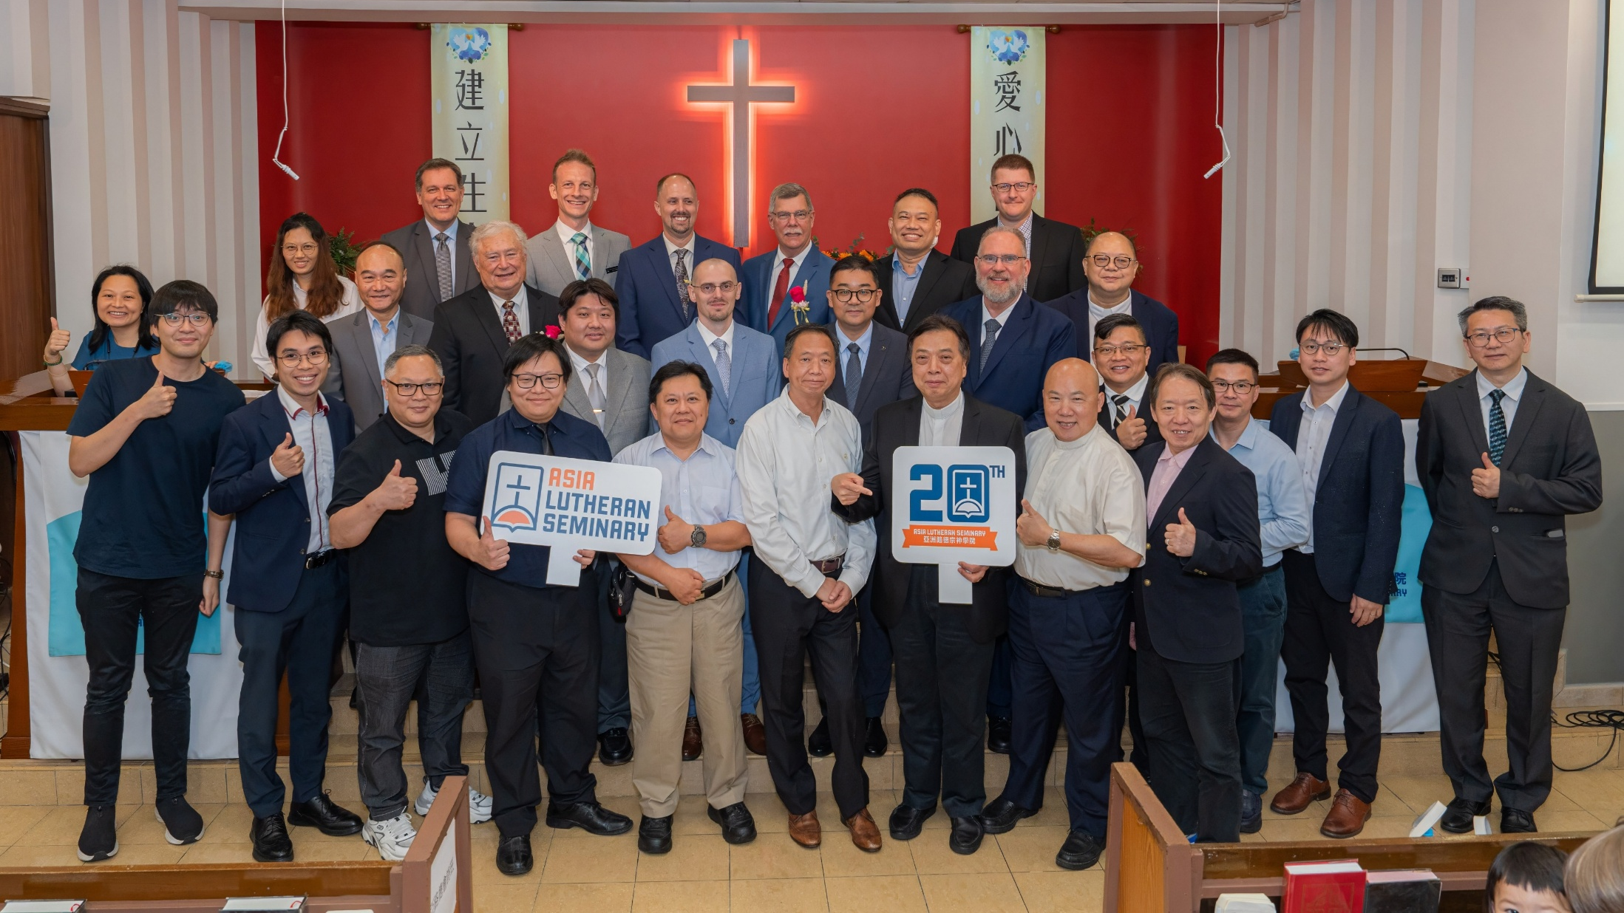
Asia Lutheran Seminary celebrates 20 years
Notes:
On June 1, 2025, Asia Lutheran Seminary (ALS) celebrated its 20th anniversary with a special worship service and banquet in Hong Kong. From its beginnings as a seminary for Hong Kong and East Asia, ALS has grown into a truly regional seminary with hubs in both Hong Kong and Chiang Mai, Thailand. ALS now supports theological education efforts in more than 18 countries and reaches students across four continents.
Watch the special 20th anniversary video: https://wels.net/together-video-june-17-2025/
Read more: https://wels.net/asia-lutheran-seminary-celebrates-20-years-of-gospel-ministry/

Slide 23
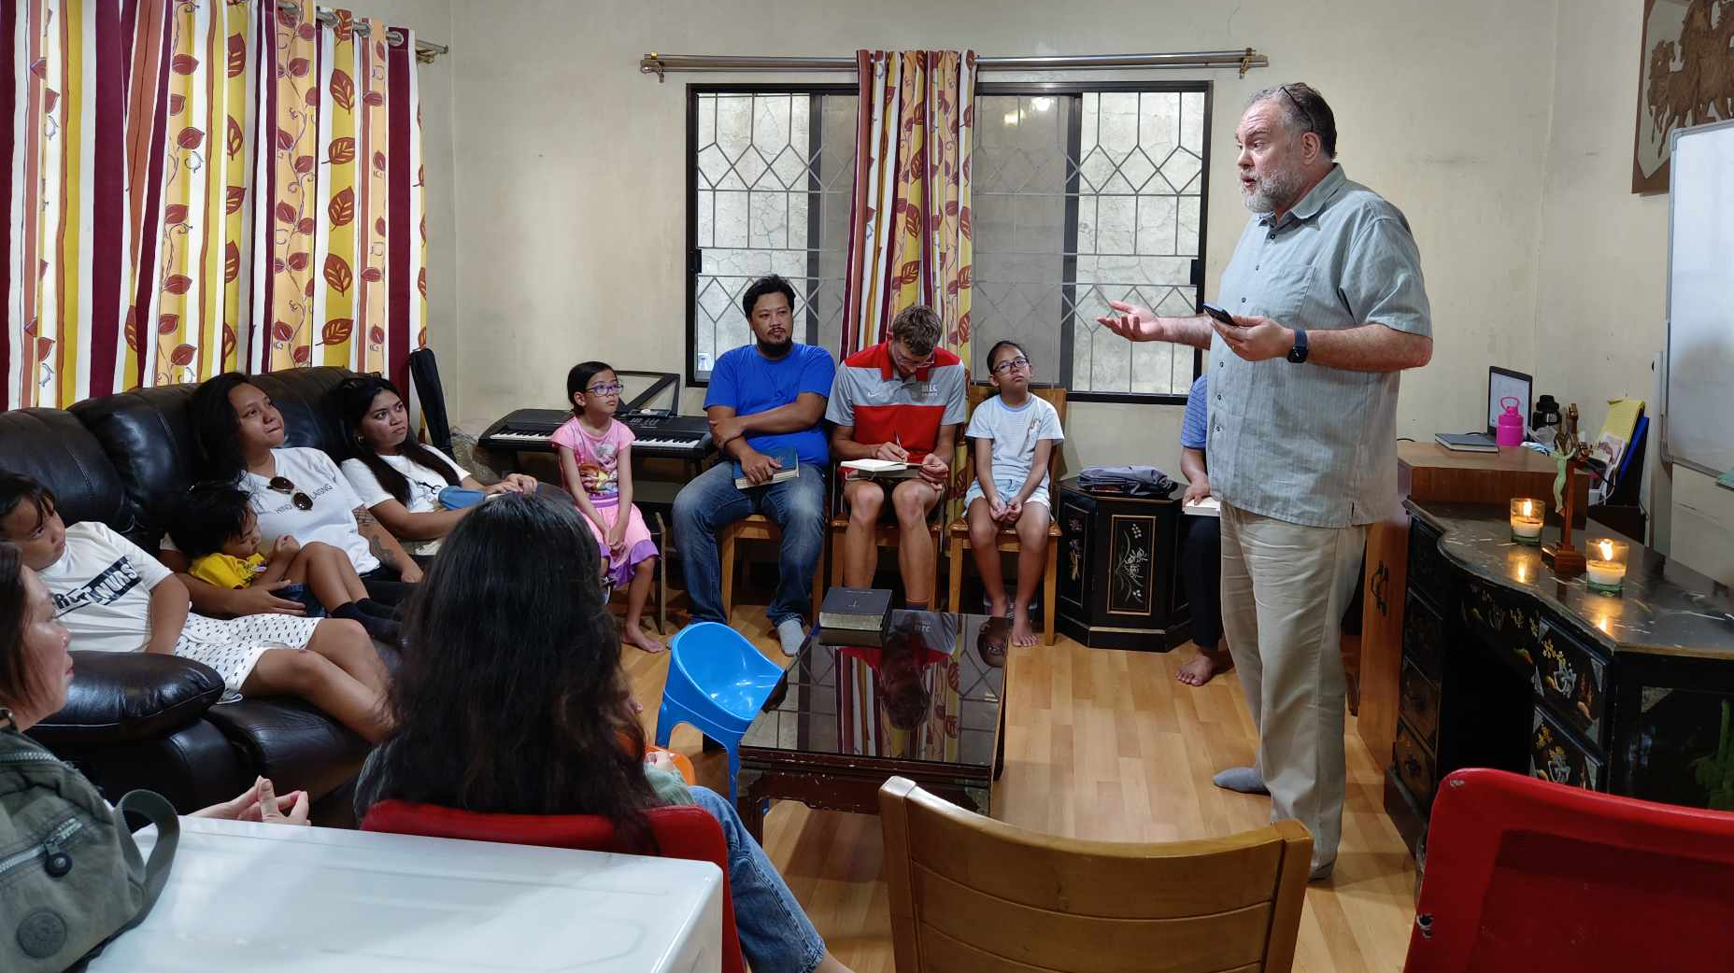
Regional training in Asia through
Asia Lutheran Seminary
Notes:
Pictured: Rev. Dr. Guy Marquardt meets with the Davao Mission Group with Filipino leader and ALS student Marzan.
Initially focused on Chinese-speaking students, ALS has now expanded its reach to serve students across Asia and Oceania. A partnership with Multi-Language Production’s TELL Network has expanded ALS into new, unreached areas. The Regional Theological Education Program (RTEP), purposefully based out of the Chiang Mai office, collaborates with sister churches throughout Asia and Oceania to ensure consistent training through consultation, curriculum development, and visiting instructors. Dr. Guy Marquardt serves as the program’s director. Where possible, the program seeks to serve as an on-ramp into Asia Lutheran Seminary’s mainstream certificate and degree programs for students across Asia.
The RTEP is currently working with programs/students in places like Nepal, Pakistan, Bangladesh, Indonesia, Philippines, Vietnam, and more. Across Asia, over 300 students are being served through the Regional Theological Education Program (RTEP)

Slide 24
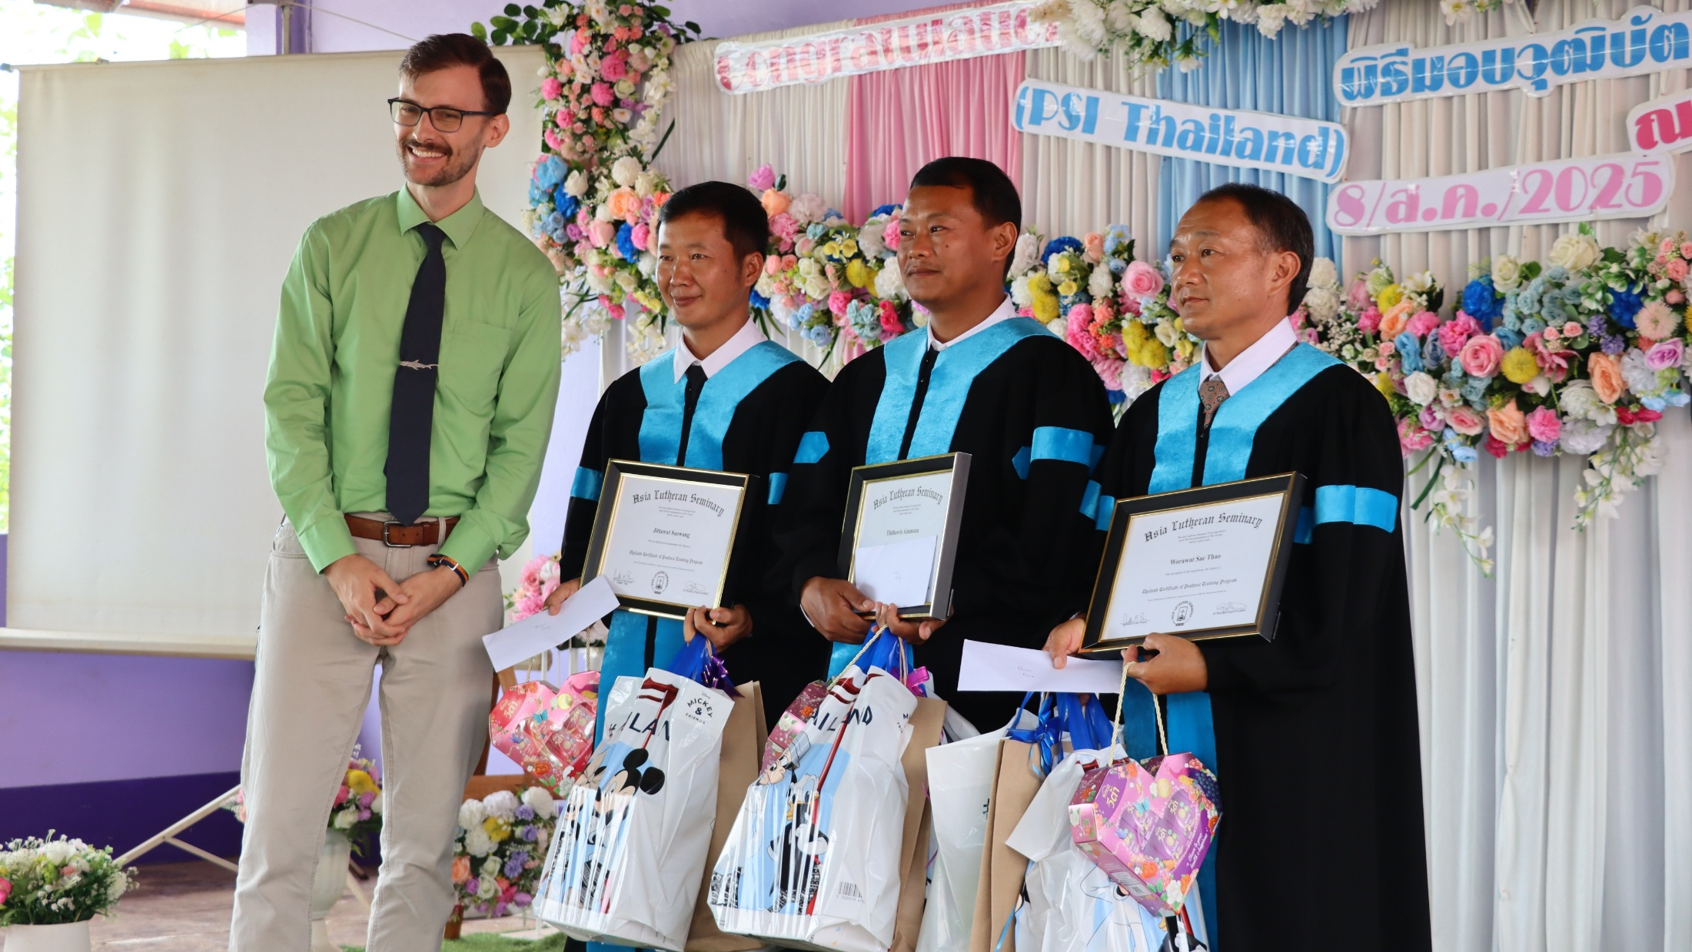
Three evangelists graduate in Thailand
Notes:
The churches in Thailand celebrated the graduation of three evangelists from the Pastoral Studies Institute program run with the assistance of Asia Lutheran Seminary’s Regional Theological Education Program (RTEP) in August 2025. Two of these three men will continue their work planting churches in two different nearby villages. The third will help support the ministry of another church in the area. Lord willing, we will see more leaders trained in the future by them!
Pictured: WELS Missionary Mark Zondag with the three graduates from the graduation ceremony on August 8, 2025.

Slide 25
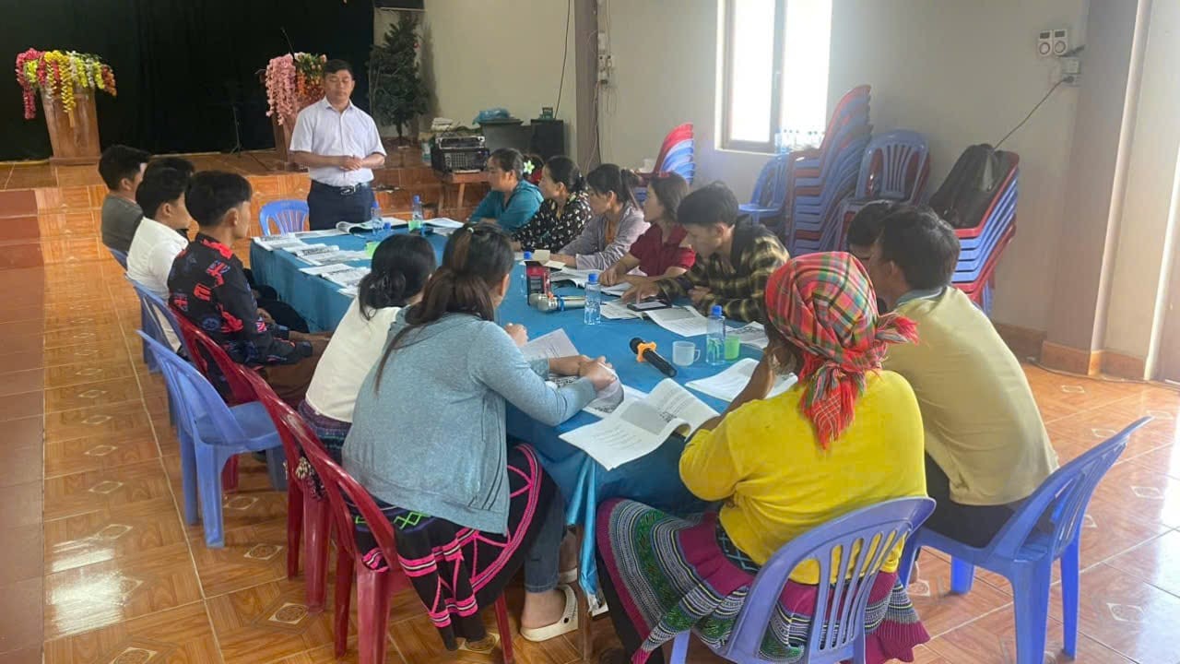
God’s plan flourishes in Vietnam
despite earthly setbacks
Notes:
Fourteen years ago, Hmong church leaders in Vietnam invited WELS to train their pastors in the gospel. Seven years ago, the Vietnamese government approved the construction of a theological education center in Hanoi. We knew that the Lord had opened a door for outreach, but we also knew that the door could close at any time. WELS World Missions worked quickly to take advantage of the time the Lord provided. And God’s work moved forward in ways we could have never predicted. We were able to build the building, but government regulations have kept us from using it for now. A former partner church began demanding practices contrary to Scripture. WELS’ partner church stood firm, losing government recognition in the process and delaying occupancy. Despite these challenges, ministry thrives. Over 160,000 Hmong believers now call themselves Lutheran, 55 pastors have been trained, and 120 more are in seminary-level studies. Without the building, training continues in rented spaces and online. Though red tape persists, we see God’s hand at work, growing the church beyond expectations. The delay has provided more time to strengthen faith and train leaders. We remain confident. We thought we needed that building. God knew we needed him—and him alone.
Read more: https://wels.net/gods-plan-flourishes-in-vietnam/
Stay up to date on progress at wels.net/asiaoceania.

Slide 26
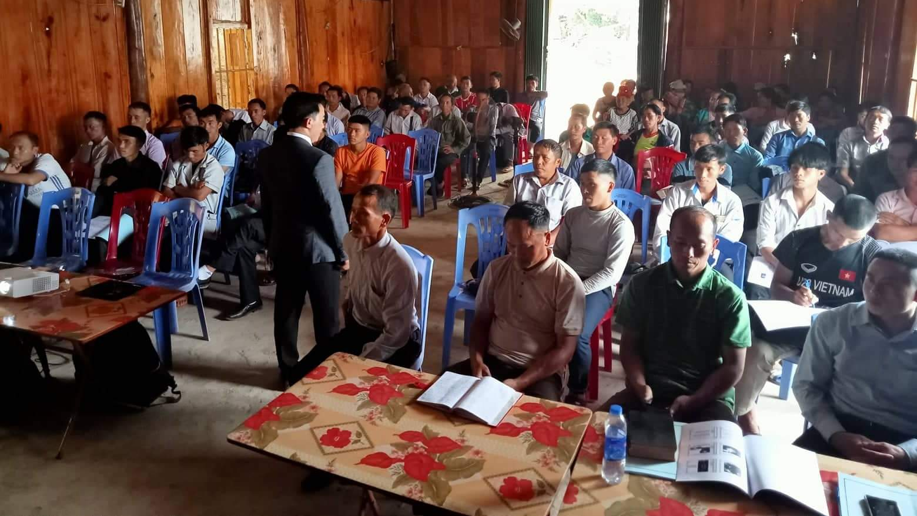
Rural training in Vietnam continues
Notes:
In addition to the seminary training being provided, a new rural training program developed by WELS missionaries Bounkeo Lor and Joel Nitz is training 700 rural church leaders in the basic truths of the Bible, with 700 more church leaders targeted for future training. Twelve of the new HFC graduates were commissioned to serve as instructors in the program
Online courses led by full-time professors Bounkeo Lor and Joel Nitz (pictured) continue to be taught to rural church leaders of the Hmong Fellowship Church (HFC) while residency visas for Lor and Nitz and HFC government registration are still pending.
Learn more at wels.net/vietnamhmongoutreach.

Slide 27
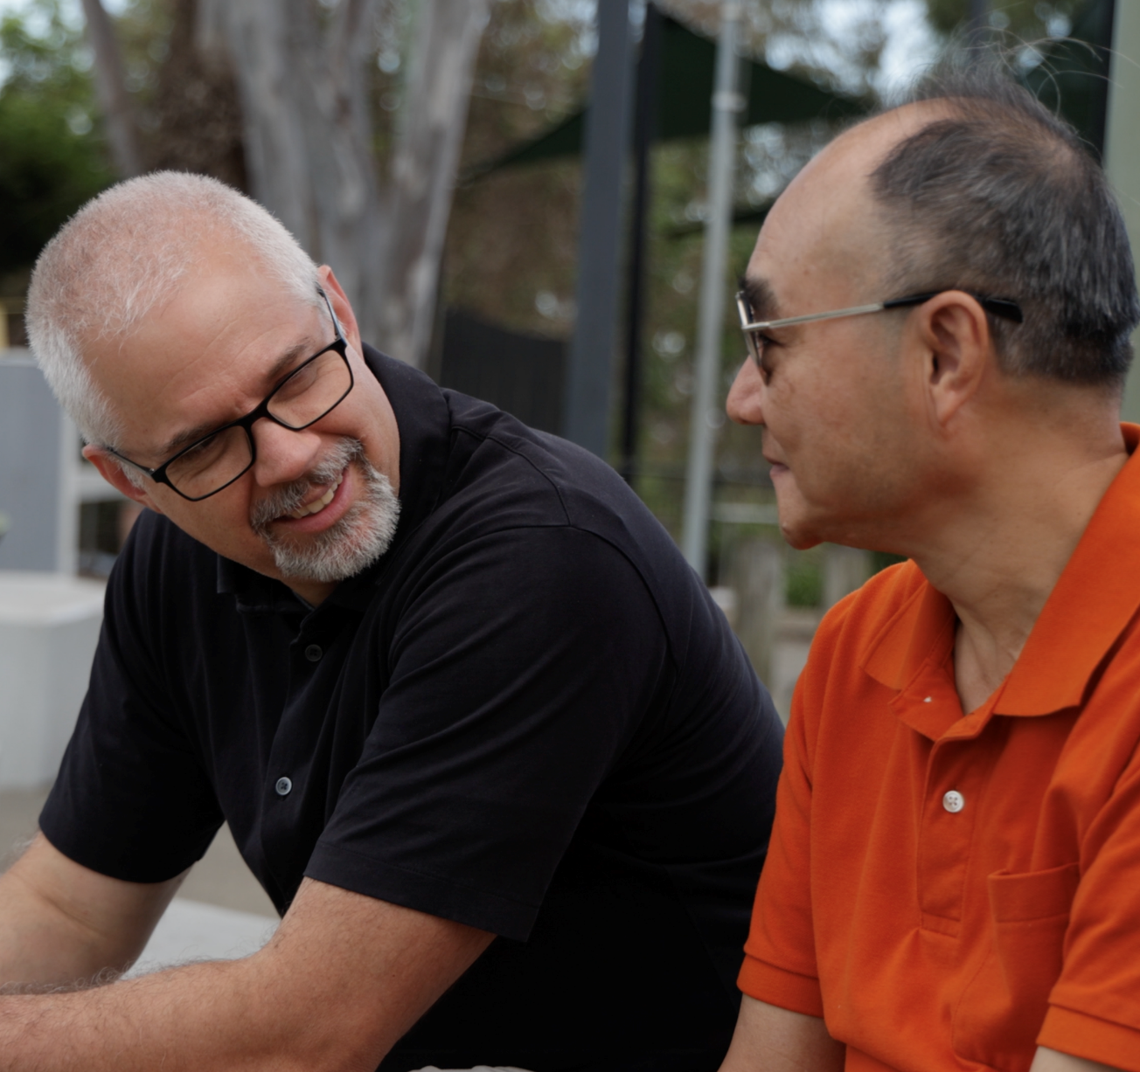
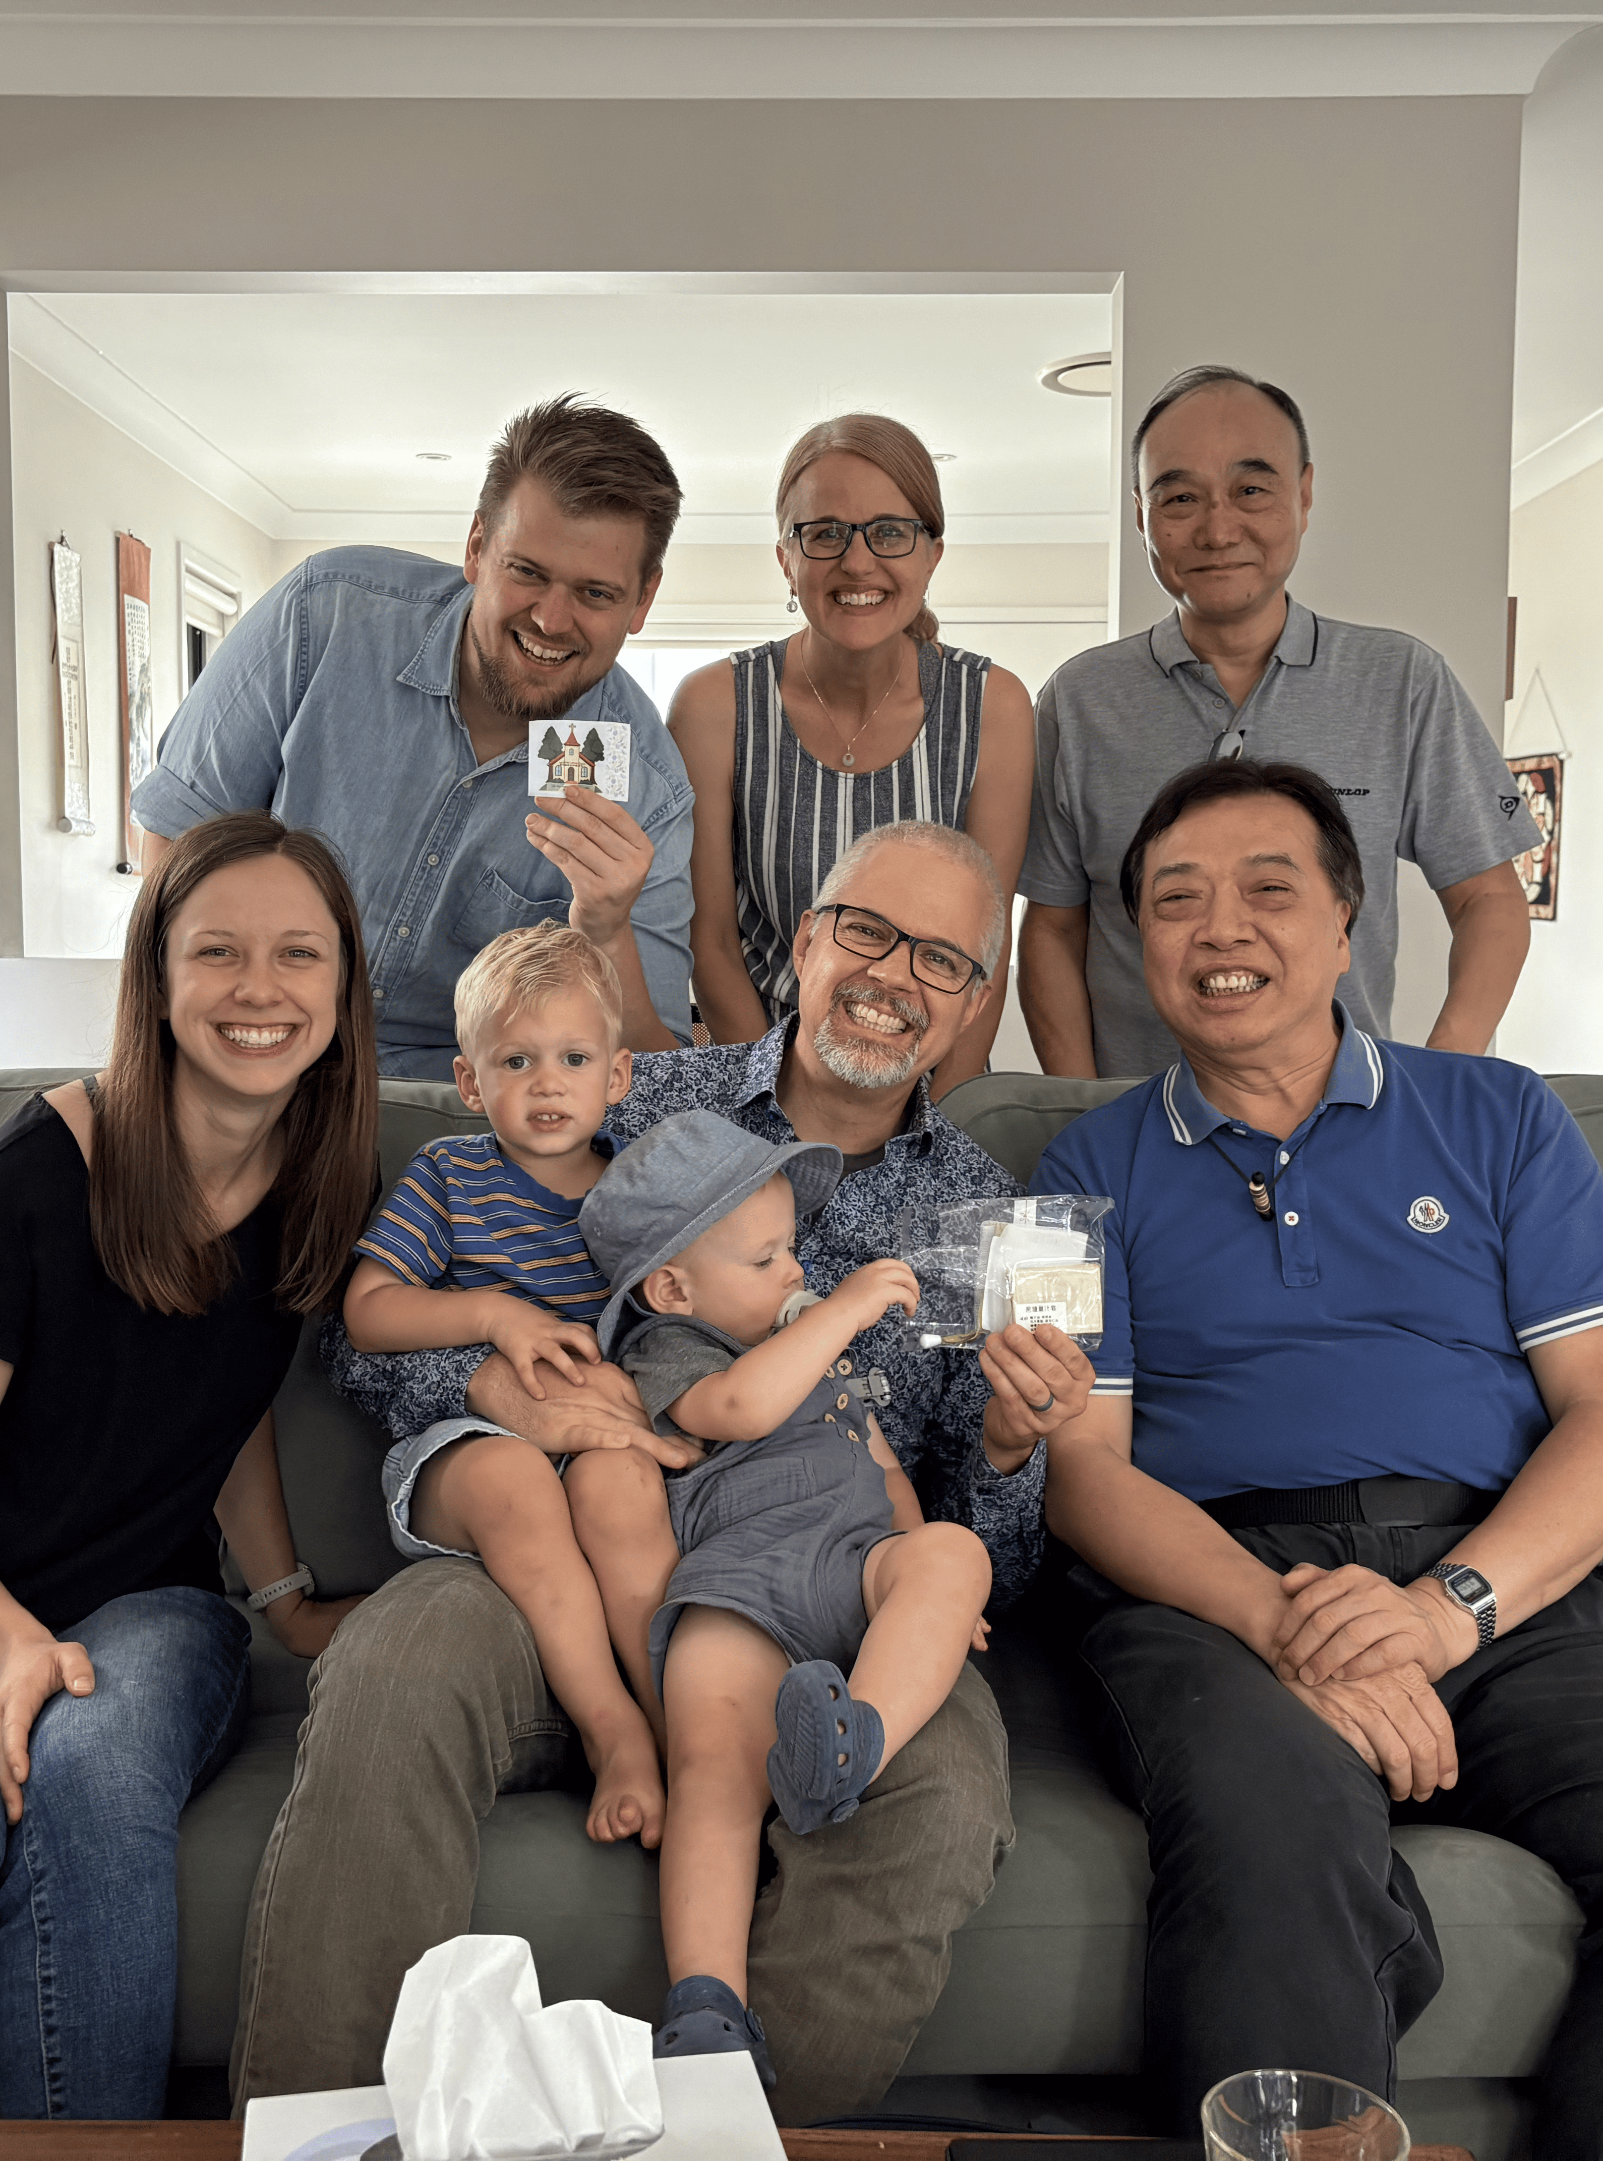
World Missions expands to Australia
Notes:
WELS has launched a new world mission effort in Australia. With a large focus on the country’s growing immigrant communities, two WELS missionaries and their families relocated to Brisbane, Queensland, in the summer of 2024 to plant the seeds of the gospel in a region that has been described as largely post-Christian. They are working closely with local congregations, Our Redeemer Lutheran Church in Brisbane and Fountain of Life in Maryborough, as a foundation for expanding ministry. With nearly 30% of Australia’s population born overseas and over 500,000 new immigrants arriving last year, there is an increasing need for spiritual community. The missionaries are focusing on relationship-building through neighborhood engagement, English language programs, and small gatherings of believers meeting in homes to study God's Word and share in fellowship (similar to early Christianity). The missionaries’ goal is to train and mentor local leaders to establish and lead house churches. This grassroots approach is already bearing fruit. In Melbourne, a new life group has formed, including believers from diverse backgrounds. The mission is still in its early stages, but meaningful connections are being established, planting the seeds for lasting faith communities. Follow along at wels.net/asiaoceania.

Slide 28
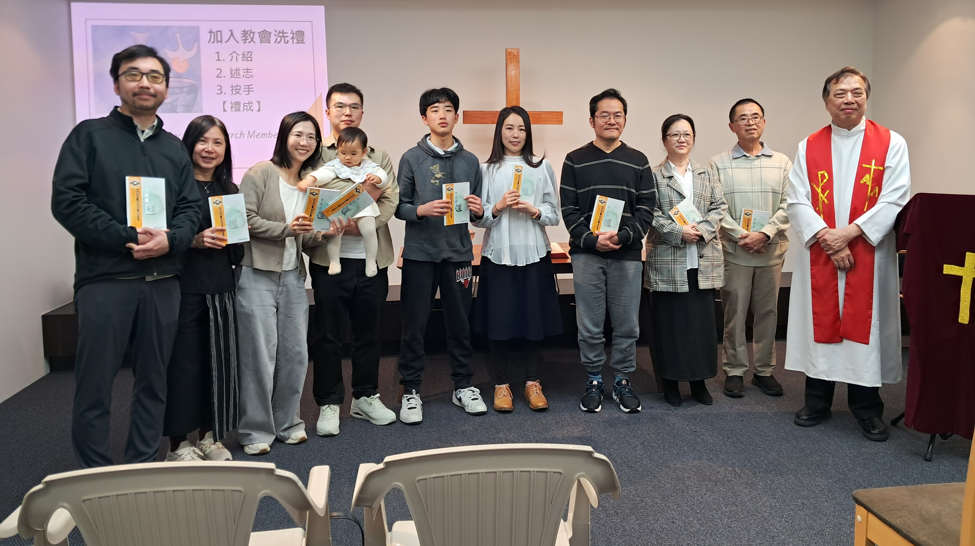
New mission work in New Zealand through SALEM
Notes:
Years ago, a few South Asian Lutheran Evangelical Mission (SALEM) members who immigrated from Hong Kong to New Zealand began meeting online with SALEM leadership for Bible Study and fellowship. This group, located in Auckland, has grown to over 20 members. In January 2023, they began a monthly worship gathering facilitated by local leaders. Rev. Titus Tse (pictured right), retired chairman of SALEM in Hong Kong, moved to New Zealand in mid-2025 to help lead this group. Pictured: Eleven people were welcomed into membership as founding members of SALEM New Zealand Lutheran Church, and two individuals (a child and adult) were all baptized during a service held in October 2025.
WELS is excited to continue assisting our sister church SALEM as they foster this new mission in New Zealand.

Slide 29
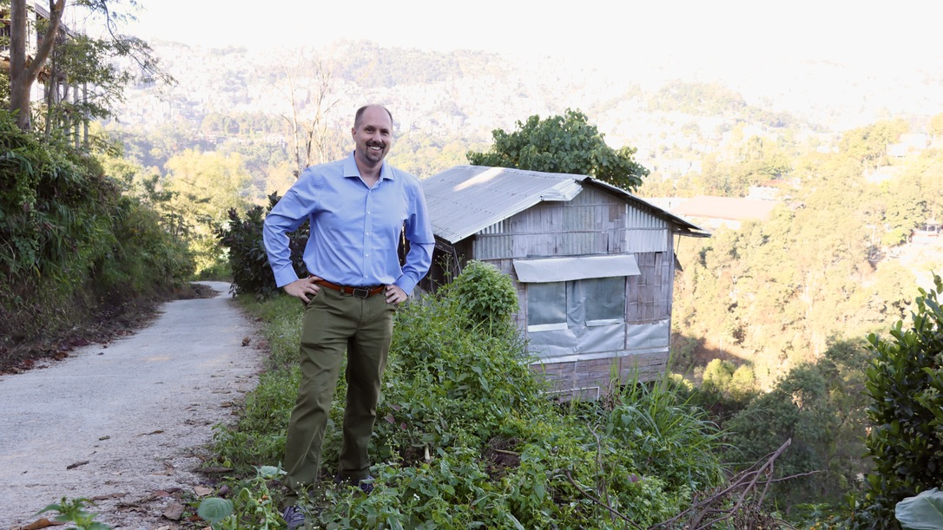
Mission work you won’t always see in Asia-Oceania
Notes:
In Asia-Oceania, a significant portion of our work happens in places where openly sharing details could put people at risk. Missionaries often travel to locations they cannot name, meeting with church leaders and believers whose identities must remain protected for their safety. These precautions are not about secrecy for its own sake, but about protecting brothers and sisters in Christ who may face persecution or danger if their connection to gospel outreach becomes known.
This means that the full story of God’s work in this region often goes unseen. Yet behind the scenes, believers are gathering around the Word, expressing joy in the gospel, and seeking fellowship with others who share their confession of faith.
While we may not be able to share names, locations, or images, we can confidently share that God’s mission is advancing, even in places where it must remain largely hidden for now.

Slide 30
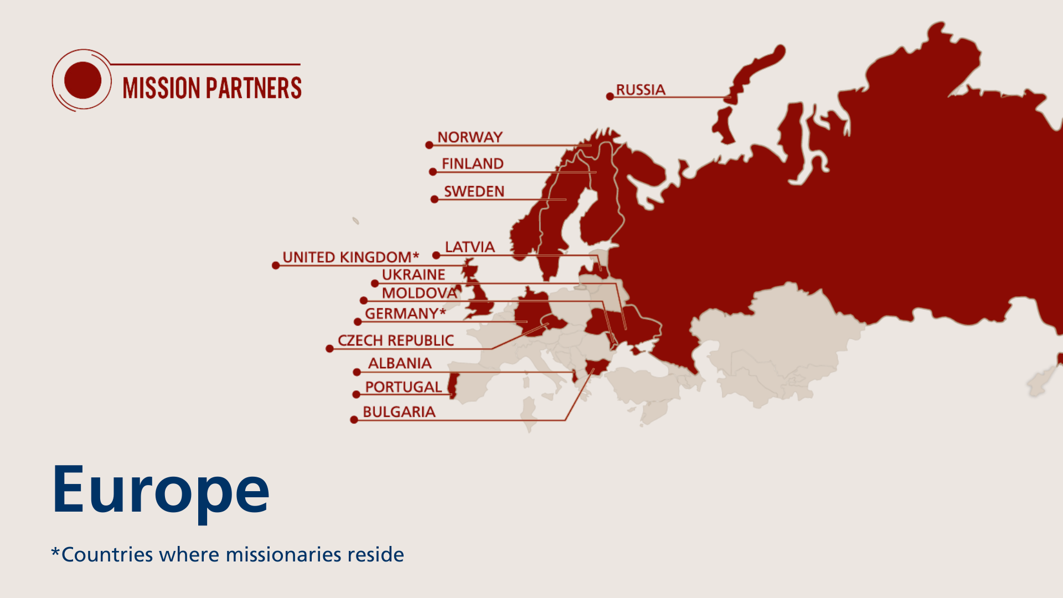
Notes:
The Europe mission team partners to share Christ’s grace across the continent, supporting gospel outreach and assisting with theological education and ministry training in 12 different countries. This work is carried out through collaborative ministry efforts with sister churches, grounded in a shared confession of faith. Three WELS missionaries reside in Europe.
Fast facts
Mission partners in 13 countries
3 missionaries

Slide 31
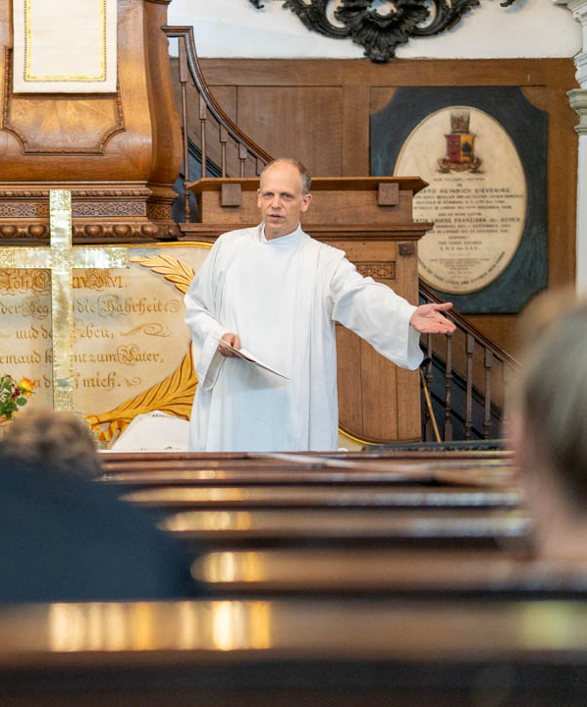
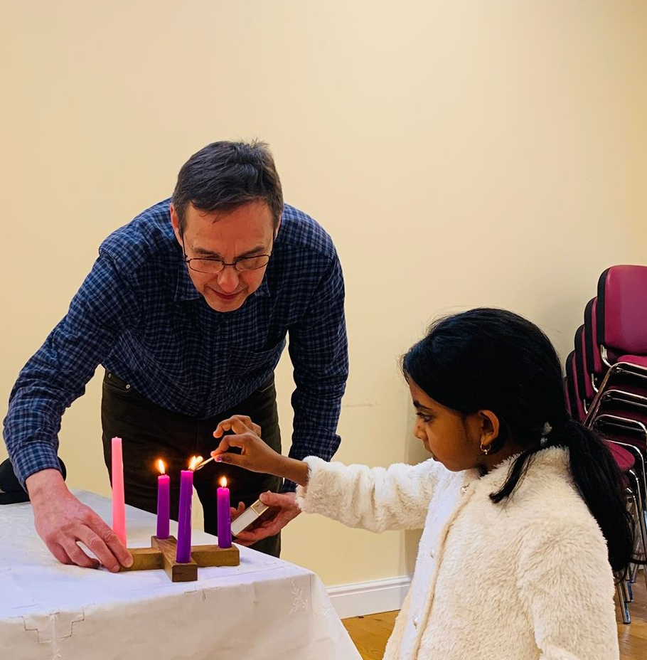
Mission work in London underway
Notes:
Mission work in the United Kingdom is centered in London, where Missionary Mike Hartman is leading outreach in one of the most diverse cities in the world. Through weekly worship, Bible study, and outreach such as hosting Bible-based book clubs in local pubs, Hartman is building relationships and connecting people from many backgrounds to God’s Word.
This growing ministry is expanding beyond London through new contacts and small-group gatherings across the country. One example is Lawrence McCatty (pictured right), who returned to the U.K. as a WELS Lutheran before missionaries were established and became part of the core group supporting this work. Today, he leads the group in Wolverhampton while training through the Pastoral Studies Institute.
Read more about Lawrence McCatty at https://wels.net/from-a-uk-baptist-to-a-confessional-lutheran-pastor/.

Slide 32
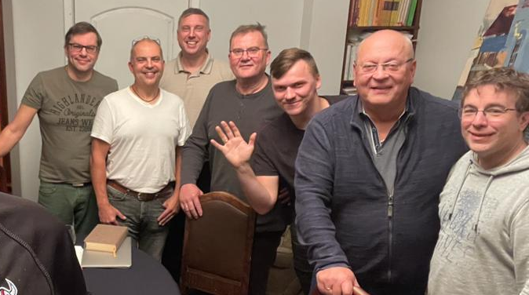
WELS-provided regional training through existing seminary programs in Europe
Notes:
Missionary Luke Wolfgramm and his wife Jennifer relocated to Leipzig, Germany, in summer 2023 which serves as a central base of operations for travel throughout Europe. Missionary Wolfgramm is working closely with Holger Weiß, the rector of the seminary of the Evangelical Lutheran Free Church in Leipzig (pictured right). Their goal is to make seminary training more available for students throughout Europe, including offering more classes in English, Europe’s common language. He and Weiß also provide continuing education for pastors in Europe.

Slide 33
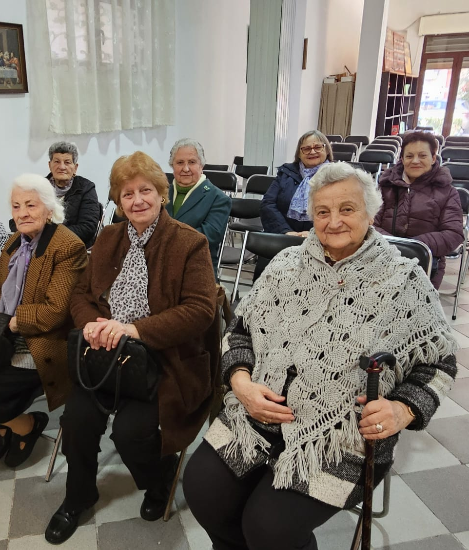
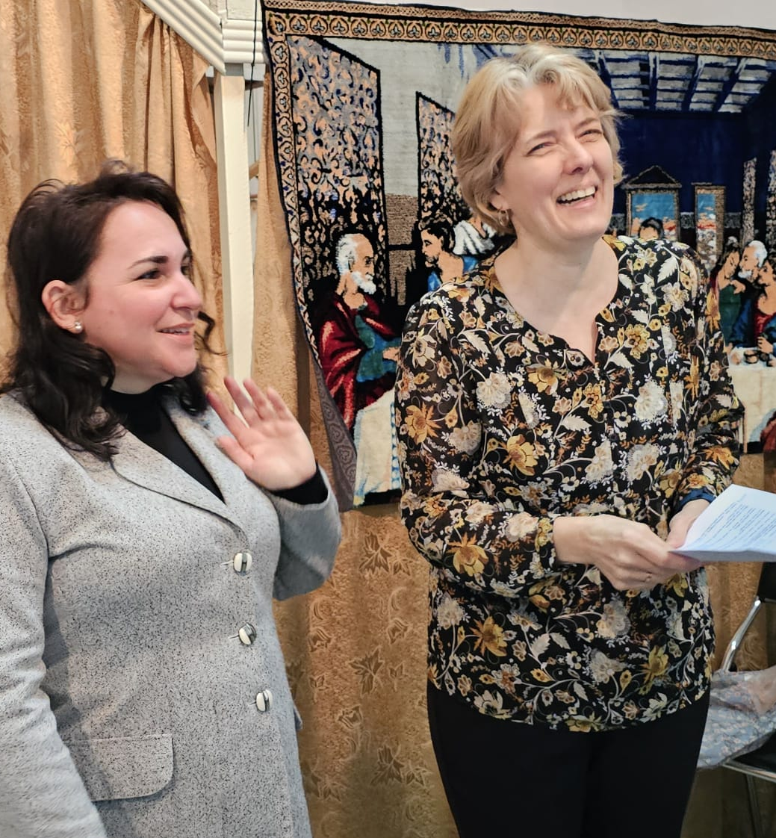
Jennifer Wolfgramm leads women’s ministry efforts across Europe
Notes:
Jennifer Wolfgramm, wife of Missionary Luke Wolfgramm, was recently called by the Europe Team to serve women in Europe. Jennifer travels with Missionary Wolfgramm, building relationships and learning about opportunities for women’s ministry in our sister churches on individual, congregational, and inter-European levels. As her role grows, she looks forward to engaging in more mentoring, teaching, praying with, and encouraging women across Europe.
Pictured: Jennifer Wolfgramm leads a new ministry opportunity for women in Albania. On Wednesday, February 25th, ten women gathered in Durrës for a dedicated women’s Bible study. The study created space for meaningful conversation and connection, and it was a positive experience for everyone involved. Jennifer looks forward to continuing these women’s Bible studies and strengthening faith-filled friendships whenever possible in her new role as Women’s Ministry Coordinator
While she led the women’s study, her husband, Missionary Luke Wolfgramm, partnered with Pastor Nikolla Bishka to prepare a Lenten Bible study series, with 31 people attending the first session led by Missionary Wolfgramm.

Slide 34
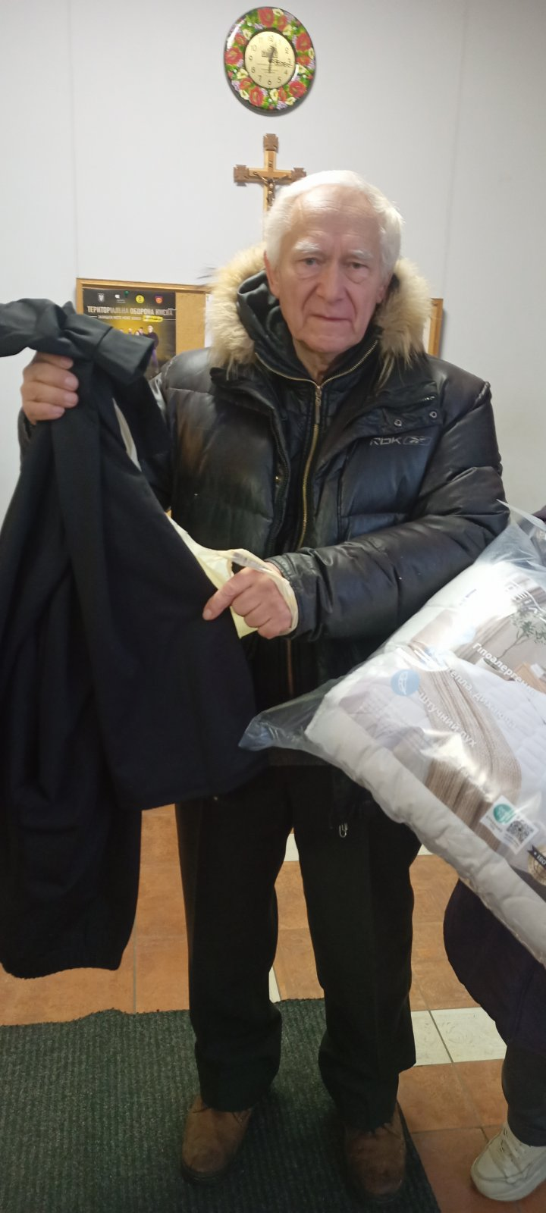
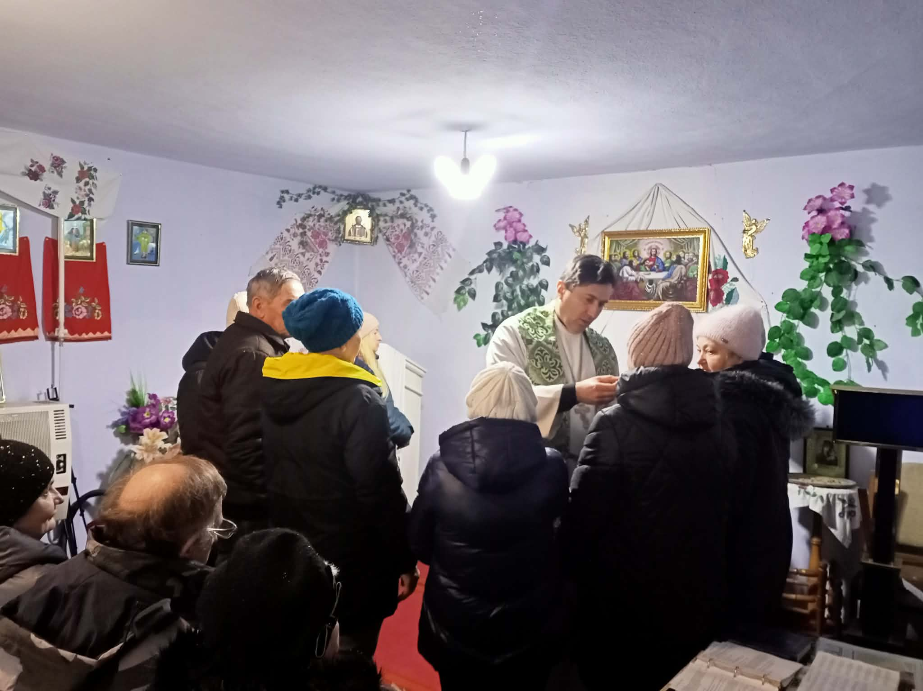
God’s work in Ukraine continues
Notes:
Even amid continuing war and widespread hardship, God’s work through the Ukrainian Lutheran Church (ULC) continues as congregations remain active in worship, mercy, and outreach. With support from WELS prayers and offerings, the ULC has been able to provide essential aid such as food, fuel, medicine, clothing, and heating supplies to congregation members and neighbors affected by displacement, winter conditions, and infrastructure damage. Rather than keeping this aid only for themselves, ULC members have shared generously within their communities, creating new opportunities for Christian witness. Through these works of love, many non‑Christians have come into contact with the gospel, leading new people to worship, instruction, and confirmation, even as pastors continue preaching, caring for the needy, and encouraging God’s people in the midst of ongoing instability.

Slide 35
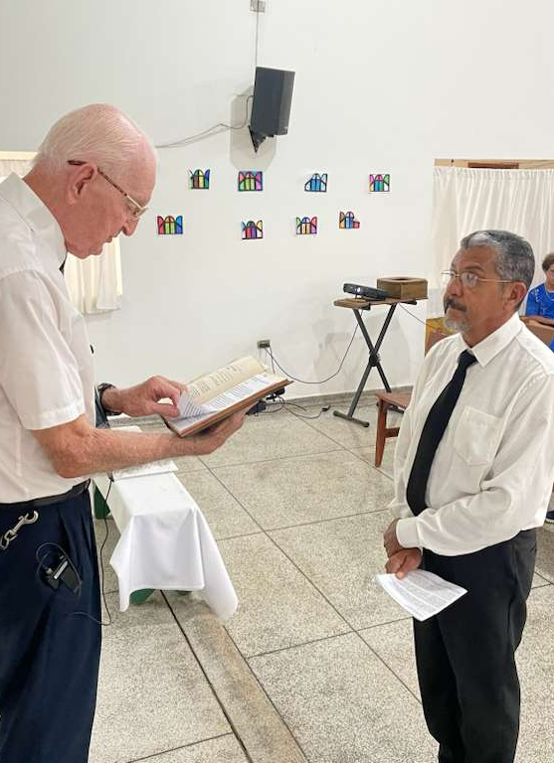
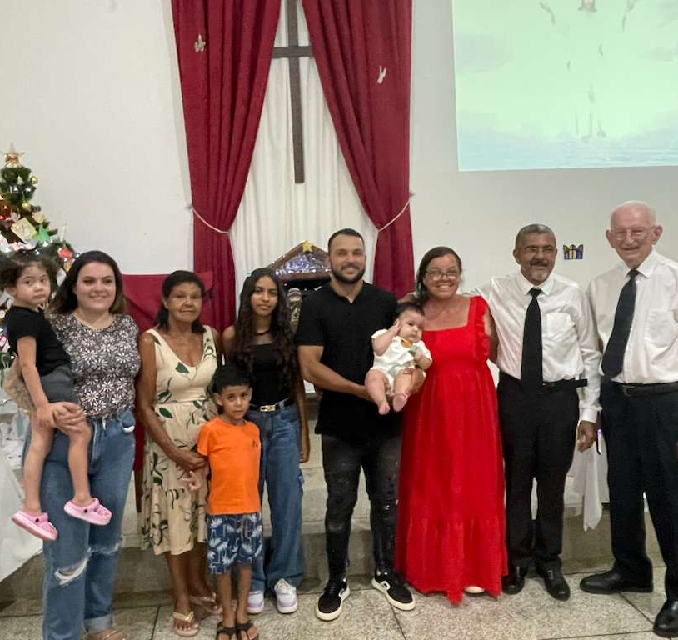
The Europe Team goes to Brazil
Brazilian pastor ordained, Missionary Flunker returns to the U.S.
Notes:
Global Lutheran partnerships continue to grow through intentional, on‑the‑ground engagement, including a recent visit to Brazil coordinated by the WELS Europe Team. During a December 2025 trip, Rev. Dr. Ken Cherney of Wisconsin Lutheran Seminary, who serves as liaison to Portuguese‑speaking churches, traveled across multiple regions to encourage congregations, support church leaders, and strengthen fellowship with the Lutheran Church of Portugal and the Brazilian Lutheran Church. The visit included the ordination and installation of Pastor Gilberto Andrade da Silva (pictured left), who is now serving geographically isolated congregations, as well as support and transition planning following the return to the U.S. of retired Missionary Charles Flunker (pictured far right) after years of faithful service in Brazil.
Read more: wels.net/the-europe-team-goes-to-brazil

Slide 36
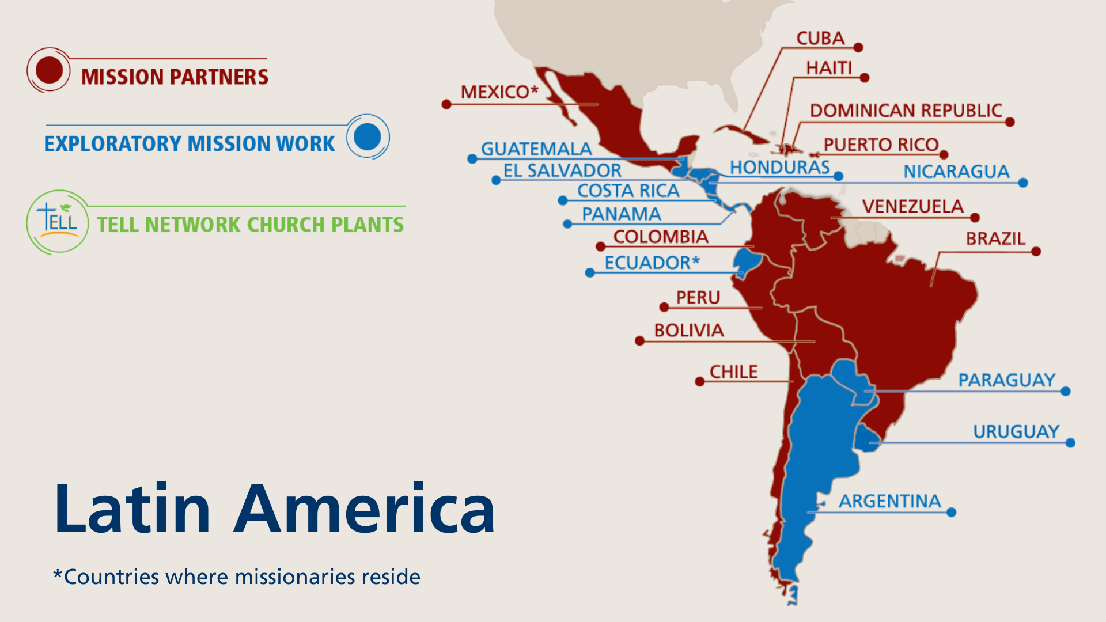
Notes:
The primary focus of the One Latin America Team is Academia Cristo. Academia Cristo is a multi-faceted effort which seeks to 1) make disciples in Latin America by sharing the message of God’s grace with as many people as possible, 2) identify and train potential church planters, and 3) encourage those church planters to make disciples who plant even more churches. The One Latin America Team uses social media to promote Academia Cristo throughout Latin America.

Slide 37
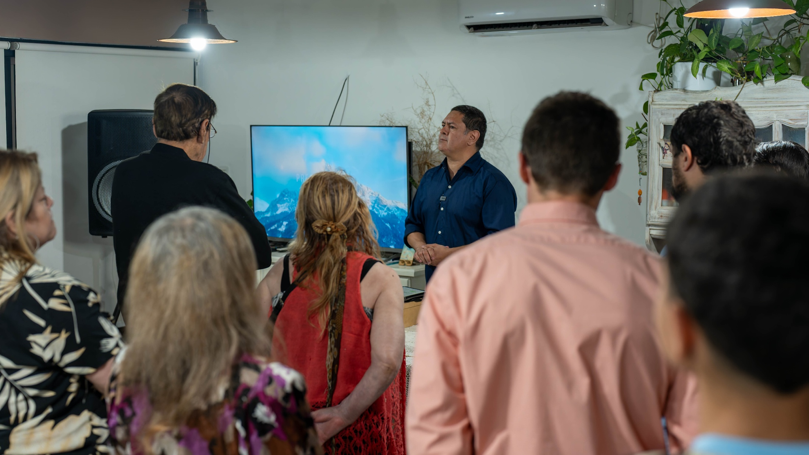
10 years of Academia Cristo
Notes:
Academia Cristo celebrated their 10 year anniversary in October 2024. The One Latin America Team’s new 10-year goals were set at their meeting that same month: 10,000 have finished at least one Discipleship Course; 1,000 Church Plants (Grupos Sembrador) planted; 100 Church Plants (Grupos Sembrador) have become congregations of Iglesia Cristo WELS Internacional.
Pictured: Academia Cristo student Luis Bello leads a Grupo Sembrador (church plant) in Barradero, Argentina. Around 30 people worship in his house every Saturday night at 8:30pm. He also does devotions with small groups every Tuesday, Wednesday, and Friday night with members of this group.

Slide 38
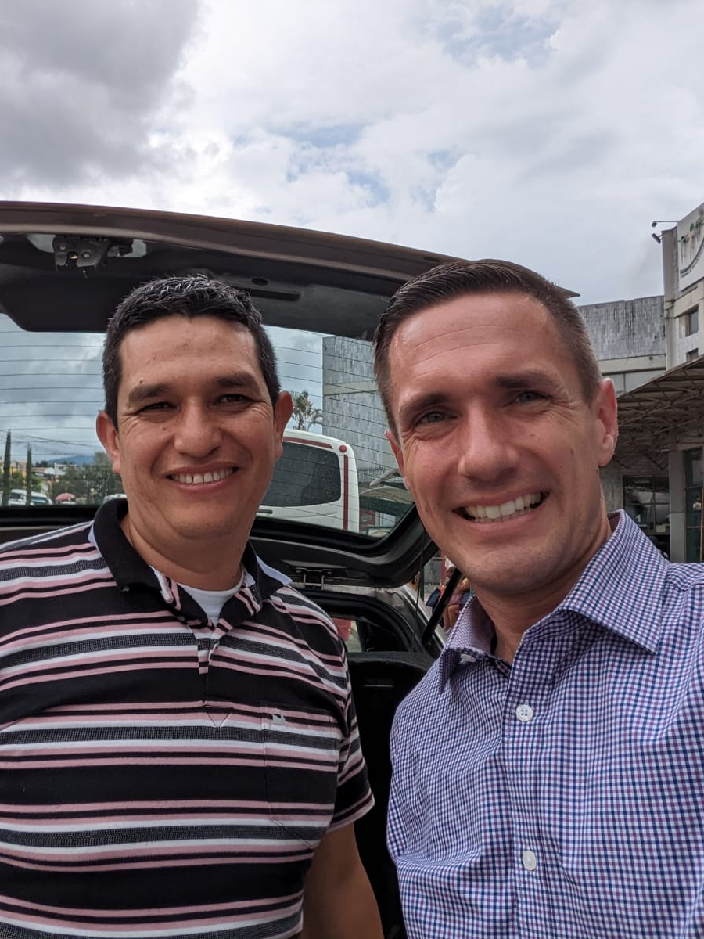
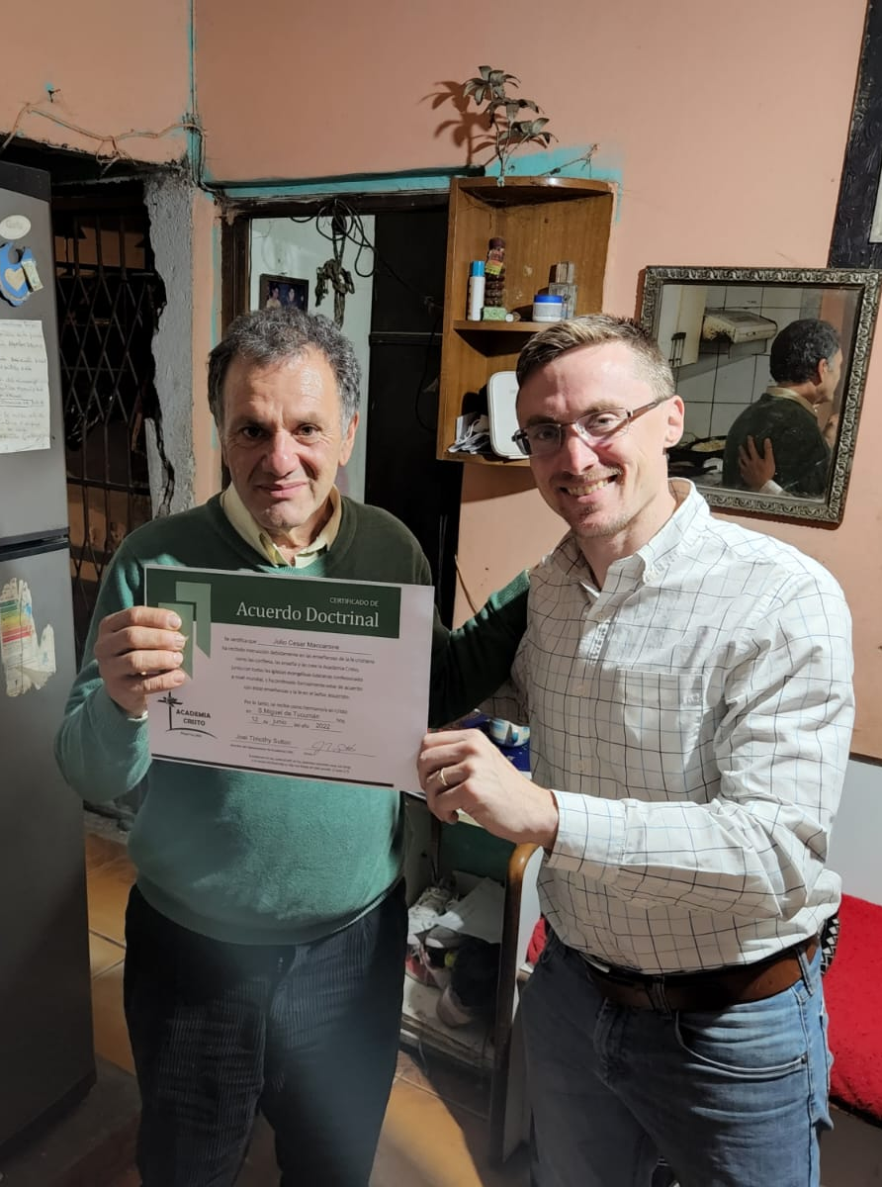
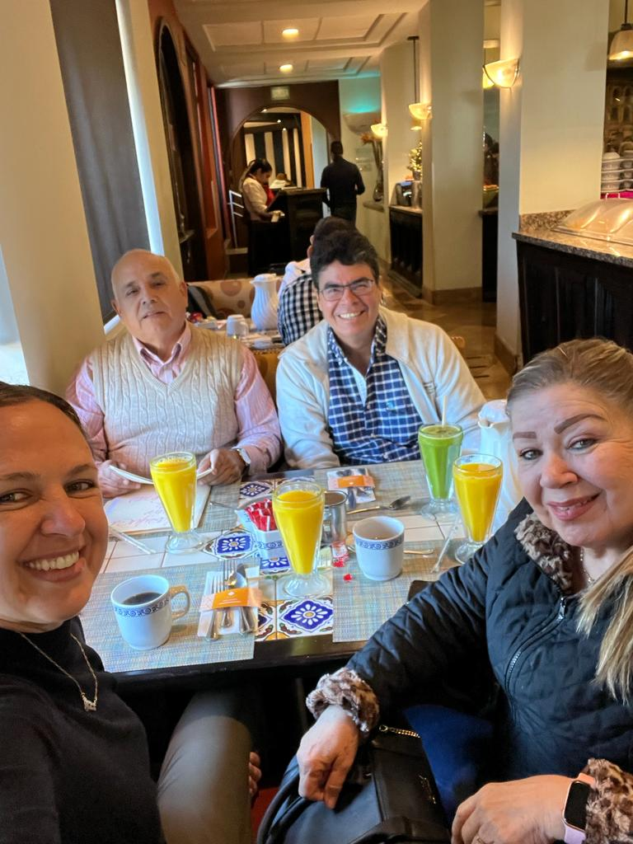

1,830+ students
Have completed at least one live Academia Cristo class online
Notes:
Pictured: Confirmands of Academia Cristo outreach efforts from across Latin America
Amazing blessings through Academia Cristo:
An average of 50+ students complete the Self-Study Level of courses each week
1,830+ students have completed one Discipleship Level live course
179+ students have completed the Discipleship Level (13 live courses)
57 Academia Cristo students are actively leading church plants (Grupos Sembrador)

Slide 39

Baptisms in Guayaquil, Ecuador
Notes:
The One Latin America Team continues to see strong, measurable momentum across the region, with 57 active church plants (Grupos Sembrador) currently being led by trained local leaders across Latin America.
Ecuador provides a clear example of this fruit. Missionary Nixon Vivar and Vicar Jonas Landwehr traveled to Guayaquil, Ecuador, in May 2026 to see firsthand the ministry of Academia Cristo at work through Silvia and Daniel’s church plant.
Each Saturday, Silvia and Daniel gather with their church plant at a community center to share God’s Word. Through these regular gatherings, many people—including children and young adults—have been led to learn more about God’s promises in baptism. On May 9, 2026, 42 children and young people were baptized (pictured). Vicar Landwehr had the special opportunity to perform his first baptisms, baptizing 13 children, while Missionary Vivar baptized 18 individuals and Daniel baptized 11.

Slide 40

Missionaries relocating to
capitalize on
mission opportunities
Notes:
To better support follow‑up, mentoring, and in‑person encouragement of emerging leaders, Missionary Luis Acosta has relocated from Doral, Florida, to Quito, Ecuador; Missionary Abe Degner is relocating from Asunción, Paraguay, to Quito, Ecuador; and Missionaries Joel Sutton and Matt Behmer (pictured), along with their families, have relocated to Mexico City.
This mobile hub concept is designed to allow the One Latin America Team to remain flexible to pursue emerging opportunities. It also keeps locations diversified in case of regional instability. Using this approach, the One Latin America Team will temporarily place missionaries in various locations. Mexico City has been chosen to serve as the first mobile hub due to feasibility of visas, efficient connections to the rest of the Latin America through its major airport, and the number of active students and church planters.

Slide 41


Women’s ministry in Latin America
continues to grow
Notes:
Elise Gross (pictured left) serves on the One Latin America Team as the Director of Women’s Ministry for Academia Cristo. Gross teaches online courses, supports those who are planting churches, and oversees the development of Women’s Ministry together with the Academia Cristo multiplication and instruction teams.
Examples of Women’s Ministry in Latin America:
Maria Luisa Fanarraga from Alto Laran, Peru, (pictured) is in doctrinal agreement and is already teaching two different groups.
On the banks of the upper Amazon, in Pucallpa, Peru, Amelia Torres purchased land in her hometown so that those she has been sharing the gospel with will have a place to gather.
Women from Buenos Aires and Montevideo, Argentina, connect for Bible study, encouragement, and prayer through WhatsApp led by Viviana Alejandra Vigna. Due to the distances between them, they meet in person twice a year to strengthen their bonds of faith and fellowship.
A group in San Jose, Costa Rica, led by Nathalie Hernández Arbur meets weekly for Bible study and gathers regularly for worship.
A group of women in Quito, Ecuador, worship together in their homes every weekend. During the week, they meet online via Zoom for Bible study led by Fabiola Guaman.
A married couple leads several small groups in Mexicali, Mexico, gathering in homes to study God's Word together.

Slide 42


Iglesia Cristo WELS Internacional welcomes new church plants into fellowship
Notes:
Iglesia Cristo WELS Internacional, WELS’ sister church, was formed in 2021 through the partnership of WELS sister churches across five countries throughout Latin America. This international synod is also where Academia Cristo church plants are welcomed into fellowship after completing a two-year confessional process to become full-fledged churches.
A maxillofacial surgeon in Cochabamba, Bolivia, named Eduardo Milanesi became an Academia Cristo student in 2020. In less than a year he finished the program, confessed doctrinal agreement, and started gathering a group in his medical office to study God’s Word. In February 2023, Eduardo completed the studies prepared for church planting groups and his group was received by Iglesia Cristo WELS Internacional as a congregation, the first Academia Cristo church plant to do so. He has now launched a second group in Santa Cruz (pictured right), recently gathering over 30 eager listeners to God’s Word.
The church group in Tenancingo, Mexico, led by Juan Reyes (pictured far left) was formed after Reyes learned God’s Word and how to share it through Academia Cristo. He began by sharing the gospel with his family in 2021, and the group has since grown to a congregation of about 45 members. In October 2025, the congregation was welcomed into fellowship with Iglesia Cristo WELS Internacional, WELS’ sister synod in Latin America, becoming the second church plant formed through Academia Cristo outreach to join the synod. Read more about Juan Reyes: https://forwardinchrist.net/juan-reyes/

Slide 43

Multiple languages to
multiply Christians around the world
Notes:
Multi-Language Productions (MLP) has created nearly three million video, audio, and print resources for use in global outreach. Materials have been translated into 56 languages to date—all to share the gospel message with people around the world.
MLP continues to expand well beyond conventional ways of reaching the lost, embracing emerging technology trends such as data-driven automation, e-learning, mobile websites, smart devices, and social media. Through these varied resources, MLP assists and enhances outreach and training for all world mission fields and national churches.
Traditional means of reaching the lost have not been forgotten. MLP continues to provide resources in different languages for people who don’t have access to the internet and technology, including ministry resources like The People’s Bible, textbooks, illustrated story cloths and posters, as well as worship and praise music.

Slide 44

Missionary Jon Gross – Innovation consultant
Helping teams use technology to spread the gospel
Notes:
Mr. Jonathan Gross serves as Innovation Consultant for WELS World Missions. He works with world mission teams and national church leaders to develop systems and sustainable strategies that expand gospel ministry around the world. His work includes guiding technology and training initiatives, building tools for collaboration across cultures and languages, and helping local leaders use digital resources to reach more people with the gospel.
One project he is currently working on is the Lutheran Leader’s Companion, a secure, multilingual platform that connects confessional Lutheran leaders across the globe. This platform enables verified leaders to teach, learn, and collaborate across languages using AI supported translation guided by theological glossary safeguards to preserve confessional accuracy.
Pictured: Missionary Jon Gross on a trip to WELS’ sister church in Dominican Republic in May 2026.

Slide 45



TELL Network:
Think. Evaluate. Learn. Lead.
Notes:
Multi-Language Productions (MLP) operates the TELL Network, an online training and church multiplication program. TELL Network provides Bible study curriculum focused on leadership training for students across the globe, preparing them to gather groups, lead Bible studies, and plant churches. TELL is both the program name and a representation of the method used to teach the Bible: Think, Evaluate, Learn, and Lead. The training method is customized across four programs offered in English, Mandarin, Spanish, and Tagalog.
Students gain knowledge and confidence to lead others to the saving message of the gospel using the straight-forward and easy to remember training method. Based off the original Academia Cristo (TELL Spanish) curriculum, TELL Network students complete video courses, participate in live Zoom courses with theologically trained instructors, and learn to lead groups in their own communities.
Fast Facts:
TELL is training students from 58 countries around the world; of these, many do not otherwise have a WELS presence.
More than 130 TELL Network students have been recognized for completing eight or more courses.
There are 38 advanced TELL students leading groups and starting churches.

Slide 46


TELL students in 30 countries across Africa
Seminars in Nairobi, Kenya
Notes:
Fast facts about TELL in Africa:
There are TELL students in 30 countries across Africa.
There are 46 students in the Multiplication Level of the program who are actively involved leading a group. They are located in Botswana, Ghana, Kenya, Liberia, Malawi, Nigeria, South Africa, Uganda, and Zimbabwe.
Five of the Multiplication Level students are in doctrinal agreement:
Opiew Adiew (Ethiopia)
Patrick Charo (Joined WELS’ sister church, LCMC-Kenya)
Frank Mazinga (Malawi)
Francis Mwangi (Joined WELS’ sister church, LCMC-Kenya)
Abraham (Joined WELS’ sister church, Obadiah Lutheran Synod in Uganda)
Pictured: In October 2025, TELL participants from across Kenya gathered in Nairobi for two intensive seminars led by WELS missionaries Jake Vilhauer (pictured left) and Joel Hoff (pictured right), allowing students who had previously studied together only online to meet face to face and deepen their understanding of key scriptural teachings, including Baptism as a means of grace. The seminars also outlined next steps for the program, as students prepare to serve as growth group leaders and potential church planters in their own communities. Read more: wels.net/face-to-face-for-the-first-time/

Slide 47

Notes:
TELL English student enrollment is growing fast with more than 500 active students. TELL depends on its teachers to guide leaders-to-be in the foundational truths needed to share the gospel.
As part of the TELL Faculty, non-missionary TELL instructors are given an honorarium. If you are a mission-minded pastor, have some tech sense and aware of cross-cultural relationships, TELL is in desperate need of your skills to meet the needs of our ever-expanding student body. Most TELL courses average three hours per week for six weeks. The TELL registrar and staff handle most of the administration. Between teaching LIVE Classes, TELL Instructors message their students using WhatsApp. After classes are complete, the instructor collects and grades students’ final projects.
If you are interested in teaching for TELL, you are invited to attend a live orientation with a member of the TELL team. Contact TELL Network at ask@tellnetwork.org for more details or visit teach.tellnetwork.org.

Slide 48

Notes:
The Apache mission in Arizona celebrated 125 years of God’s blessings in 2018 as the first world mission of WELS. Today, WELS’ Native American mission serves nine churches and two elementary schools, and it provides theological education through the Apache Christian Training School (ACTS) on the White Mountain and San Carlos Apache reservations in Arizona. New Native American outreach is also occurring in the Four Corners area of Arizona, New Mexico, Utah, and Colorado through the Native Christians Network.
Fast facts
Baptized members: 2700+
Congregations/preaching stations: 9
K-8 schools: 2
Missionaries: 6 (1 Apache)
Teachers: 17 (5 Apache)
Apache Christian Training School students: 60

Slide 49

Native Christians Network stands ready to reach out with the gospel to the 574 Native American Reservations throughout the U.S.
Notes:
Pictured: Members of the Native Christian Team met for their annual meeting/retreat in July 2025. Attendees included the missionaries, national pastors and lay leaders, teachers at the two schools on the Apache reservations in Arizona, and their families. WELS World Missions representatives were also in attendance.

Slide 50

Training through the Apache Christian Training School (ACTS)
Notes:
The Apache Christian Training School (ACTS) provides theological courses to train and equip Apache members for ministry. The program offers a wide variety of in-depth Bible studies designed to strengthen faith and prepare individuals for leadership roles within their local congregations. In addition to classroom work, participants can practice and model ministry in their home congregations. The program trains men to serve as pastors, evangelists, and deacons, while women may study to serve as deaconesses. Additionally, it prepares individuals to become certified Lutheran teachers and lay leaders within their churches.
Pictured: In July 2025, the Apache Christian Training School and the Native Christians Network hosted a presentation featuring Aaron Newman, a Marine Corps veteran and active member of Christ the Rock Lutheran Church in Farmington, New Mexico. The event focused on Newman’s journey of integrating his Navajo heritage with his Christian faith, offering a deeply personal reflection on the challenges Native Christians face—including cultural pressures and misconceptions about faith. Held as part of ongoing efforts to equip Native American leaders for ministry, the gathering brought together mostly Apache participants for a time of mutual encouragement and spiritual growth. Newman’s testimony, grounded in Scripture and lived experience, emphasized that being Christian does not mean abandoning Native identity.

Slide 51

Partnering with a new nonprofit to support Native American wellness through peer support and community education on reservations around the country
Notes:
WELS’ Native American mission is partnering with the Native Strength Network, a 501(c)3 nonprofit organization that seeks to address the mental health crisis in Native American communities by re-establishing peer recovery groups that offer culturally relevant support and foster community resilience.
After many months of prayer, planning, conversations, fundraising, and preparation, the first peer support cohort is set to begin training in June 2026. These men and women are preparing to take an important step. They will begin the training and certification process to become peer supporters, so they can walk alongside others in their own communities who may be facing addiction, grief, depression, anxiety, trauma, loneliness, or other life challenges.
Learn more at https://nativestrength.net/

Slide 52

Native American outreach in the
Four Corners region
Notes:
Missionary Nathan Wagenknecht accepted the call to serve as Outreach Counselor on the Native Christians team in 2024. He coordinates outreach to the Native American tribes in the Four Corners area of Arizona, New Mexico, Utah, and Colorado, working closely with Native members who want to reach out to other Natives with the pure gospel message. He is also leading the expansion of digital outreach and ministry training efforts for the Native Christians Network.
Pictured: Missionary Wagenknecht and Navajo members at Christ the Rock in Farmington, NM, partnered with the Native Strength Network to host a booth at Riverfest in Farmington in May 2025.

Slide 53


Hellos and goodbyes on the
White Mountain Apache Reservation
Notes:
In May 2025, Pastor Dave and Jo Bostedt (pictured left) concluded eight years of ministry on the White Mountain Apache Reservation, serving the congregations of Canyon Day and East Fork. Their retirement was marked by a congregational celebration of gratitude.
On August 3, 2025, Pastor David Wietzke was installed as the new pastor for these congregations (pictured right). The installation service included participation from all Apache congregations and marked the beginning of Wietzke’s ministry in Arizona. He previously served congregations in Wisconsin, Nebraska, and Colorado.

Slide 54


Join us at Taste of Missions for the commissioning of
five new world missionaries
Notes:
Taste of Missions
Saturday, June 13, 2026 | Wisconsin Lutheran Seminary, Mequon, Wis.
Register today for Taste of Missions, a celebration of gospel outreach and the commissioning of new home and world missionaries. Enjoy a special commissioning worship service, ethnic cuisine from mission fields, fellowship with fellow attendees, and firsthand accounts from missionaries about their work.
Five world missionaries are confirmed to be commissioned at Taste of Missions:
Ms. Louisa Felgenhauer – Peridot-Our Savior’s Lutheran School, San Carlos Apache Reservation, Ariz.
Rev. Stephen Gerling - Missionary, Senegal
Rev. Dan Kroll – Missionary, Senegal
Ms. Cindy Lendt – Women’s ministry coordinator, Asia-Oceania Team
Dr. Chris Pluger – Missionary, One Africa Team
If you can’t attend in person, tune into the livestream and join us virtually!
Learn more and register at tasteofmissions.com.

Slide 55

Notes:
Speakers: World Missionaries, Board for World Missions members, and other World Missions representatives are willing and able to present on WELS World Missions at your next church Mission Festival, LWMS circuit rally, school assembly, or small group gathering. Fill out a request at wels.net/speaker-request to find a speaker for your event.
Social Media: Follow us on Facebook and Instagram @WELSmissions
E-Mails: Subscribe to Missions emails at wels.net/subscribe.
Faces of Faith: The new edition of Faces of Faith is now available. This is a great overview of the work we’re doing in Home and World Missions.
It is available online and by request at wels.net/facesoffaith. Any congregation OR LWMS circuit is welcome to request up to 50 copies of the magazine, and we are also offering 100 Missions in 10 Years brochures and large home and world mission maps (24” x 36”) free of charge. Note – Faces of Faith is automatically sent to any congregation hosting a Mission Festival.

Slide 56

New interactive Google maps on wels.net
Notes:
New, interactive Google maps that feature mission partners and exploratory mission work in various parts of the world can now be viewed on the regional World Missions pages on wels.net:
Africa: wels.net/africa
Asia-Oceania: wels.net/asiaoceania
Europe: wels.net/europe
Latin America: wels.net/latinamerica
Native American Missions: wels.net/nativeamerican

Slide 57

Notes:
WELS Mission Journeys provides an opportunity for all WELS members to walk together in the Great Commission. Through service opportunities in WELS mission fields at home and abroad, members can engage in Christian service. While volunteering, the learning and sharing of outreach ideas will allow individuals and teams to explore how they can use their God-given abilities to engage in outreach activities in their local communities upon their return home. With the Lord’s blessing, these trips will inspire a lifelong journey of service and outreach for all who volunteer.
Learn more at wels.net/missionjourneys.

Slide 58

Notes:
Pray. Ask God for more opportunities to reach those who don’t know Jesus Christ as their Savior from sin.
Share. Tell others about the work WELS is doing in the United States and around the world.
Discover. Subscribe to Missions emails at wels.net/subscribe and follow us on Facebook and Instagram @WELSMissions. Learn more at wels.net/missions or e-mail missionspromotions@wels.net with questions.
GIVE – Visit wels.net/missionsgift or mail checks with your preferred mission designation (e.g. Home or World Missions) in the memo field to:
WELS, Attn. Gift Processing
N16W23377 Stone Ridge Drive
Waukesha, WI 53188

Slide 59
“My name will be great among the nations, from where the sun rises to where it sets. In every place incense and pure offerings will be brought to me, because my name will be great among the nations,” says the Lord Almighty.”
Malachi 1:11

