Slide 1


Mission partners in 49 countries
Prospective mission fields in 16 new countries
47 missionaries (and counting!)
500+ national pastors
400+ students in theological training
WELS WORLD MISSIONS
Notes:
7.6 billion people inhabit this earth. 362 million of those reside in the United States and Canada.
We have before us the largest mission field the world has ever seen.
WELS World Missions conducts and encourages gospel outreach in 49 countries and is exploring outreach opportunities in 16 prospective new mission fields. World Missions brings the light of God’s Word to the world through evangelism efforts, church planting, training national workers for ministry, and providing religious materials in foreign languages. 47 world missionaries partner with over 500 national pastors to conduct outreach and train more than 400 students for service in Christ’s kingdom.

Slide 2
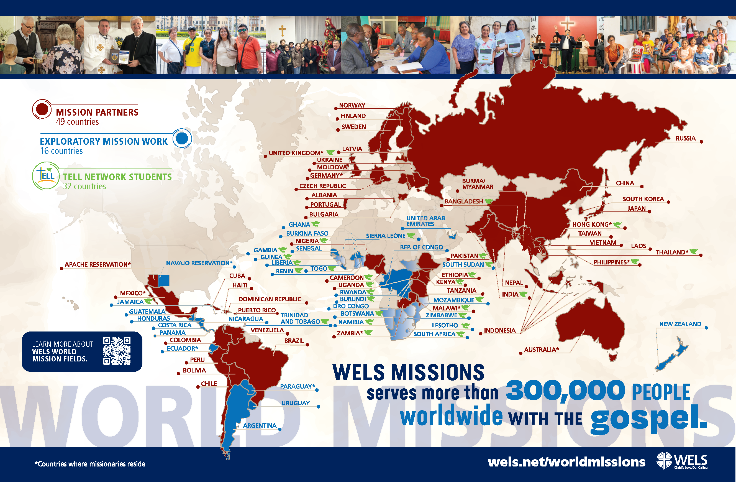
Notes:
World Mission supports mission work:
in Africa, where missionaries partner with national church bodies in eight countries and are exploring outreach in 10 additional locations throughout the continent;
in Asia-Oceania, where 17 missionaries partner with God’s people to equip, encourage, and empower others to bring the good news of Jesus Christ to the billions still lost in darkness;
in Europe, where missionaries partner with national churches to train the next generation of church leaders and bring the true gospel to countries without a strong Lutheran presence;
in Latin America, where tens of thousands of people are being reached through Academia Cristo online courses and more than 35 individuals are actively leading a group in worship and study;
through Multi-Language Productions, which has produced materials in 56 languages and reaches tens of thousands of English-speakers in 32 different countries through the TELL online training platform;
and on Native American reservations, where the gospel is being shared on the Apache reservations in Arizona and the Native Christian Network has begun outreach to additional tribes.

Slide 3

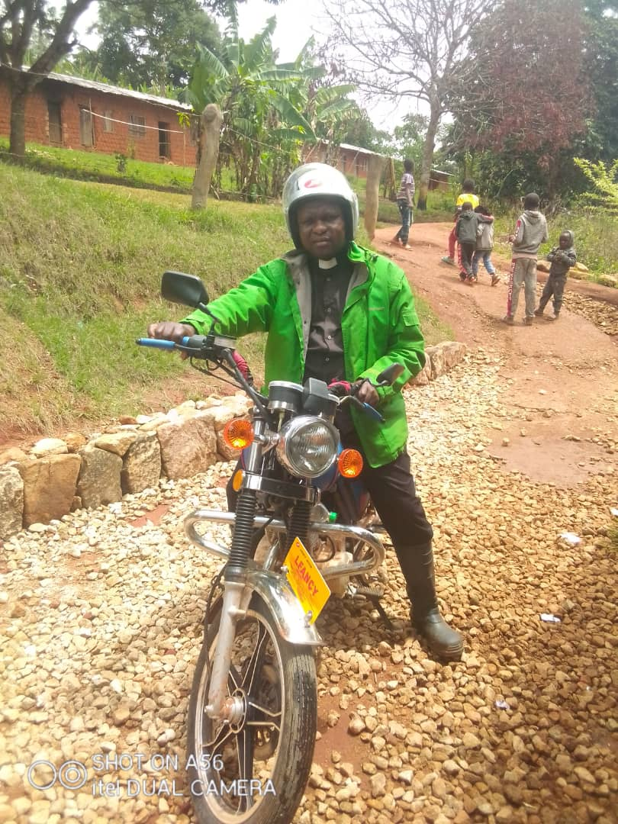
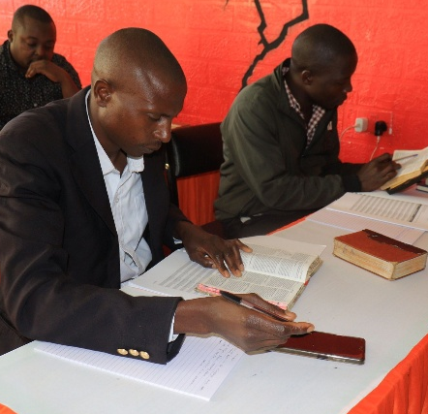
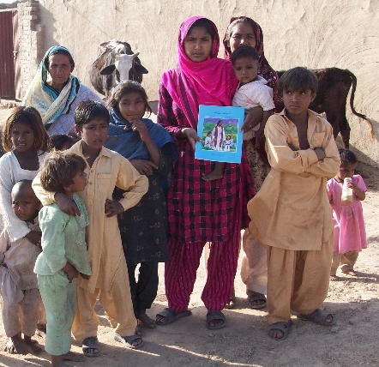
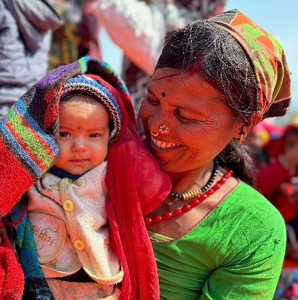
WELS Long-Range Plan: Bringing Christ to the Nations
Forge a borderless support network
Equip a global missionary force
Establish Confessional Lutheran seminaries
Expand multi-language mission efforts
Pioneer missions in high-risk and unreached areas
Notes:
The “Christ through us” Long-Range Strategic Plan was adopted at the 2025 Synod Convention. This issues-based strategic plan names four strategic priorities—Culture, Congregations, Commission, and Calling. Each priority offers a rationale for its urgency, followed by goals—tangible steps showing how, by God’s grace, we will meet these trials. Priorities frame the struggles; goals forge the path.
The “Commission” priority affirms the synod’s commitment to global gospel outreach through WELS World Missions. As the church responds to the spiritual needs of billions who have yet to hear the gospel, this priority calls for bold, Spirit-led action to expand confessional Lutheran witness across continents. The following five goals guide this effort:
Forge a borderless support network: We aim to build a global, cross-border network of generosity and collaboration by partnering with confessional Lutheran church bodies worldwide, equipping pastors and congregations to thrive in gospel ministry beyond traditional U.S.-based support.
Equip a global missionary force: We seek to train indigenous leaders from partner churches around the world to serve as missionaries in their own regions and beyond, shifting from a model of dependence to one of global partnership that strengthens outreach both abroad and in North America.
Establish Confessional Lutheran seminaries: We plan to plant seminaries in strategic global locations to train pastors and leaders with theological depth and Lutheran fidelity, ensuring a strong, sustainable gospel witness rooted in Scripture and the Lutheran Confessions.
Expand multi-language mission efforts: We aim to strengthen global gospel outreach by translating and distributing confessional Lutheran materials in native languages through print, digital media, and theological publications, ensuring doctrinal clarity and deep-rooted faith across diverse mission fields.
Pioneer missions in high-risk and unreached areas: We seek to bring the gospel to the most spiritually isolated regions by developing tailored strategies—such as underground networks, business-as-mission models, and digital outreach—and training workers to serve faithfully in places where Christ’s message is least known.

Slide 4
WELS and the world
WELS
Rest of the world
Goal:
330,000 members
300,000+ members
1,000,000
members
1,200 pastors
500+
pastors
Notes:
As part of the “Commission” priority in WELS’ Long-Range Strategic Plan, the synod envisions a bold expansion of its global gospel outreach—one that culminates in a vibrant fellowship of one million believers inside and outside North America by 2035. From the 150,000 believers in Vietnam to the anticipated 50,000 in Tanzania and thousands more across Latin America, this isn’t just a numeric milestone—it’s a growing family of faith. The strategic plan supports this vision through their five interwoven goals.

Slide 5

Notes:
Video link: https://wels.net/wels-world-missions-until-every-nation-knows-his-love/
“My name will be great among the nations,” says the Lord Almighty. Today, that promise is taking root in places both expected and unexpected—through the mission God has entrusted to his people.
Across Africa, Asia-Oceania, Europe, Latin America, and Native American communities, WELS World Missions partners with local believers to plant churches, train leaders, and share the gospel in heart languages around the world. It’s not just a mission to the nations—it’s a movement with the nations.
Through your prayers and support, local leaders are reaching their own people and crossing borders with the good news. Seminaries are equipping faithful shepherds. Digital tools are proclaiming Christ where missionaries can’t go. Together, we proclaim his name—until every tribe, tongue, and nation knows the love of the Lamb.
This is not our mission. This is God’s mission. And by his promise, it cannot fail.
Consider sharing this short video with your congregation!

Slide 6
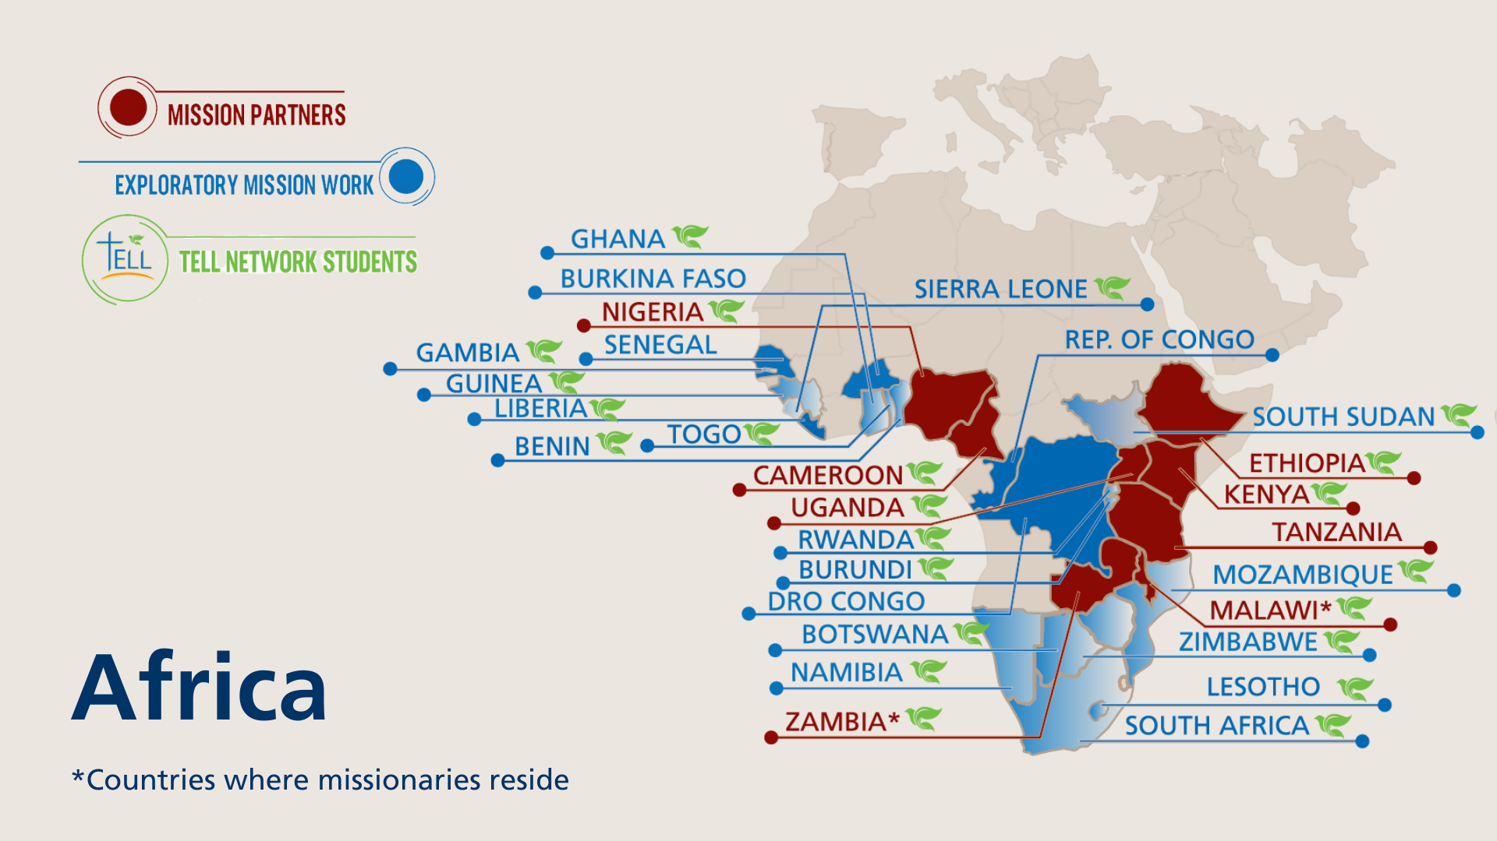
Notes:
The WELS One Africa Team currently works with established church bodies in Cameroon, Ethiopia, Kenya, Malawi, Nigeria, Tanzania, Uganda, and Zambia, partnering in outreach and assisting with theological education programs. The team is also working with groups, exploring outreach, and following up on promising contacts identified through Multi-Language Production’s TELL program in 20 additional African countries. Eight missionaries serve on the One Africa Team and an additional Multi-Language Productions missionary based in Zambia oversees the TELL Africa program.
Fast facts
Mission partners in 8 countries
Exploratory mission work in 5 additional countries
9 missionaries
TELL students in 23 African countries

Slide 7
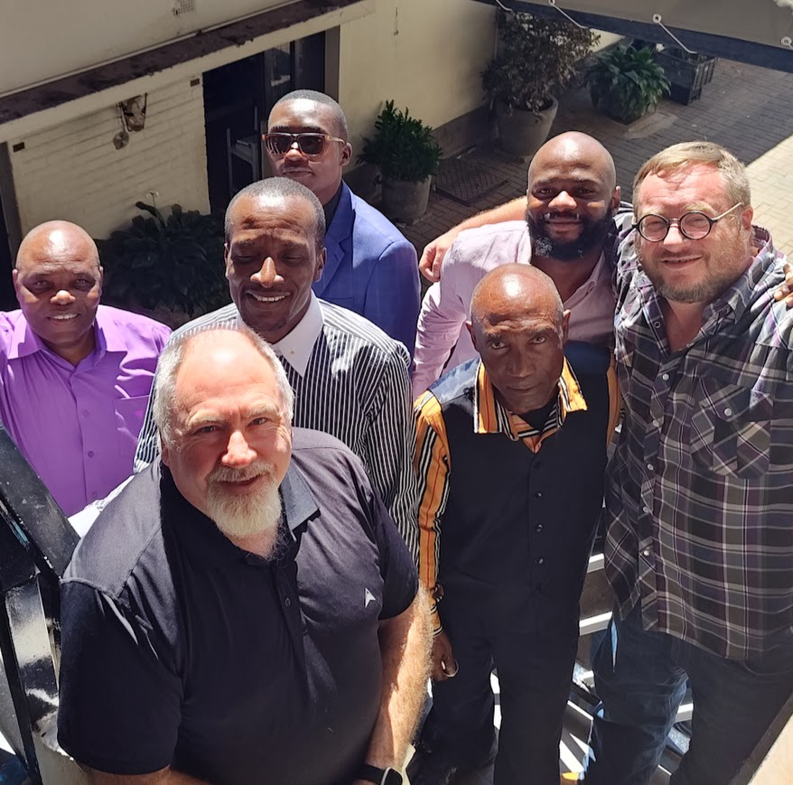
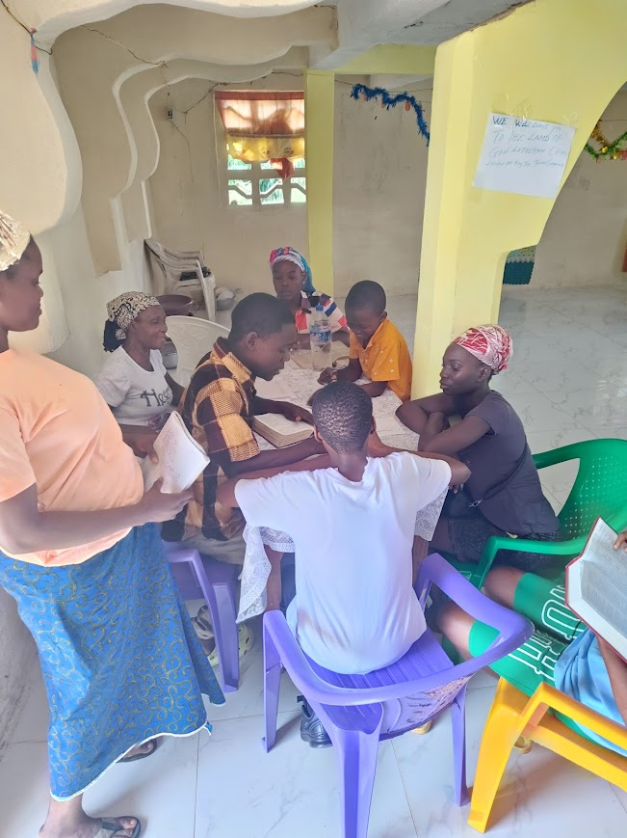

Exploring partnerships and outreach with more than 10 different groups throughout Africa
Notes:
The One Africa Team is expanding its outreach and exploring potential partnerships in several new countries:
Burkina Faso: Working with the L'Église Évangelique Lutherienne du Burkina Faso (EELBF), a synod of about 700 French-speaking Lutherans across several regions of Burkina Faso.
Cameroon: Holy Trinity Lutheran Synod consists of St. John's congregation in Fondonera, as well as its various daughter churches and preaching stations throughout the region. They are served by Pastor Julius Nkwetta. One Africa Team missionaries meet with Pastor Nkwetta and his leadership in the city of Douala, Cameroon, for doctrinal workshops. Holy Trinity would like to begin a ministry to university students in the regional hub of Dschang.
Democratic Republic of the Congo:
Evangelical Lutheran Mission to The Congo in Lubumbashi (pictured left – more on an upcoming slide)
Working with The Community of Evangelical Lutheran Churches of Central Africa (CEELAC) to provide pastoral training and explore fellowship.
Ethiopia
Opiew Okugn approached the One Africa Team in 2018, looking for a church body that teaches the truth of Scripture. He formed the Gambella Evangelical Lutheran Church after studying in the Multi-Language Production’s TELL program. They currently worship in a temporary building on a member's property. They are in stage two of the four-stage process the One Africa Team uses to guide discussions with potential ministry partners.
Confessional Evangelical Lutheran Church in South Sudan and Ethiopia (More on an upcoming slide)
Kenya: Nuer connections in the U.S. have connected the One Africa Team with contacts in Kakuma, Kenya. Pastor Onunda from the Lutheran Congregations in Mission for Christ-Kenya is visiting and assisting with training.
Sudan: They are in contact with the Lutheran Church of Sudan (LCS), an Arabic-speaking group with approximately 16,000 members, though visa and passport issues have delayed in-person meetings.
Liberia (pictured right): Lamb of God Lutheran Church in Buchanan (more on an upcoming slide)
Tanzania: Africa Mission Evangelism Church (AMEC) – More on an upcoming slide
Uganda (more on an upcoming slide):
Confessional Lutheran Synod of Uganda
Evangelical Church of the Augsburg Confession in Uganda (ECACU)
Learn more at wels.net/africa.

Slide 8
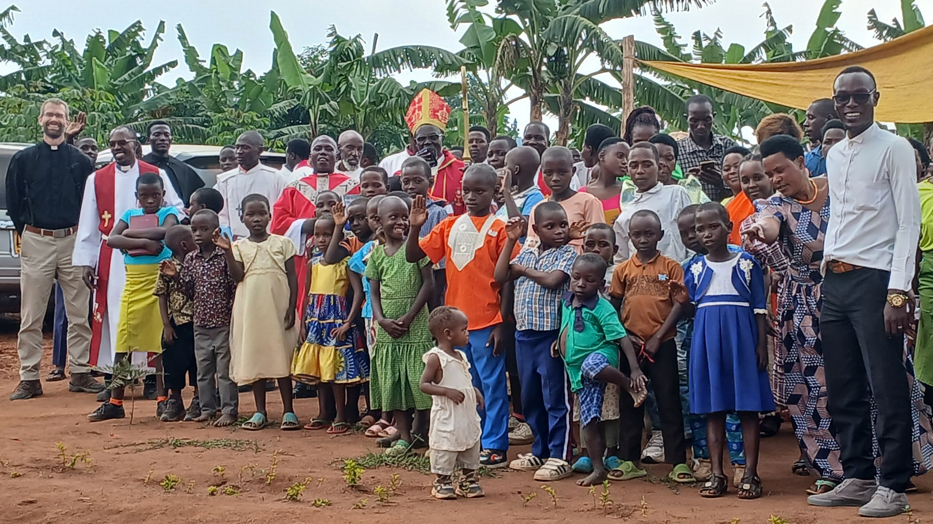
Continued exploratory work in Uganda
Notes:
In Uganda, the One Africa Team is exploring fellowship/partnership with two different synods:
In western Uganda, the Confessional Lutheran Synod of Uganda (CLSU), serves about 3,000 members and operates a small seminary with 7 students graduating this December and 12 more preparing to enroll.
In central Uganda, the Evangelical Church of the Augsburg Confession in Uganda (ECACU), a smaller synod of around 950 members, focuses on outreach through schools, including one serving 300 children.
In addition to exploring fellowship with these two synods, WELS has been in fellowship with/partners with Obadiah Lutheran Synod in Uganda since 2023.
Pictured: Missionary Ben Foxen (far left) visits Christ the Vine, a congregation within the Confessional Lutheran Synod in Uganda in August 2025.
Read more: https://welsfriendsofafrica.com/seeking-and-strengthening-synods-in-uganda/

Slide 9
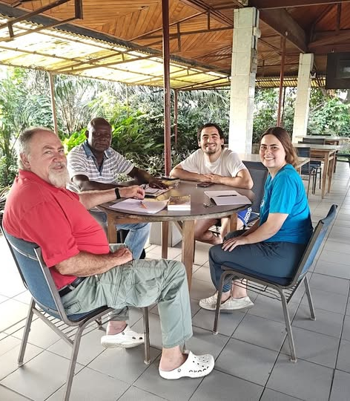
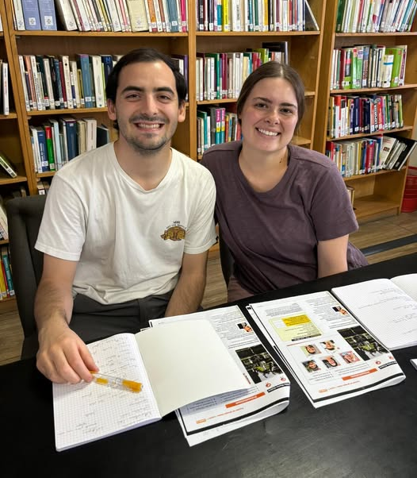
Newest missionary to Africa Jake Vilhauer and wife Maddie, learning French in Cameroon with Missionary Dan Kroll
Notes:
Missionary Jake Vilhauer graduated and was assigned to the One Africa Team from Martin Luther College in May 2024. He and his wife Maddie started their ministry in France with a three-month immersion course in the French language, followed by an additional three months in Douala, Cameroon, using the French language. They then relocated to Lusaka, Zambia, to begin work with the One Africa Team.
Vilhauer serves on the One Africa Team outreach team, assisting in the work of reaching out to new contacts and developing relationships with potential new gospel outreach partners. His work focuses on French-speaking contacts. He also teaches classes and serves as a counselor for students in the TELL Network and serves as an advisor to the One Africa Team in educational matters, especially with church partners who operate or want to start elementary and secondary schools.

Slide 10
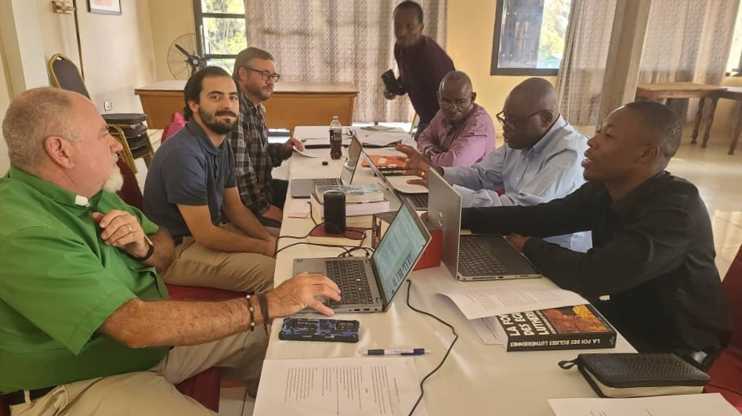
Workshops for French-speaking church body in the Democratic Republic of the Congo
Notes:
The One Africa Team has been holding regular Bible studies via Zoom and in-person workshops with the Evangelical Lutheran Mission to The Congo (MELC) since late 2023. The people of MELC use both French and Swahili, two languages which are mushrooming in their significance for the One Africa Team’s current outreach efforts.
PICTURED: One Africa Team’s newest missionary, Jake Vilhauer enjoyed his debut outreach workshop with the Mission Evangélique Luthérienne du Congo (MELC), which has its headquarters in Lubumbashi, Democratic Republic of Congo., in July 2025. Due to security concerns, OAT Missionaries Keegan Dowling and Daniel Kroll joined Vilhauer in meeting representatives from MELC in the nearby town of Ndola, Zambia.

Slide 11
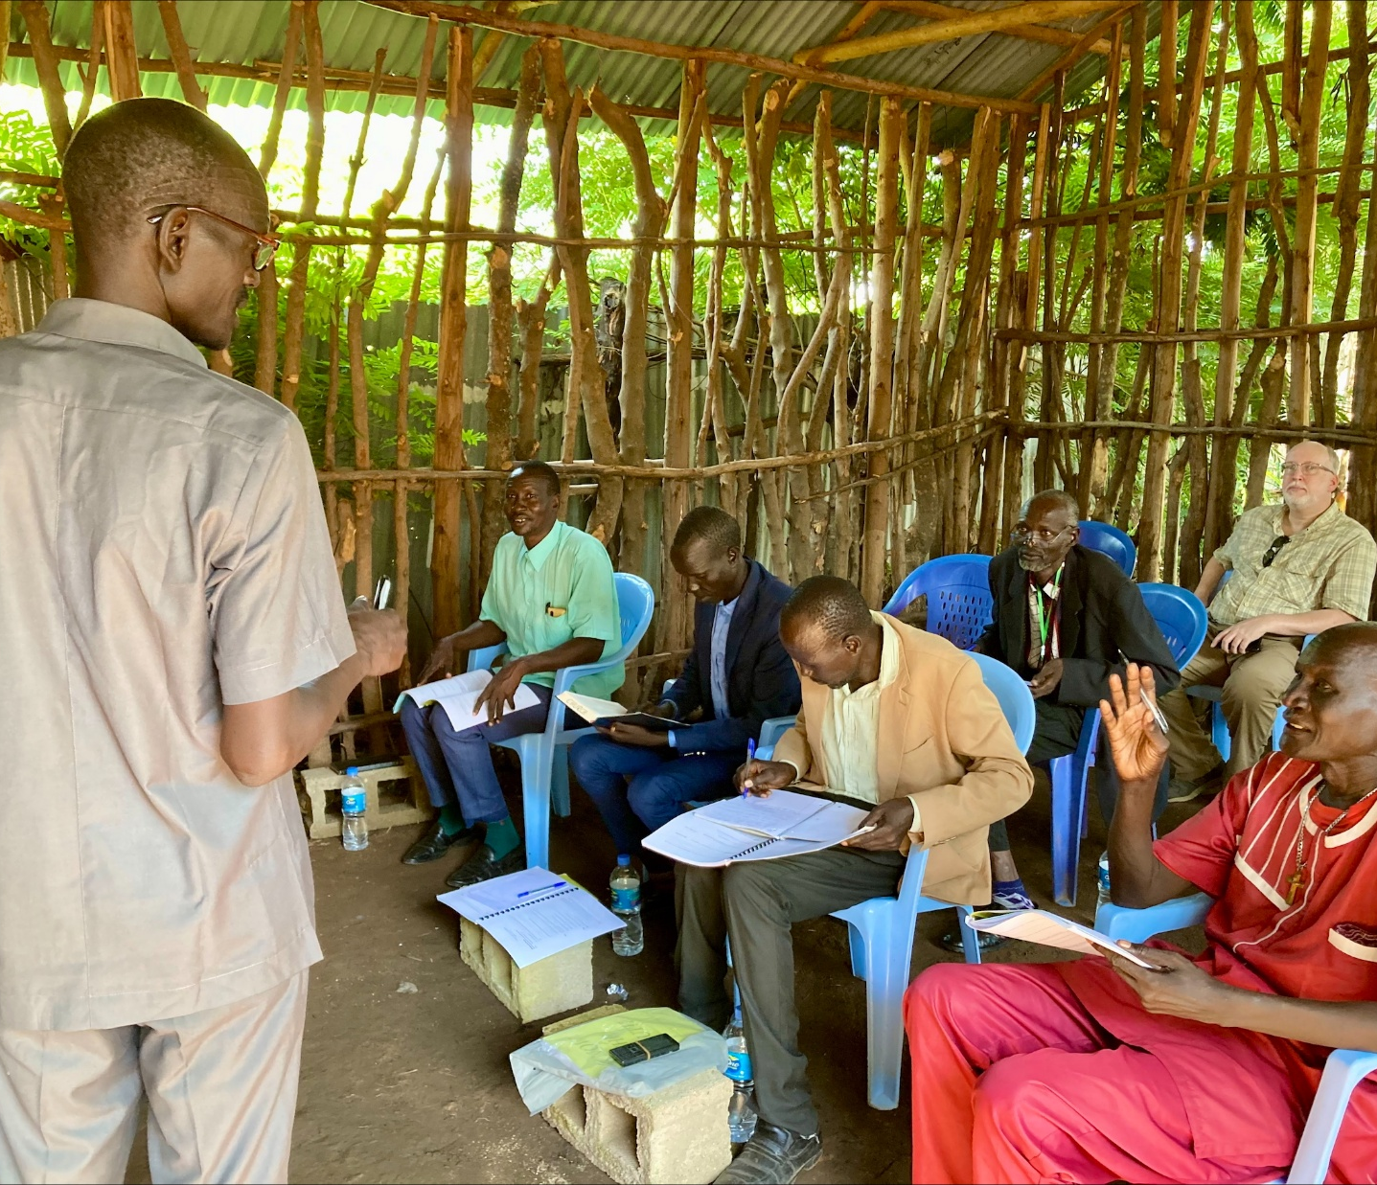
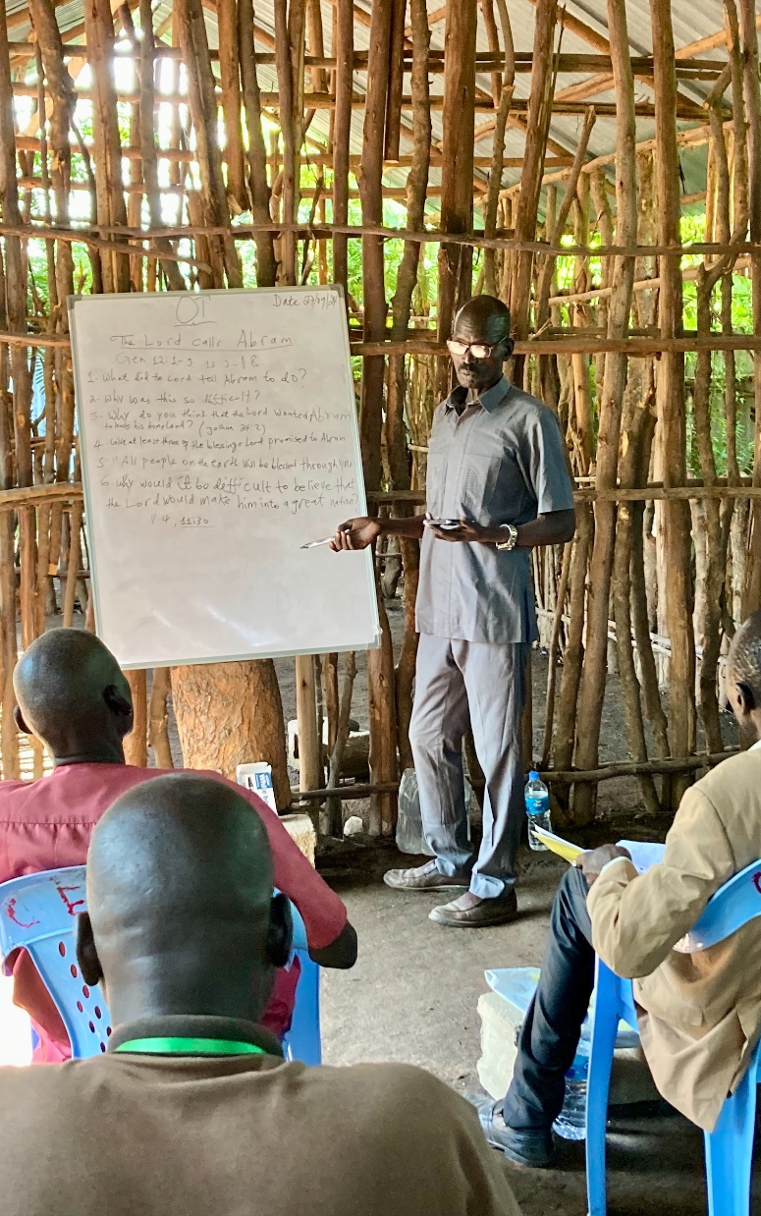
Theological education workshops for the
Nuer Sudanese in Ethiopia
Notes:
In the heart of East Africa, Lam Nhial Luak is equipping the next generation of church leaders. An ethnic Nuer Sudanese born in Ethiopia, Lam grew up in the Gambella refugee camp. As a young man, he became a Christian and felt called to share God’s Word with fellow refugees. This passion led him to theological training, culminating in his studies at Maor Lutheran Theological Seminary, operated by the Lutheran Church of Ethiopia, WELS’ sister church. Now, Lam is using his training to strengthen the Lutheran church in Gambella.
After completing his studies, Lam was ordained into a new teaching ministry in September 2024. Today, Lam leads critical pastoral training workshops for the Confessional Evangelical Lutheran Church in South Sudan and Ethiopia (CELCESS), a church body with 28 congregations and approximately 14,000 members. Many CELCESS pastors faithfully serve their congregations but have little formal training. Lam’s workshops provide them with essential instruction in Luther’s Small Catechism, Old Testament History, and Introduction to Preaching.
Each month, 14 congregational leaders attend these three-day workshops, held in two locations: Gambella Town and Kuergeng. WELS covers the costs of food, travel, and printed materials. The total cost to run these workshops is just $500 per month.

Slide 12
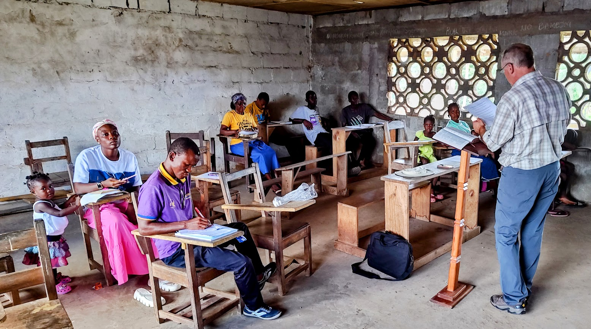
Exploring potential partnership in
Buchanan, Liberia
Notes:
Lamb of God Lutheran Church in Buchanan, Liberia, and its leader, Pastor Toye Barnard, broke away from a Pentecostal group in 2022 and were introduced to the One Africa Team. They are in stage two of the four-stage process the One Africa Team uses to guide discussions with potential ministry partners. They are currently looking at a piece of land where they might eventually build a church as well as a school.
Pictured: Pastor Paul Hirsch of St. Paul's Lutheran Church and School in Norfolk, NE, leads a workshop with Lamb of God in October 2024. Pastor Hirsch taught the 10 Commandments, while OAT Missionary Dan Kroll led a review of the Ministry of the Keys and the practical applications of baptism.

Slide 13
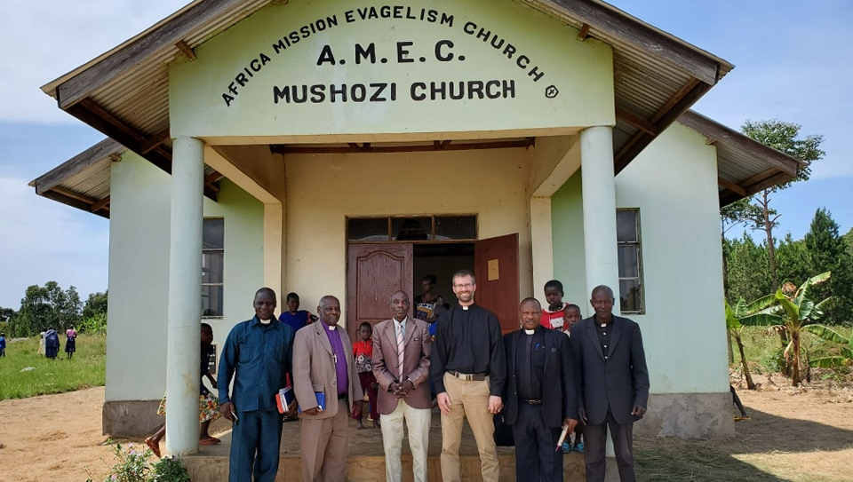
Fellowship opportunity being explored with AMEC in Tanzania
Notes:
In Tanzania, The Africa Mission Evangelism Church (AMEC) split from a larger group of Lutherans in the mid-1990s. AMEC is in five provinces of Tanzania and has 81 congregations, most of which have a pastor and/or an evangelist. They serve about 13,000 members.
The Africa Mission Evangelism Church (AMEC) recently consecrated Pastor Judah Pallangyo as its new bishop, succeeding Bishop Baltazar Kaaya after 17 years of service. WELS has been building a relationship with AMEC since 2020, engaging in regular meetings to study Scripture and explore fellowship. While a formal declaration of fellowship was initially planned for 2025, Bishop Pallangyo has requested more time to review doctrinal statements with AMEC’s pastors and elders. Discussions and study continue as both churches seek unity and clarity.
Pictured: Missionary Ben Foxen from the One Africa Team visits congregations located in the central and northwest regions of Tanzania - August 2023

Slide 14
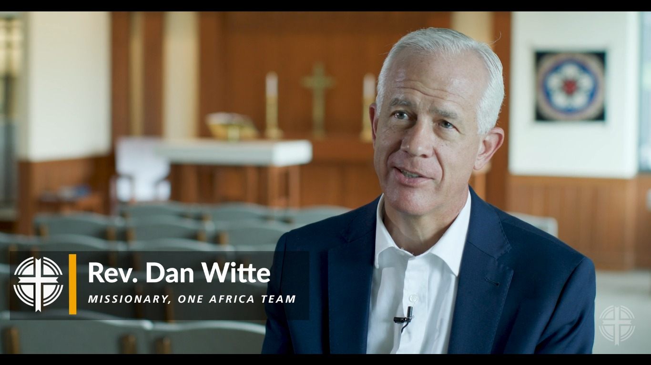
Longstanding theological education in Africa and opportunities in even more countries
Notes:
Previous WELS mission efforts have led to strong, independent church bodies in Zambia, Malawi, Nigeria, and Cameroon. Missionaries work closely with sister synods to support their seminary program. In addition, the theological education arm of the One Africa Team is currently providing a Bachelor of Divinity degree program (BDiv) to 17 pastors and a Master of Theological studies (MTh) program for 3 pastors in addition to providing professional development and continuing education courses for pastors at all our African sister synods. The cohort of 17 BDiv students are on track to graduate in summer 2026.
Video: https://wels.net/together-video-july-15-2025/

Slide 15
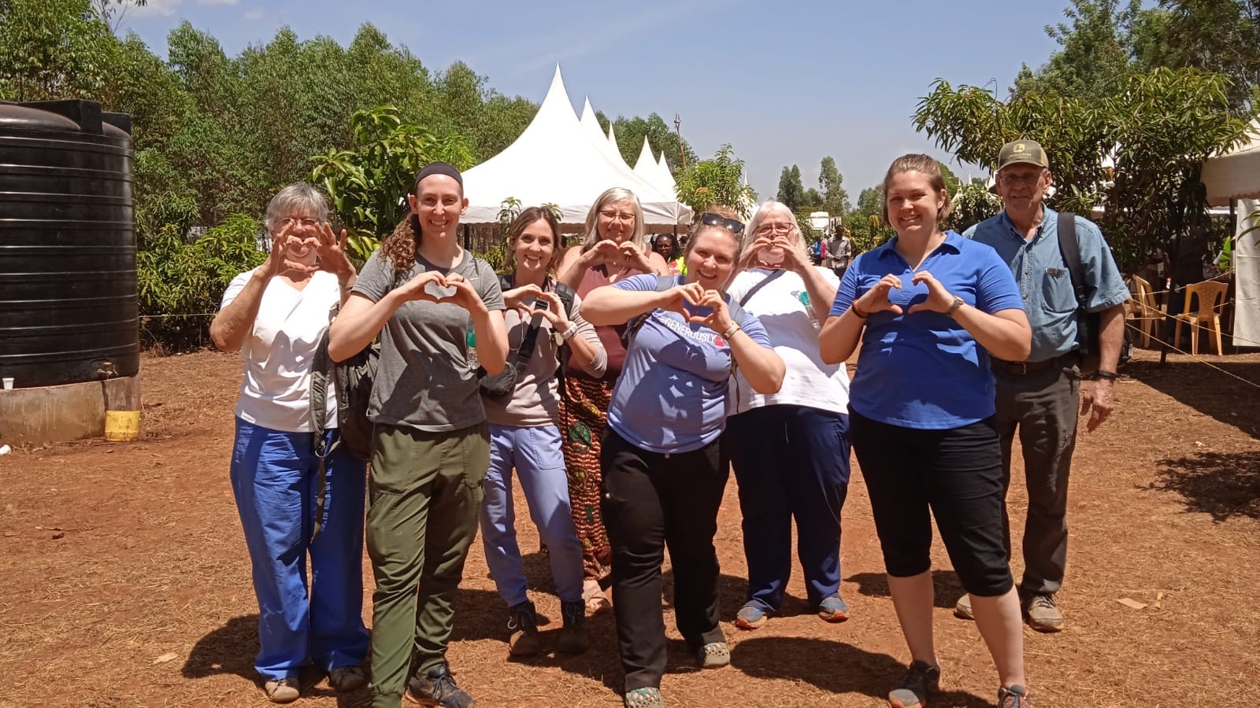
Five-day medical camp offered in Kenya
Notes:
The WELS Central Africa Medical Mission (CAMM) recently hosted a rural medical clinic in Sagana, Kenya, in partnership with Karima Lutheran Church, the WELS One Africa Team, and WELS Christian Aid and Relief. During the five-day medical camp in February 2025, a team of volunteers worked alongside church leaders and local healthcare workers to provide free health screenings and private consultations. They assisted nearly 2,000 patients with blood pressure checks, blood sugar testing, and pharmacy support—all while sharing the love of Christ with each person they served.

Slide 16

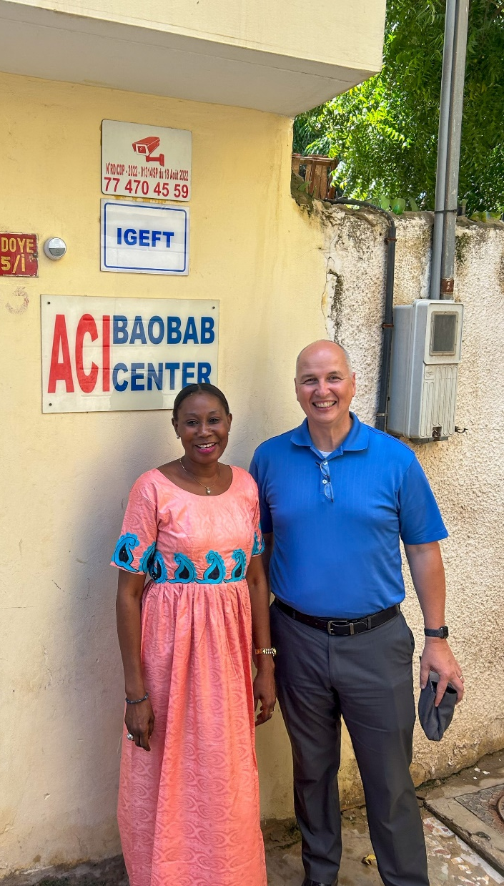
Plan in place to start a mission in Senegal
Notes:
The goal would be for two new missionaries to spend up to six months living with a Muslim family from the Wolof tribe, immersing themselves as they learn the culture and language of the people they are trying to reach with the gospel. Once time is taken to understand the culture and Muslim influence, more specific plans for outreach will be developed. The Board for World Missions is committed to supporting this new mission field for a minimum of two years, to give missionaries ample time to work within the culture while we rely on the Holy Spirit to produce his fruit in his time and place. Learn more about this opportunity at wels.net/mission-work-approved-in-senegal.
The country of Senegal in Western Africa has a population of almost 17 million people. The Wolof tribe makes up about 40 to 45 percent of the total population and is less than 0.01 percent Christian. Despite the fact that Senegal is an overwhelmingly Muslim country, the constitution staunchly defends freedom of religion and is a relatively peaceful and stable place.
Rev. Larry Schlomer, Board for World Missions Administrator, and Stefan Felgenhauer, Director of World Missions Operations, went on an exploratory trip to Dakar, Senegal, in September 2023. They had the opportunity to meet people from the business community, local charitable organizations, and an international school to determine how easy it is for Americans to live and work in the country. The highlight of the trip was connecting with a cross-cultural learning consultant (Pictured right with Schlomer) that provided a cultural study and who WELS can partner with for cultural immersion opportunities for future missionaries.

Slide 17
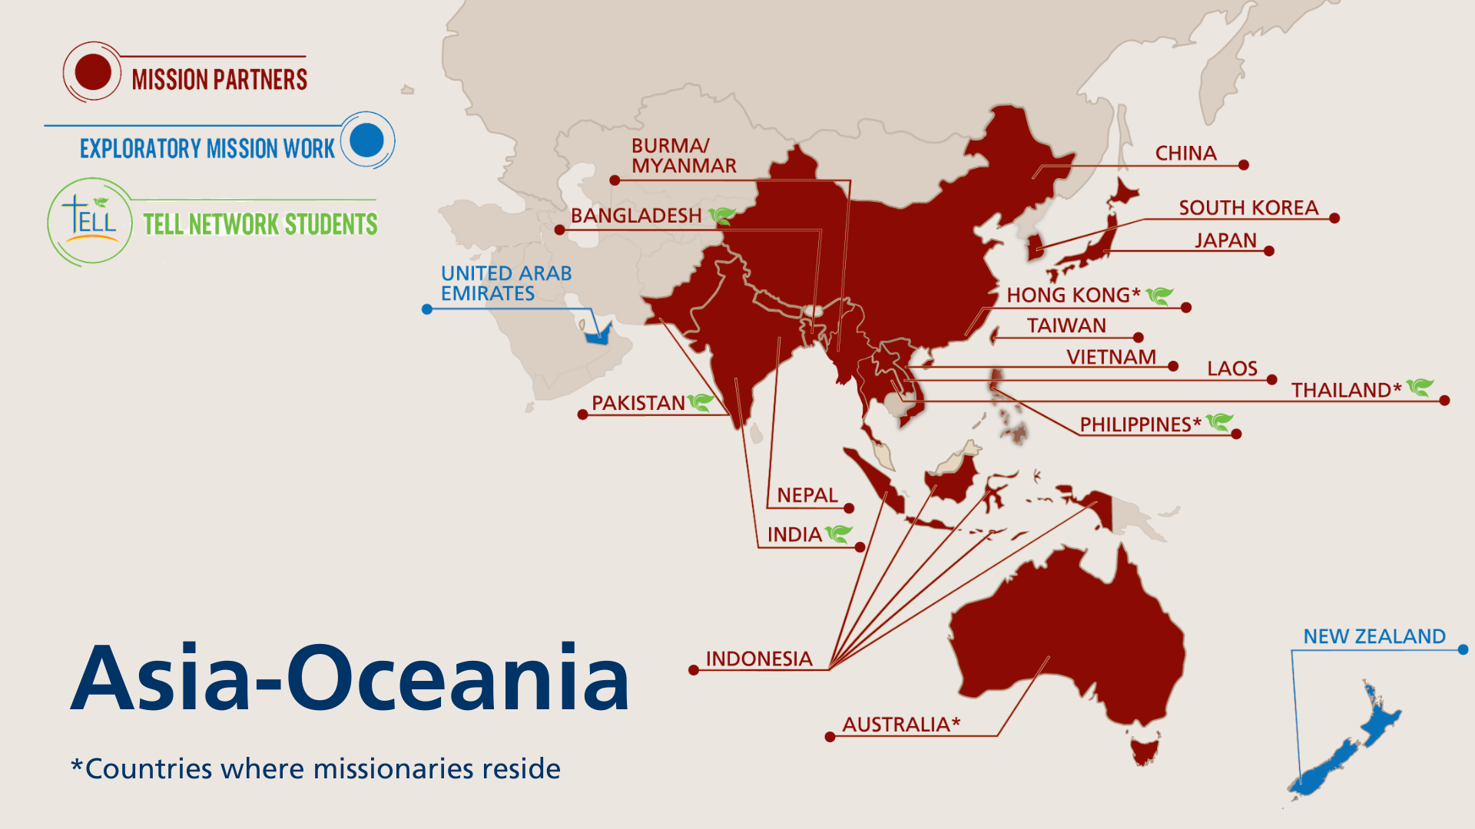
Notes:
The Asia-Oceania Team is made up of 17 missionaries serving 18 different countries throughout Asia and Oceania. The team—with members in Thailand, Hong Kong, the Philippines, and Australia—partners with God’s people to equip, encourage, and empower others to bring the good news of Jesus Christ to the billions still lost in darkness. The Asia-Oceania Team explores new mission opportunities, supports existing sister synods, and trains current and future leaders for service in their churches through Asia Lutheran Seminary.
Fast facts
Mission partners in 16 countries
Exploratory mission work in 2 additional countries
17 missionaries
11,900+ people baptized in 2024
153,000+ people gathered weekly around God’s word in 2024

Slide 18
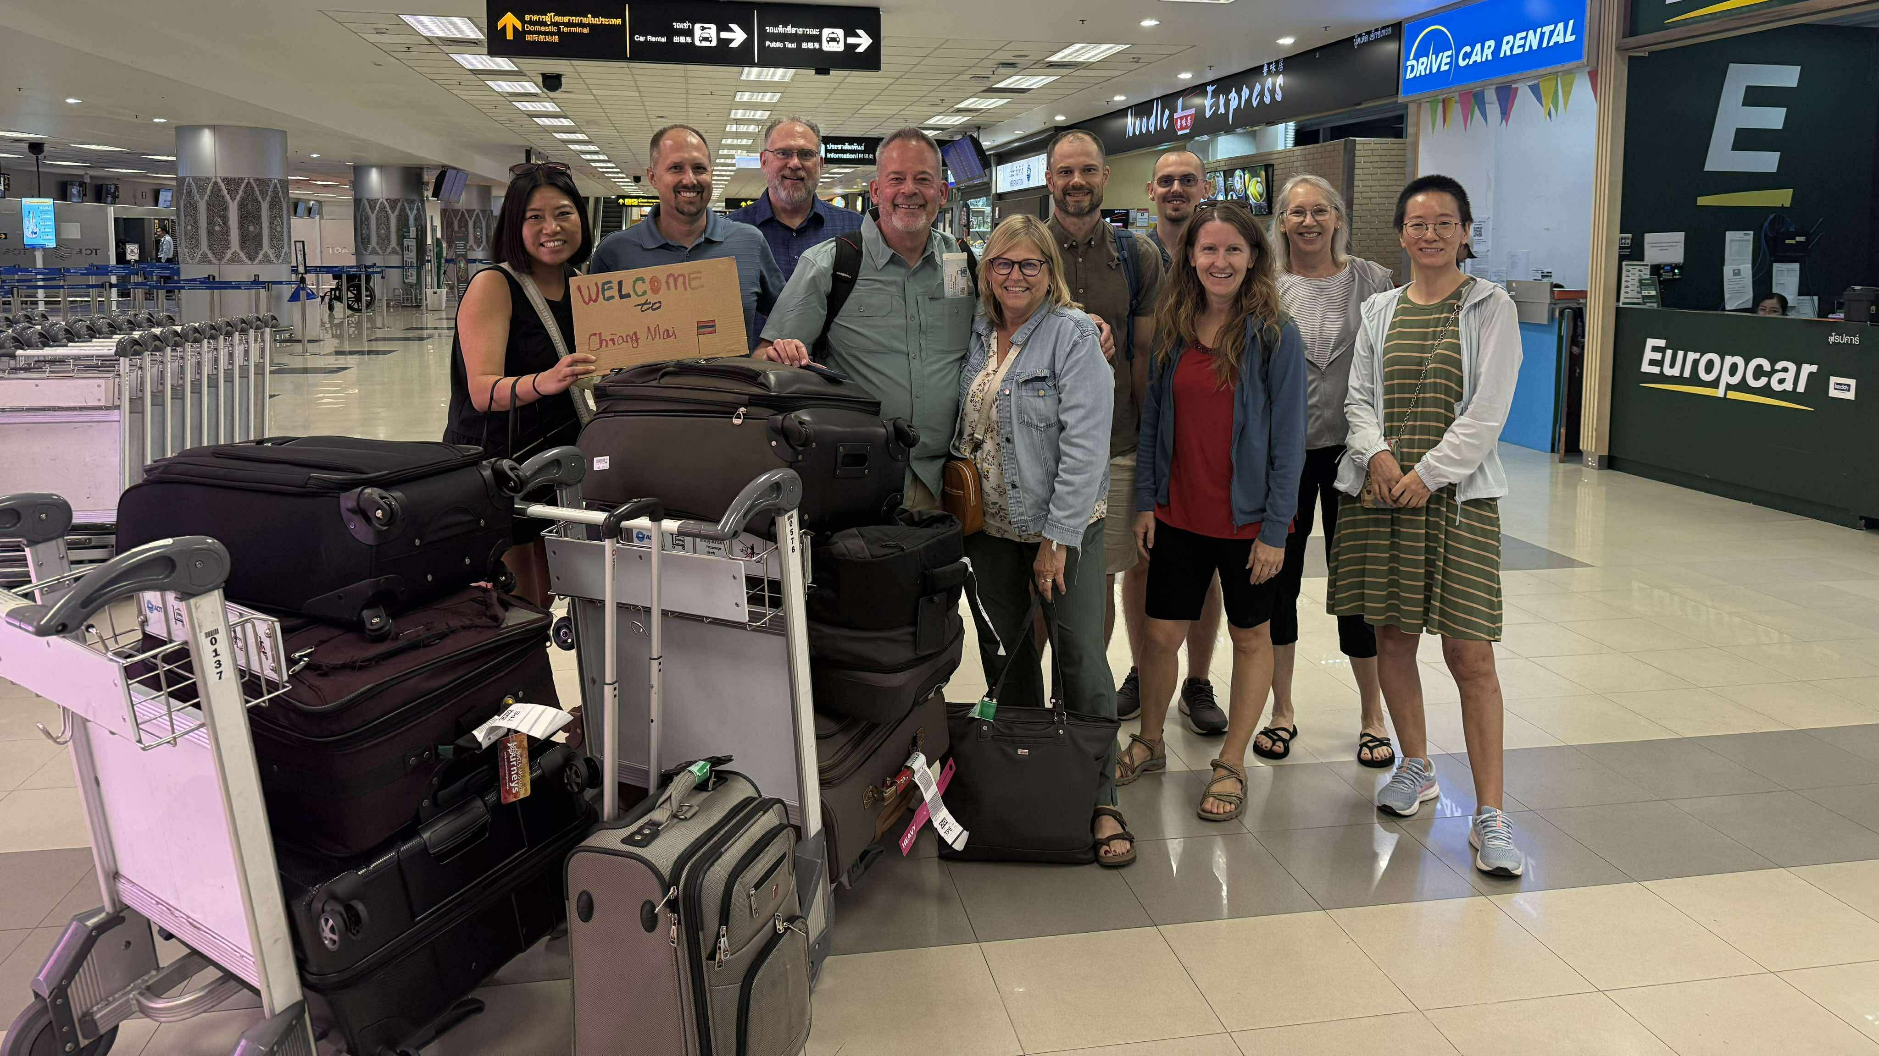
New Asia-Oceania team leader and missionary: Mr. Jim Brandt
Notes:
Mr. James Brandt accepted the call to serve the Asia-Oceania Team as the team leader in January 2025. In this role, Brandt guides Asia-Oceania Team efforts by leading vision, strategy, and operational planning; coordinating team functions and the efforts of field liaisons; supporting missionaries and their continued development; coordinating mission advancement with the Mission Advancement and Promotions team; and strengthening relationships with national partners and WELS organizations in both the U.S. and Asia-Oceania.
Following his graduation from Dr. Martin Luther College in 1985, Brandt served as a teacher in Fond du Lac, WI (1985-1989), principal of Lutheran schools in California and Illinois (1989-2002), administrator for the WELS Commission on Lutheran Schools (2002-2009), vice president at Wisconsin Lutheran College (2009-2018), and academic dean at Wisconsin Lutheran High School (2018-2025). He served World Missions as a member of the administrative committee for India missions from 1998-2004. He received his Master of Science in Educational Leadership from the University of Wisconsin–Oshkosh in 1995.
Jim and his wife, Kathy, moved to Chiang Mai, Thailand, in August 2025 (pictured). They have three adult children: Samuel, Zachary, and Jacob (Katie); and one grandchild, Hazel.

Slide 19
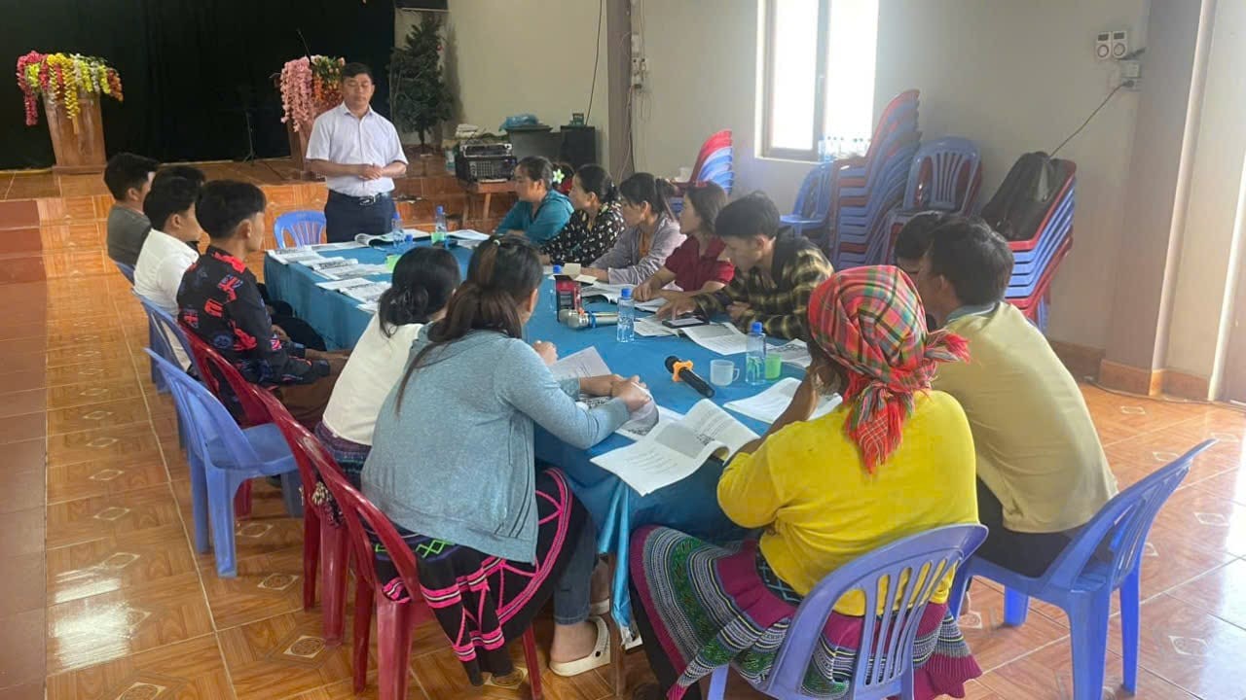
God’s plan flourishes in Vietnam
despite earthly setbacks
Notes:
Fourteen years ago, Hmong church leaders in Vietnam invited WELS to train their pastors in the gospel. Seven years ago, the Vietnamese government approved the construction of a theological education center in Hanoi. We knew that the Lord had opened a door for outreach, but we also knew that the door could close at any time. WELS World Missions worked quickly to take advantage of the time the Lord provided. And God’s work moved forward in ways we could have never predicted. We were able to build the building, but government regulations have kept us from using it for now. A former partner church began demanding practices contrary to Scripture. WELS’ partner church stood firm, losing government recognition in the process and delaying occupancy. Despite these challenges, ministry thrives. Over 160,000 Hmong believers now call themselves Lutheran, 55 pastors have been trained, and 120 more are in seminary-level studies. Without the building, training continues in rented spaces and online. Though red tape persists, we see God’s hand at work, growing the church beyond expectations. The delay has provided more time to strengthen faith and train leaders. We remain confident. We thought we needed that building. God knew we needed him—and him alone.
Read more: https://wels.net/gods-plan-flourishes-in-vietnam/
Stay up to date on progress at wels.net/asiaoceania.

Slide 20
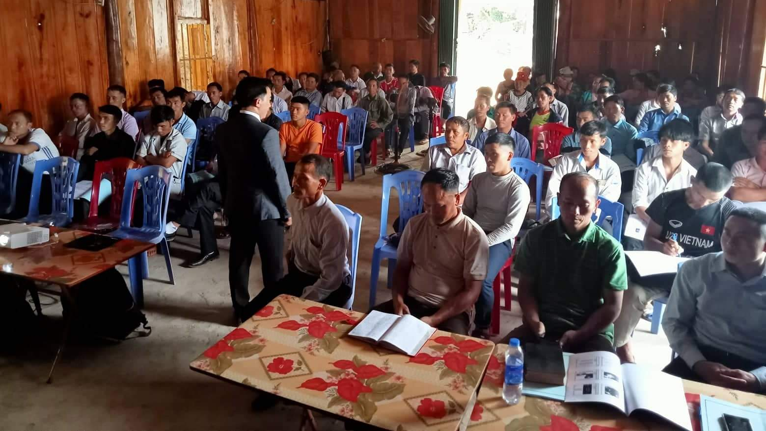
Rural training in Vietnam continues
Notes:
In addition to the seminary training being provided, a new rural training program developed by WELS missionaries Bounkeo Lor and Joel Nitz is training 700 rural church leaders in the basic truths of the Bible, with 700 more church leaders targeted for future training. Twelve of the new HFC graduates were commissioned to serve as instructors in the program
Online courses led by full-time professors Bounkeo Lor and Joel Nitz (pictured) continue to be taught to rural church leaders of the Hmong Fellowship Church (HFC) while residency visas for Lor and Nitz and HFC government registration are still pending.
Learn more at wels.net/vietnamhmongoutreach.

Slide 21
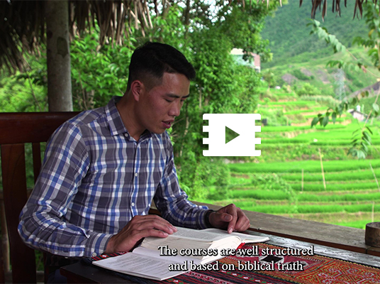
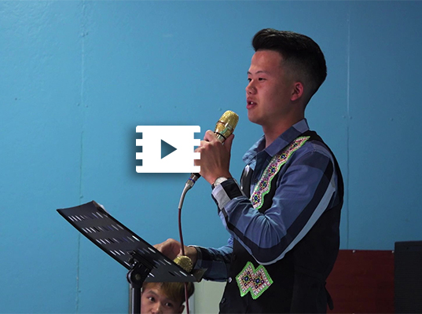
Num
Zag
Meet two Hmong leaders in Vietnam
Notes:
Men like Num and Zag are learning how to differentiate between law and gospel and are sharing that freedom that comes from the gospel with those in their communities.
Num (https://wels.net/faces-of-faith-num/) is a Hmong regional church leader in Vietnam who’s benefiting from WELS’ rural training program. He also began his pastoral studies in July 2023 as a member of the third cohort of students.
Zag (https://wels.net/faces-of-faith-zag/) is in the second group of 60 students studying to be a pastor.

Slide 22

Asia Lutheran Seminary provides theological education across the continent
Notes:
Asia Lutheran Seminary (ALS), the regional seminary for Asia and Oceania, trains Christian leaders by equipping students to reach out, disciple believers, train leaders, and multiply groups for the advancement of God’s kingdom. ALS offers a comprehensive evangelist through pastor-level training program, ranging from certificate courses to a Master of Divinity degree.
Asia Lutheran Seminary is served by eight professors and additional adjunct faculty (Pictured – Prof. Angus Cheung, national pastor from Hong Kong and Professor at ALS). 83 Chinese-speaking students are enrolled in the core ALS program; in the English-language certificate program, 86 students have signed up for the first live TELL class.

Slide 23
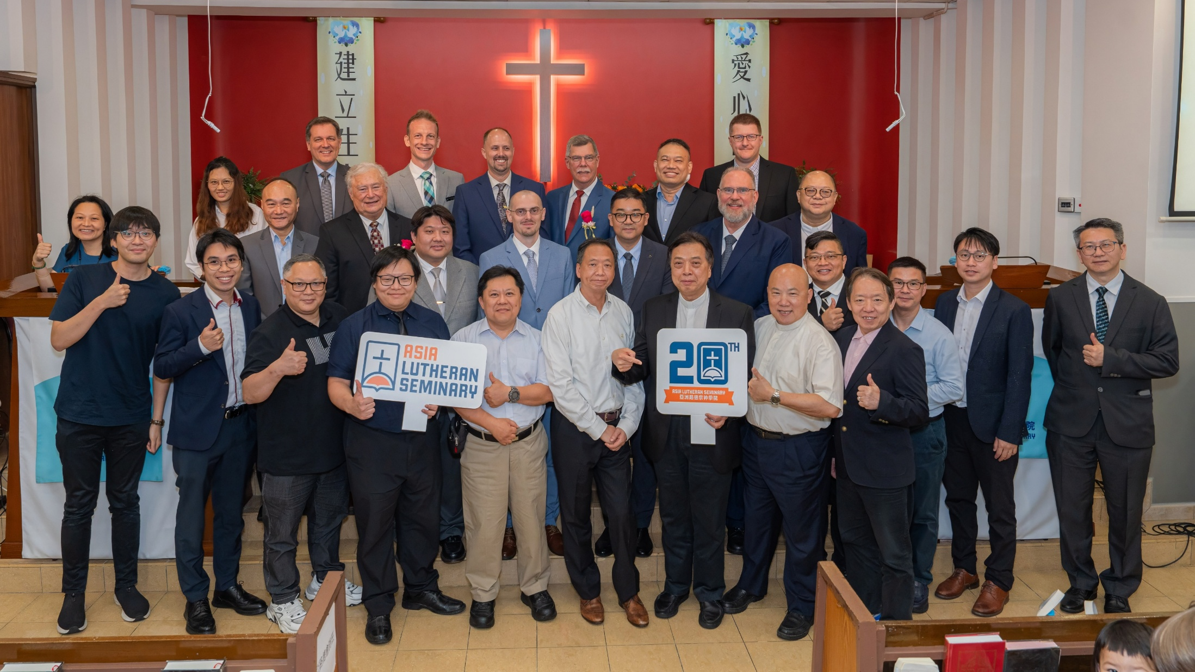
Asia Lutheran Seminary celebrates 20 years
Notes:
On June 1, 2025, Asia Lutheran Seminary (ALS) celebrated its 20th anniversary with a special worship service and banquet in Hong Kong. From its beginnings as a seminary for Hong Kong and East Asia, ALS has grown into a truly regional seminary with hubs in both Hong Kong and Chiang Mai, Thailand. ALS now supports theological education efforts in more than 18 countries and reaches students across four continents.
Watch the special 20th anniversary video: https://wels.net/together-video-june-17-2025/
Read more: https://wels.net/asia-lutheran-seminary-celebrates-20-years-of-gospel-ministry/

Slide 24
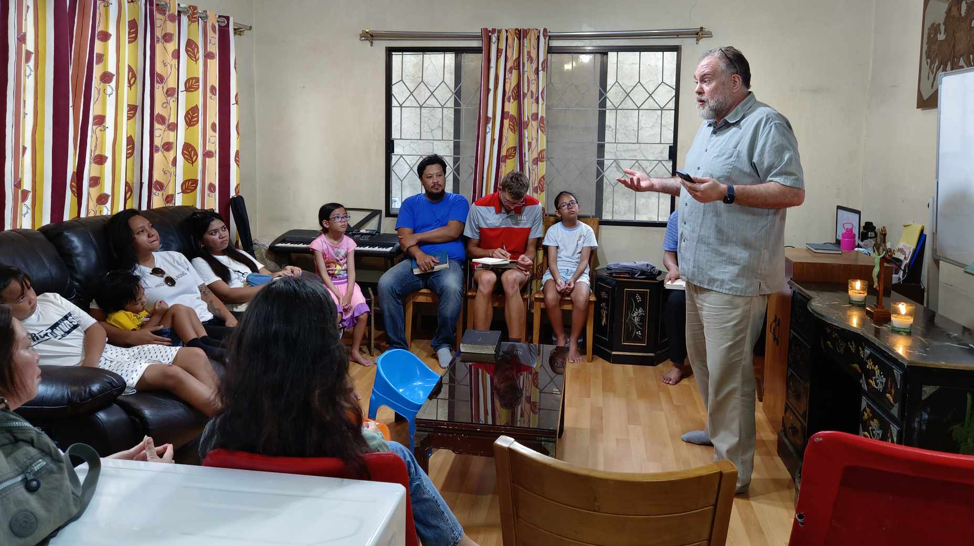
Regional training in Asia through
Asia Lutheran Seminary
Notes:
Pictured: Rev. Dr. Guy Marquardt meets with the Davao Mission Group with Filipino leader and ALS student Marzan.
Initially focused on Chinese-speaking students, ALS has now expanded its reach to serve students across Asia and Oceania. A partnership with Multi-Language Production’s TELL Network has expanded ALS into new, unreached areas. The Regional Theological Education Program (RTEP), purposefully based out of the Chiang Mai office, collaborates with sister churches throughout Asia and Oceania to ensure consistent training through consultation, curriculum development, and visiting instructors. Dr. Guy Marquardt serves as the program’s director. Where possible, the program seeks to serve as an on-ramp into Asia Lutheran Seminary’s mainstream certificate and degree programs for students across Asia.
The RTEP is currently working with programs/students in places like Nepal, Pakistan, Bangladesh, Indonesia, Philippines, Vietnam, and more. Across Asia, over 300 students are being served through the Regional Theological Education Program (RTEP)

Slide 25
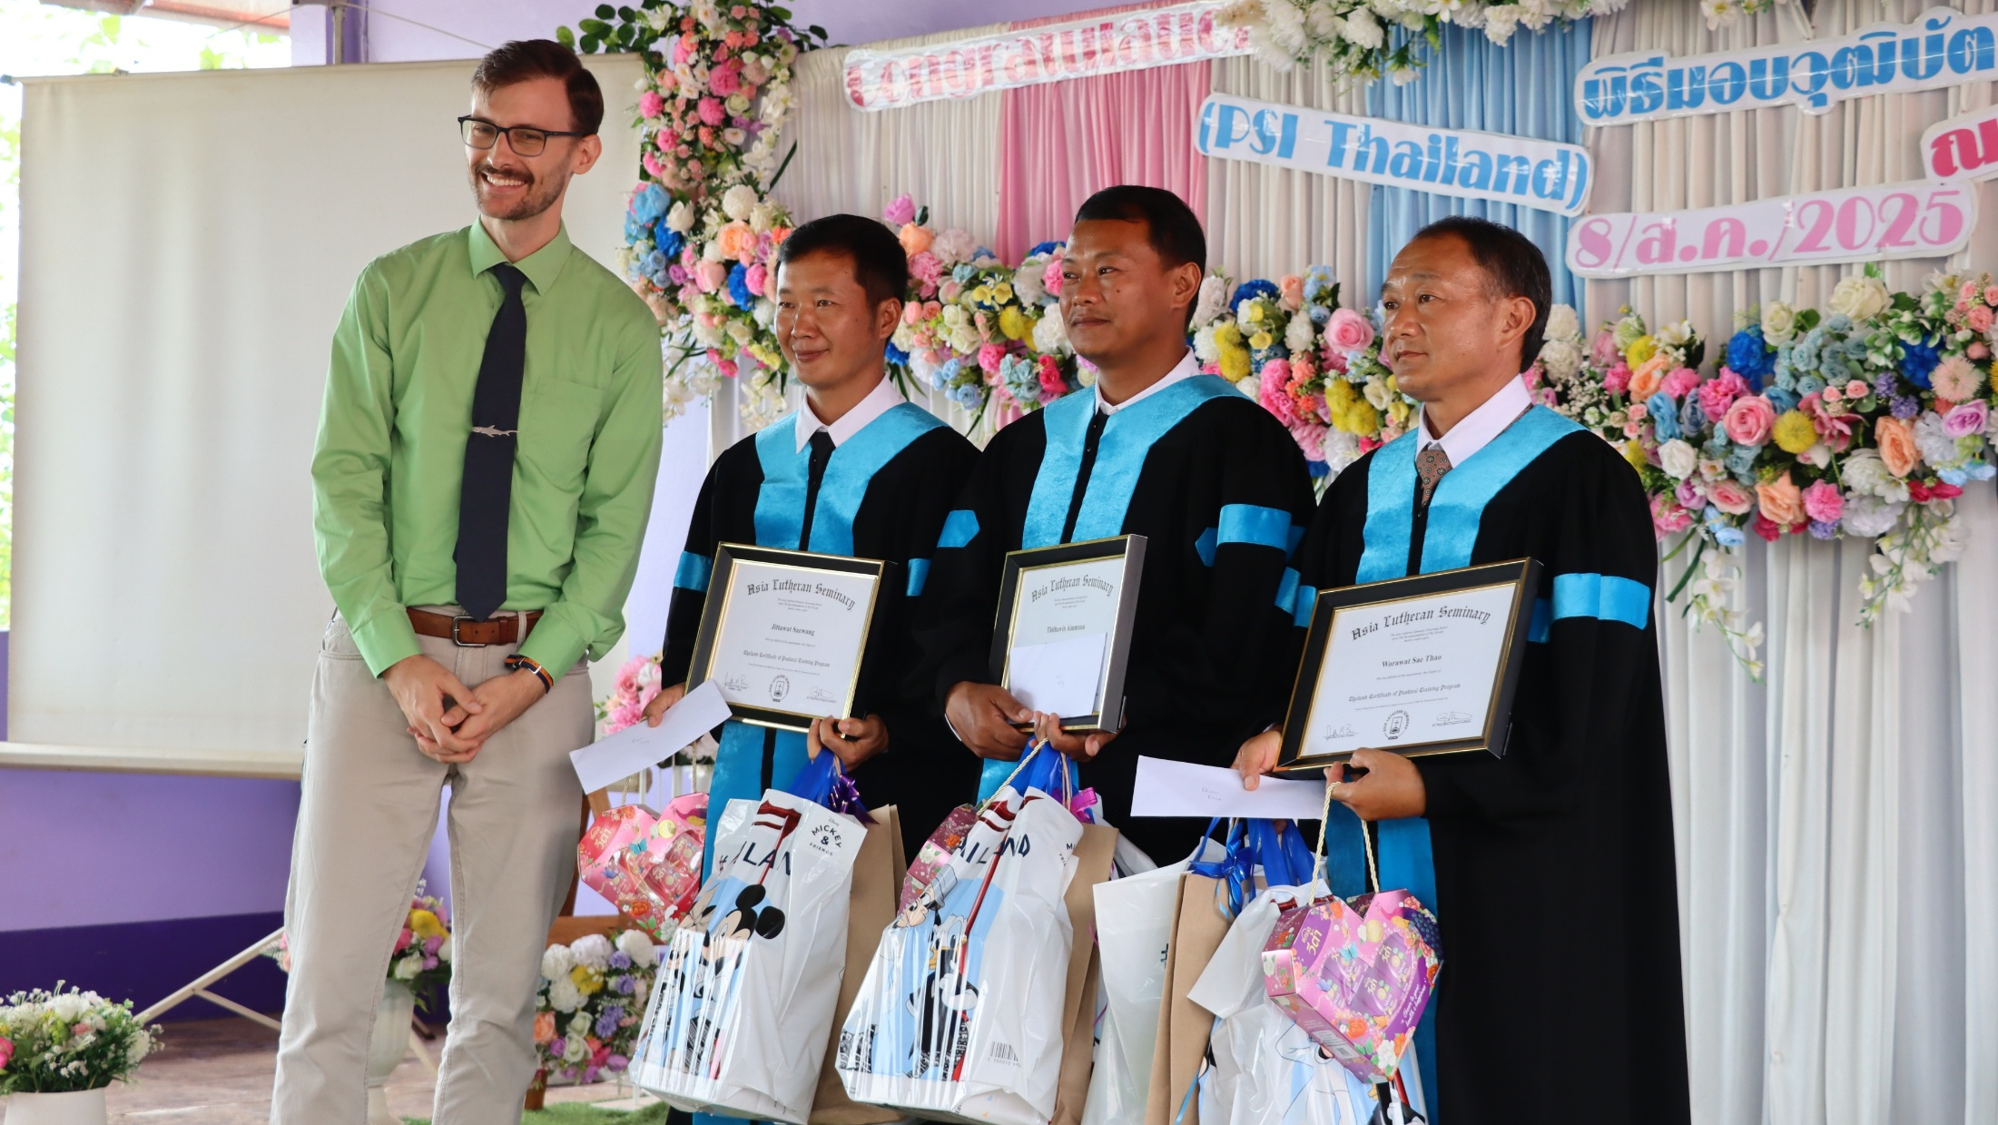
Three evangelists graduate in Thailand
Notes:
The churches in Thailand just celebrated the graduation of three evangelists from the Pastoral Studies Institute program run with the assistance of Asia Lutheran Seminary’s Regional Theological Education Program (RTEP). Two of these three men will continue their work planting churches in two different nearby villages. The third will help support the ministry of another church in the area. Lord willing, we will see more leaders trained in the future by them!
Pictured: WELS Missionary Mark Zondag with the three graduates from the graduation ceremony on August 8, 2025.

Slide 26
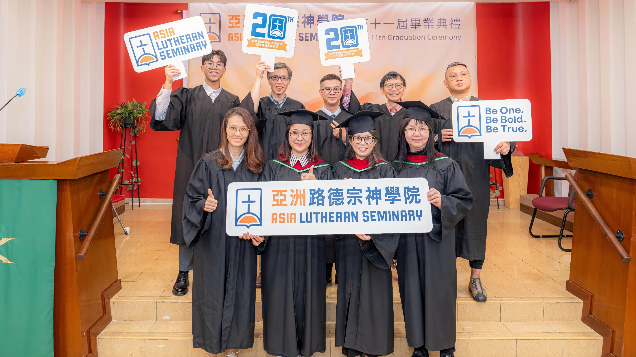
Graduation at Asia Lutheran Seminary
Notes:
On October 27, 2024, 13 students from the certificate through Bachelors degree programs graduated from Asia Lutheran Seminary. Nine were in attendance at the ceremony held at SALEM Grace Lutheran Church in Hong Kong. Nine of the students received certificates in either Greek or Hebrew, two received an associate of arts degree in theology, and two were awarded a diploma of Christian Studies. Academic Dean Dr. Angus Cheung preached. Many of them plan to continue their studies with ALS at the next level.

Slide 27
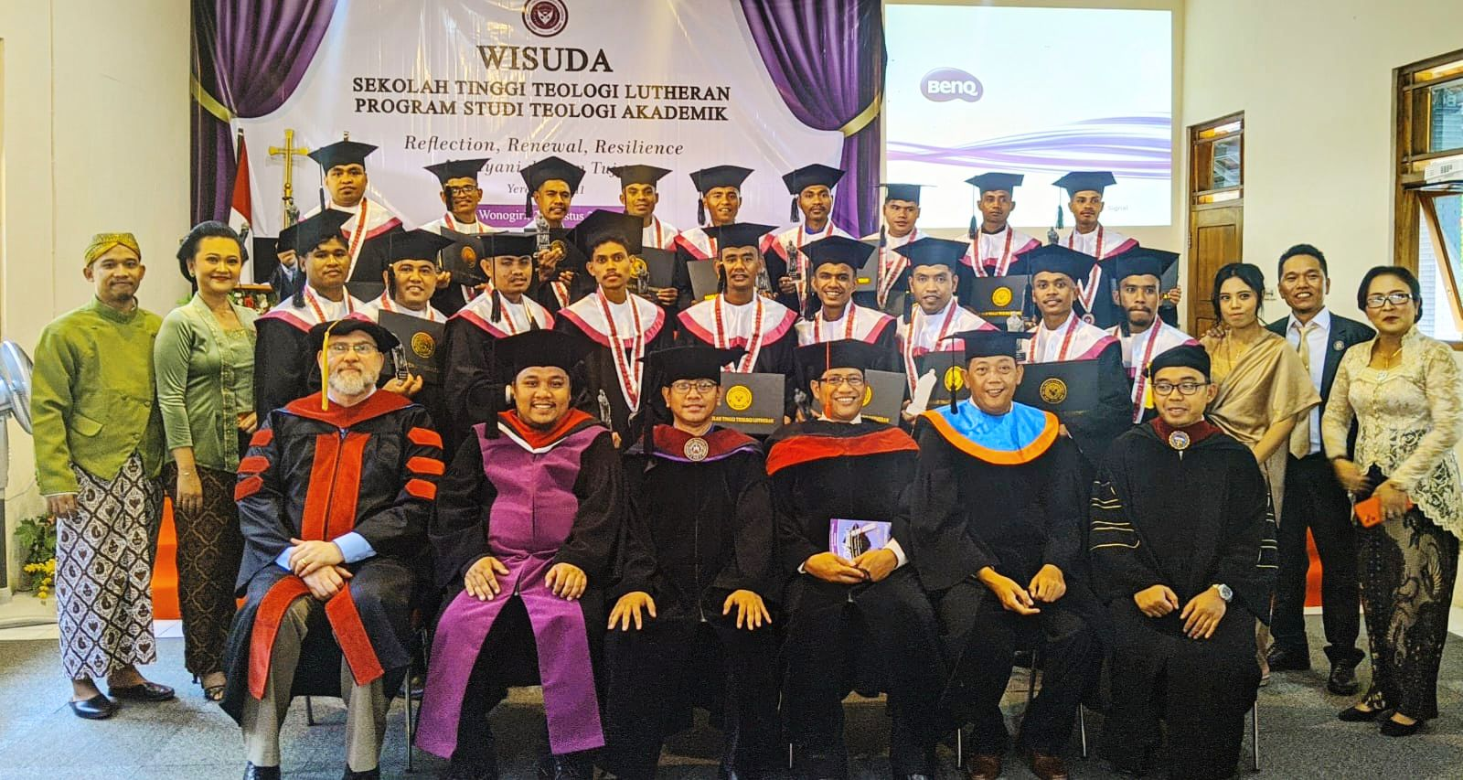
18 students graduate from pastoral training program in Indonesia
Notes:
The faculty and staff of Sekolah Tinggi Teologi Lutheran (STTL), the seminary of our sister church in Indonesia, worked hard this last year toward the goal of official accreditation for their school. Accreditation would mean that the certificate the school offers after four years of classroom training would be nationally recognized. Graduates could then use that certificate to apply for part-time employment as religion instructors in government schools. And since children in Indonesia have the right to have religion class according to their own faith, there is often a need for Christian teachers. This would be ideal for many pastors who will need to have “tent-making” ministries. STTL was fully accredited earlier in 2024.
WELS’ sister church in Indonesia, Gereja Lutheran Indonesia (GLI), celebrated the graduation of 18 students who had recently completed the four-year course of study either in 2023 or 2024 and received these government-recognized certificates! STTL’s pastoral training program includes two to three years of practical experience as vicars following the years in the classroom. So these 18 men were not yet ordained as pastors, but some of them received their first assignments as vicars in that same service. Others were reassigned to meet ministry needs in their church body. Asia One Team Missionaries and Professor Rev. Dr. Guy Marquardt represented Asia Lutheran Seminary and the WELS Asia One Team to congratulate our brothers in Christ for their hard work.

Slide 28
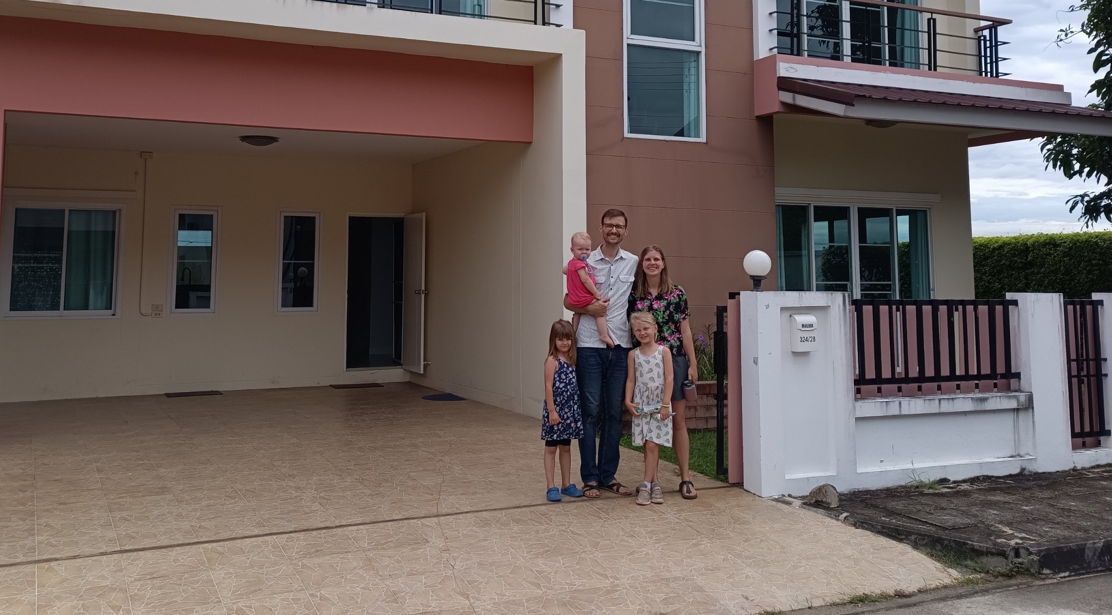
Missionary Zondag and family relocates to Bangkok
Notes:
Zondag family moves from Chiang Mai to Bangkok, Thailand
Missionary Mark Zondag, his wife Sarah, and their three girls have relocated from Chiang Mai, Thailand, to Bangkok, Thailand—a journey of about nine hours by car. The transition has felt like moving from the outskirts of Green Bay, Wis., to the outskirts of New York City—more people, faster pace, and more complexity.
Here are a few reasons that led to the move:
Around half of Bangkok’s population comes from outside the region.
An estimated 30-40 percent of Thai people will live in Bangkok at some point in their lives.
Bangkok is home to 11 million people, but only 1.1 percent identify as Christian.
This means many still need to hear about Jesus. And those who come to faith here often carry the message back to their hometowns—potentially spreading the gospel throughout Thailand. Please pray for the Zondags as they settle into their new home, face new challenges, and seek opportunities to share God’s grace with those around them.

Slide 29
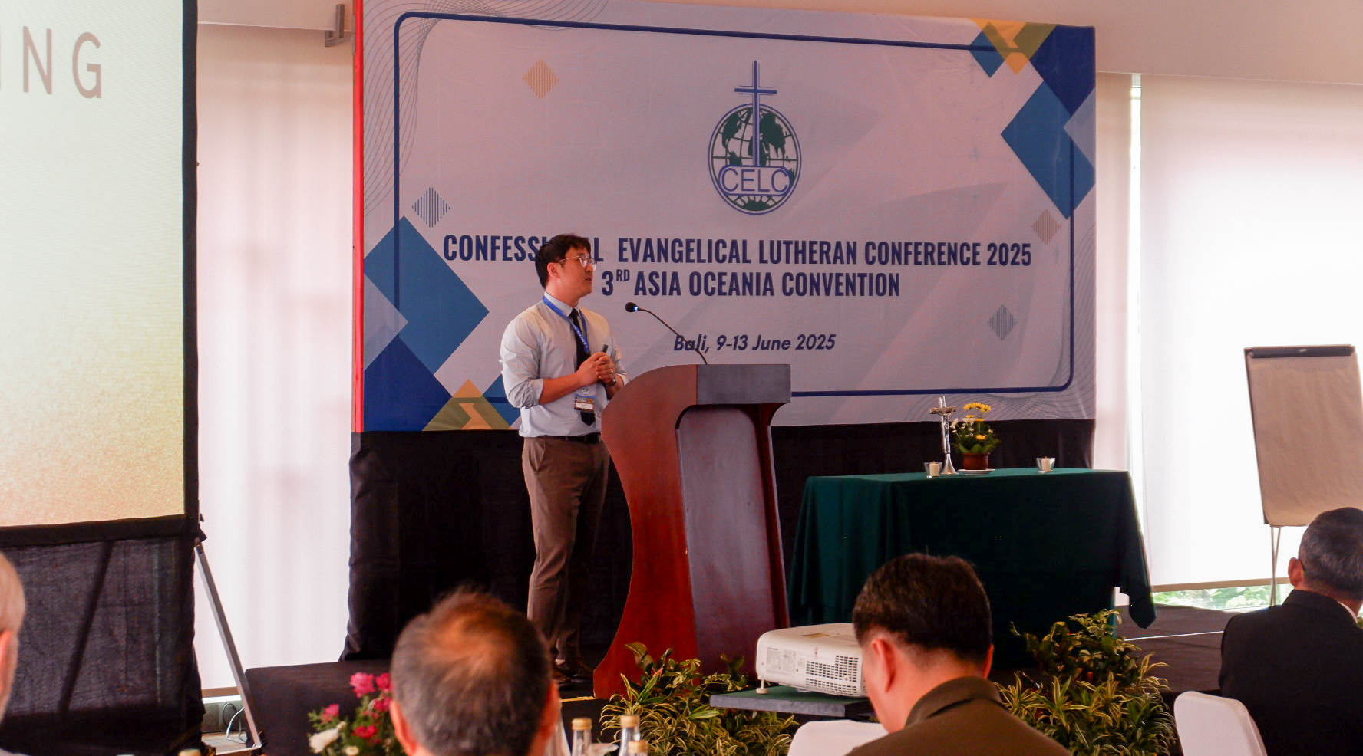
Regional CELC Conference bring together Lutherans from Asia-Oceania
Notes:
Asia-Oceania Regional CELC Conference – June 2025
The Asia-Oceania Convention of the Confessional Evangelical Lutheran Conference (CELC) convened June 9–13, 2025, in Bali, Indonesia, under the theme “That All May Hear and Believe.” Hosted by Geraja Lutheran Indonesia, the event gathered 72 attendees from 14 countries, including WELS missionaries and leaders. With only 8% of Asia and Oceania’s 4.5 billion people knowing Christ, the convention offered a rare and secure space for worship, study, and encouragement. Participants emphasized unity in faith, mutual support, and the value of building lasting ministry connections across the region. Read more: https://wels.net/united-in-christ-sharing-the-gospel/

Slide 30
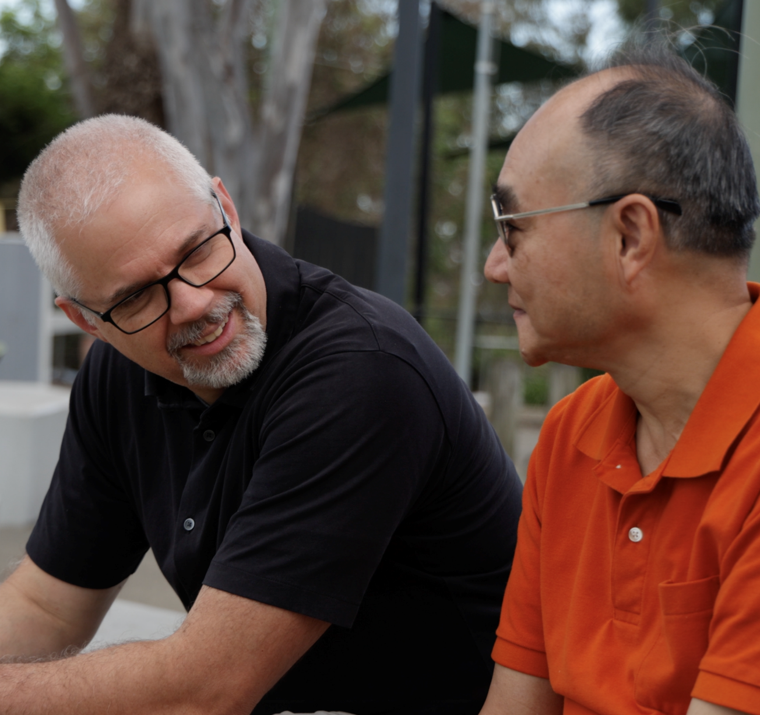
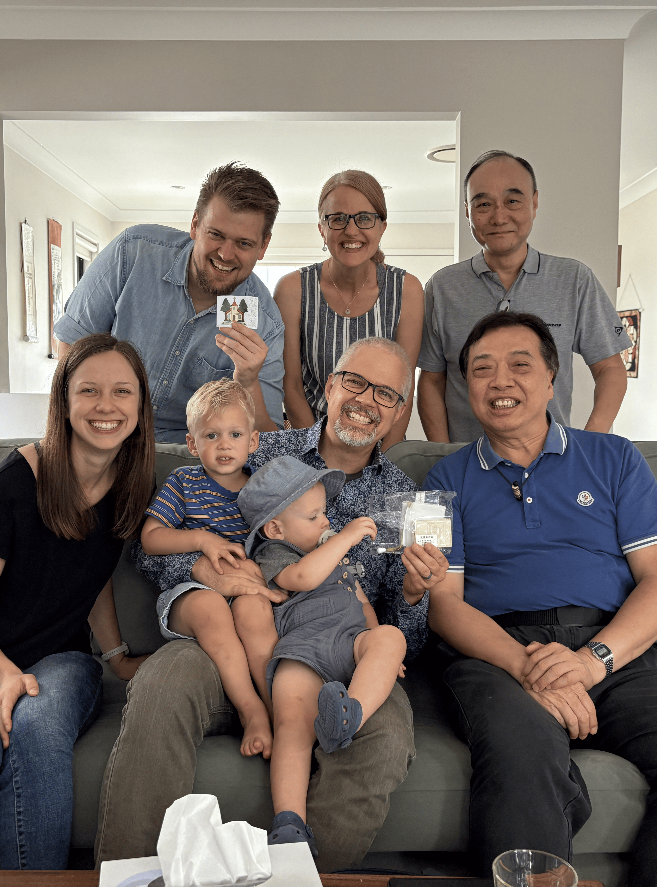
World Missions expands to Australia
Notes:
WELS has launched a new world mission effort in Australia. With a large focus on the country’s growing immigrant communities, two WELS missionaries and their families relocated to Brisbane, Queensland, in the summer of 2024 to plant the seeds of the gospel in a region that has been described as largely post-Christian. They are working closely with local congregations, Our Redeemer Lutheran Church in Brisbane and Fountain of Life in Maryborough, as a foundation for expanding ministry. With nearly 30% of Australia’s population born overseas and over 500,000 new immigrants arriving last year, there is an increasing need for spiritual community. The missionaries are focusing on relationship-building through neighborhood engagement, English language programs, and small gatherings of believers meeting in homes to study God's Word and share in fellowship (similar to early Christianity). The missionaries’ goal is to train and mentor local leaders to establish and lead house churches. This grassroots approach is already bearing fruit. In Melbourne, a new life group has formed, including believers from diverse backgrounds. The mission is still in its early stages, but meaningful connections are being established, planting the seeds for lasting faith communities. Follow along at wels.net/asiaoceania.

Slide 31
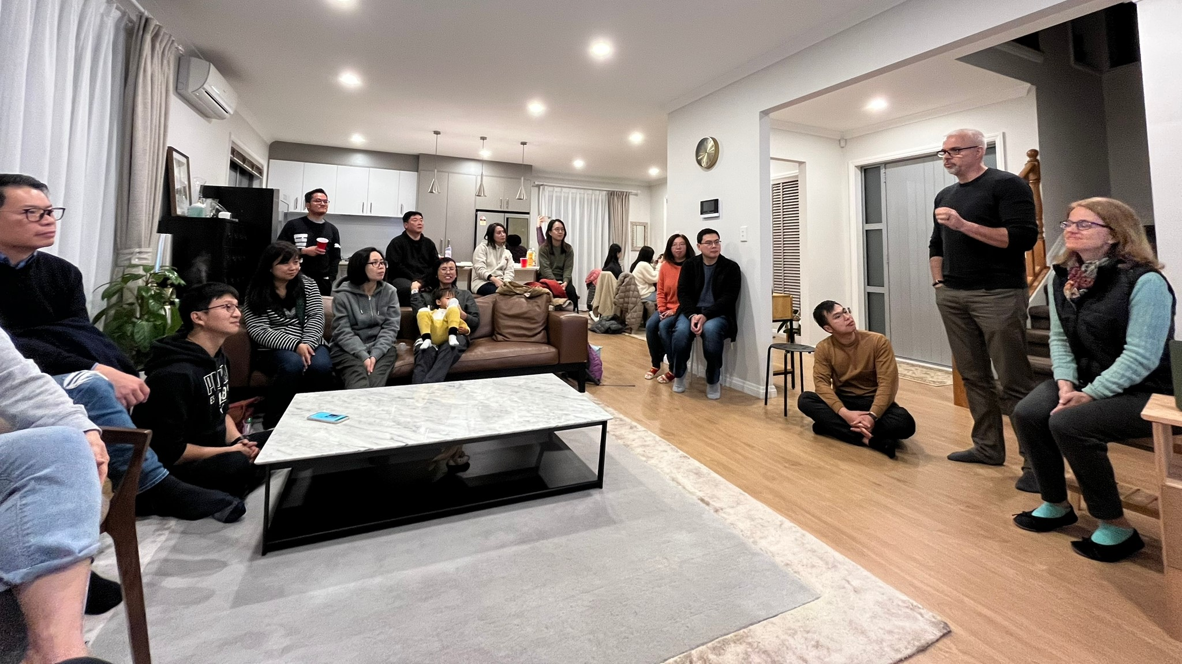
New mission work in New Zealand through SALEM
Notes:
Over three years ago, a few South Asian Lutheran Evangelical Mission (SALEM) members who immigrated from Hong Kong to New Zealand began meeting online with SALEM leadership for Bible Study and fellowship. This group, located in Auckland, has grown to over 20 members. In January 2023, they began a monthly worship gathering facilitated by local leaders, and they continue to meet every week online and in person. Thirteen members of their group are currently enrolled in a foundational course at Asia Lutheran Seminary. These brothers and sisters welcome all newcomers to their group with open arms. They want to see many more Chinese-speaking people brought to faith and strengthened in Christ, and there are countless opportunities to do just that. Chinese people already make up five percent of the population of New Zealand, and experts predict that this number will grow to ten percent in the next 20-30 years. WELS is excited to continue assisting our sister church SALEM as they foster this new mission in New Zealand.
Pictured: Asia One Team Missionary Matt Doebler and his wife Christine visit South Asian Lutheran Evangelical Mission (SALEM) members who immigrated from Hong Kong to New Zealand and have started a new worship gathering in Auckland. - May 2023

Slide 32
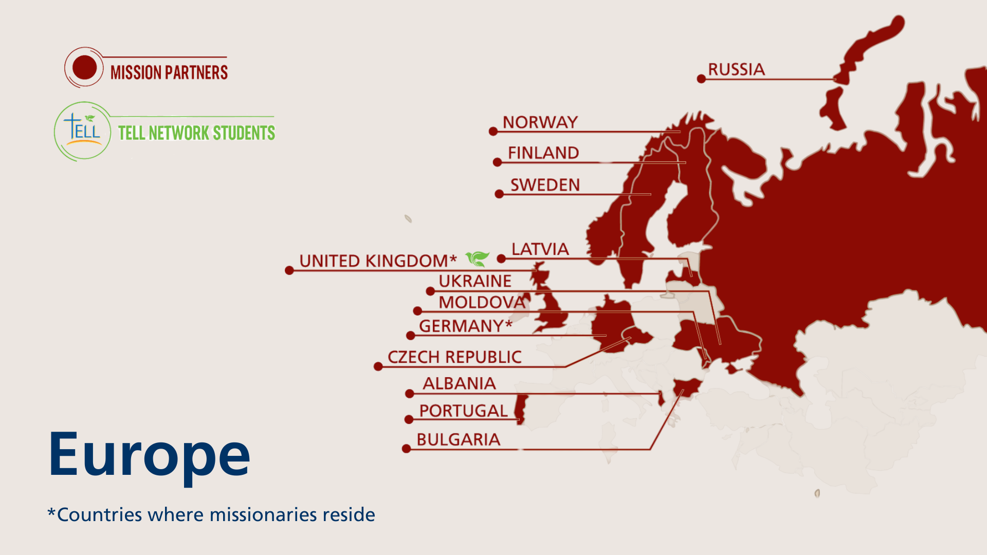
Notes:
The Europe mission team partners to share Christ’s grace in Albania, Bulgaria, the United Kingdom, Portugal, Russia, and Ukraine while supporting sister church bodies in seven additional countries. Two WELS missionaries reside in Europe. A stateside administrative committee appointed by the Board for World Missions helps facilitate their work.
The Europe mission team partners with sister synods and independent churches in fellowship with WELS in Norway, Sweden, Finland, and Germany. This partnership and support can come in the form of financial assistance, theological training or continuing education, visits and assistance from other World Missions representatives or missionaries, as well as the sharing of outreach ideas. A church in the Czech Republic and a synod in Latvia are directly supported by our mission partners in the Evangelical Lutheran Synod (ELS). Most mission partners are a part of the Confessional Evangelical Lutheran Conference (CELC), a worldwide fellowship of confessional Lutherans. Learn more at celc.info.
Fast facts
13 sister synods in Europe
Mission partners in 12 countries
2 missionaries

Slide 33
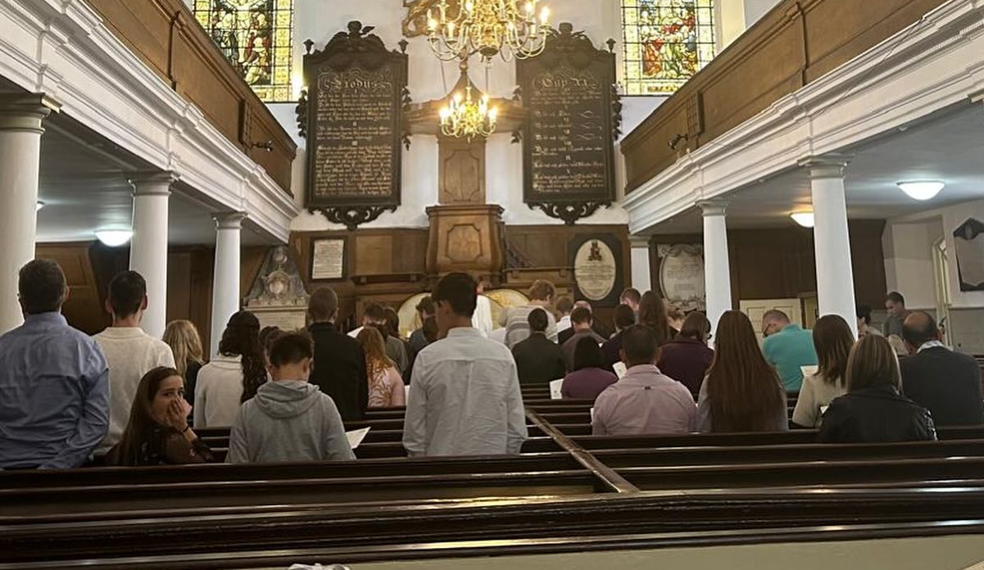
Mission work in London underway
Notes:
World mission work in London is up and running! Missionary Mike Hartman works primarily with a group in London Aldgate, and Pastoral Studies Institute (PSI) student Lawrence McCatty leads the group in Wolverhampton.
Read more about Lawrence McCatty at https://wels.net/from-a-uk-baptist-to-a-confessional-lutheran-pastor/.

Slide 34
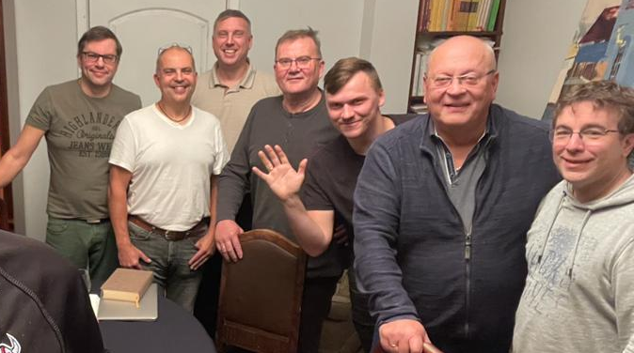
WELS-provided regional training through existing seminary programs in Europe
Notes:
Missionary Luke Wolfgramm and his wife Jennifer relocated to Leipzig, Germany, in summer 2023 which serves as a central base of operations for travel throughout Europe. Missionary Wolfgramm is working closely with Holger Weiß, the rector of the seminary of the Evangelical Lutheran Free Church in Leipzig (pictured right). Their goal is to make seminary training more available for students throughout Europe, including offering more classes in English, Europe’s common language. He and Weiß also provide continuing education for pastors in Europe.

Slide 35
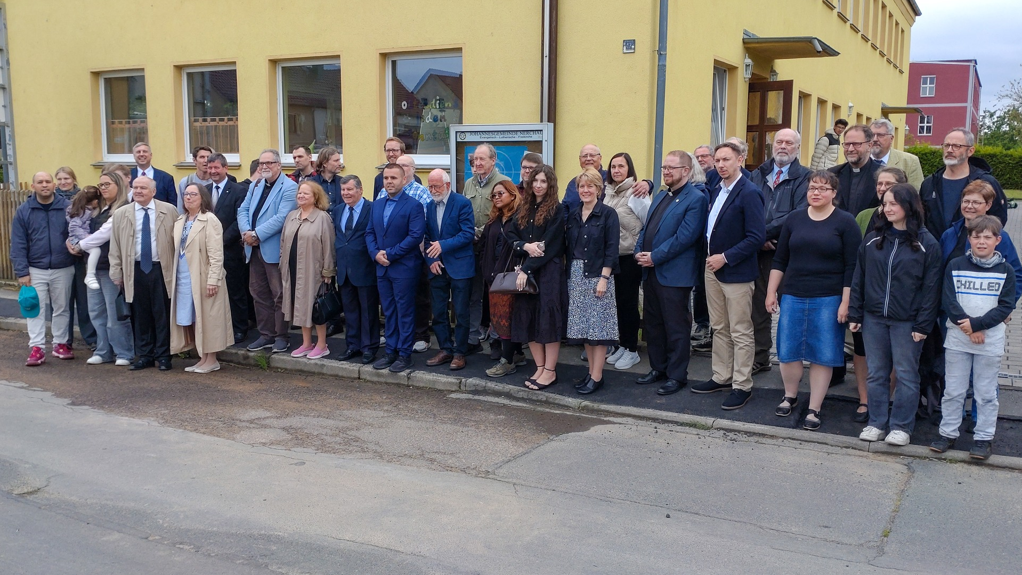
Regional CELC Conference bring together Lutherans from Europe
Notes:
European Regional CELC Conference – May 2025
The European Regional CELC Conference, held May 22–25, 2025, in Nerchau, Germany, gathered about 50 attendees from across Europe and beyond to explore the theme “The creation of man—Wonderful news for the world.” Hosted by the Evangelical Lutheran Free Church, the event featured four theological papers, including presentations by Prof. Tim Schmeling and Rev. Nikolla Bishka, and updates from WELS and ELS mission leaders. Highlights included the installation of Jennifer Wolfgramm as WELS mobile ministry partner for women in Europe and a closing worship service led by Rev. Holger Weiß. Read more: https://wels.net/european-regional-celc-conference/

Slide 36
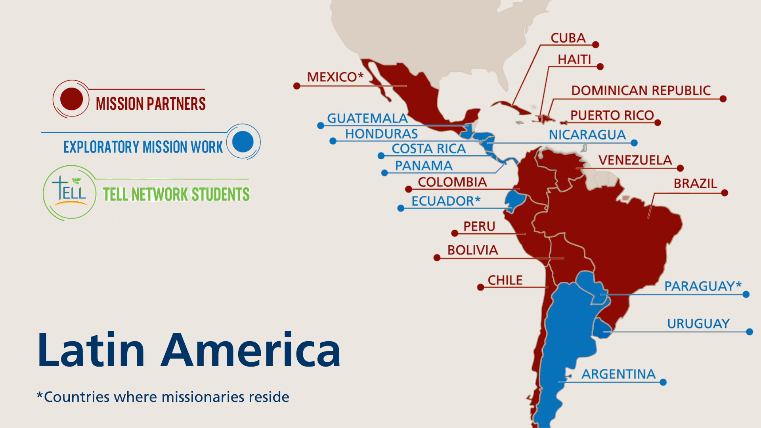
Notes:
The primary focus of the One Latin America Team is Academia Cristo. Academia Cristo is a multi-faceted effort which seeks to 1) make disciples in Latin America by sharing the message of God’s grace with as many people as possible, 2) identify and train potential church planters, and 3) encourage those church planters to make disciples who plant even more churches. The One Latin America Team uses social media to promote Academia Cristo throughout Latin America.

Slide 37
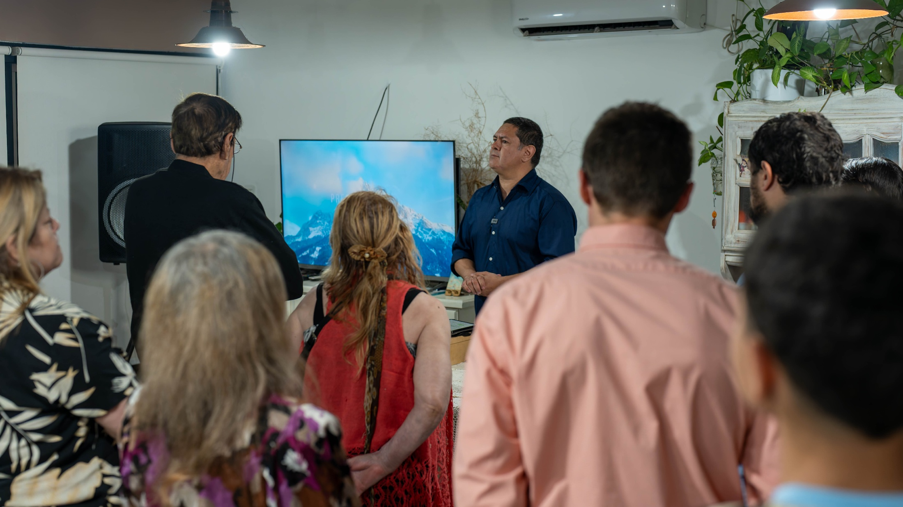
10 years of Academia Cristo
Notes:
Join us as we celebrate 10 incredible years of Academia Cristo, a ministry that has shared the gospel and touched the lives of thousands across Latin America! Over the past decade, we have witnessed transformations, blessings, and life-changing moments as the message of Christ has reached new hearts and homes. Video if there’s time: https://wels.net/10-years-of-academia-cristo/
New ten-year goals were recently set: 10,000 have finished at least one Discipleship Course; 1,000 Church Plants (Grupos Sembrador) planted; 100 Church Plants (Grupos Sembrador) have become congregations of Iglesia Cristo WELS Internacional
Pictured: Academia Cristo student Luis Bello leads a Grupo Sembrador (church plant) in Barradero, Argentina. Around 30 people worship in his house every Saturday night at 8:30pm. He also does devotions with small groups every Tuesday, Wednesday, and Friday night with members of this group. WELS representatives traveled to visit his group in November 2024 to discuss becoming a formal church and joining Iglesia Cristo WELS Internacional.
Learn more about Academia Cristo and mission work throughout Latin America at wels.net/latinamerica.

Slide 38
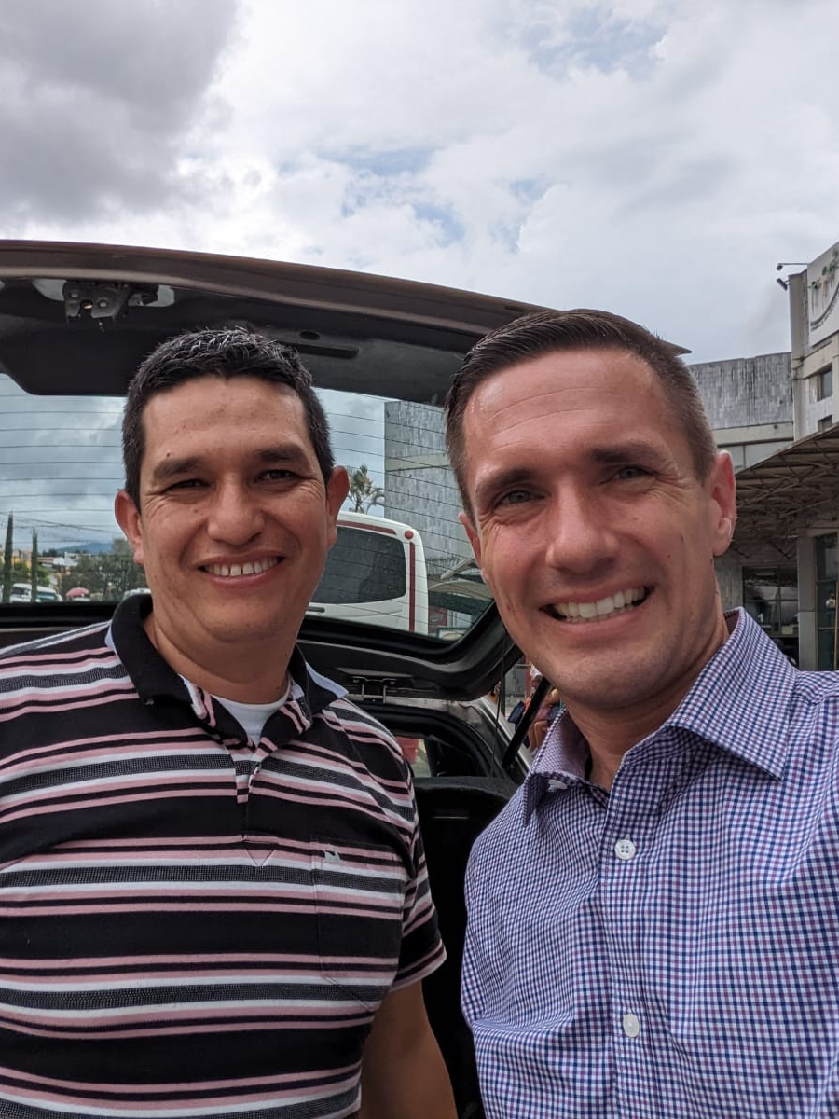
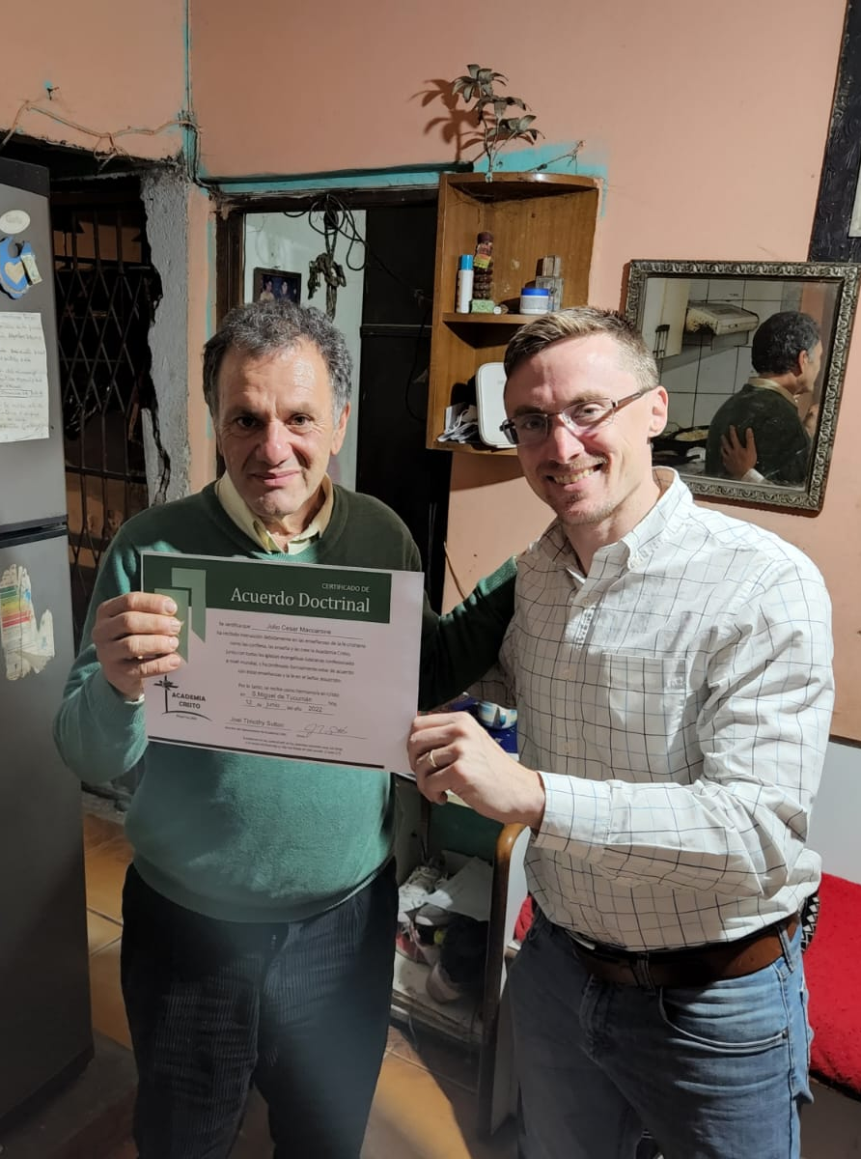
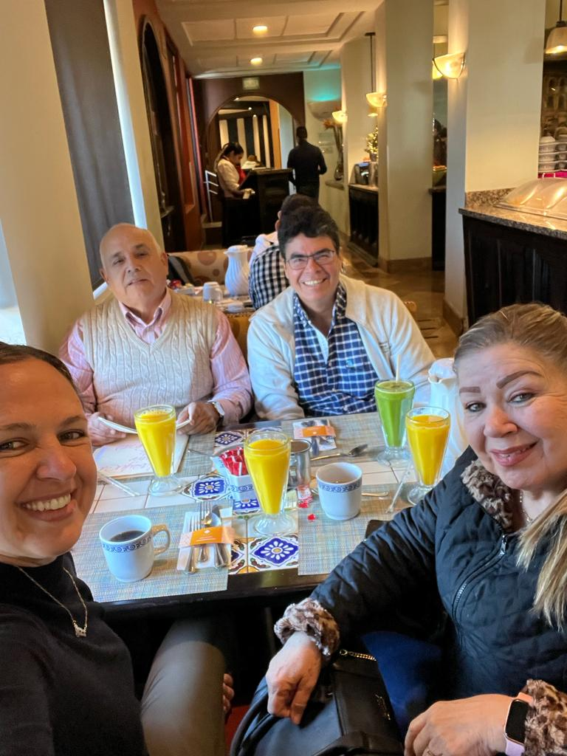
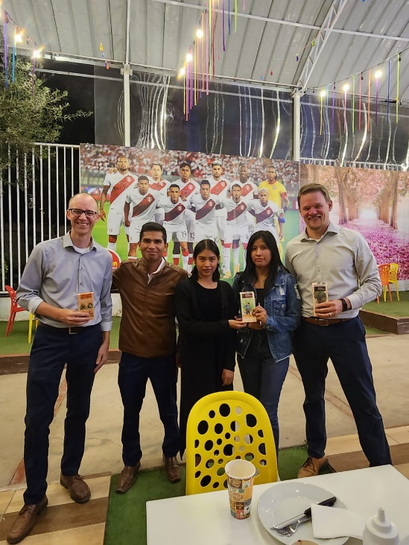
1,400+ students
Have completed at least one online Academia Cristo Zoom class
Notes:
Pictured: Confirmands of Academia Cristo outreach efforts from across Latin America
Amazing blessings through Academia Cristo:
A total of 50,866 students have enrolled in the Self-Study Level of courses
1,400+ students have completed one Discipleship Level live course
165 students have completed the Discipleship Level (13 live courses)
54 students have completed the Church Planting Level (ten live courses)
45 Academia Cristo students are actively leading church plants (Grupos Sembrador)

Slide 39
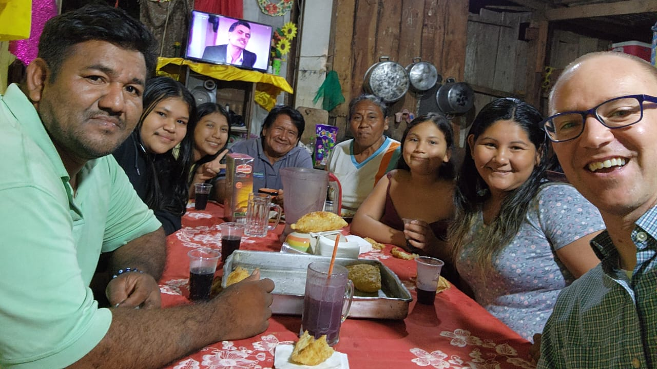
Church planting expands rapidly
in Latin America
Notes:
Over the past several months, 11 students from Paraguay, Argentina, Ecuador, Venezuela, and Mexico were welcomed into doctrinal agreement after reviewing 95 key doctrinal questions with a missionary. This means the students have expressed a commitment to the teachings of the confessional Lutheran church and a desire to be doctrinally affiliated with the ministry of Academia Cristo.
This past quarter saw new church planters in Puente Piedras, Peru; San José de Caaguazú, Paraguay; and Concepción del Uruguay, Argentina. There are now 45 Academia Cristo students are actively leading church plants (Grupos Sembrador).
Pictured above: Missionary Abe Degner visited Manglio Dider, his family, and his church plant in Guayaramerín, Bolivia. During the visit, a memorial service was held for Manglio’s son, giving Missionary Degner the opportunity to share the gospel with over 100 attendees.

Slide 40
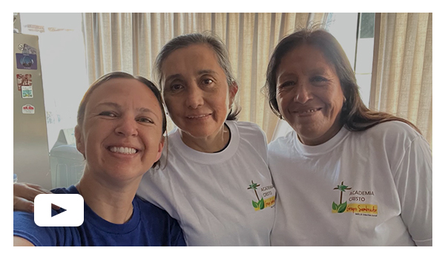
Women’s ministry in Latin America
Notes:
Elise Gross, a missionary on the One Latin America Team, describes her ministry serving women in Latin America. Learn how God is using Gross and her students to spread his Word in this Together video update: https://wels.net/together-video-march-18-2025/
Examples:
Maria Luisa Fanarraga from Alto Laran, Peru, (pictured) is in doctrinal agreement and is already teaching two different groups.
On the banks of the upper Amazon, in Pucallpa, Peru, Amelia Torres purchased land in her hometown so that those she has been sharing the gospel with will have a place to gather.
Women from Buenos Aires and Montevideo, Argentina, connect for Bible study, encouragement, and prayer through WhatsApp led by Viviana Alejandra Vigna. Due to the distances between them, they meet in person twice a year to strengthen their bonds of faith and fellowship.
A group in San Jose, Costa Rica, led by Nathalie Hernández Arbur meets weekly for Bible study and gathers regularly for worship.
A group of women in Quito, Ecuador, worship together in their homes every weekend. During the week, they meet online via Zoom for Bible study led by Fabiola Guaman.
A married couple leads several small groups in Mexicali, Mexico, gathering in homes to study God's Word together.

Slide 41
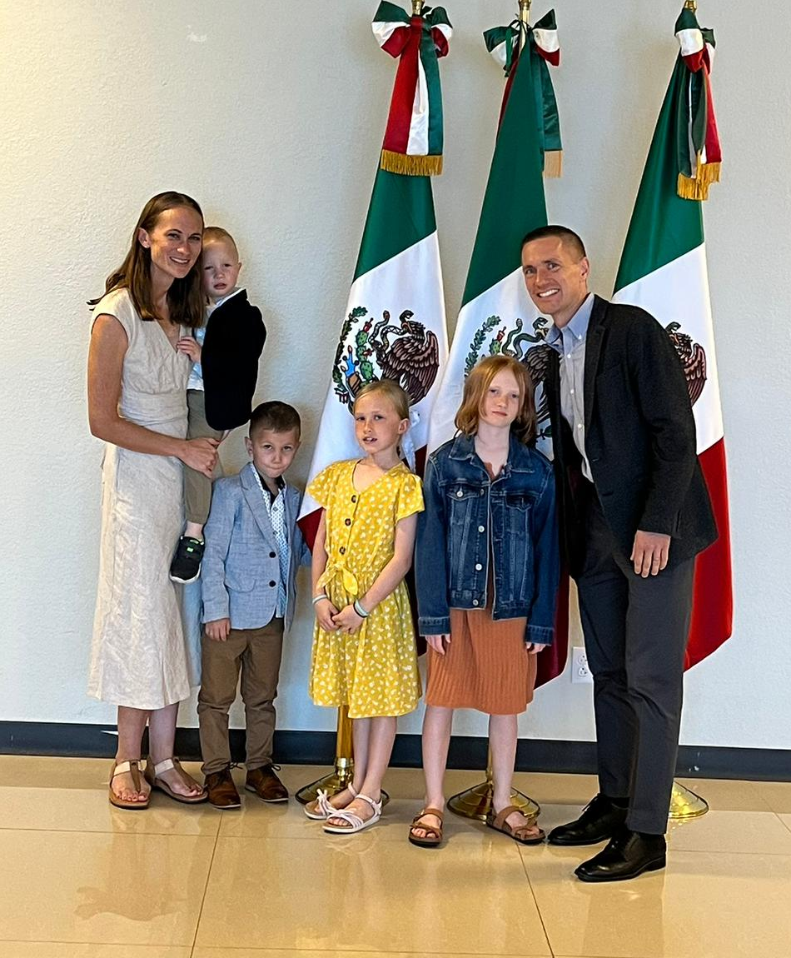
Missionaries relocating to
capitalize on
mission opportunities
Notes:
Missionaries will remain in Quito, Ecuador, and Doral, Fla., and those locations will remain as permanent hubs for the team. The plan is to discontinue Asunción, Paraguay, as one of the One Latin America Team hubs. Missionaries Joel Sutton and Abe Degner have been asked to redeploy to other locations. Additionally, a new, mobile hub concept is being developed.
The mobile hub is designed to allow the One Latin America Team to remain flexible to pursue emerging opportunities. It also keeps locations diversified in case of regional instability. Using this approach, the One Latin America Team will temporarily place missionaries in various locations. Mexico City has been chosen to serve as the first mobile hub due to feasibility of visas, efficient connections to the rest of the Latin America through its major airport, and the number of active students and church planters. The Behmer family moved there after their furlough in summer 2025 (pictured at the Mexican consulate), with the Sutton family joining them in January 2026.

Slide 42
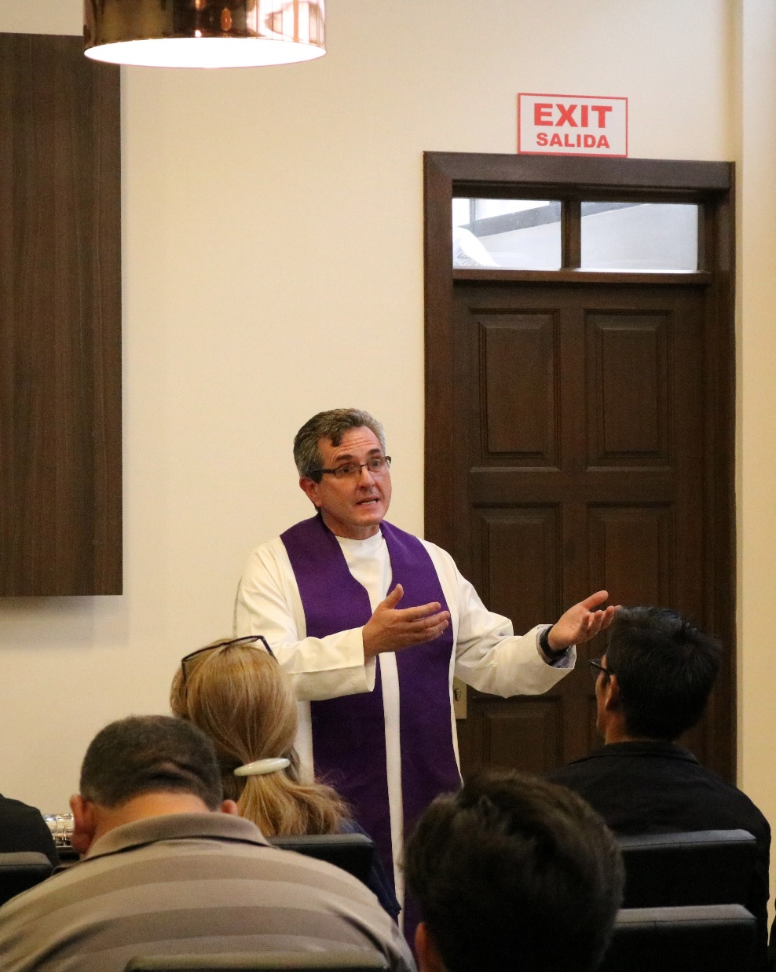
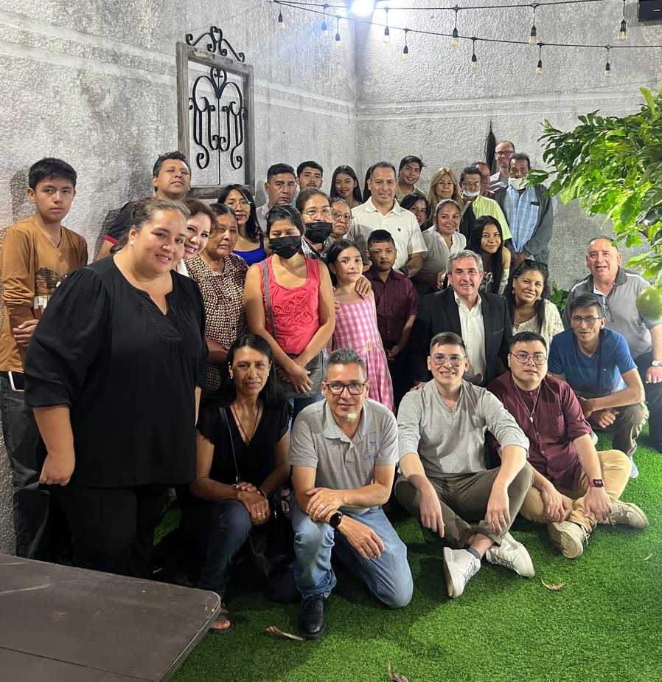
Iglesia Cristo WELS Internacional welcomes new church plants into fellowship
Notes:
Iglesia Cristo WELS Internacional, WELS’ sister church, was formed in 2021 through the partnership of WELS sister churches across five countries throughout Latin America. This international synod is also where Academia Cristo church plants are welcomed into fellowship after completing a two-year confessional process to become full-fledged churches.
A maxillofacial surgeon in Cochabamba, Bolivia, named Eduardo Milanesi (pictured left) became an Academia Cristo student in 2020. In less than a year he finished the program, confessed doctrinal agreement, and started gathering a group in his medical office to study God’s Word. In February 2023, Eduardo completed the studies prepared for church planting groups and his group was received by Iglesia Cristo WELS Internacional as a congregation, the first Academia Cristo church plant to do so. He has now launched a second group in Santa Cruz, recently gathering over 30 eager listeners to God’s Word (pictured right).
Plans are in place to welcome a second Academia Cristo church plant from Tenancingo, Mexico, into fellowship with Iglesia Cristo WELS Internacional at their annual convention in early October 2025. Their leader is Academia Cristo student Juan Reyes.

Slide 43

Multiple languages to
multiply Christians around the world
Notes:
Multi-Language Productions (MLP) has created nearly three million video, audio, and print resources for use in global outreach. Materials have been translated into 56 languages to date—all to share the gospel message with people around the world.
MLP continues to expand well beyond conventional ways of reaching the lost, embracing emerging technology trends such as data-driven automation, e-learning, mobile websites, smart devices, and social media. Through these varied resources, MLP assists and enhances outreach and training for all world mission fields and national churches.
Traditional means of reaching the lost have not been forgotten. MLP continues to provide resources in different languages for people who don’t have access to the internet and technology, including ministry resources like The People’s Bible, textbooks, illustrated story cloths and posters, as well as worship and praise music.

Slide 44

Notes:
Multi-Language Productions (MLP) operates the TELL Network, an online training and church multiplication program. Working closely with WELS world mission teams, TELL Network provides Bible study curriculum focused on leadership training for students across the globe, preparing them to gather groups, lead Bible studies, and plant churches. TELL is both the program name and a representation of the method used to teach the Bible: Think, Evaluate, Learn, and Lead. The training method is customized across four programs offered in English, Mandarin, Spanish, and Tagalog.
Students gain knowledge and confidence to lead others to the saving message of the gospel using the straight-forward and easy to remember training method. Based off the original Academia Cristo (TELL Spanish) curriculum, TELL Network students complete video courses, participate in live Zoom courses with theologically trained instructors, and learn to lead groups in their own communities.
Fast Facts:
1,600+ students have participated in online Bible study with TELL.
500+ students are currently in live online TELL classes.
50+ students who have completed more than 8 courses are working with a TELL counselor to provide extra support and in-depth doctrinal study.
TELL students are leading Bible study groups and gathering regularly for worship.

Slide 45


TELL Network expanding rapidly throughout Africa
Notes:
There are active TELL students in 24 different countries throughout the continent of Africa.
Pictured left: The TELL Africa Team hosted a special workshop in Uganda in January 2024 where locals and TELL students came together to learn about God's word. (TELL Missionary Joel Hoff with TELL students)
Pictured right: Elijah Adongo, a TELL student from Nairobi, Kenya. In March 2023, he attended a special TELL event in Nairobi. Elijah continues his studies with TELL and shares what he has learned with others.

Slide 46



teach.tellnetwork.org
TELL Network adds many new students – teachers are needed!
Notes:
TELL English student enrollment is growing fast with more than 500 active students. TELL depends on its teachers to guide leaders-to-be in the foundational truths needed to share the gospel.
As part of the TELL Faculty, non-missionary TELL instructors are given an honorarium. If you are a mission-minded pastor, have some tech sense and aware of cross-cultural relationships, TELL is in desperate need of your skills to meet the needs of our ever-expanding student body. Most TELL courses average three hours per week for six weeks. The TELL registrar and staff handle most of the administration. Between teaching LIVE Classes, TELL Instructors message their students using WhatsApp. After classes are complete, the instructor collects and grades students’ final projects.
If you are interested in teaching for TELL, you are invited to attend a live orientation with a member of the TELL team. Contact TELL Network at ask@tellnetwork.org for more details or visit teach.tellnetwork.org.

Slide 47

Notes:
The Apache mission in Arizona celebrated 125 years of God’s blessings in 2018 as the first world mission of WELS. Today, WELS’ Native American mission serves nine churches and two elementary schools, and it provides theological education through the Apache Christian Training School (ACTS) on the White Mountain and San Carlos Apache reservations in Arizona. New Native American outreach is also occurring in the Four Corners area of Arizona, New Mexico, Utah, and Colorado through the Native Christians Network.
Fast facts
Baptized members: 2,459
Congregations/preaching stations: 9
K-8 schools: 2
Missionaries: 7 (1 Apache)
Teachers: 17 (5 Apache)
Apache Christian Training School students: 60

Slide 48

Native Christians Network stands ready to reach out with the gospel to the 574 Native American Reservations throughout the U.S.
Notes:
Pictured: Members of the Native Christian Team met for their annual meeting/retreat in July 2025. Attendees included the missionaries, national pastors and lay leaders, teachers at the two schools on the Apache reservations in Arizona, and their families. WELS World Missions representatives were also in attendance.

Slide 49


Hellos and goodbyes on the
White Mountain Apache Reservation
Notes:
In May 2025, Pastor Dave and Jo Bostedt (pictured left) concluded eight years of ministry on the White Mountain Apache Reservation, serving the congregations of Canyon Day and East Fork. Their retirement was marked by a congregational celebration of gratitude.
On August 3, 2025, Pastor David Wietzke was installed as the new pastor for these congregations (pictured right). The installation service included participation from all Apache congregations and marked the beginning of Wietzke’s ministry in Arizona. He previously served congregations in Wisconsin, Nebraska, and Colorado.

Slide 50

Training through the Apache Christian Training School (ACTS)
Notes:
The Apache Christian Training School (ACTS) provides theological courses to train and equip Apache members for ministry. The program offers a wide variety of in-depth Bible studies designed to strengthen faith and prepare individuals for leadership roles within their local congregations. In addition to classroom work, participants can practice and model ministry in their home congregations. The program trains men to serve as pastors, evangelists, and deacons, while women may study to serve as deaconesses. Additionally, it prepares individuals to become certified Lutheran teachers and lay leaders within their churches.
Pictured: In July 2025, the Apache Christian Training School and the Native Christians Network hosted a presentation featuring Aaron Newman, a Marine Corps veteran and active member of Christ the Rock Lutheran Church in Farmington, New Mexico. The event focused on Newman’s journey of integrating his Navajo heritage with his Christian faith, offering a deeply personal reflection on the challenges Native Christians face—including cultural pressures and misconceptions about faith. Held as part of ongoing efforts to equip Native American leaders for ministry, the gathering brought together mostly Apache participants for a time of mutual encouragement and spiritual growth. Newman’s testimony, grounded in Scripture and lived experience, emphasized that being Christian does not mean abandoning Native identity.

Slide 51

Partnering with a new nonprofit to support Native American wellness through peer support and community education on reservations around the country
Notes:
WELS’ Native American mission is partnering with the Native Strength Network, a 501(c)3 nonprofit organization that seeks to address the mental health crisis in Native American communities by re-establishing peer recovery groups that offer culturally relevant support and foster community resilience.
Learn more at https://nativestrength.net/

Slide 52

New Native American outreach in the
Four Corners region
Notes:
Missionary Nathan Wagenknecht accepted the call to serve as Outreach Counselor on the Native Christians team in 2024. He coordinates outreach to the Native American tribes in the Four Corners area of Arizona, New Mexico, Utah, and Colorado, working closely with Native members who want to reach out to other Natives with the pure gospel message. He is also leading the expansion of digital outreach and ministry training efforts for the Native Christians Network.
Pictured: Missionary Wagenknecht and Navajo members at Christ the Rock in Farmington, NM, partnered with the Native Strength Network to host a booth at Riverfest in Farmington in May 2025.

Slide 53

Notes:
Speakers: District Mission Board members, Home Missionaries, Mission Counselors, and other Home Missions representatives are willing and able to present on the 100 missions in 10 years initiative at your next church Mission Festival, LWMS circuit rally, school assembly, or small group gathering. Contact your local District Mission Board OR fill out a request at wels.net/speaker-request to find a speaker for your event this fall.
Social Media: Follow us on Facebook and Instagram @WELSmissions
E-Mails: Subscribe to weekly Missions Blogs and quarterly Missions Update E-Newsletters at wels.net/subscribe.
Faces of Faith: The 7th annual edition of Faces of Faith is now available. This is a great overview of the work we’re doing in Home, World, and Joint Missions.
It is available online and by request at wels.net/facesoffaith. Any congregation OR LWMS circuit is welcome to request up to 50 copies of the magazine, and we are also offering 100 Missions in 10 Years brochures and large home and world mission maps (24” x 36”) free of charge. Note – Faces of Faith is automatically sent to any congregation hosting a Mission Festival.

Slide 54

New interactive Google maps on wels.net
Notes:
New, interactive Google maps that feature mission partners and exploratory mission work in various parts of the world can now be viewed on the regional World Missions pages on wels.net:
Africa: wels.net/africa
Asia-Oceania: wels.net/asiaoceania
Europe: wels.net/europe
Latin America: wels.net/latinamerica
Native American Missions: wels.net/nativeamerican

Slide 55

Notes:
WELS Mission Journeys provides an opportunity for all WELS members to walk together in the Great Commission. Through service opportunities in WELS mission fields at home and abroad, members can engage in Christian service. While volunteering, the learning and sharing of outreach ideas will allow individuals and teams to explore how they can use their God-given abilities to engage in outreach activities in their local communities upon their return home. With the Lord’s blessing, these trips will inspire a lifelong journey of service and outreach for all who volunteer.
Learn more at wels.net/missionjourneys.

Slide 56

Notes:
Pray. Ask God for more opportunities to reach those who don’t know Jesus Christ as their Savior from sin.
Share. Tell others about the work WELS is doing in the United States and around the world.
Discover. Subscribe to weekly Missions Blogs and quarterly Missions Update E-Newsletters at wels.net/subscribe and follow us on Facebook and Instagram @WELSMissions. Learn more at wels.net/missions or e-mail missionspromotions@wels.net with questions.
GIVE – Visit wels.net/missionsgift or mail checks with your preferred mission designation (e.g. Home or World Missions) in the memo field to:
WELS, Attn. Gift Processing
N16W23377 Stone Ridge Drive
Waukesha, WI 53188

Slide 57
“My name will be great among the nations, from where the sun rises to where it sets. In every place incense and pure offerings will be brought to me, because my name will be great among the nations,” says the Lord Almighty.”
Malachi 1:11

